Slide 1
CitationPy
Analysis on City of Los Angeles Parking Citations
Ka-ri, Sujita, and Sisay
March 29, 2019

Slide 2
Agenda
Purpose
Methodology
Resources
Hypotheses
Data
Data clearing
Random sampling
Grouping
Results
Conclusion

Slide 3
Purposes
Uncover citation patterns around the city of Los Angeles.
Explore the relationship between the makes of vehicles and number of parking citations.
Explore the a relationship between the colors of vehicles and parking citations.
Explore if sample means of the vehicle citations belong to the same population.

Slide 4
Methodology
Bar charts to compare makes and colors to citations.
Heat map to show locations where citations occurred.
Chi-Square test of independence between means of two samples of the population

Slide 5
Resources
Sample dataset from the City of Los Angeles from May - July 2018
Folium Mapping
Jupiter notebook
Git Hub

Slide 6
Hypotheses
Q1. What is the relationship between the make of vehicle and the number of citations received in the City of Los Angeles between May – July 2018?
H_{o}: there is no significant relationship between the make of vehicles and the number of citations.
H_{a}: there is a significant relationship between the make of vehicles and the number of citations
Q2. What is the relationship between the make of vehicles and the number of citations received in the e City of Los Angeles between May – July 2018?
H_{o}: there is no significant relationship between color of vehicles and the number of parking
citations.
H_{a}: there is a significant relationship between color of vehicles and the number of parking citations.
Q3. Are the means of the citations received of two groups of vehicles different (independent)?
H_{o}: there is no significant relationship between the means of the two groups.
H_{a}: Alternate Hypotheses: there is no significant relationship between the means of the two groups.

Slide 7
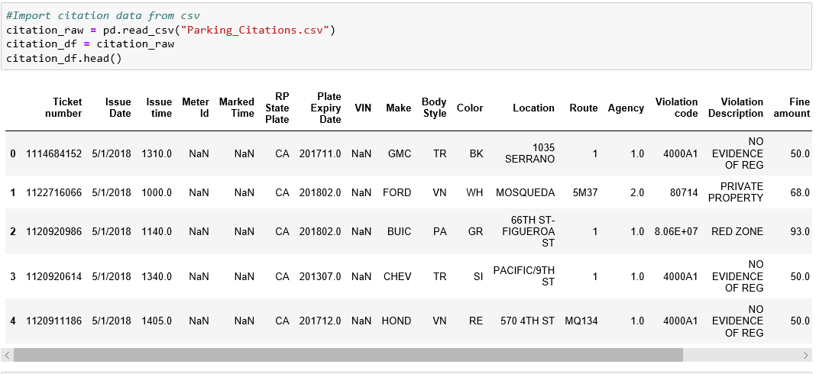
Data

Slide 8
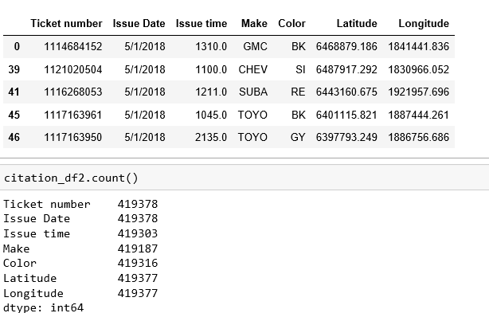
Data Cleaning

Slide 9
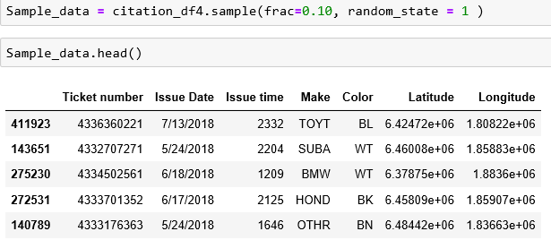
Random Sampling

Slide 10
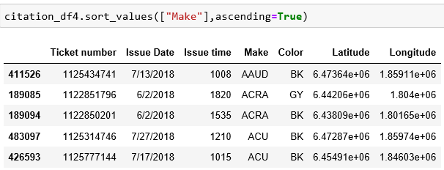
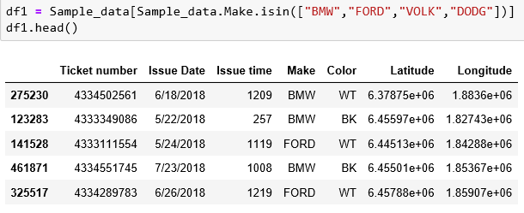
Grouping by Make

Slide 11
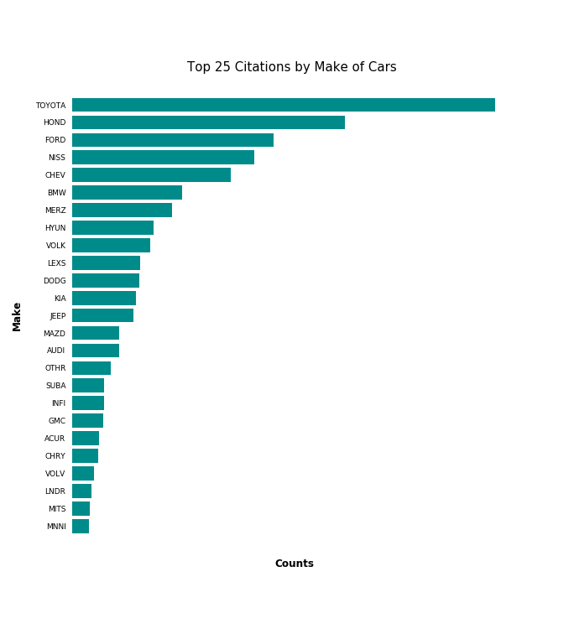
Findings: Makes vs. Citations
Q1. What is the relationship between the make of vehicle and the number of citations received in the City of Los Angeles between May – July 2018?

Slide 12
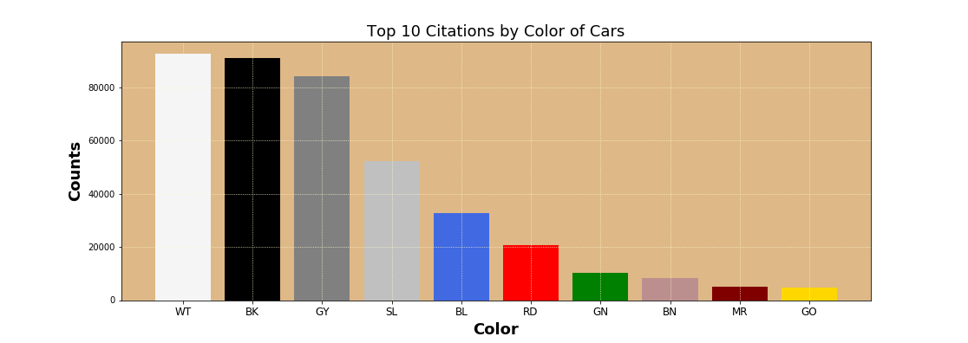
Color vs. Citations
Q2. What is the relationship between the make of vehicles and the number of citations received in the e City of Los Angeles between May – July 2018?

Slide 13

Findings: 23 top makes of cars
Toyota
Ford
Honda
Other
Chevy
Nissan
Dodge
Mercedes
Lexus
BMW
Hyundai
GMC
Jeep
Volkswagen
Mazda
Kia
Subaru
Acura
Chrysler
Infiniti
Audi
Volvo
Mitisubishi

Slide 14
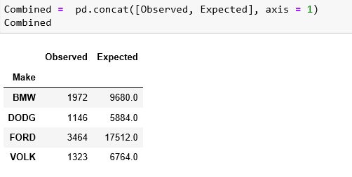
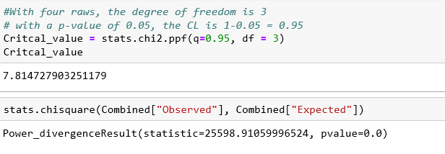
Chi-Square

Slide 15
Cont..
Observed distribution is significantly different from expected distribution indicates there is no relationship
Calculated Chi-Square (25598.9) is greater than the critical value (7.8).
There is a statistically significant evidence at α=0.05 to show that H₀ is false
H₀ is rejected

Slide 16
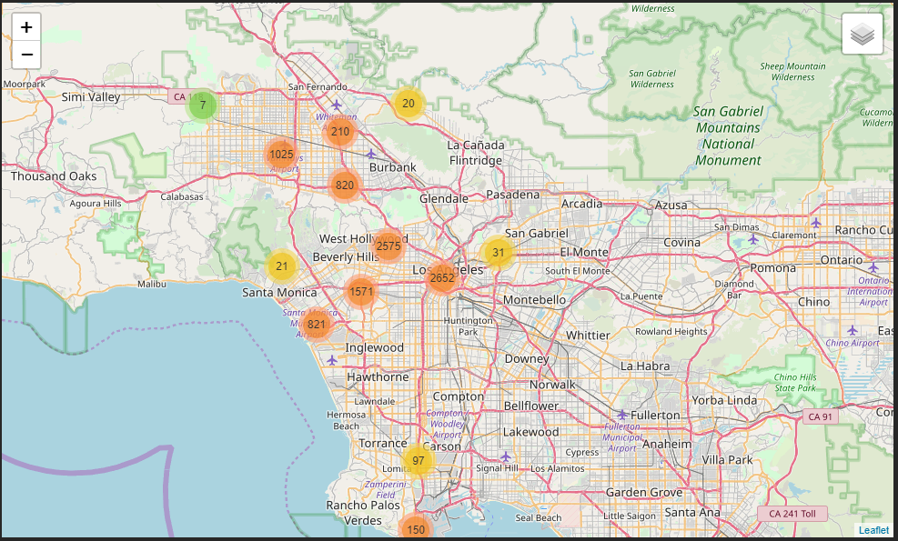
Citation Location Map

Slide 17
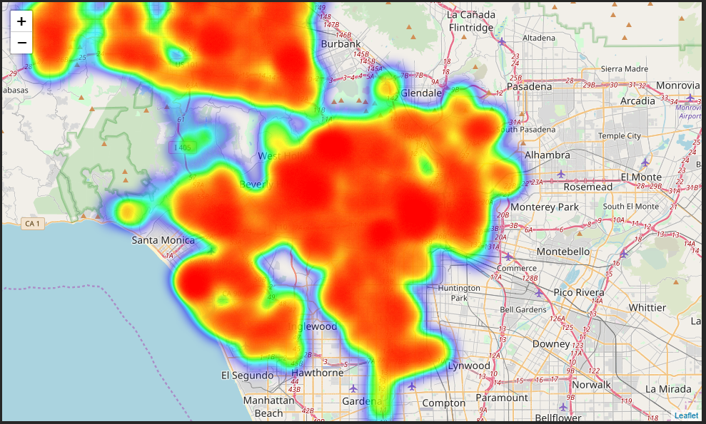
Citation Heat Map

Slide 18
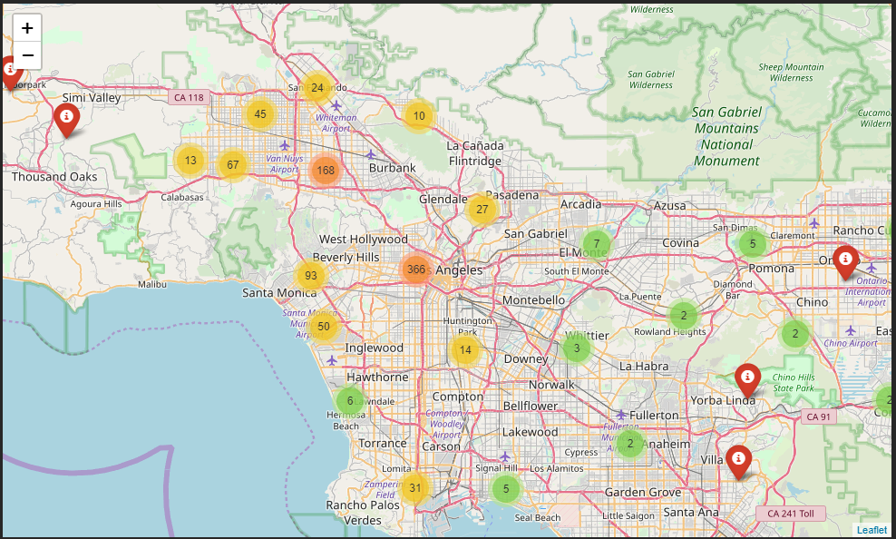
Restaurant Location Map

Slide 19
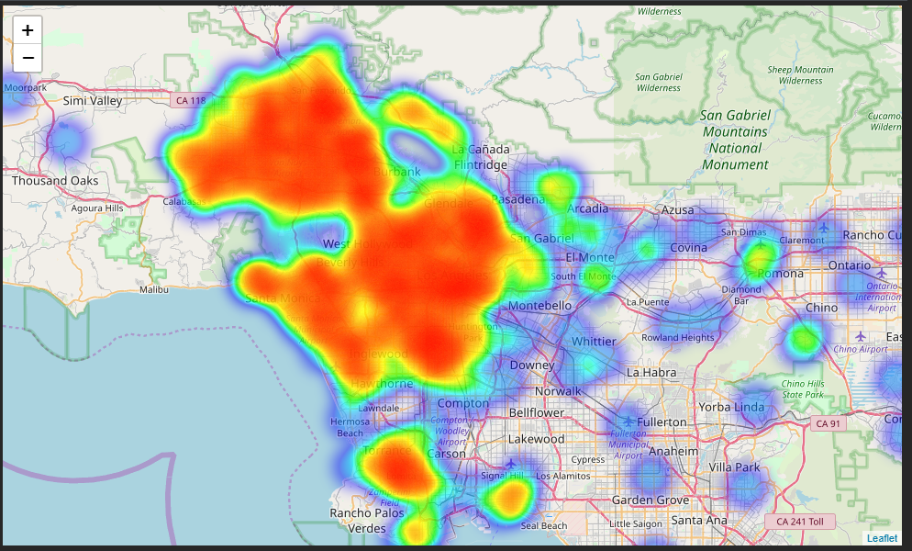
Restaurant Heat Map

Slide 20
Conclusions
The top five vehicles that received the highest citations were Toyota, Honda, Ford, and Nissan among the 25 different models of vehicles
White and black vehicles received the highest citations compared to gray, silver, red, and green vehicles.
There is no significant relationships or association between makes of cars and the number of citations received within different samples.
There is no relationships or association between citations and restaurant locations.

Slide 21
Recommendations
From our evaluation of the data used we recommend that you park in designated areas and do not violate the parking laws.
The Analysis is limited to the sample data set of May – July of 2018.
Use a more current dataset to further evaluate the findings.

