Slide 1
CitationPy
An Analysis of Parking Citations in the city of Los Angeles
Team 3
Kari
Sujita
Sisay
03/30/2019

Slide 2
Project Introduction
Uncover patterns in parking activity around the city of Los Angeles.
Examine a relationship between the makes of vehicles and number of parking citations.
Second purpose was to examine a relationship between the colors of vehicles and parking citations.

Slide 3
Data and Technology Used:
Sample dataset from the City of Los Angeles from May - July 2018
Los Angeles DMV vehicle count data.
API call to Google places.
Folium Mapping.
Jupiter notebook.
Git Hub.

Slide 4
List of dependencies used

Slide 5
API Calls
City of Las Angels
gmaps
Citipy
Google API
Folium Mapping

Slide 6
Methodology:
Bar charts to compare makes and colors to citations.
Heat map to show locations where citations occurred.
Chi-Square test to check if a relationship exists between the two samples

Slide 7
Hypothesis Testing:
Purpose One:
Null hypothesis: there is no significant relationship between the make of vehicles and the number of citations.
Alternate hypothesis: there is a significant relationship between the make of vehicles and the number of citations.
Purpose Two:
Null Hypotheses: there is no significant relationship between color of vehicles and the number of parking citations.
Alternate hypothesis: there is a significant relationship between color of vehicles and the number of parking citations.
Purpose Three
Null Hypotheses: there is no significant relationship between the means of the two samples.
Alternate Hypotheses: there is no significant relationship between the means of the two samples.

Slide 8
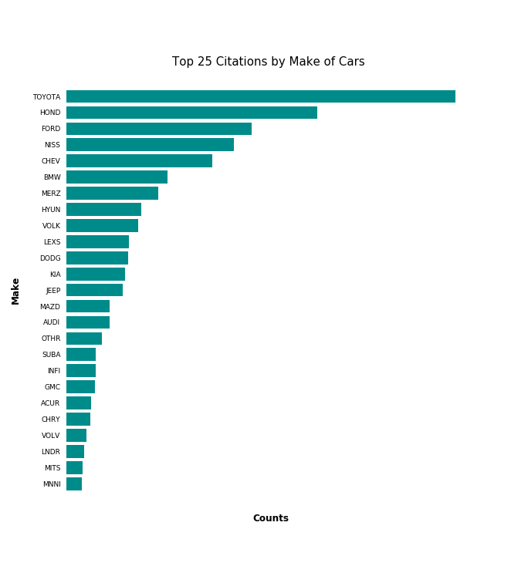
Findings: Makes vs. Citations (Do we want to add count labeles?)

Slide 9
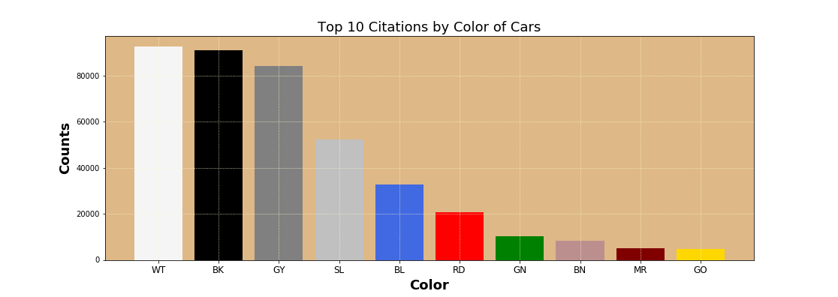
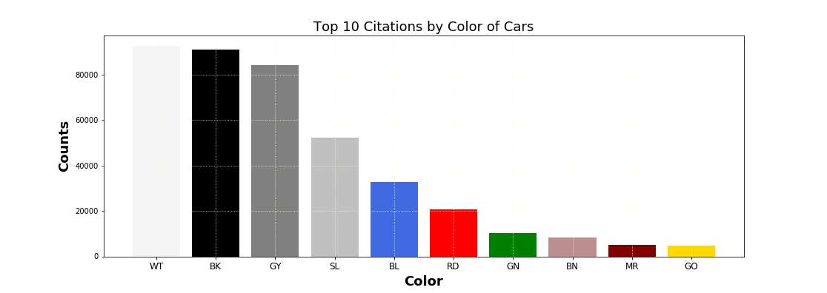
Findings: Color vs. Citations

Slide 10

Findings: 23 top makes of cars ( change this?)

Slide 11
Findings: Chi-Square

Slide 12
Findings: Heat Maps

Slide 13
Findings: Heat Maps

Slide 14
Findings: Heat Maps

Slide 15
Findings: Heat Maps

Slide 16
Conclusions:

Slide 17
Recommendations:

