Slide 1


Integrating Data from the Web into your App

Slide 2




You’ll Need
A macOS, Windows, or Linux computer connected to the internet
Postman (download at getpostman.com/downloads/)
Java 7+ OR Python 3+ OR NodeJS 4+ installed and running
A cell phone to activate your Phone2Action API Key (optional)

Slide 3
If you don’t have any of these, download them now!

Slide 4
After the workshop, download the demo code (and examples) here:
github.com/phone2action/hacktj-examples

Slide 5
How can I GET data from the internet?
Send the API an HTTP GET Request!

Slide 6
What is an API?
An Application Programming Interface (API) is a set of functions, procedures, methods or classes used by computer programs to request services from the operating system, software libraries or any other service providers running on the computer. A computer programmer uses the API to make application programs.
Types of API include web services API like the Twitter API, which allows programs to use the API to receive updates on tweets.
Wikipedia

Slide 7
How can I access a Web Services API?
Web Service APIs are the same thing as “HTTP REST APIs”
You can tell the Web Service API to GET information for you by making an HTTP Request in your app
For example, we’ll use an HTTP GET Request to GET Wikipedia data
Your App
HTTP GET Request
Wikipedia Web Services API
HTTP Response

Slide 8
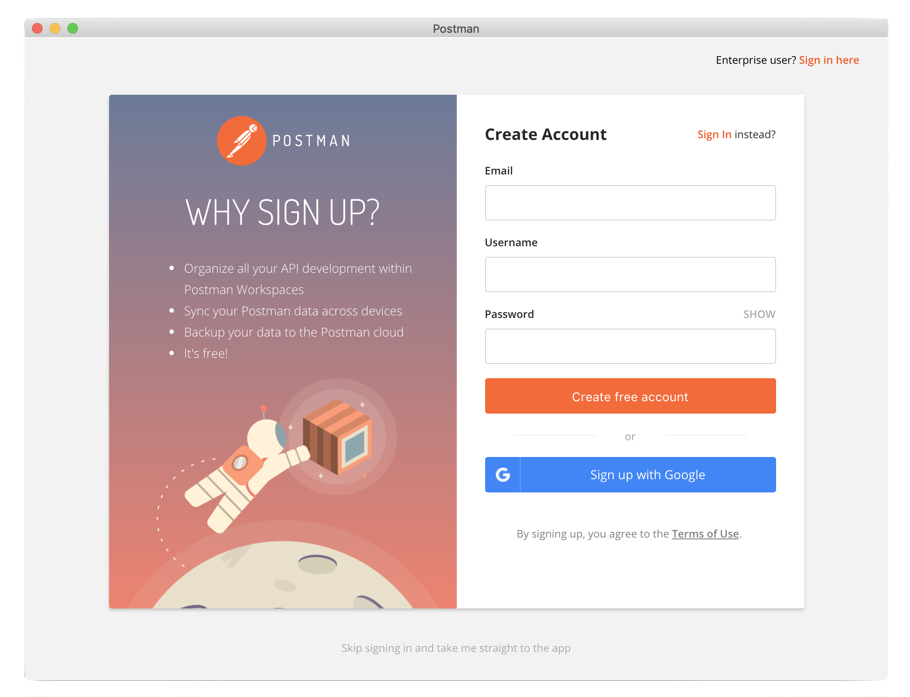
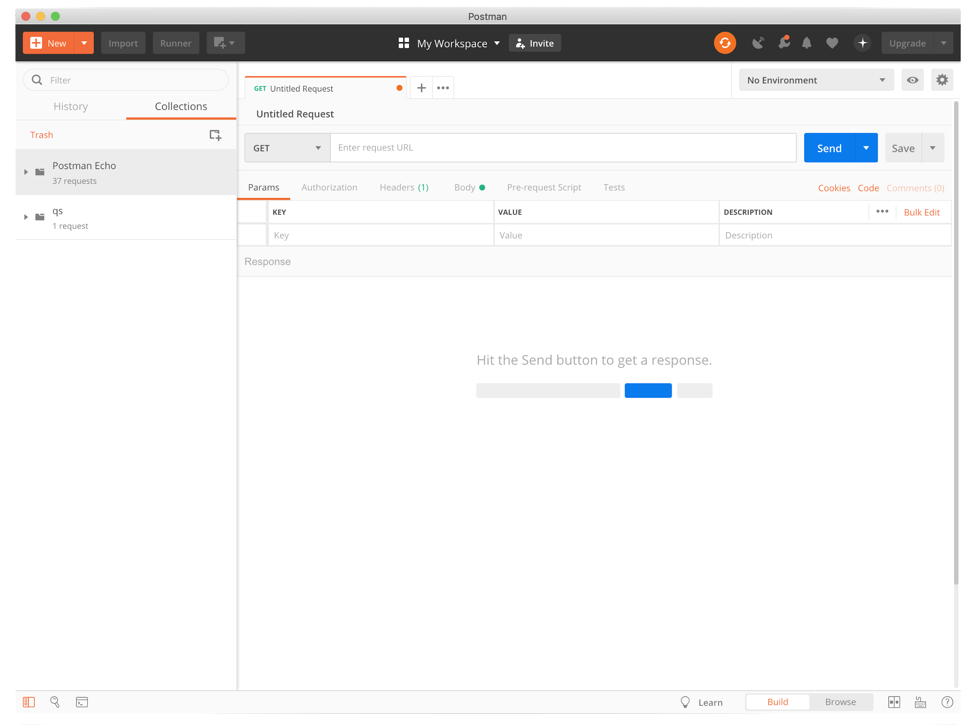

Make Your Own HTTP GET Request! (Setup)
Open the Postman desktop app
Skip making an account (or make one anyway 😈)
Make sure that this search bar is visible!

Slide 9
Demo: Making HTTP Requests in Postman

Slide 10
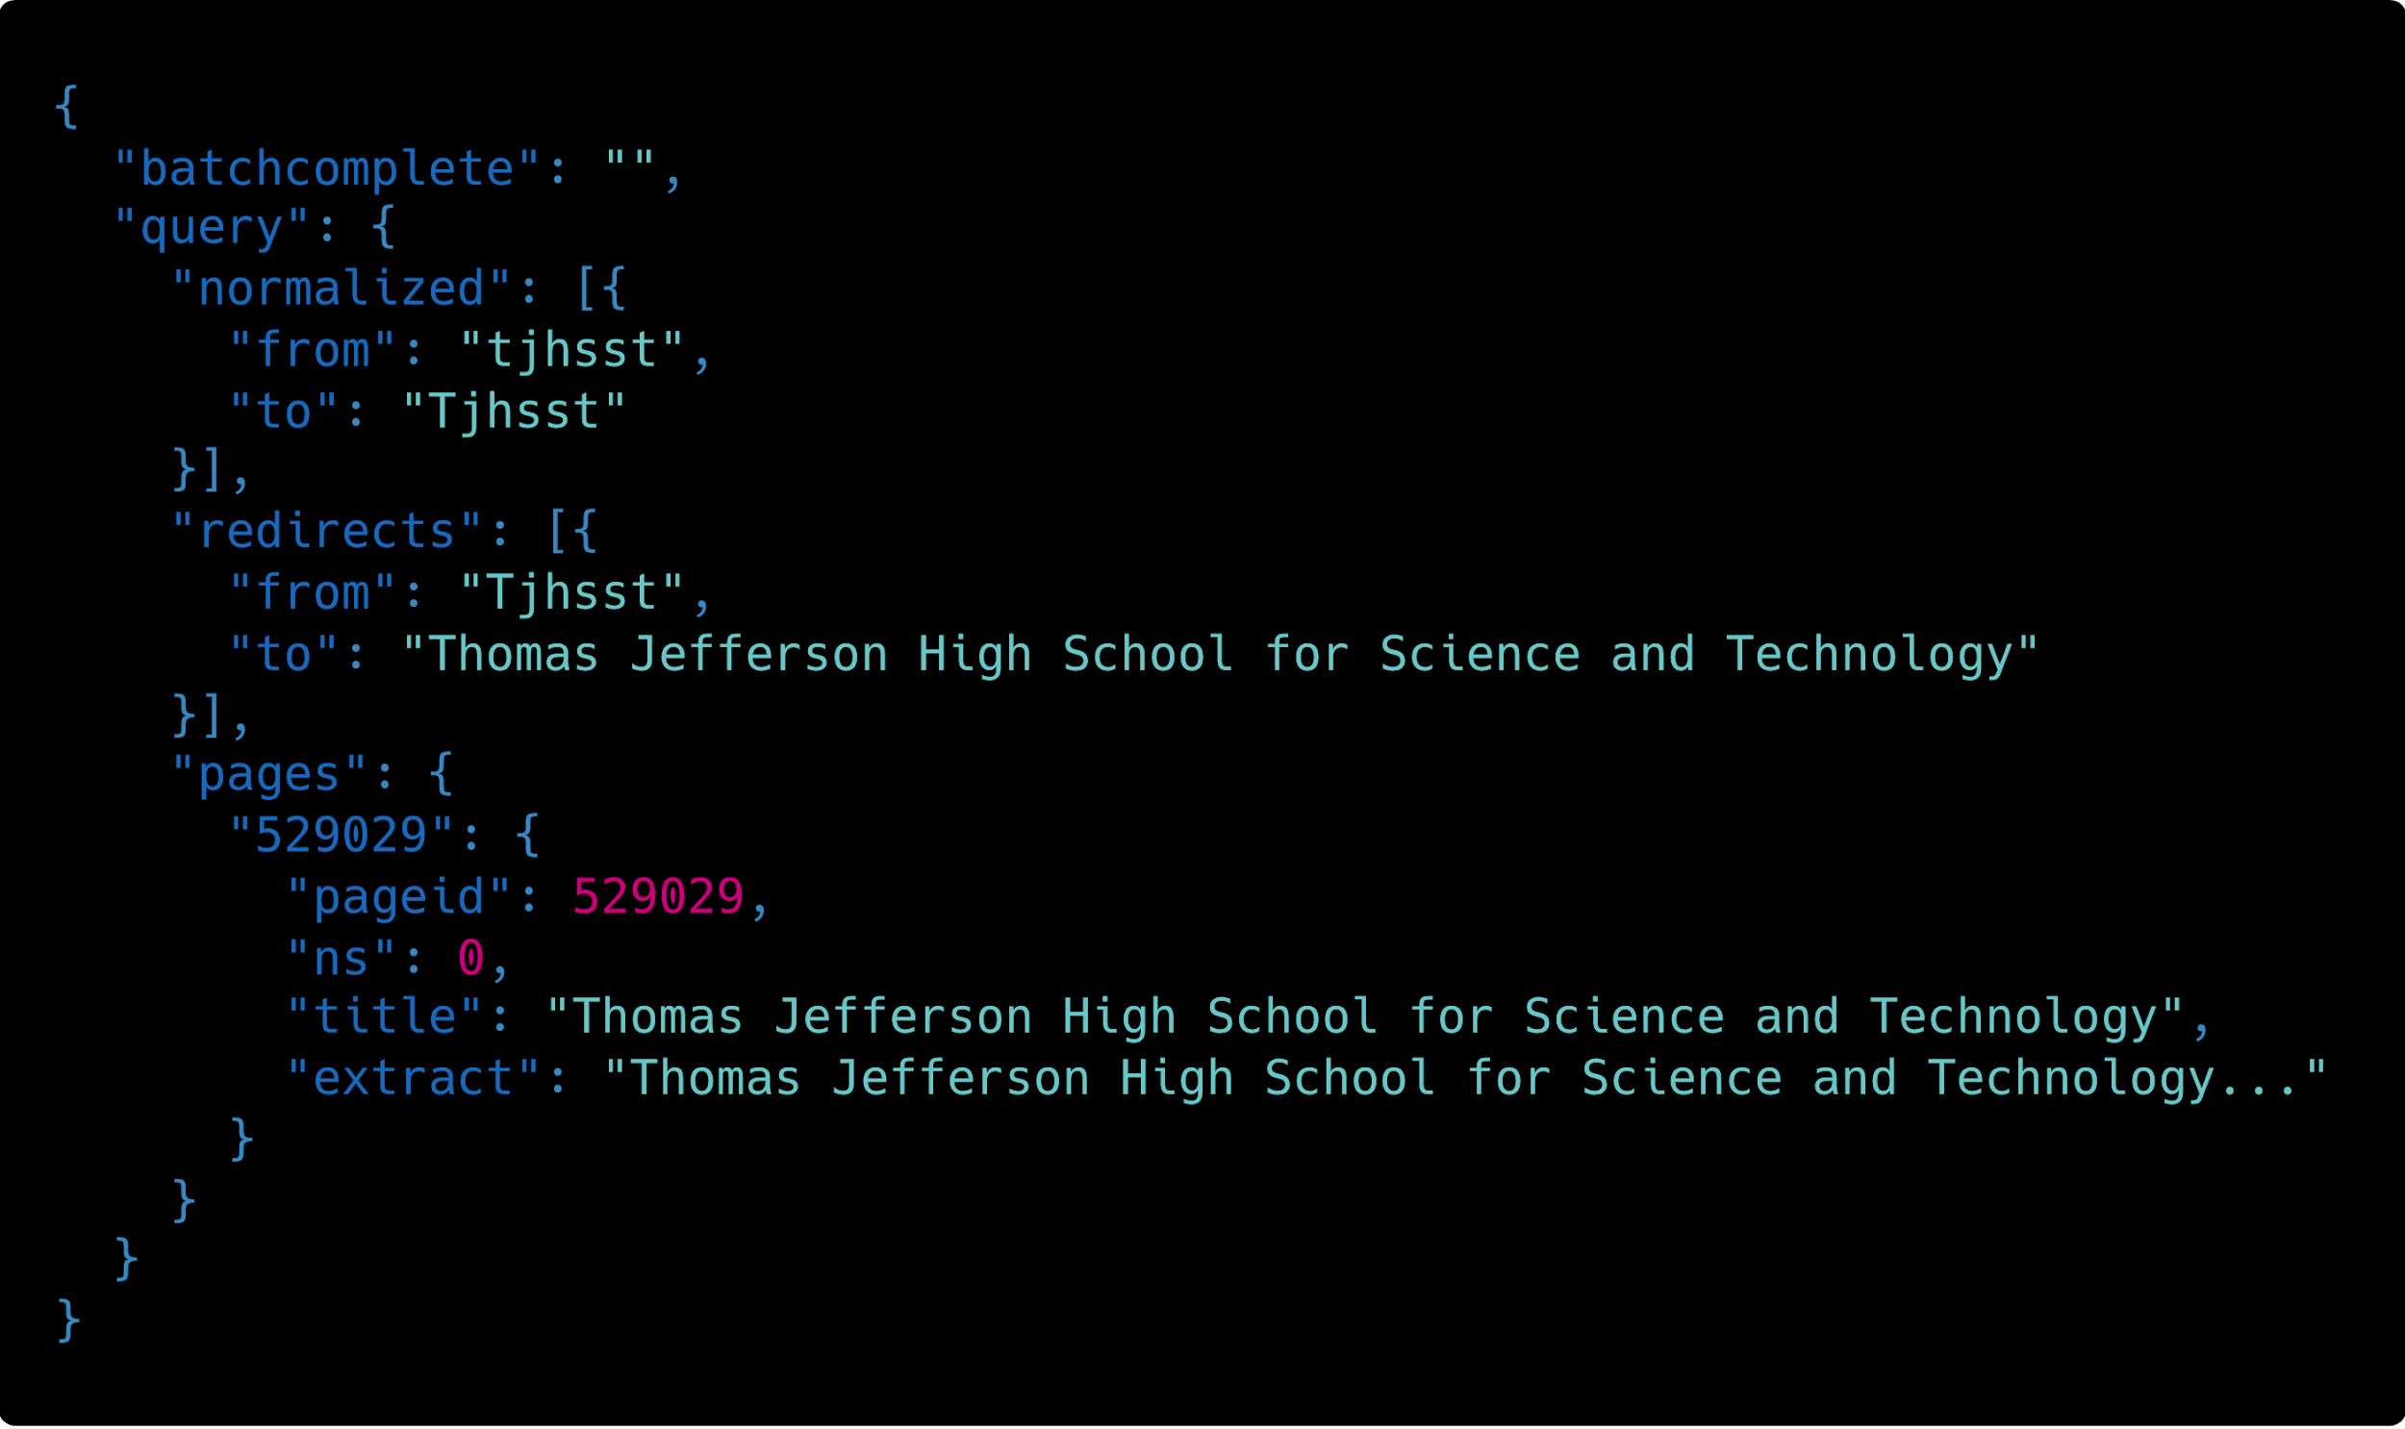
Make Your Own HTTP GET Request! (Results)
The data you received is in the JSON format, and it should look something like this.
We’ll go over the JSON format later, but let’s understand what we just did first.

Slide 11
Deconstructing our HTTP GET Request
https://en.wikipedia.org/w/api.php?format=json& action=query&prop=extracts&exintro=1&explaintext=1&redirects=1&titles=tjhsst
https://en.wikipedia.org/w/api.php is the API Endpoint
? is the Query String, which you need before adding Parameters
format=json, action=query, prop=extracts, etc... are Parameters
& is a Delimiter, which we use between Key-Value Pairs

Slide 12
More about API Endpoints
https://en.wikipedia.org/w/api.php?format=json&action=query&prop=extracts&exintro=1&explaintext=1&redirects=1&titles=tjhsst
The API Endpoint is the server address your app is connecting to
https://en.wikipedia.org/w/api.php is the Wikipedia endpoint
Multiple endpoints exist, like https://pokeapi.co/api/v2/pokemon/ditto
https://pokeapi.co/api/v2/ is the Base URL
pokemon/ditto is the Route
In this case, the API Endpoint is the Base URL + Route

Slide 13
More about Parameters
https://en.wikipedia.org/w/api.php?format=json&action=query&prop=extracts&exintro=1&explaintext=1&redirects=1&titles=tjhsst
The Parameters are Key-Value Pairs APIs sometimes require
format=json is a Key-Value Pair (the request’s format equals "json")
Often used where Routes aren’t helpful (random order, many Parameters)
Values sometimes encoded when they contain special characters (space)
titles=united+states or titles=united%20states
https://en.wikipedia.org/w/api.php?format=json&action=query&prop=extracts&exintro&explaintext&redirects=1&titles=tjhsst

Slide 14
Some (Loose) Analogies
Request to https://en.wikipedia.org/w/api.php vs Wikipedia.getAPI()
Calling an API Endpoint is like calling a function
Request to https://pokeapi.co/api/v2/pokemon/ditto vs PokeAPI.getPokemon().getDitto()
Calling API Endpoints with Routes is like calling functions successively
Request to https://en.wikipedia.org/w/api.php?exintro vs Wikipedia.getAPI(exintro)
Keys and Key-Value Pairs are like arguments passed into the function
The request’s Key-Value Pairs are like HashMaps, dictionaries, or JSON

Slide 15
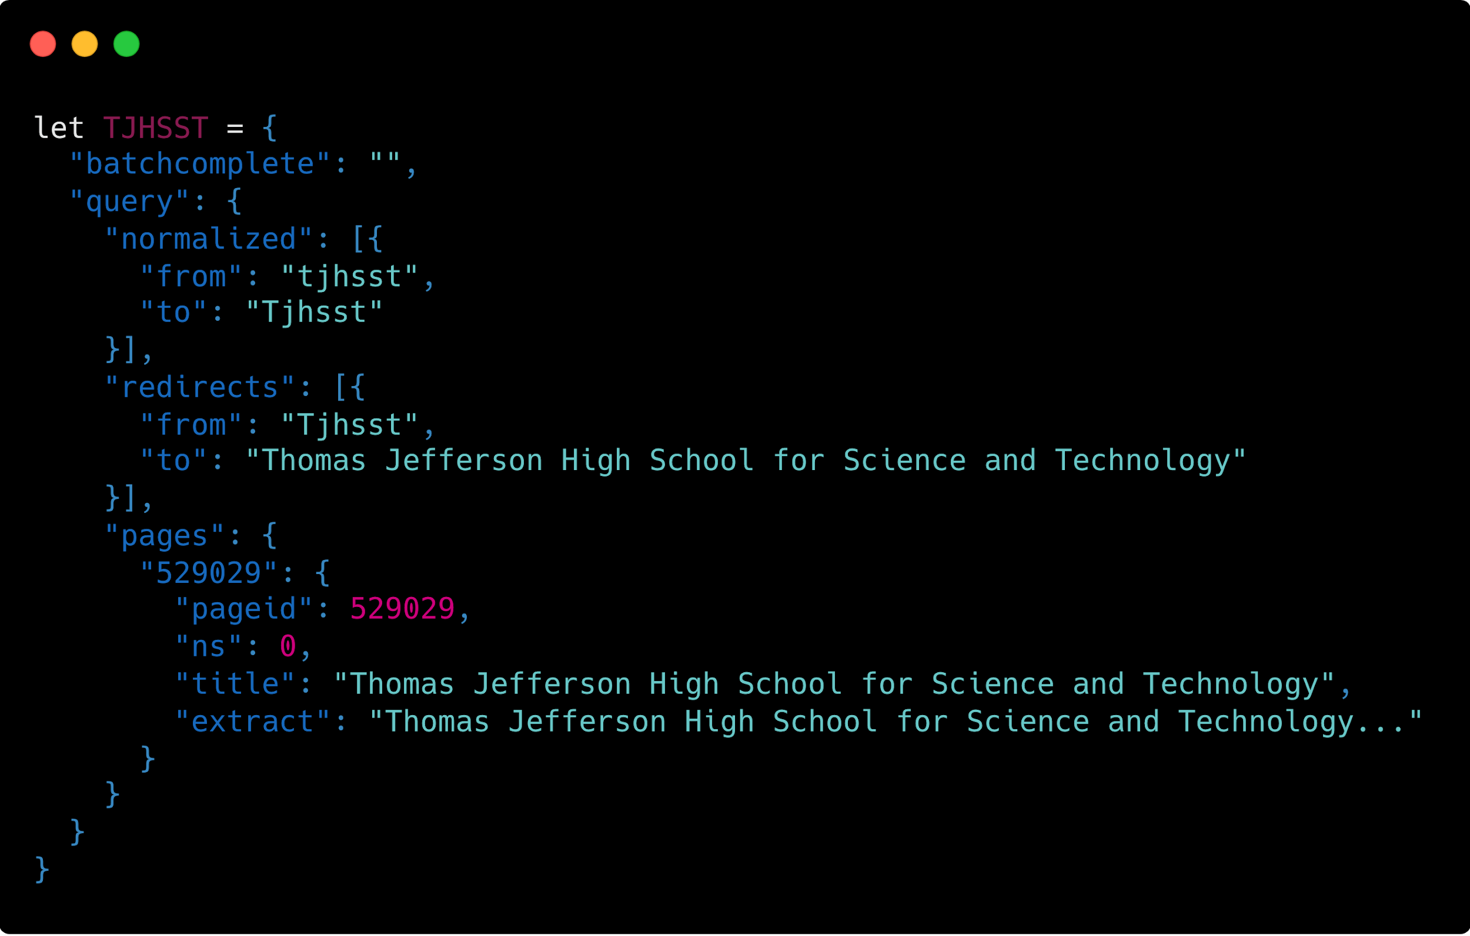
Why Does JSON Exist?
Webpages run JavaScript (JS)
JSON: JS Object Notation
Simple, flexible, and portable
TJHSST.redirects[0].to
TJHSST.pages["529029”].extract

Slide 16
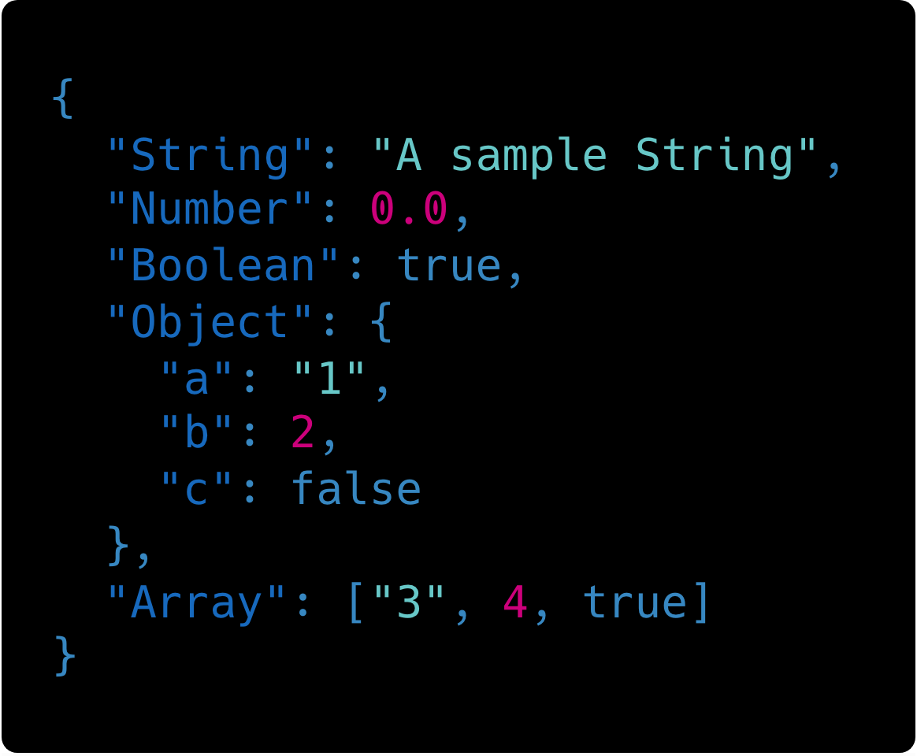
JSON Data Types
Data types aren’t explicit
Numbers are floating-point (decimals OK)
Everything’s inside a big Object
Nested Objects/Arrays possible

Slide 17
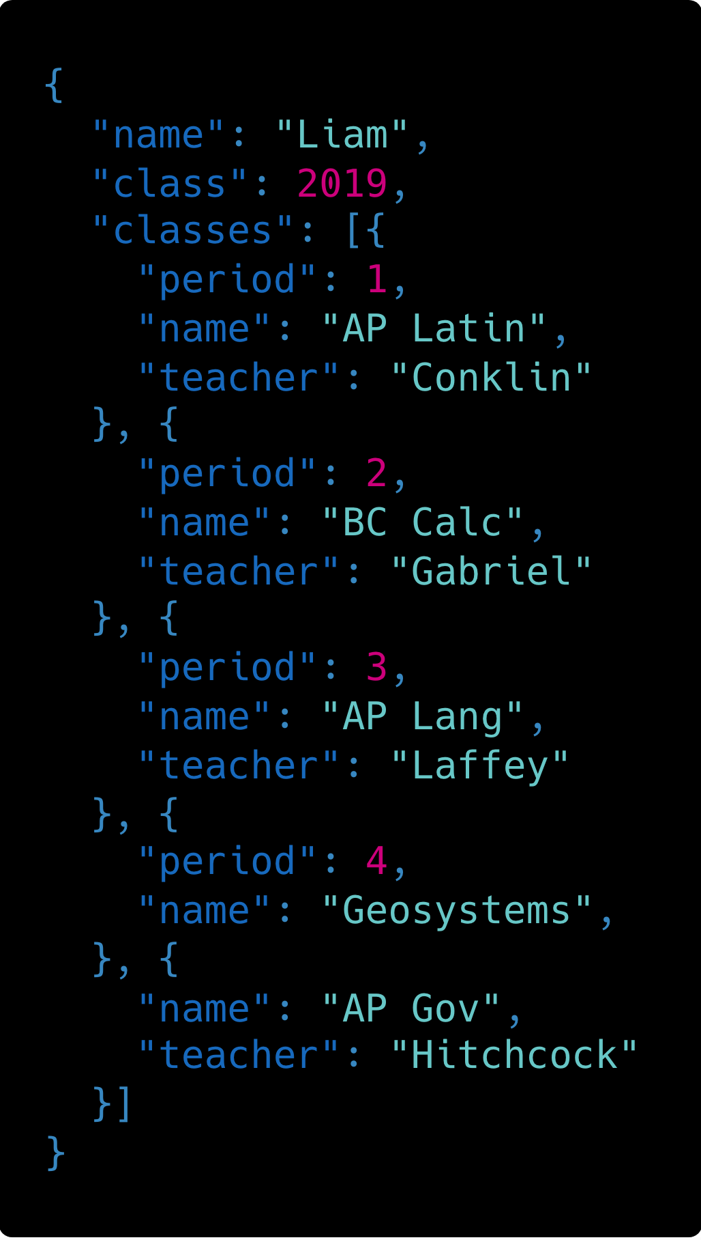
Nested JSON Questions
What type is classes[0]?
How would I find my 2nd period teacher’s name?
If I loop through classes and display the data, what might I have to watch out for?
What does classes[4].period evaluate to?

Slide 18
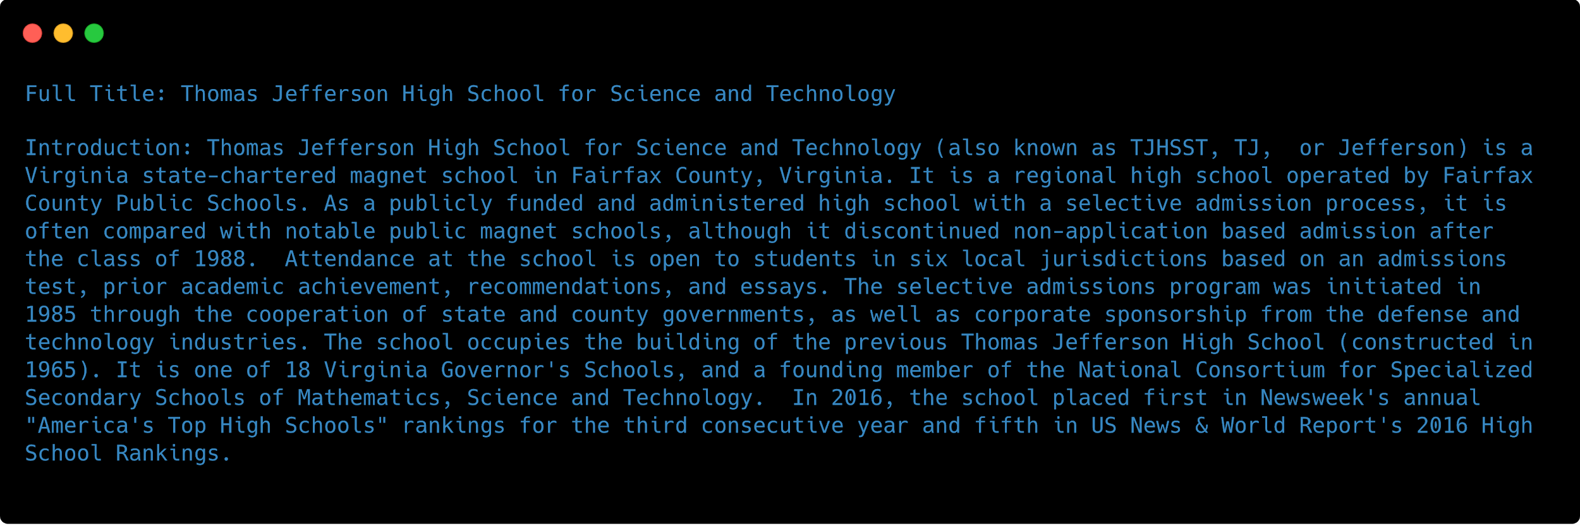
Making an HTTP GET Request with code
Java, Python, and NodeJS examples for this program available on GitHub

Slide 19
Another HTTP Request Type:
HTTP POST
Used to upload data to a Web API
Called very similarly to an HTTP GET Request
Routes are for specific HTTP Requests, so don’t make an HTTP GET Request to a POST route
Example: Sending a Tweet from your program

Slide 20
Protected APIs

Slide 21
HTTP Request Headers and API Keys
Many APIs require some sort of authentication or authorization
Often, a service provides you an API Key, to be part of your request
This API Key is included in the HTTP Request’s Header
The API checks your API Key each request
To get your Phone2Action API Key, text HACKTJ19 to 52886

Slide 22
Demo: Protected APIs in Postman

Slide 23
Demo: Protected APIs in NodeJS and Java

Slide 24
Demo: Web App (Phone2Action API)

Slide 25
Questions?

