Slide 1
Grocery Price Comparison Application

Slide 2
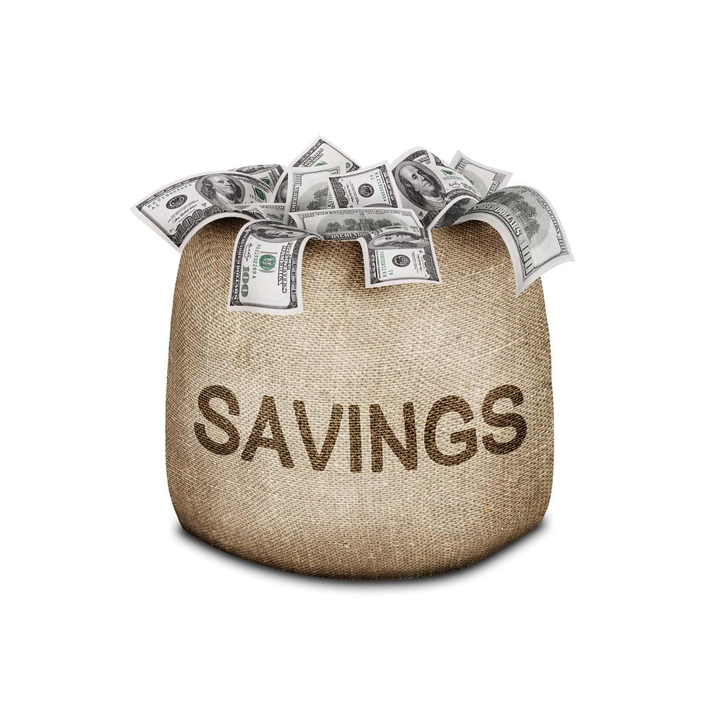
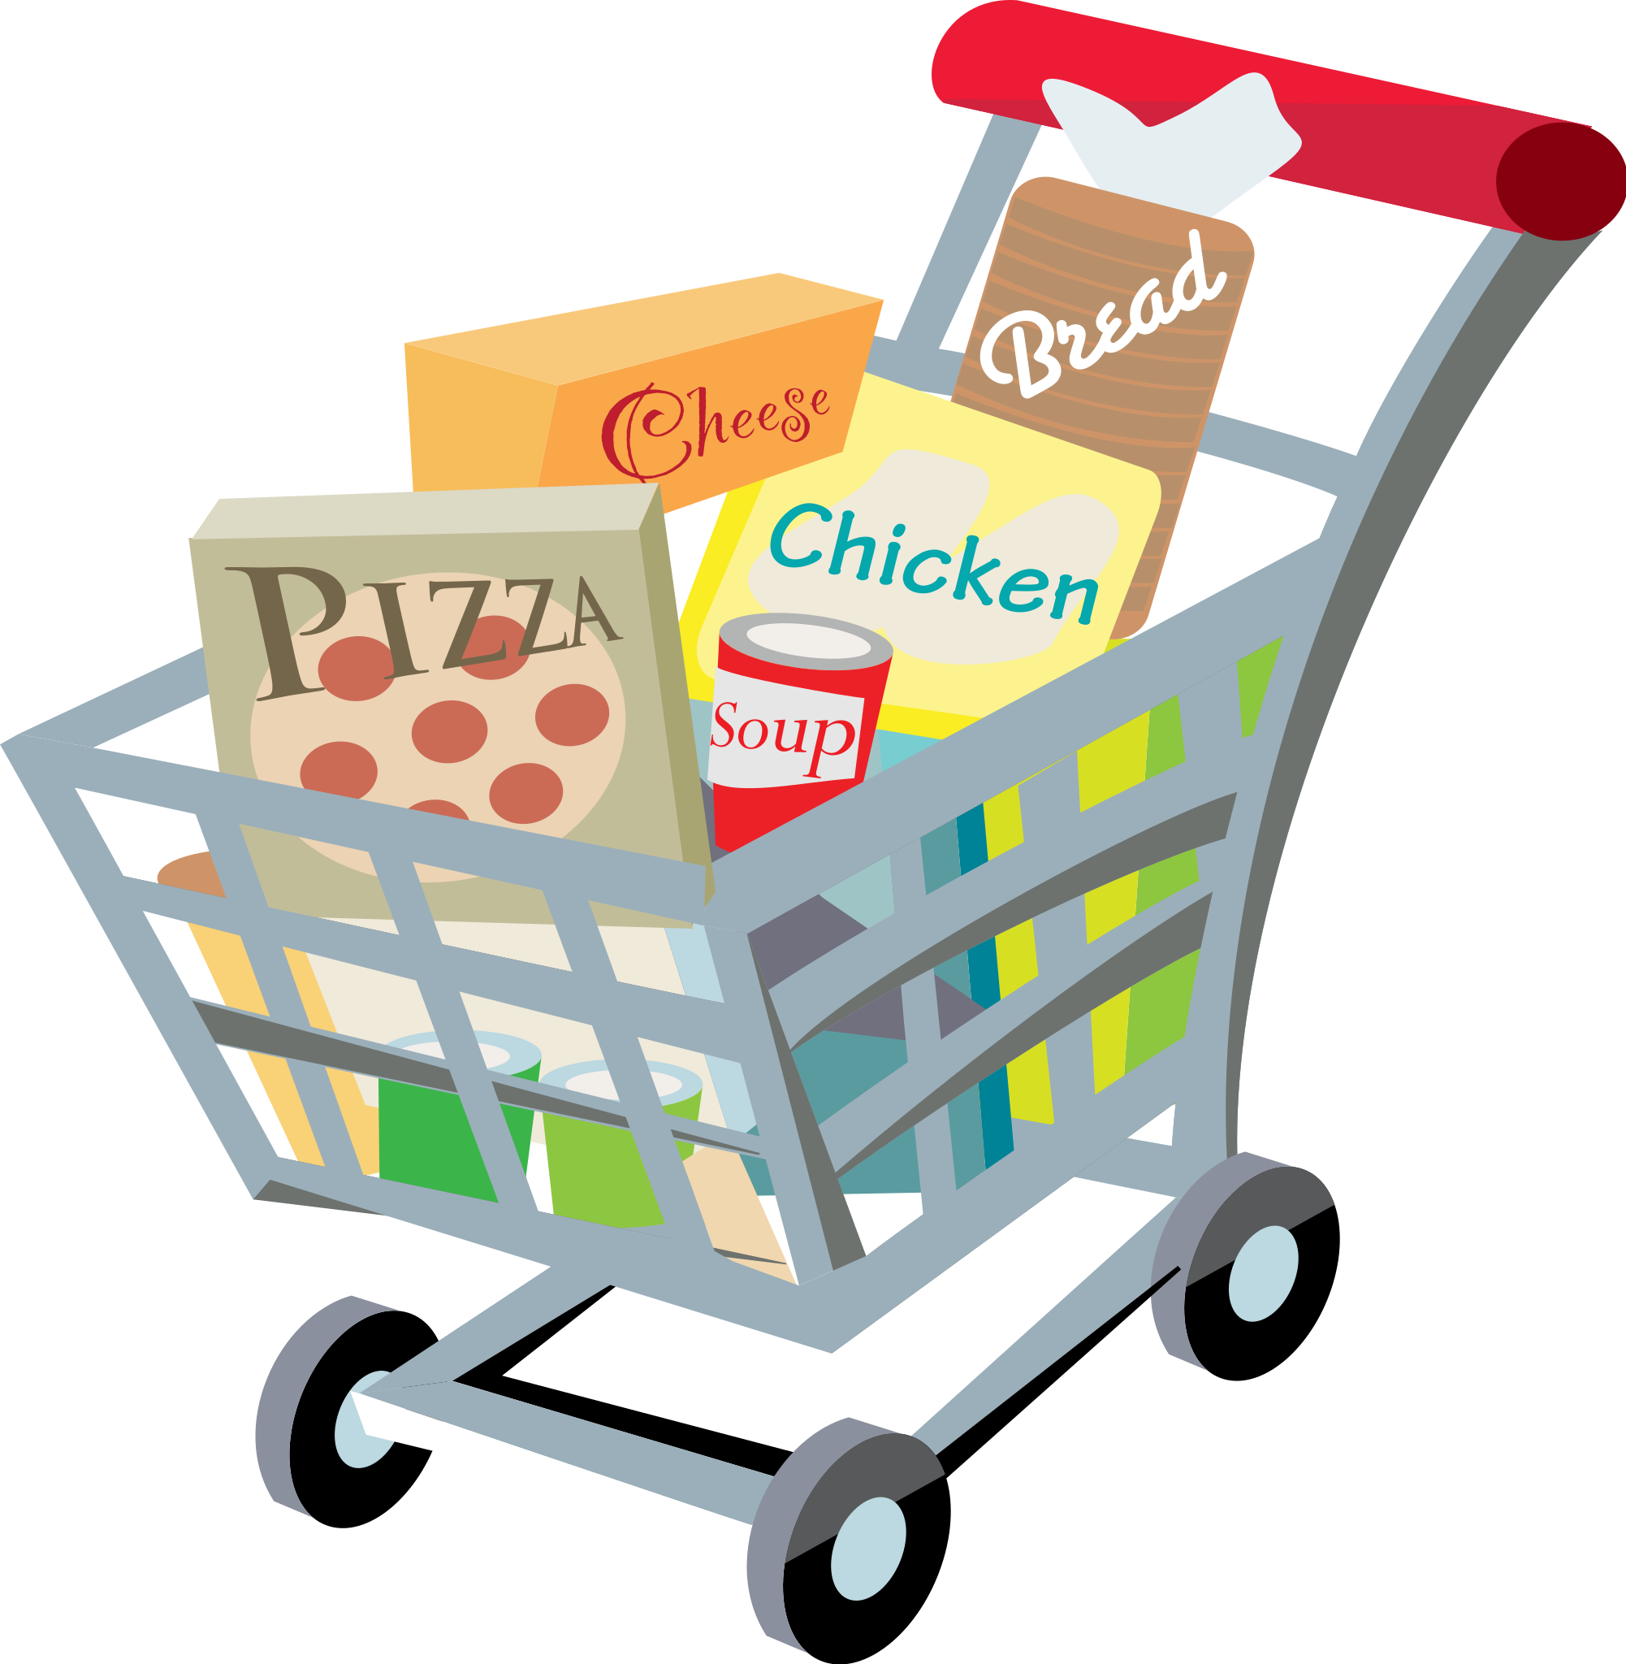
Purpose
The “Grocery Price Comparison” application enables the user to place the order of their shopping list for the best deal. The application compares item prices across different shopping stores offering the best price for the items. This way their monthly expenses will be saved by getting the best deal on all items.

Slide 3
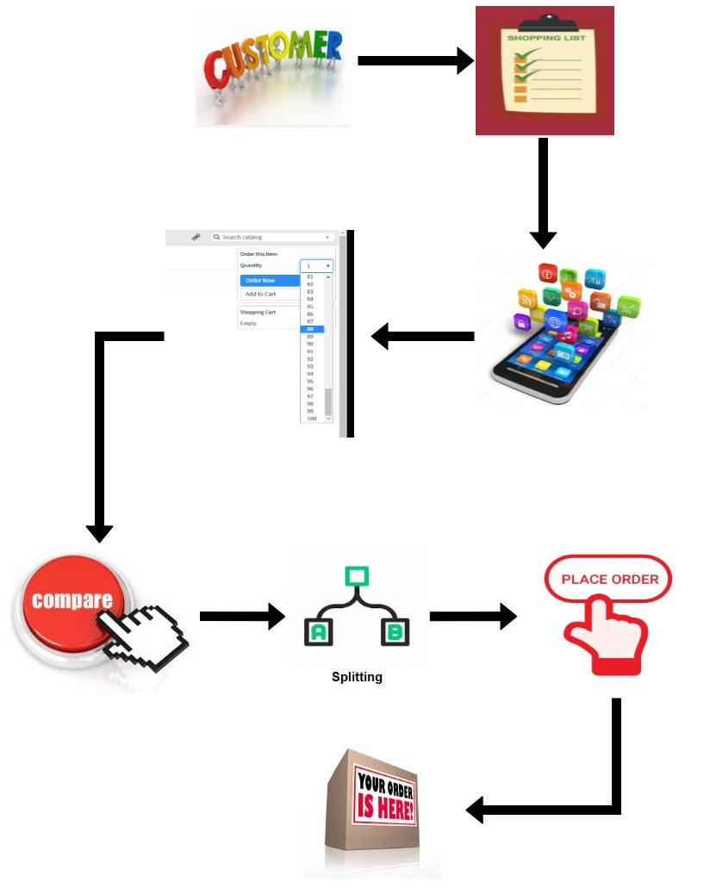
Block Diagram

Slide 4
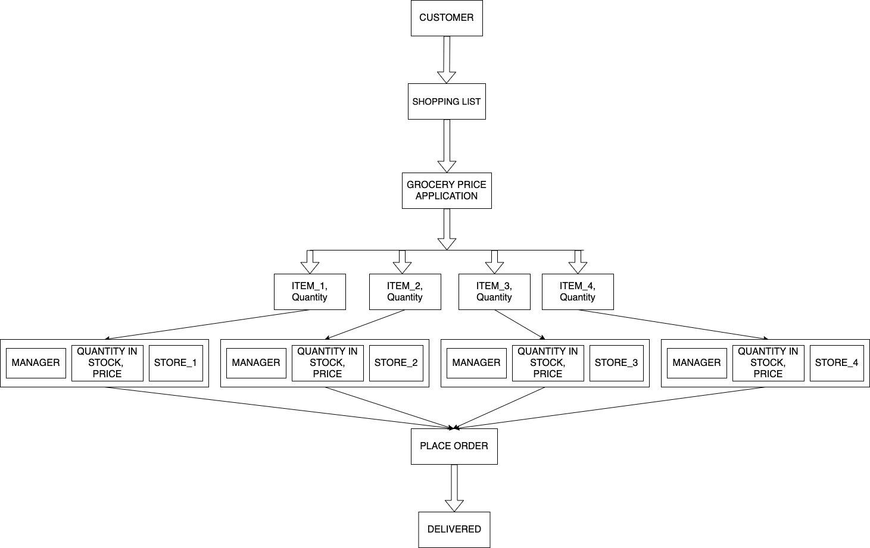
Final overall architecture:block/component diagram

Slide 5
Key Functions - Manager
Manager login
Update store inventory
Manage store information

Slide 6
Key Functions - Customer
User registration/ login
Create shopping list
Remove/ add Items to shopping list
Check items in inventory
Check prices of specific item from different stores
Place order on the application for the cheapest deal

Slide 7
Key Functions of Grocery Price Comparison Application
It takes the shopping list from the customer and places the order at the cheapest store.
Moves to the next cheapest store if inventory is insufficient.

Slide 8
DataBase Design
EERD
Schema diagram
Table design
Stored procedures and views
Transactions

Slide 9
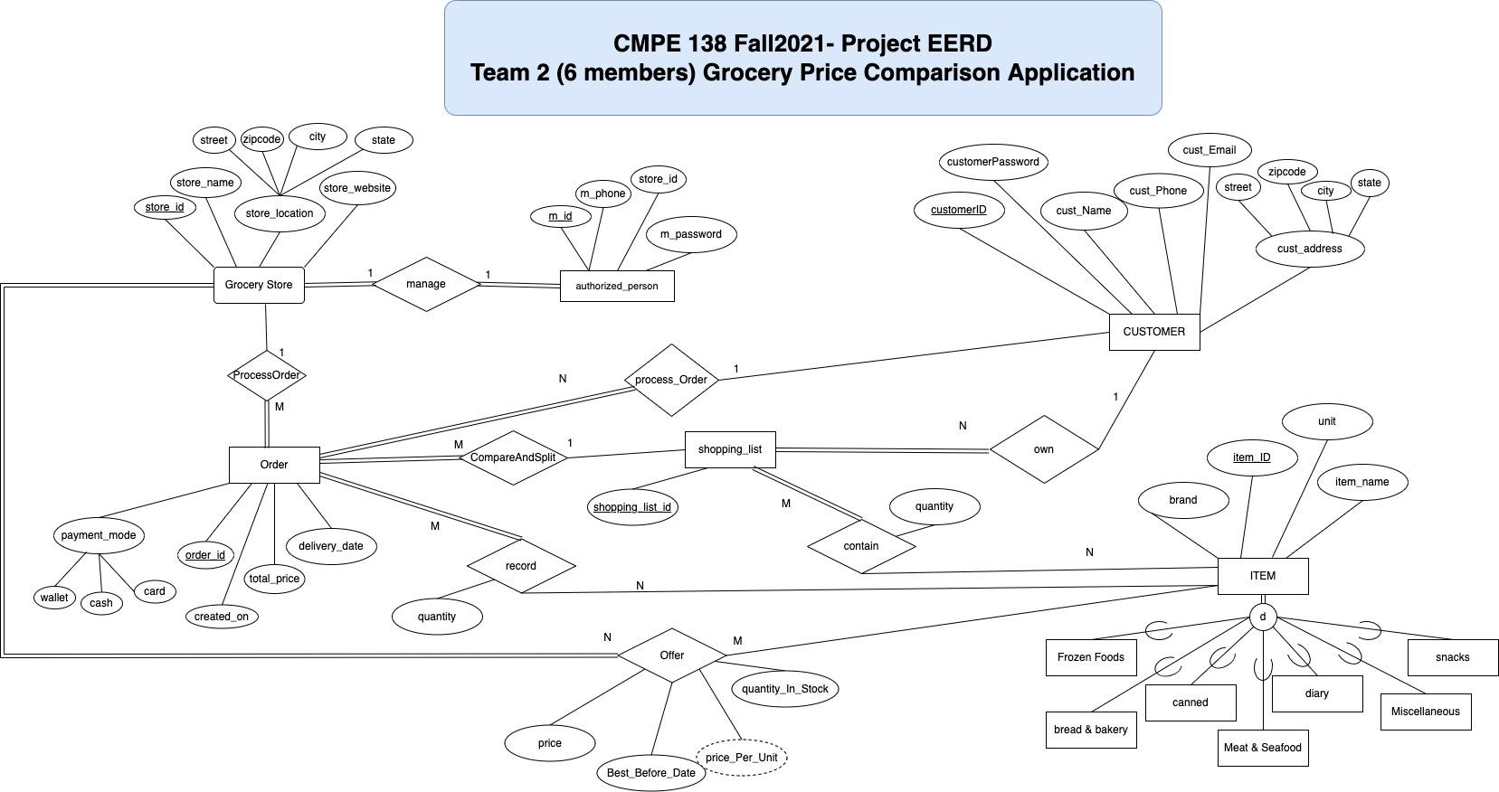
EERD DIAGRAM

Slide 10
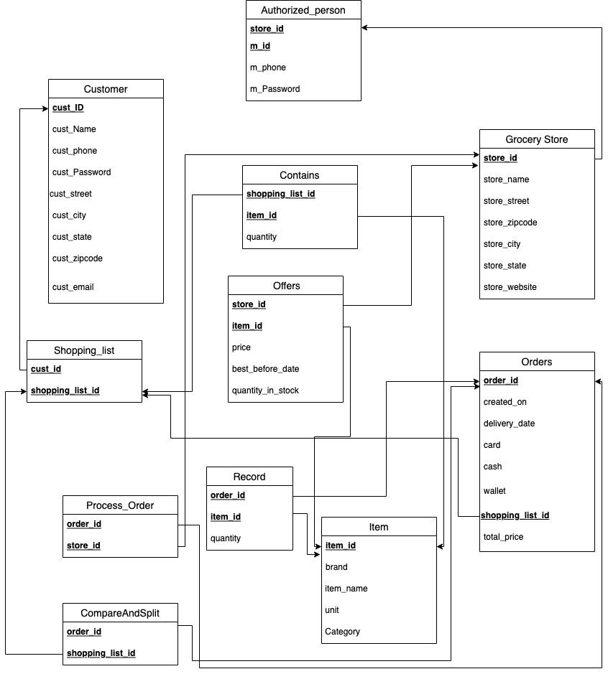
Schema Diagram

Slide 11
SPECIFICATION OF EACH DB OBJECT
GROCERY STORE:
store_id | store_name | store_street | store_zip | store_city | store_state | store_website
AUTHORIZED_PERSON:
m_id | store_id | m_phone | m_password
OFFERS:
store_id | item_id | price | best_before_date | quantity_in_stock
ORDERS:
order_id | order_time | order_date | delivery_date | payment_mode | shopping_list_id | total_price
SHOPPING_LIST:
cust_id | shopping_list_id
CUSTOMER:
cust_ID | cust_Name | cust_Password | cust_phone | cust_email | cust_street | cust_zip | cust_city | cust_state

Slide 12
SPECIFICATION OF EACH DB OBJECT
ITEM:
item_id | brand | item_name | unit | category
CONTAINS:
shopping_list_id | item_id | quantity
Record:
order_id | item_id | quantity
Process_Order:
order_id | store_id

Slide 13
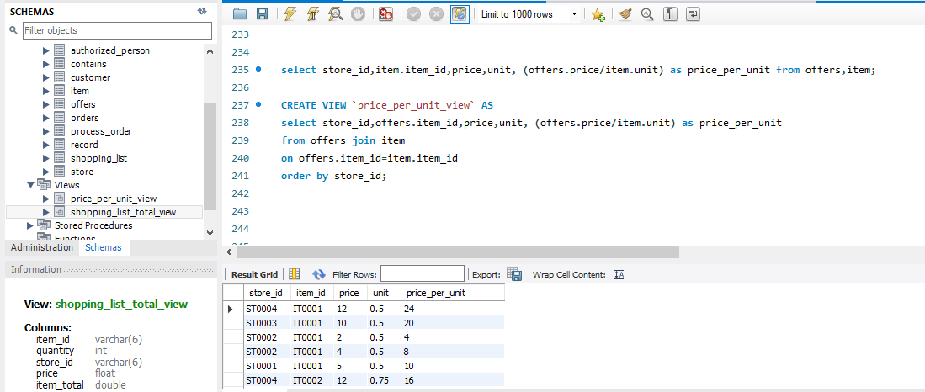
VIEWS
A view is a virtual table based on the result-set of an SQL statement.

Slide 14
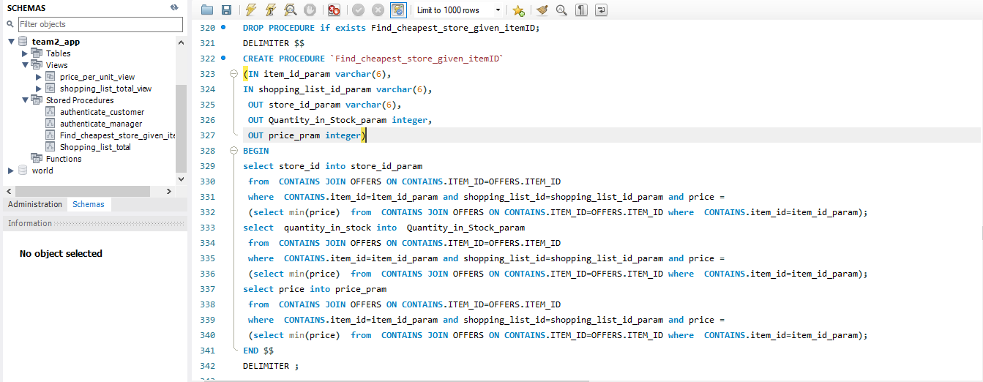
STORED PROCEDURE
A stored procedure is a prepared SQL code that you can save, so the code can be reused over and over again

Slide 15
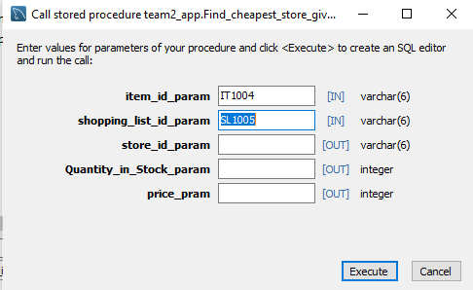
Find_cheapest_store_given_itemID:

Slide 16
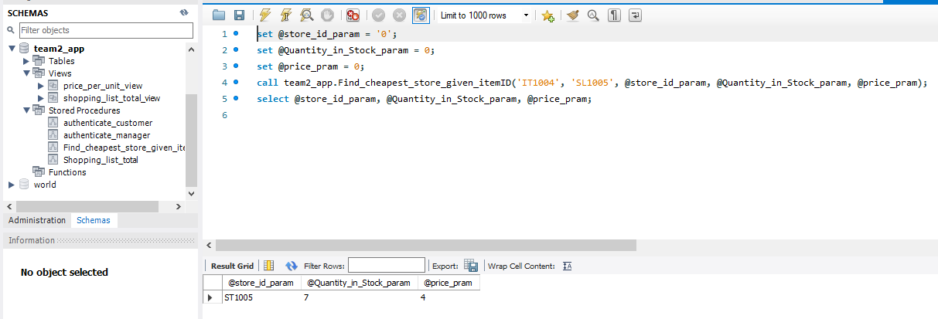
Find_cheapest_store_given_itemID:

Slide 17
User login password
We have used the Customer table for the user login password, based on registration the customer choses a password for registering the grocery price comparison application, the password is encrypted and stored in the database of the customer table.
We have used a password in SHA1() function format, the SHA1() function in MySQL is used to encrypt a string using the SHA-1 algorithm. The SHA1 algorithm, which stands for the secure hash algorithm, generates a 160-bit checksum for a user-supplied string. If the string supplied as an argument is NULL, the MySQL SHA1() method returns NULL. The SHA1() function takes only one parameter, which is the encrypted string.

Slide 18
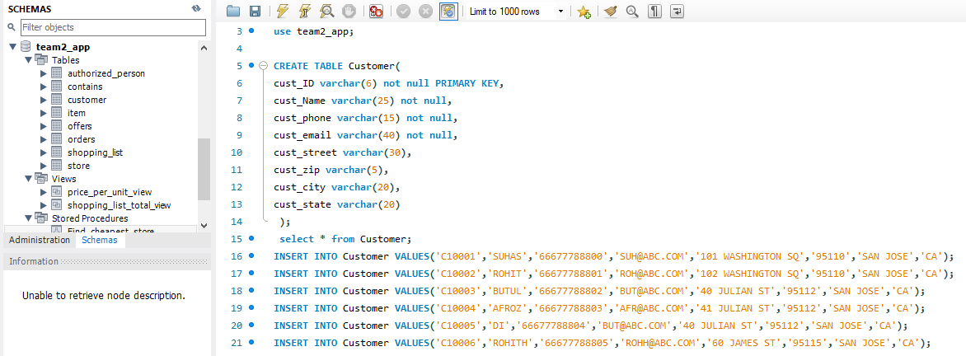
After adding the password from the application the customer table is updated in the below screenshot.
In the customer table without password.

Slide 19
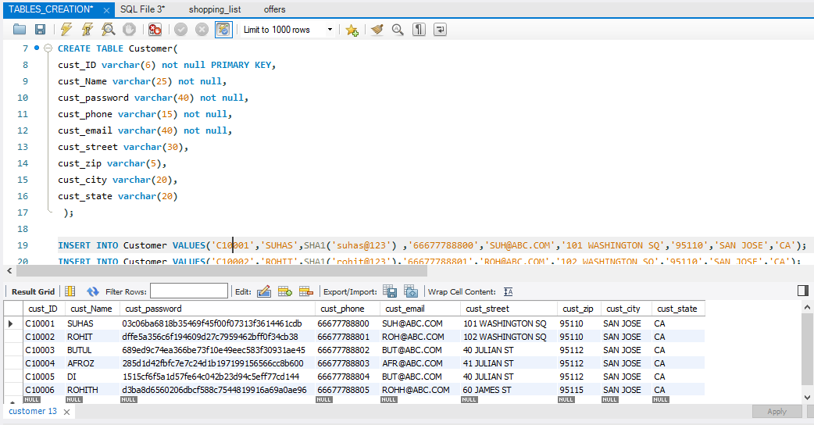
In the customer table after the password in DB-side, it is encrypted.

Slide 20
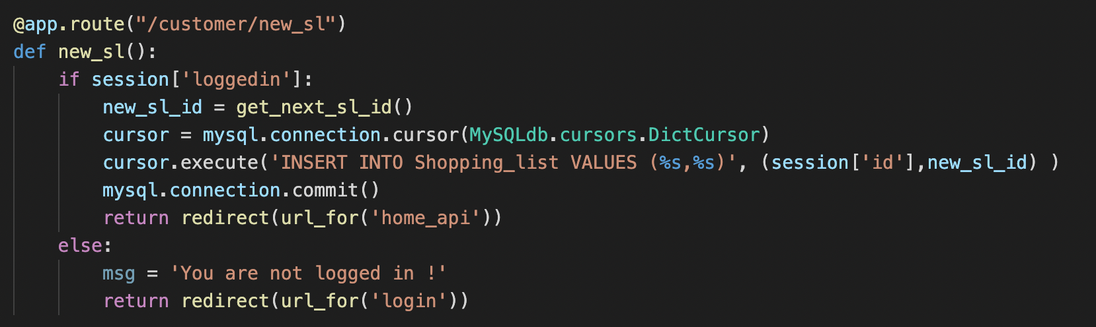
DB transactions from Flask backend
Added logic in the backend to update the DB table
For example:- Create a new shopping list
Place your screenshot here

Slide 21
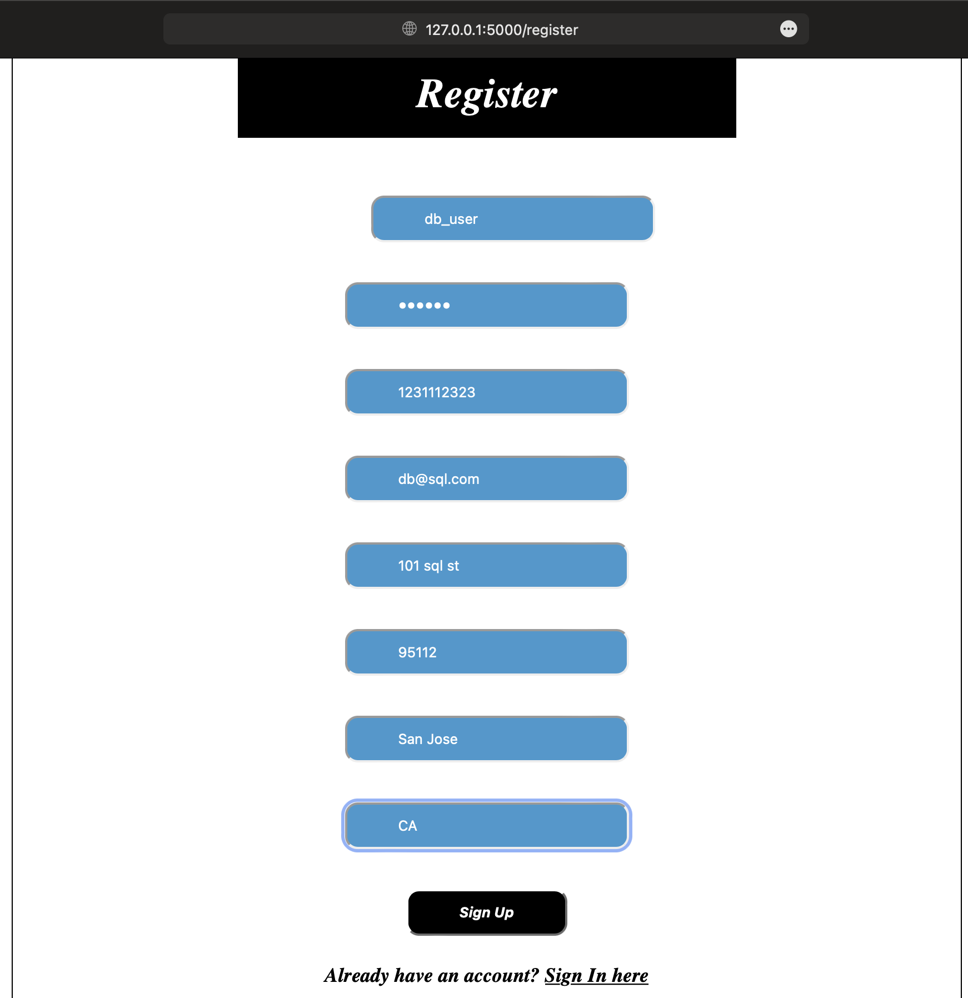
Final design of DB apps portion:
Customer Sign-up page

Slide 22
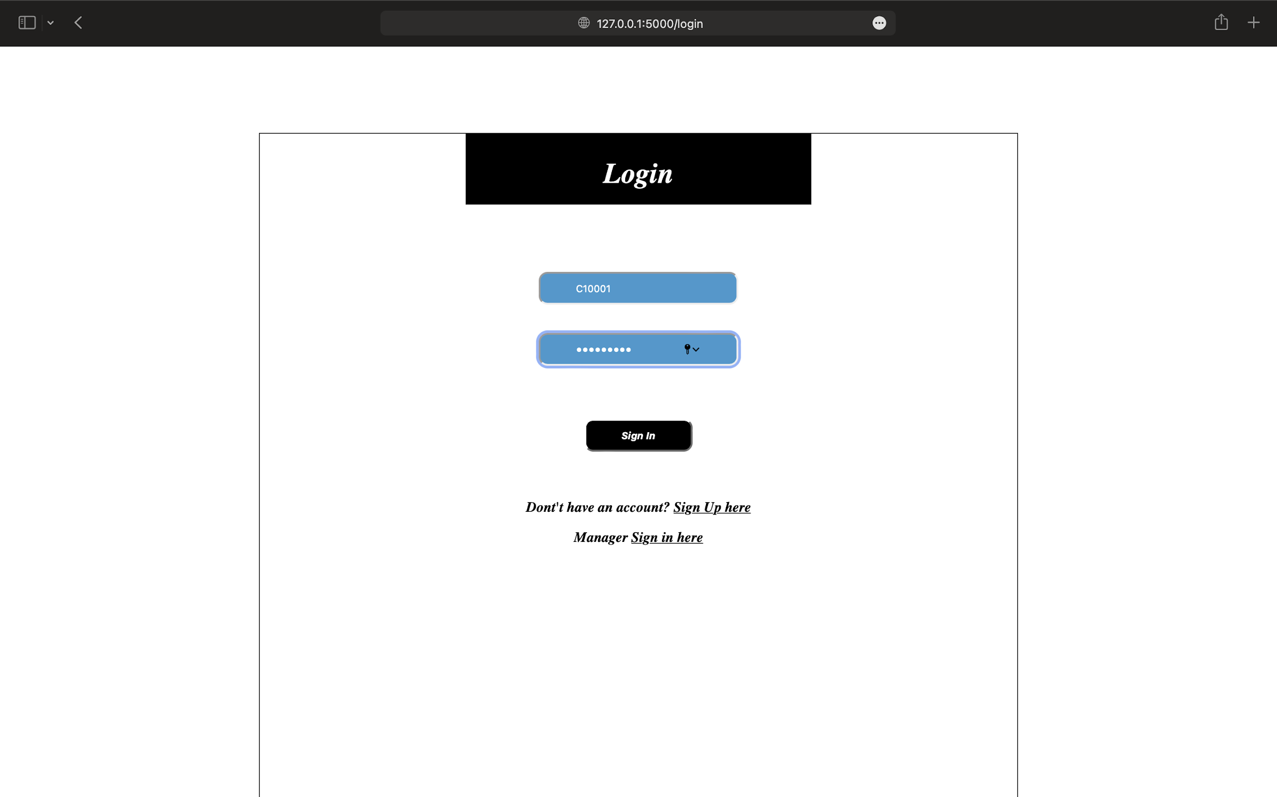
Customer Login page

Slide 23
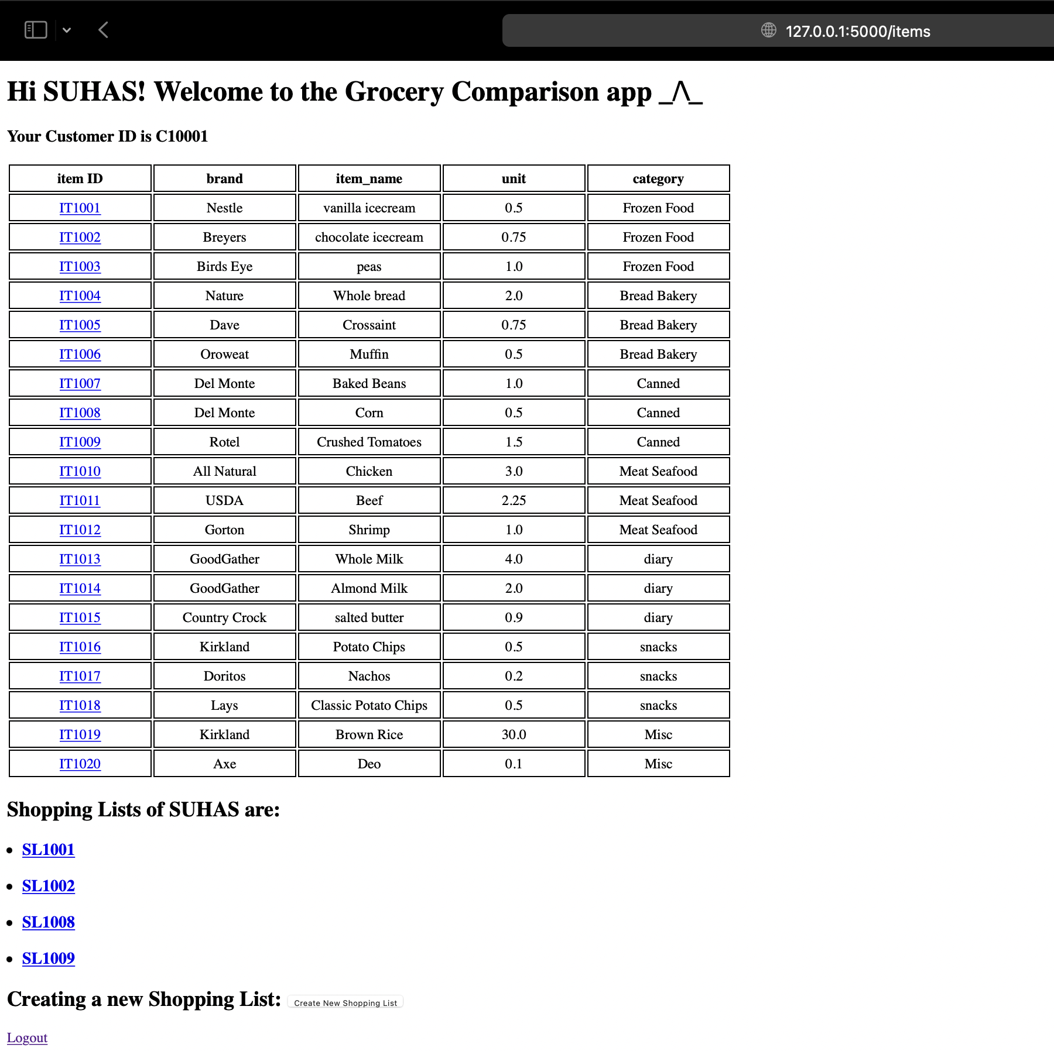
Item Home Page

Slide 24
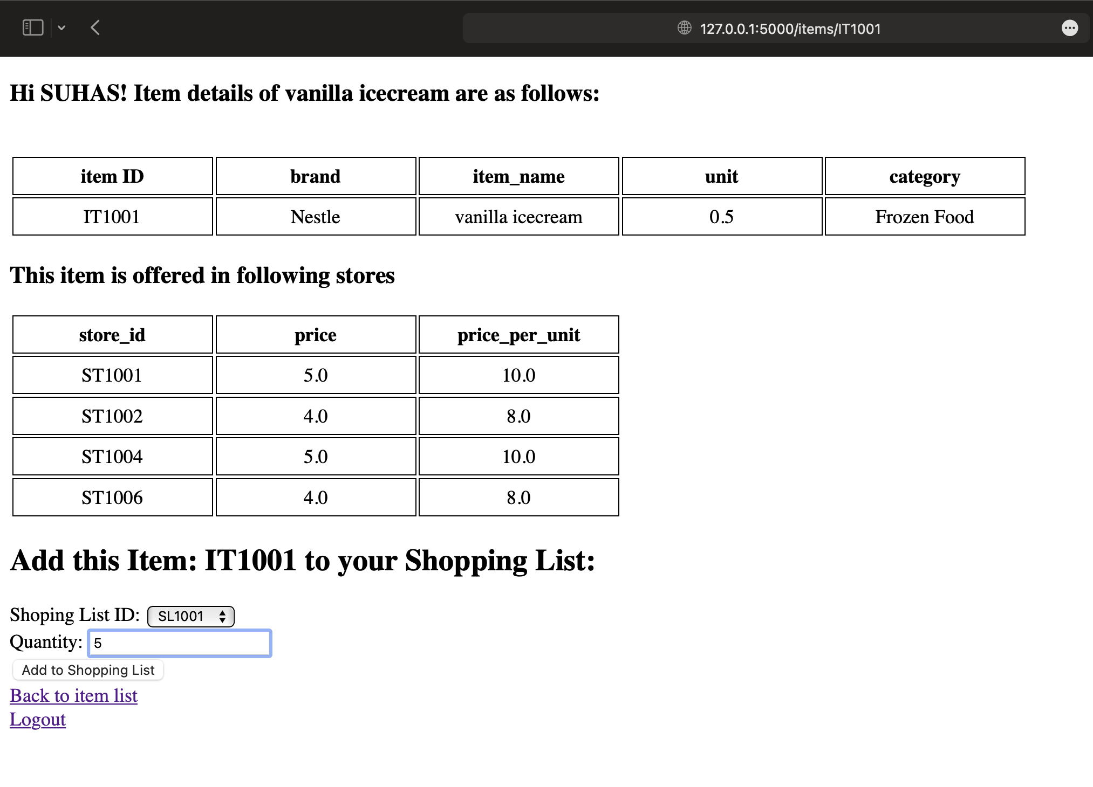
Shopping List Add or Remove

Slide 25
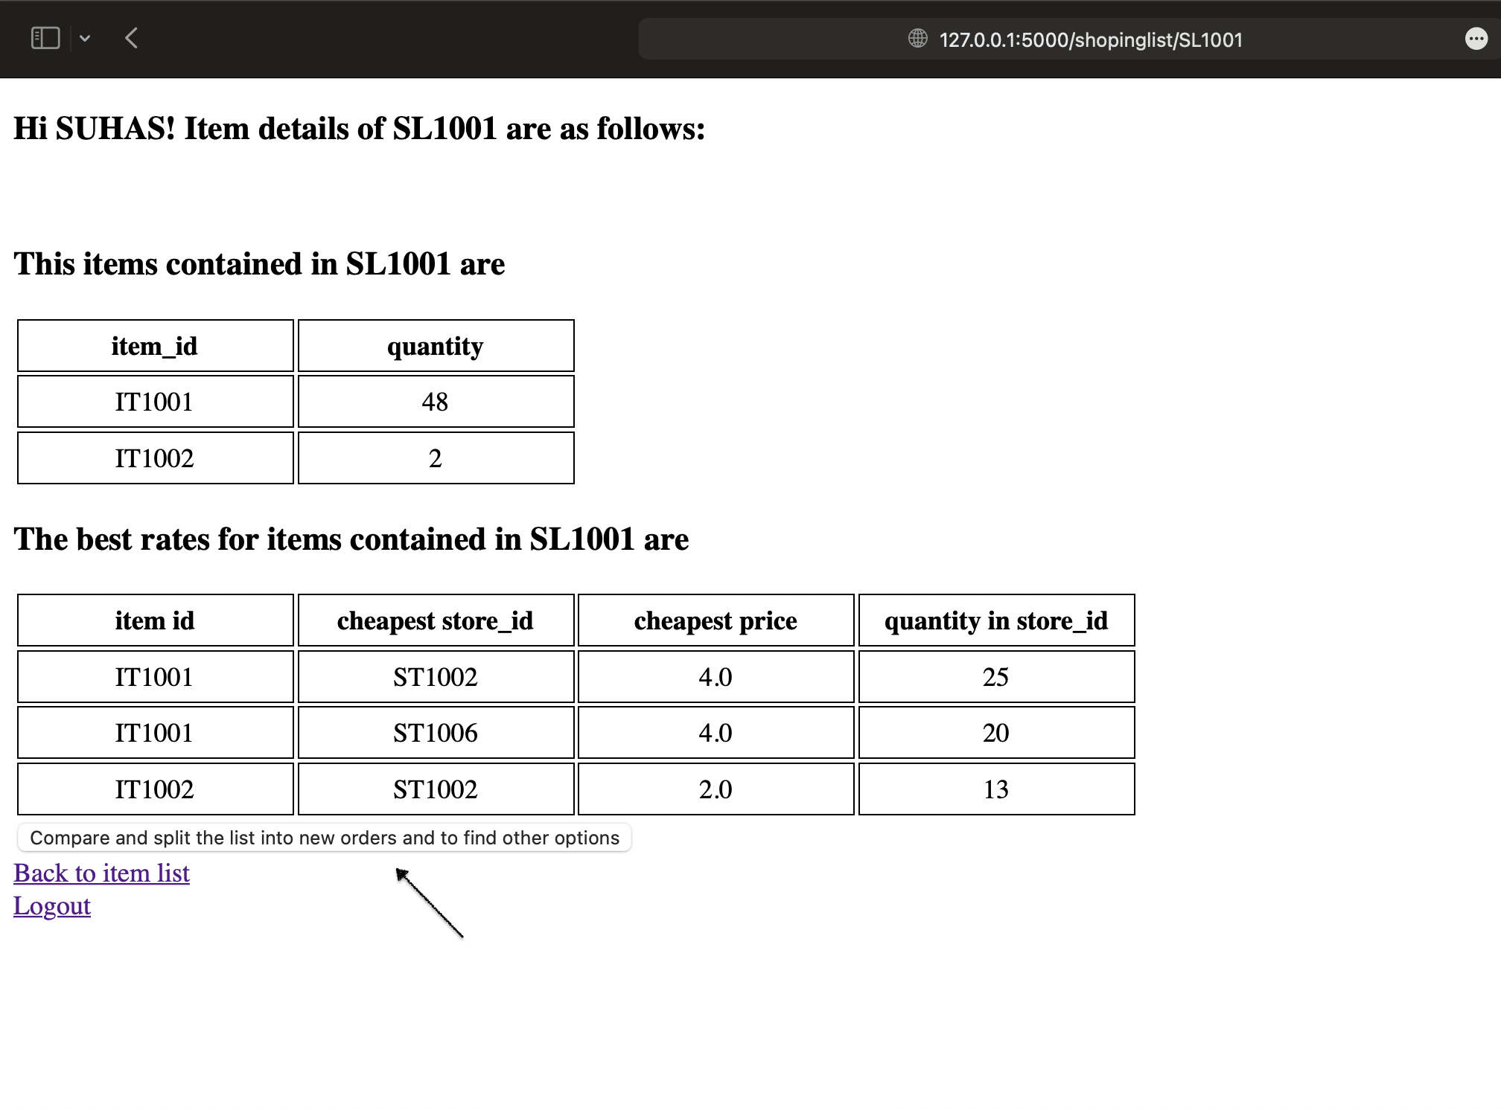
Compare and split

Slide 26
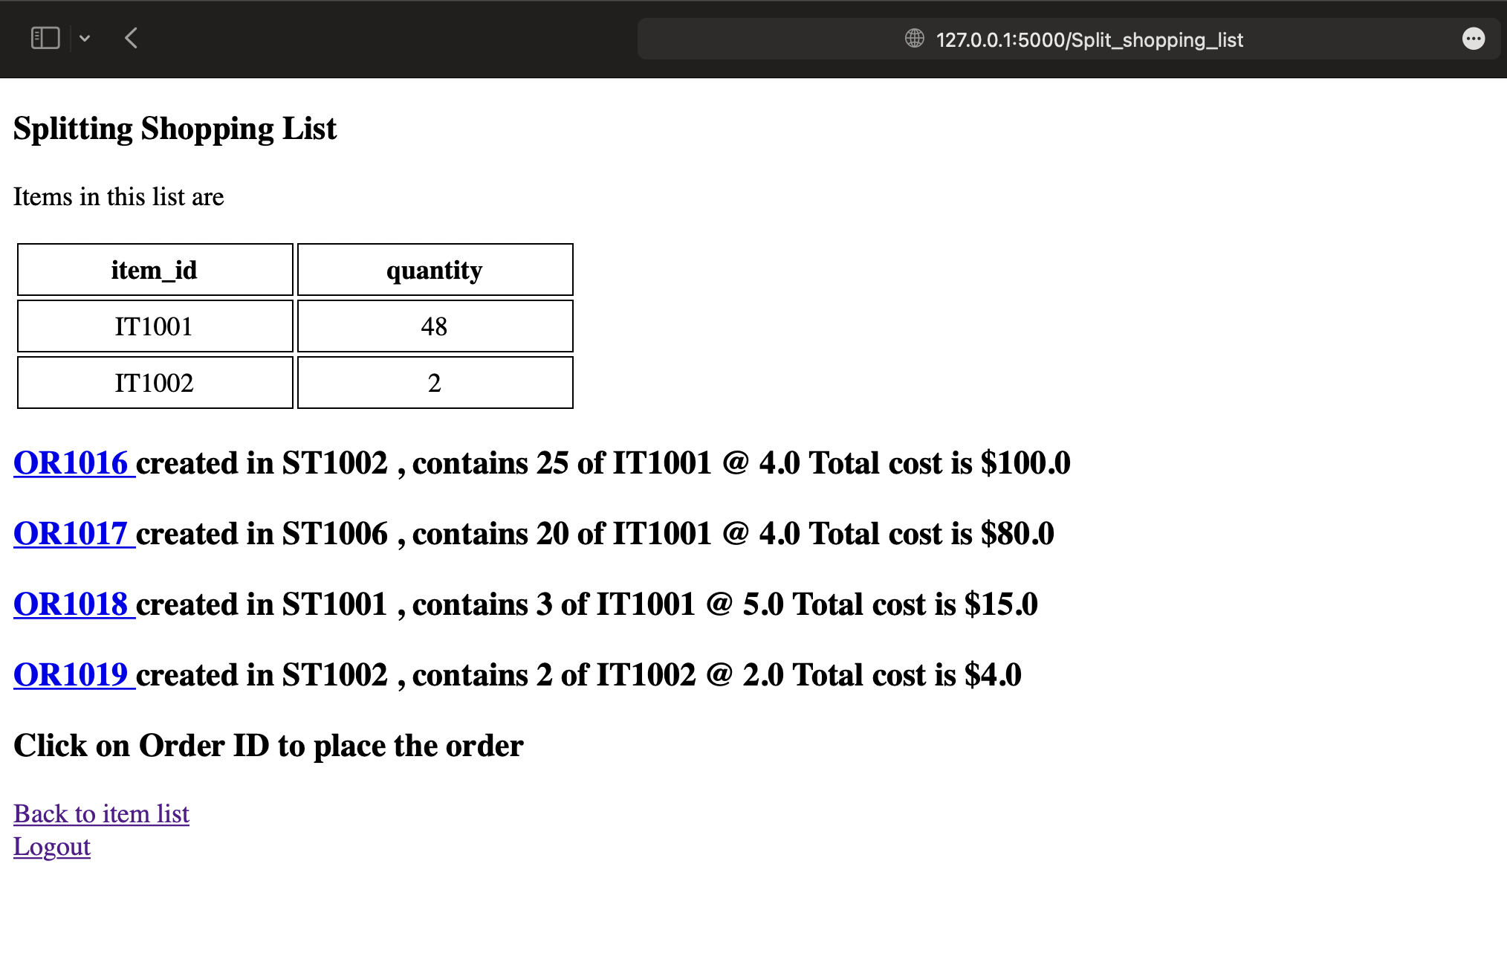
Splitting

Slide 27

Any unique designs you are proud of!
The Grocery Price Comparison Application automatically places orders at the cheapest store offering an item. Moreover, if the required quantity is not available, it places the order at the next cheapest store and updates the inventory of the store.

Slide 28
Thank you!

