Slide 1
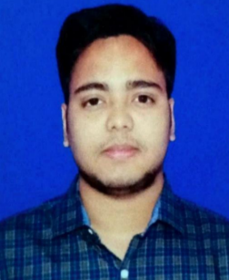
Rakesh Kumar Basantara | Analyst / Software Engineer
Name Rakesh Kumar Basantara
Title Analyst/ Software Engineer
Location Bhubaneswar, India
Competencies
Have thorough understanding of Integration Principles and Design Patterns.
Ability to comprehend the Business Requirement, Design and proficient in using Anypoint Platform to discover, consume, build, deploy, manage, and govern APIs.
Well versed in Agile Methodology and working within.
Hands on experience in building API-led and Connector-based integrations for end points like Salesforce, Files, Database etc.
Analytical mindset and problem-solving skills.
Good communication skills and effective team player.
Training Skills:
Mule 4.x, Agile Development, Core Java , MySQL, XML, JSON
Mule Specification :
RAML, Exchange, API Manager, Runtime Manager, Dataweave, Scheduler, Connectors
Experience Summary
Working knowledge of policies via API Manager .
Working knowledge of exception handling and logging, in API-led distributed environment.
Used Dataweave transformations to handle diverse set of message formats like JSON, XML, CSV, etc. and have worked on various operators like map, pluck, Arrays, lookup and modules.
Working knowledge of batch implementations.
Used Database and HTTP connectors to implement API methods to fetch data from database.
Competencies
Having Knowledge on Inbound and Outbound EDI transactions.
Worked on Creating Processing Group Adding Trading Partners And routing to particular processes
Configured EDI Envelops.
Certifications
MuleSoft Certified Developer Level 1
Agile Software Development
AWS Level ) Migration Ambassador Foundations
TCA-TIBCO BusinessWorks™.

