Slide 1
Student Name : M.BUVANESWARAN
Final Project
3/21/2024 Annual Review

Slide 2
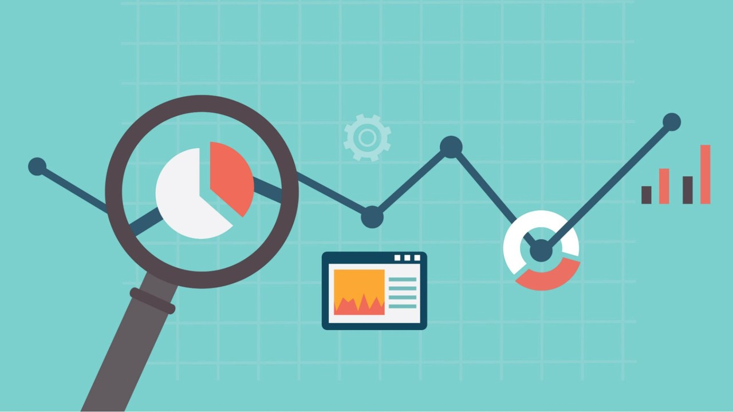
PROJECT TITLE
TIME SERIES FORECASTING USING RNN
3/21/2024 Annual Review

Slide 3
OUTLINE
PROBLEM STATEMENT
PROJECT OVERVIEW
WHO ARE THE END USERS
YOUR SOLUTION AND IT’S PROPOSITION
THE WOW IN YOUR SOLUTION
APPLICATIONS
RESULT
REFERENCE
3/21/2024 Annual Review

Slide 4

PROBLEM STATEMENT
Traditional time series forecasting methods struggle to accurately predict future observations due to complex patterns and dependencies. Existing techniques often fail to capture temporal dynamics effectively, leading to suboptimal results in various domains. To address this, a robust forecasting approach leveraging Recurrent Neural Networks (RNNs) is essential. This project aims to develop an advanced RNN-based forecasting model capable of improving predictive accuracy by effectively modeling temporal dependencies and intricate patterns in time series data. The objective is to overcome the limitations of traditional methods and provide reliable forecasting solutions across diverse industries, including finance, healthcare, energy, and transportation.
3/21/2024 Annual Review

Slide 5

PROJECT OVERVIEW
This project overview explores the utilization of Recurrent Neural Networks (RNNs) in time series forecasting. RNNs, adept at capturing sequential patterns, offer a robust solution for predicting future observations in various domains. Key components include understanding time series data characteristics, selecting appropriate RNN architecture, training the model with historical data, and evaluating its performance. Through a real-world case study, we'll illustrate the practical application of RNNs, addressing challenges and solutions encountered. By emphasizing best practices and emerging trends, this project aims to enhance understanding and application of RNNs in time series forecasting, enabling more accurate predictions across different industries.
3/21/2024 Annual Review

Slide 6

WHO ARE THE END USERS?
The end users of the developed RNN-based time series forecasting model encompass a diverse range of professionals across various industries. Financial analysts stand to benefit significantly from the model's capability to predict stock prices, currency exchange rates, and financial market trends, aiding in informed investment decisions. Supply chain managers can utilize the model to forecast product demand, optimize inventory levels, and streamline production planning processes. Meteorologists could employ the model for weather forecasting, including temperature variations, precipitation patterns, and severe weather events, enhancing disaster preparedness and resource allocation strategies. Healthcare professionals may leverage the model to predict patient admissions, disease outbreaks, and healthcare resource demand, facilitating better resource allocation and healthcare planning. Similarly, professionals in the energy sector and transportation planners can also utilize the model for forecasting energy demand, optimizing energy production, and predicting traffic patterns, respectively. Ultimately, the developed forecasting model serves as a versatile tool catering to the needs of diverse end users across multiple industries.
3/21/2024 Annual Review

Slide 7

YOUR SOLUTION AND ITS VALUE PROPOSITION
Our solution entails developing a robust time series forecasting model leveraging Recurrent Neural Networks (RNNs) to address the challenges inherent in traditional forecasting methods. By harnessing the power of RNNs, our model aims to accurately predict future observations in diverse domains with complex and dynamic data patterns. The proposition lies in the model's ability to effectively capture temporal dependencies and intricate patterns within time series data, thereby improving forecasting accuracy. Through extensive training and optimization, our model offers a reliable solution for various end users, including financial analysts, supply chain managers, meteorologists, healthcare professionals, energy sector specialists, and transportation planners. By providing accurate forecasts, our solution empowers decision-makers to make informed choices, optimize resource allocation, and enhance operational efficiency across different industries.
3/21/2024 Annual Review

Slide 8

THE WOW IN YOUR SOLUTION
Our solution focuses on developing an advanced time series forecasting model leveraging Recurrent Neural Networks (RNNs) to address the limitations of traditional forecasting approaches. By integrating RNNs, renowned for their ability to capture temporal dependencies and intricate patterns within sequential data, our model enhances predictive accuracy across diverse domains. The crux of our proposition lies in providing end users such as financial analysts, supply chain managers, meteorologists, healthcare professionals, energy sector specialists, and transportation planners with a reliable tool to make informed decisions. Through rigorous training and optimization, our solution empowers stakeholders to optimize resource allocation, improve operational efficiency, and drive strategic decision-making based on accurate forecasts.
3/21/2024 Annual Review
8

Slide 9
APPLICATIONS
Finance: Predicting stock prices, currency exchange rates, and financial market trends for informed investment decisions.
Supply Chain Management: Forecasting product demand, optimizing inventory levels, and improving production planning processes.
Meteorology: Predicting weather patterns, including temperature variations, precipitation levels, and severe weather events, for disaster preparedness and resource allocation.
Retail: Predicting sales trends, optimizing pricing strategies, and managing inventory levels effectively.
Manufacturing: Forecasting equipment failures, optimizing maintenance schedules, and improving production efficiency.
Marketing: Predicting customer behavior, optimizing marketing campaigns, and enhancing customer engagement strategies.
Agriculture: Forecasting crop yields, optimizing planting and harvesting schedules, and managing agricultural resources effectively.
3/21/2024 Annual Review

Slide 10
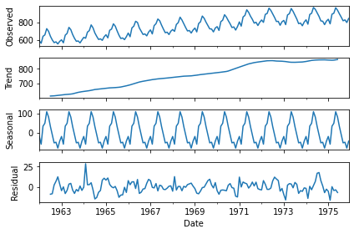
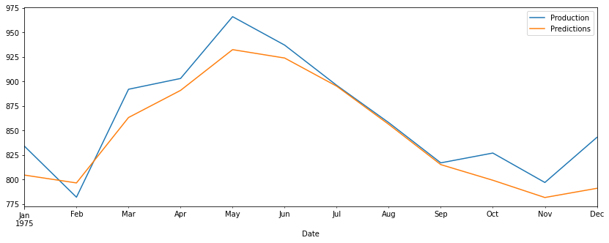
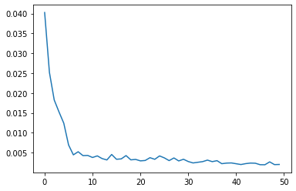
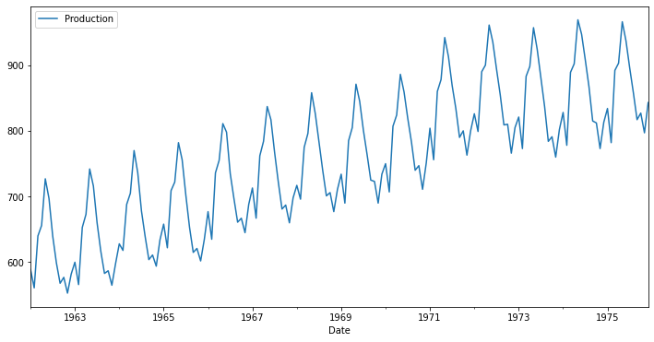
RESULTS
https://github.com/Buvanesh3/timeseriesforecasting.git
3/21/2024 Annual Review
10

Slide 11
REFERENCE
The realm of time series forecasting, enriched by the fusion of recurrent neural networks (RNNs) and data analytics, has witnessed a paradigm shift in predictive modeling across diverse industries. Renowned for their ability to capture temporal dependencies and intricate patterns within sequential data, RNNs serve as the cornerstone of modern forecasting methodologies. Through a blend of advanced algorithms and robust training procedures, these models offer unparalleled accuracy in predicting future observations across various domains. From finance and supply chain management to meteorology and healthcare, the applications of RNN-based time series forecasting are vast and far-reaching. By harnessing the power of RNNs, decision-makers can make informed choices, optimize resource allocation, and drive strategic decision-making based on precise forecasts. As the field continues to evolve, the integration of RNNs into forecasting frameworks promises to revolutionize industries, empowering stakeholders with actionable insights and predictive capabilities crucial for navigating an increasingly complex and dynamic world.
3/21/2024 Annual Review

