Slide 1
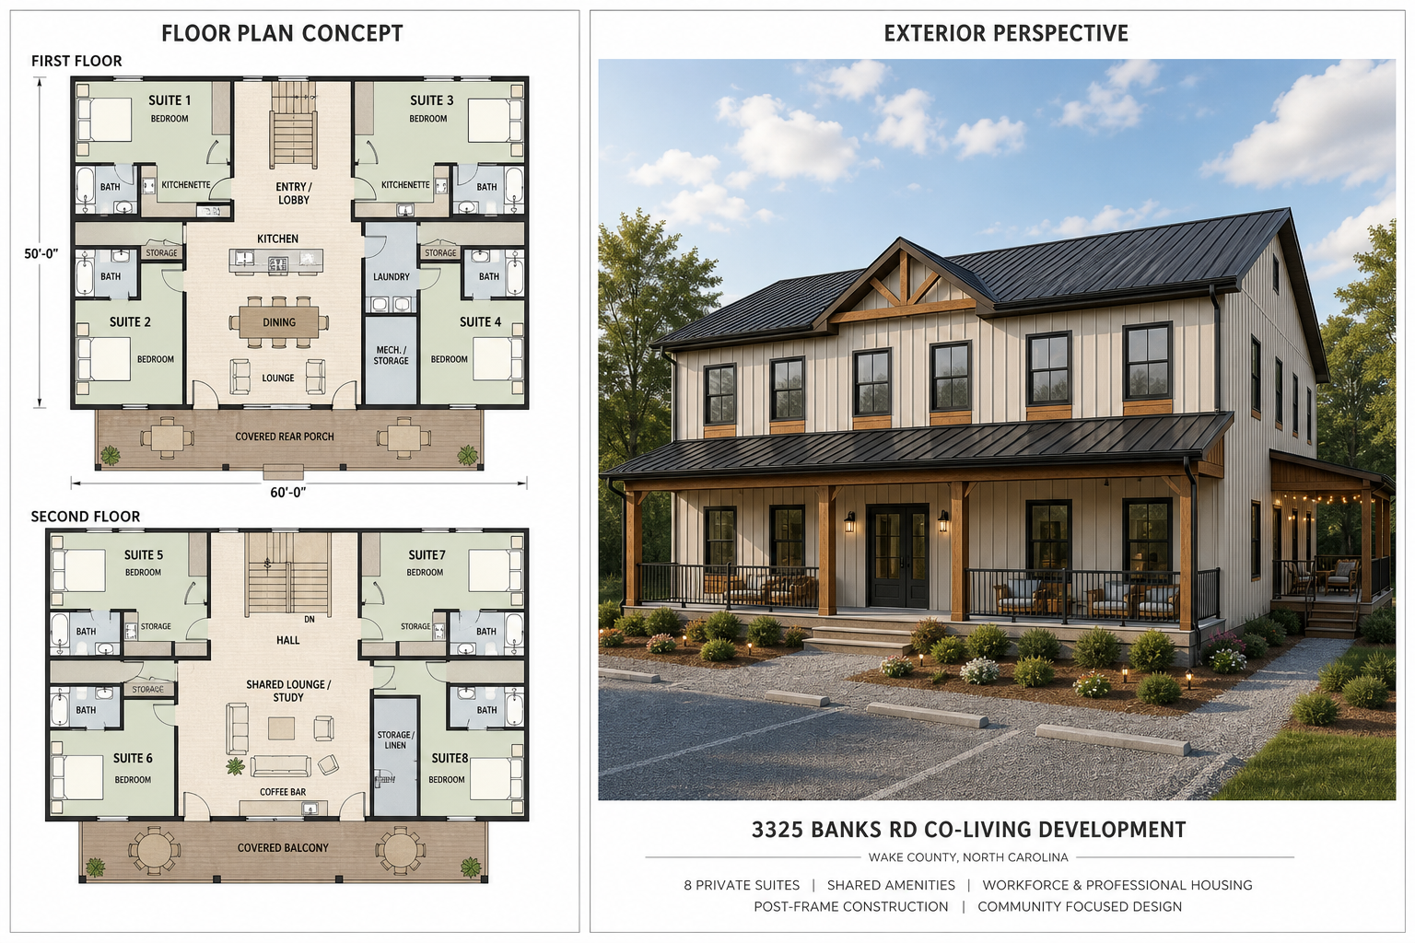
3325 Banks Rd
Co-Living Residential Development with Optional STR Operating
Wake County near Raleigh, North Carolina
Base residential underwriting remains the control case .
one-floor and whole-building STR are presented as upside operating scenarios.
Investor pitch deck | STR workbook version
Notes:
This presentation introduces the 3325 Banks Road project as a flexible residential rental platform. The base business plan is co-living and furnished medium-term rental housing. The STR, or short-term rental, strategy is not being presented as the only way the project works. It is additional upside that can be tested after the building is delivered and operating. The key point for investors is flexibility. The same building design can serve workforce tenants, graduate students, traveling professionals, medium-term furnished renters, one-floor group stays, or potentially whole-building weekly rentals. That optionality is valuable because it lets the project adapt to demand instead of depending on one narrow tenant type.

Slide 2
OVERVIEW
Investment Thesis
Sponsor-led co-living residential development in the Triangle market corridor.
Base case targets workforce housing, graduate/professional co-living, and furnished medium-term renters.
STR scenarios test one-floor and whole-building weekly rental upside.
Capital recovery strategy relies on stabilization, refinance, and operating cash flow.
Competitive Advantage
Controlled land position, 6,000 SF post-frame construction strategy, sponsor equipment and crew capacity, and flexible floor-by-floor rental configuration.
Current Status
STR workbook model with base-case underwriting, rent options, participant returns, refinance timing, sale timing, and waterfall assumptions under active refinement.
Notes:
The investment thesis starts with a long-term income-producing residential asset. This is not a speculative resale project. The sponsor controls the land position and is developing a boutique residential platform near the Raleigh and Triangle employment corridor. The base case is co-living and medium-term furnished rental. That is the most stable underwriting case.
The STR scenarios are used to test whether the project can earn more by renting one floor or the entire building on a weekly basis. This creates upside, but it does not replace the need to underwrite the base residential case carefully. The current model is still active and subject to refinement. It includes rent options, participant returns, refinance timing, sale timing, and waterfall assumptions.

Slide 3
ASSET
Development Program
1.1 AC
6,000 SF
8
Post-frame
Site Area
Building Area
Residential Suites
Construction
First Floor
2 premium suites and 2 co-living suites.
A Kitchen, Dining and Lounge are planned.
Second Floor
2 premium suites and 2 co-living suites. Matching floor mix supports operating flexibility, including a possible one-floor short-term rental scenario.
Shared Lounge and Entertainment are planned.
Shared amenities include communal kitchen, dining, lounge, laundry, storage/mechanical areas, and covered outdoor gathering areas.
Notes:
This slide summarizes the physical program. The project is approximately 1.1 acres with a planned 6,000 square foot post-frame residential building. The current program has eight private suites. The intended layout is two floors. Each floor has two premium suites and two co-living suites. Premium suites include a private bedroom, private bathroom, kitchenette, and storage. Co-living suites include a private bedroom, private bathroom, and storage with access to shared common amenities. The operating flexibility comes from the same layout. The building can be rented by individual suite under the base model. One floor can be tested as short-term rental while the other floor remains residential. If the market and regulations support it, the whole building can also be tested as a weekly group-rental product.
The construction is a Post-frame design which offers building simplicity and efficiency, energy savings, and cost reduction for a large building footprint.

Slide 4
DESIGN
Concept Design Direction
Concept image for discussion only. Final dimensions, code compliance, accessibility, fire/life-safety, wastewater, and engineering requirements remain subject to professional design and permitting.
Notes:
This is a concept image only. It is meant to communicate design direction and project scale, not final construction documents. Before this becomes a buildable plan, the design still needs professional architecture, engineering, code review, accessibility review, fire and life safety review, wastewater engineering, and permitting. The concept is useful for investor discussion because it shows the intended character and general program, but it should not be treated as final dimensions or final approval.

Slide 5
MARKET
Base Rental Positioning
Premium Suites
Co-Living Suites
Gross Monthly Rent
Low: 8,800
Medium: 10,800
High: 12,000
Low: 1,350 / mo
Medium: 1,600 / mo
High: 1,750 / mo
Low: 850 / mo
Medium: 1,100 / mo
High: 1,250 / mo
- Current model uses an escalating, table driven rent schedule; low begins Year 1, medium Year 2, high Year 3.
- Stabilized occupancy assumption: 93.0%.
- Refinance-year rent scenario currently uses 12,000 monthly gross rent.
Notes:
The base rent positioning is the control underwriting case. In year one, the model uses the low rent case. Year two uses the medium case, and year three and beyond use the high case. Premium suites are positioned as compact furnished studio alternatives because each includes a private bedroom, private bathroom, kitchenette, and storage. They justify higher pricing through private-bath utility, furnished/flexible positioning, and compact studio-like function.
The co-living suites are priced below standalone apartment replacement cost and are intended to remain accessible to workforce, graduate student, and professional co-living demand. The important point is that the base case does not rely on short-term rental income. It is designed to work as residential income first.
There is a separate Market Feasibility Study that will be provided.

Slide 6
OPERATIONS
Operating Model
12,000
93.0%
46.9%
8,035
Stabilized Monthly Gross Rent
Stabilized Occupancy
Selected OpEx Ratio
Management Fee
Expense Budget
Management Income
Operating Expense Budget currently uses the calculated budget ratio of 46.9%. Budget includes property taxes, completed property insurance, management/admin, utilities, repairs, wastewater maintenance, reserves, and compliance items.
Current analysis calculates management income dynamically as 6.00% of each year effective gross income.
Notes:
The operating model separates gross rent, occupancy, operating expenses, and management income. The base stabilized monthly gross rent is currently 12,000. Stabilized occupancy is modeled at 93 percent. The selected operating expense ratio is currently 46.9 percent, based on the operating expense budget. Management income is modeled dynamically as 6% of effective gross income. That means management income changes when revenue changes. In the STR scenarios, higher effective revenue can also increase management income, but STR operations may also require more operating discipline. The expense budget includes taxes, insurance, management and admin fees, utilities, repairs, wastewater maintenance, reserve funding, and compliance items.

Slide 7
CAPITAL
Capitalization and Cost Case
847,500
300,000
547,500
100,000
Selected Project Cost
Class A Capital
Class B Capital
Sponsor Property Payment
Sponsor-Controlled Cost Range
Capital Source Rule
Current sponsor-controlled bridge: 847,500 low / 1,585,000 high. Case assumes post-frame construction, sponsor equipment/crew capacity, disciplined finish scope, and 100,000 payment to sponsor for property.
Class A and Class B member’s capital fund development/build completion. No construction loan is currently modeled.
Notes:
The capitalization slide shows the current development funding structure. The cost of the current design of the project is 848,000. Class A capital is 300,000. Class B capital is 548,000. The property purchase payment to Sponsor is currently 100,000. The key rule is that design, development, build, and delivery capital are funded by Class A and Class B member capital. The model is not currently using a construction loan. The only new debt currently modeled refinance loan upon stabilization. Sponsor execution matters because the cost case depends on post-frame construction, sponsor-owned equipment, sponsor-controlled crew relationships, and disciplined finish scope.

Slide 8
REFINANCE
Refinance Takeout Structure
194,000
732,276
538,276
13,812
Existing Debt Payoff
Refi Loan Amount
Net After Existing Debt
Existing Annual Debt Service
- Only new loan currently modeled is the stabilization refinance/takeout loan.
- Refinance loan is the lesser of 70% of stabilized value or existing debt plus Class A plus Class B capitalization.
- Operating cash and refinance proceeds flow through the waterfall according to the selected timing and priority rules.
Notes:
The refinance is modeled as a stabilization or takeout event. It is not construction debt. Existing debt payoff is currently 194,000. The modeled refinance loan amount is 732,276, with net proceeds after existing debt of 538,276. The refinance loan is limited by the current model rule and by stabilized value constraints. Refinance proceeds flow through the waterfall and help return capital according to the priority structure. The current workbook assumes a refinance year at year 3 and a sale or exit year at year 5. Those timing assumptions are adjustable via a dynamic spread sheet. The spreadsheet allows the model to reflect the effect of any choice which materially affect returns.

Slide 9
RETURNS
Waterfall and Returns Snapshot
Class A
Class B
Sponsor
Capital Investment: 300,000
Total Profit: 219,799 | IRR: 16.34%
Capital Investment: 547,500
Total Profit: 234,783 | IRR: 8.98%
Capital Investment: 136,283
Property Payment/Basis: 100,000 | Total Profit: 327,148
- Sponsor residual share is currently 50%.
- The remaining 50% residual pool is split between Class A and Class B based on their relative capital investments; current result is Class A 18% and Class B 32%.
- Waterfall priority: reserve funding, Class A capital, Class B capital, accrued Class A preferred return, then residual split.
Notes:
This slide shows the base case return snapshot. The base case is important because it is the control case against which the STR options should be compared. Class A capital is 300,000. Class B capital is 547,500. Sponsor capital investment is separated from the sponsor property payment or basis. The current residual split is 50 percent to the sponsor and 50 percent to the Class A/Class B investor pool, with Class A and Class B sharing their pool based on relative investment. The model separates total profit, total distributions, ROI, and IRR. Investors should focus not only on total return, but also on timing, capital recovery, and downside protection if STR income does not materialize.

Slide 10
RISK
Key Risks and Mitigants
Wastewater / Septic
Utilities / Entitlement
Construction Cost
Risk: engineered system cost or density constraint. Mitigation: early soil, septic, wastewater engineering and Wake County coordination.
Risk: no planned municipal water/sewer extension. Mitigation: proceed with private utility and onsite wastewater feasibility as base case.
Risk: budget creep above sponsor-controlled range. Mitigation: post-frame system, owner equipment/crew, scope discipline, contingency.
Lease-Up / STR Operations
Risk: co-living rent acceptance, STR booking depth, and occupancy pace. Mitigation: flexible furnished medium-term and workforce/professional tenant positioning.
Notes:
This slide summarizes the core risk categories. Wastewater and septic feasibility remain major entitlement and cost variables. Because municipal water and sewer extensions are not assumed, private utility and engineered wastewater planning are central to feasibility. Discussions with municipal regulators and private engineers have been initiated to determine the feasibility of the model. STR regulation is also a risk. The project will not rely on weekly rental income until the applicable jurisdictional treatment is confirmed. Construction cost risk is mitigated by the post-frame approach and sponsor-controlled execution, but scope discipline is still necessary. Lease-up and operations also matter. The key is flexibility: the project is planned to operate as base co-living, medium-term, furnished, rental.
Alternatively, the more profitable STR model can be transitioned to. This will be determined when and if the one-floor STR, or whole-building STR is found to be supported by demand and rules.

Slide 11
TIMELINE
Execution Path
1. Entitlement + Engineering
2. Capital Formation
3. Design + Permit
4. Build + Stabilize
Confirm zoning classification, occupancy treatment, parking, soil/septic/wastewater feasibility, and private utility path.
Finalize trust/member documents, Class A capital, Class B completion capital, and sponsor contribution assumptions.
Advance architecture, civil, wastewater, and construction pricing to permit-ready package.
Deliver post-frame building, lease suites, stabilize occupancy, refinance, and execute waterfall.
- Current model stabilization/refinance year: Year 3.
- Current sale/exit year: Year 5.
Notes:
The execution path begins with entitlement and engineering. That includes zoning classification, occupancy treatment, parking, soil and septic work, wastewater feasibility, and a private utility path. The next step is capital formation: finalizing member documents, Class A capital, Class B completion capital, and sponsor contribution assumptions.
After that, the project moves through design, permitting, construction pricing, and delivery. The operating phase includes leasing the suites, testing STR demand if appropriate, stabilizing income, refinancing, and then executing the waterfall. Current model timing is refinance in year 3 and exit in year 5.

Slide 12
STR OPTIONS
Rent Option Comparison
STR scenarios are positioned behind the base case as upside comparisons, not as the starting underwriting case.
Scenario | Year 1 Gross | Stabilized Gross | Use in Model
Base Co-Living / Medium-Term | 105,600 | 144,000 | Control case
One Floor STR + Co-Living | 95,440 | 173,400 | Upside test
Whole Building STR | 70,798 | 183,040 | Highest upside
Interpretation
- Base Co-Living / Medium-Term remains the control case.
- One Floor STR + Co-Living is the preferred operational test.
- Whole Building STR is the highest-upside case but requires booking validation and stronger operating discipline.
Notes:
This slide introduces the STR options but intentionally places them behind the base case. The base co-living and medium-term rental case is the control case. The one-floor STR scenario is the first upside test. The whole-building STR scenario is the highest-upside case, but also the one that needs the most validation. The annual gross revenue comparison shows the tradeoff. In year one, STR can underperform because occupancy ramps more slowly. By stabilization, the STR scenarios can outperform the base case if weekly rates and occupancy are achieved. The purpose is not to force the project into STR. The purpose is to show that the building design creates operating optionality.

Slide 13
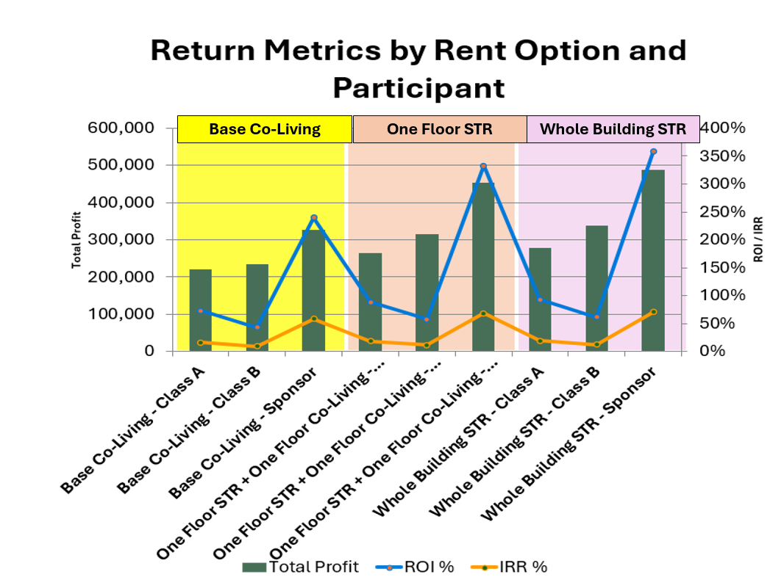
STR OPTIONS
Participant Return Comparison
Total profit, ROI, and IRR by participant across the rent options.
Chart reflects the current STR workbook comparison table. Base case is retained for comparison against one-floor and full-building STR upside.
Notes:
This chart compares participant returns across the rent options. Each scenario is broken out by Class A, Class B, and Sponsor. The chart shows total profit, ROI, and IRR. The important interpretation is that STR upside does not affect each participant identically. Because the waterfall has capital return priorities, preferred return treatment, and residual sharing, the timing and amount of added cash flow - flows differently to Class A, Class B, and Sponsor. This chart should be used as a comparison tool. It does not replace the live workbook. If assumptions change, the workbook should remain the source of truth.

Slide 14
DISCUSSION
Next Steps
Use STR as a tested option, not an unverified requirement.
Keep base co-living / medium-term rental as the control underwriting case.
Validate one-floor STR with live comp set and regulatory review before adopting as a primary strategy.
Confirm wastewater engineering path and reserve field requirements.
Refine schematic floor plan with dimensions, code/accessibility review, and stacked plumbing strategy.
Update investor package as workbook assumptions change.
Planning model only. Not tax, legal, securities, lending, engineering, or investment advice.
Notes:
The next steps are focused on confirming the base case and validating STR optionality. The base co-living and medium-term rental strategy will remain the control underwriting case. Before relying on STR, the project should validate one-floor STR through live comparable listings, demand research, pricing tests, and regulatory review. Whole-building STR should be treated as an upside option, not as the foundation of the investment case. The project also needs continued wastewater engineering, floor plan refinement, code/accessibility review, capital document alignment, and updated investor materials as assumptions change.

