Slide 1
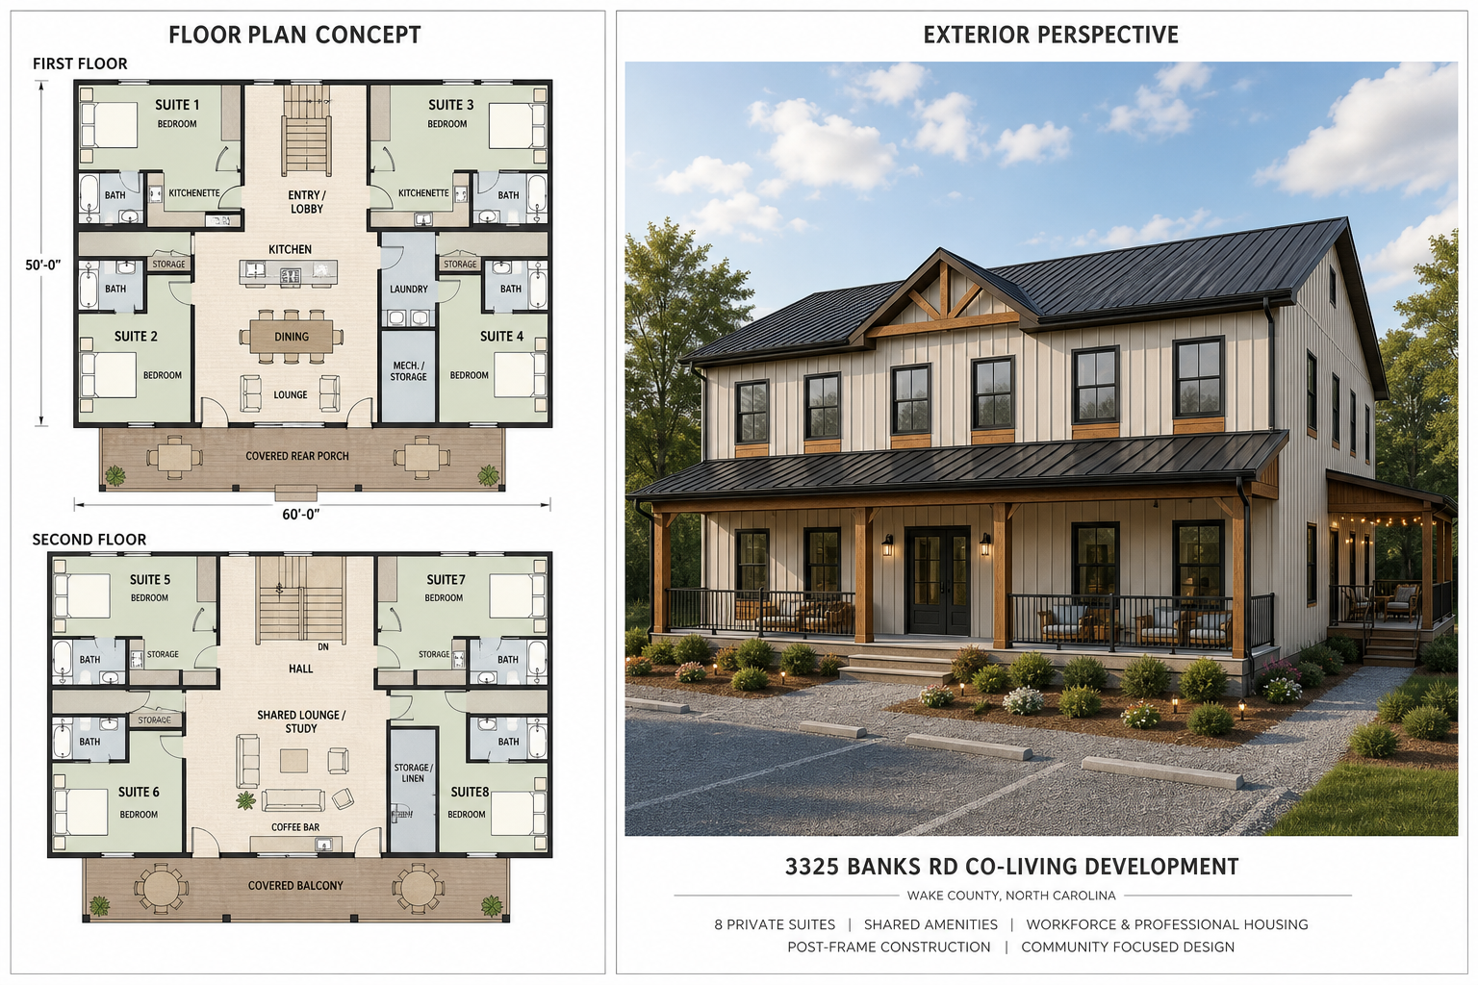
3325 Banks Rd
Co-Living Residential Development
Wake County near Raleigh, North Carolina
Professionally managed boutique co-living platform with 6,000 SF program, staged capitalization, engineered utility planning, and refinance-oriented capital recovery.
Investor pitch deck | Planning model

Slide 2
OVERVIEW
Investment Thesis
- Sponsor-led co-living residential development in the Triangle market corridor.
- Long-term income-producing asset, not a speculative resale project.
- Targets workforce housing, graduate/professional co-living, furnished medium-term rental demand, and optional one-floor short-term rental marketing.
- Capital recovery strategy relies on stabilization, refinance, and operating cash flow.
Competitive Advantage
Controlled land position, 6,000 SF post-frame construction strategy, sponsor equipment and crew capacity, and flexible floor-by-floor rental configuration.
Current Status
Planning model with entitlement, wastewater, utility, and capitalization assumptions under active refinement.

Slide 3
ASSET
Development Program
1.1 AC
6,000 SF
8
Post-frame
Site Area
Building Area
Residential Suites
Construction
First Floor
2 premium suites and 2 co-living suites. Floor plan exhibits should preserve scale against the 6,000 SF building assumption.
Second Floor
2 premium suites and 2 co-living suites. Matching floor mix supports operating flexibility, including a possible one-floor short-term rental scenario.
4 premium suites with private bedroom, bathroom, kitchenette, and storage. Designed to price near compact furnished studio alternatives.
4 co-living suites with private bedroom, bathroom, storage, and shared amenity areas.
Shared amenities include communal kitchen, dining, lounge, laundry, storage/mechanical areas, and covered outdoor gathering areas.

Slide 4
DESIGN
Concept Design Direction
Concept image for discussion only. Floor plan exhibits should preserve scale against the 6,000 SF building assumption. Final dimensions, code compliance, accessibility, fire/life-safety, wastewater, and engineering requirements remain subject to professional design and permitting.

Slide 5
MARKET
Rent Positioning
Premium Suites
Co-Living Suites
Gross Monthly Rent
Low: 8,800 | Medium: 10,800 | High: 12,000
Low: 1,350 / mo
Medium: 1,600 / mo
High: 1,750 / mo
Low: 850 / mo
Medium: 1,100 / mo
High: 1,250 / mo
Low: 8,800 | Medium: 10,800 | High: 12,000
- Current model uses effective-year rent schedule; low begins Year 1, medium Year 2, high Year 3.
- Stabilized occupancy assumption: 93.0%.
- Refinance-year rent scenario currently uses 12,000 monthly gross rent.
- Rent schedule is displayed by effective year.

Slide 6
OPERATIONS
Operating Model
12,000
93.0%
46.9%
8,035
Stabilized Monthly Gross Rent
Stabilized Occupancy
Selected OpEx Ratio
Management Fee
Expense Budget
Management Income
Operating Expense Budget currently uses the calculated budget ratio of 46.9%; the 40.0% assumed ratio remains available as an alternate toggle. Budget includes property taxes, completed property insurance, management/admin, utilities, repairs, wastewater maintenance, reserves, and compliance items.
Returns Table calculates management income dynamically as 6.00% of each year effective gross income.

Slide 7
CAPITAL
Capitalization and Cost Case
847,500
300,000
547,500
100,000
Selected Project Cost
Class A Capital
Class B Capital
Sponsor Property Payment
Sponsor-Controlled Cost Range
Capital Source Rule
Current sponsor-controlled bridge: 847,500 low / 1,585,000 high. Case assumes post-frame construction, sponsor equipment/crew capacity, disciplined finish scope, and current sponsor property payment assumption of 100,000.
Class A and Class B member capital fund development/build completion. No construction loan is currently modeled.

Slide 8
REFINANCE
Refinance Takeout Structure
194,000
732,276
538,276
13,812
Existing Debt Payoff
Refi Loan Amount
Net After Existing Debt
Existing Annual Debt Service
- Only new loan currently modeled is the stabilization refinance/takeout loan.
- Refinance loan is the lesser of 70% of stabilized value or existing debt plus Class A plus Class B capitalization.
- Existing debt is paid before waterfall cash is available; reserve funding comes before waterfall distributions.

Slide 9
RETURNS
Waterfall and Returns Snapshot
Class A
Class B
Sponsor
Capital Investment: 300,000
Total Profit: 219,799 | IRR: 16.34%
Capital Investment: 547,500
Total Profit: 234,783 | IRR: 8.98%
Capital Investment: 136,283
Property Payment/Basis: 100,000 | Total Profit: 327,148
- Sponsor residual share: 50%; Class A residual share: 18%; Class B residual share: 32%.
- Waterfall priority: existing debt, reserve funding, Class A capital, Class B capital, accrued Class A preferred return, then residual split.
- Returns Table separates Capital Investment from Basis / Property Payment.

Slide 10
RISK
Key Risks and Mitigants
Wastewater / Septic
Utilities / Entitlement
Construction Cost
Risk: engineered system cost or density constraint. Mitigation: early soil, septic, wastewater engineering and Wake County coordination.
Risk: no planned municipal water/sewer extension. Mitigation: proceed with private utility and onsite wastewater feasibility as base case.
Risk: budget creep above sponsor-controlled range. Mitigation: post-frame system, owner equipment/crew, scope discipline, contingency.
Lease-Up / Operations
Risk: co-living rent acceptance and occupancy pace. Mitigation: flexible furnished medium-term and workforce/professional tenant positioning.

Slide 11
TIMELINE
Execution Path
1. Entitlement + Engineering
2. Capital Formation
3. Design + Permit
4. Build + Stabilize
Confirm zoning classification, occupancy treatment, parking, soil/septic/wastewater feasibility, and private utility path.
Finalize trust/member documents, Class A capital, Class B completion capital, and sponsor contribution assumptions.
Advance architecture, civil, wastewater, and construction pricing to permit-ready package.
Deliver post-frame building, lease suites, stabilize occupancy, refinance, and execute waterfall.
Current model stabilization/refinance year: Year 3. Current sale/exit year: Year 5.

Slide 12
DISCUSSION
Next Steps
- Validate final sponsor capital investment and property payment treatment.
- Confirm wastewater engineering path and reserve field requirements.
- Refine scaled 6,000 SF floor plan with 2 premium suites and 2 co-living suites per floor.
- Evaluate one-floor short-term rental scenario after zoning, insurance, tax, and management review.
- Update capital documents to align with current capital-first deferred preferred return waterfall.
Planning model only. Not tax, legal, securities, lending, engineering, or investment advice.

