Slide 1
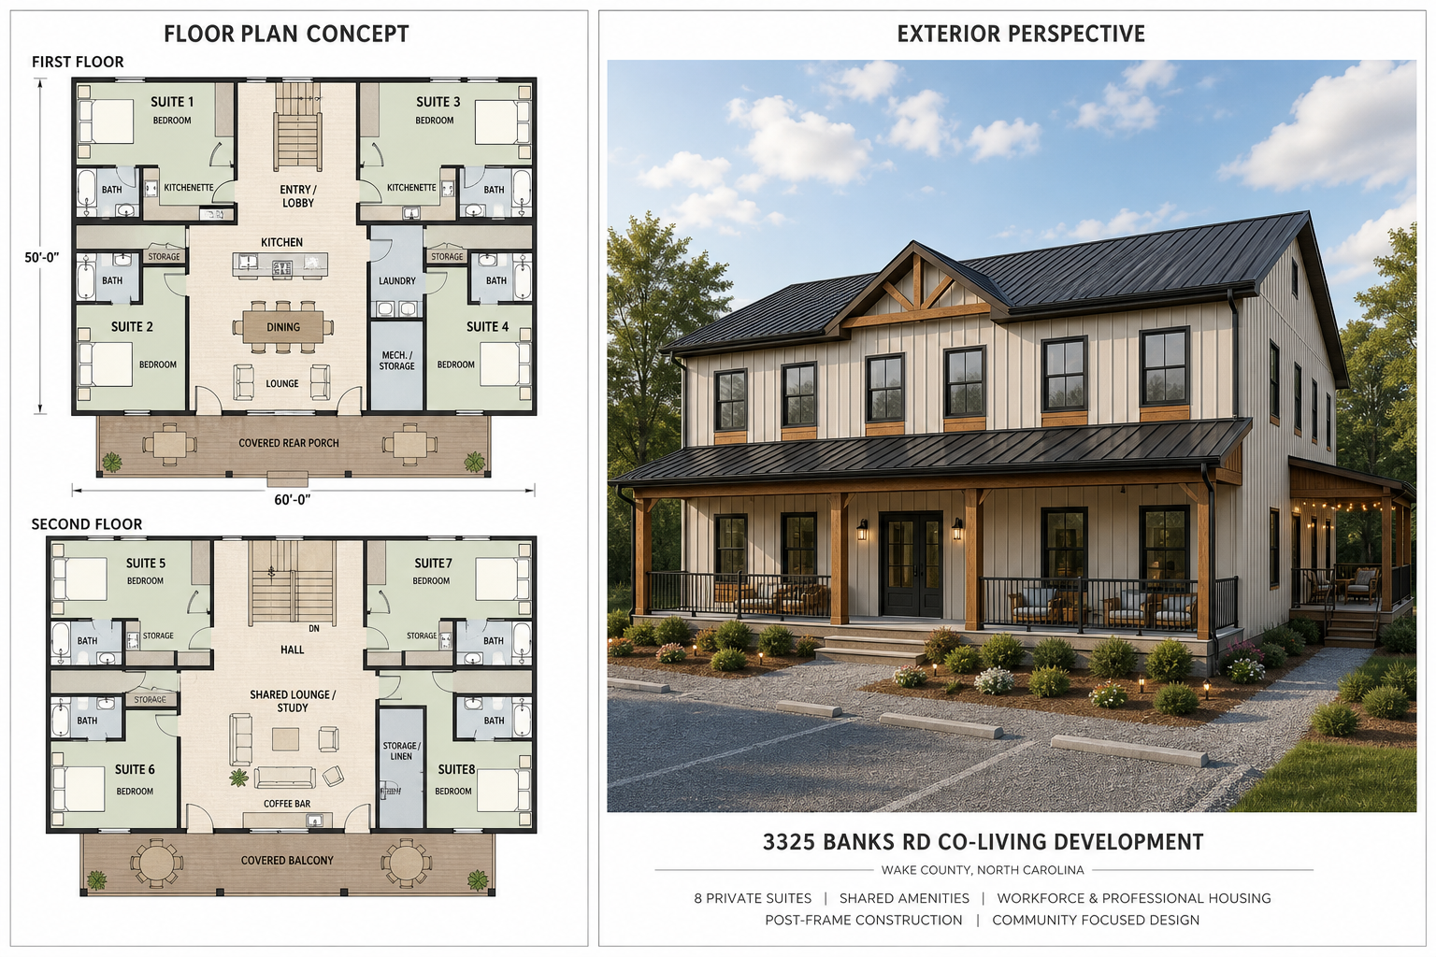
3325 Banks Rd Co-Living Development
Investor pitch deck synced to workbook and markdown status
- Sponsor-led co-living residential development near Raleigh, North Carolina
- Post-frame construction strategy with sponsor-owned equipment and crew capacity
- Current workbook status: Refi Year
- 3
- , Exit Year
- 5

Slide 2
Project Program
Eight-suite co-living residential asset
- Approximately 1.1 acres and 5,000-6,000 SF two-story post-frame structure
- Four first-floor premium suites with private bath and kitchenette
- Four second-floor co-living suites with private bath and shared amenities
- Shared kitchen, lounge, laundry, storage, and covered outdoor gathering areas

Slide 3
Rent Schedule
Annual Model uses scenario timing, not a simple average
- Year 1 low scenario: 8,800 monthly gross rent / 105,600 annual potential rent
- Year 2 medium scenario: 10,800 monthly gross rent / 129,600 annual potential rent
- Year 4 high scenario: 12,000 monthly gross rent / 144,000 annual potential rent
- Current refinance-year valuation uses
- 12,000
- monthly gross rent

Slide 4
Operating Expense Budget
Detailed budget currently controls operating expense ratio
- Selected operating expense ratio: 46.9% Stabilized effective gross income: 133,920 Total annual operating expense budget: 62,825 Repairs and maintenance reserve target: 9,000 funded before waterfall distributions

Slide 5
Capital Stack
Development/build capital comes from Class A and Class B members
- Class A capital: 300,000 with 8.00% cumulative preferred return Class B completion capital: 597,500 Sponsor property payment / basis: 150,000 Sponsor capital investment tracked separately: 125,000
300,000
Class A Capital
597,500
Class B Capital
150,000
Property Payment

Slide 6
Existing Debt And Refinance
No construction loan is modeled
- Existing debt payoff at refinance: 194,000
- Modeled refinance loan amount:
- 732,276
- Net refinance proceeds after existing debt payoff:
- 538,276
- Refinance loan is a takeout loan only, not a development capital source

Slide 7
Current Waterfall Priority
Capital Recovery First / Deferred Preferred Return
- First: return Class A capital
- Second: return Class B capital
- Third: pay accrued Class A preferred return
- Fourth: split residual according to editable Sponsor / Class A / Class B shares

Slide 8
Residual Split
Editable sponsor share with proportional Class A / Class B pool
- Sponsor residual share: 40% Class A residual share: 20% Class B residual share: 40% Class A and Class B share the non-sponsor pool in proportion to their capital
40%
Sponsor
20%
Class A
40%
Class B

Slide 9
Modeled Returns
Current workbook return summary
- Class A: 226,901 profit, 526,901 distributions, 75.63% ROI, 16.71% IRR Class B: 270,368 profit, 867,868 distributions, 45.25% ROI, 9.23% IRR Sponsor: 295,745 profit, 420,745 distributions, 236.60% ROI Sponsor IRR is not meaningful because sponsor cash flows include property payment/basis treatment

Slide 10
Cost Position
Sponsor-controlled case remains the controlling current case
- Selected total project cost: 897,500
- Sponsor-controlled bridge range: 897,500-1,635,000 including 150,000 property payment
- Outside-market benchmark retained as stress case, not current capitalization control
- Wastewater and finish-drift risks remain key cost sensitivities

Slide 11
Execution And Entitlement Focus
Highest-risk path remains utilities and wastewater
- Fuquay-Varina coordination required because the site is in the Urban Service Area
- No planned municipal water or sewer extensions are assumed
- Wake County Environmental Services coordination remains critical
- Engineered wastewater feasibility and reserve field planning drive density and layout risk

Slide 12
Current Underwriting Status
Model is internally synced as of this deck version
- Markdown files updated to capital-first deferred preferred return waterfall
- Workbook uses separate Refi Year and Exit Year option-button selectors on Waterfall tab
- Reserve is funded before distributions, then remaining cash flows through waterfall
- PowerPoint v002 reflects current workbook and markdown status

