Slide 1
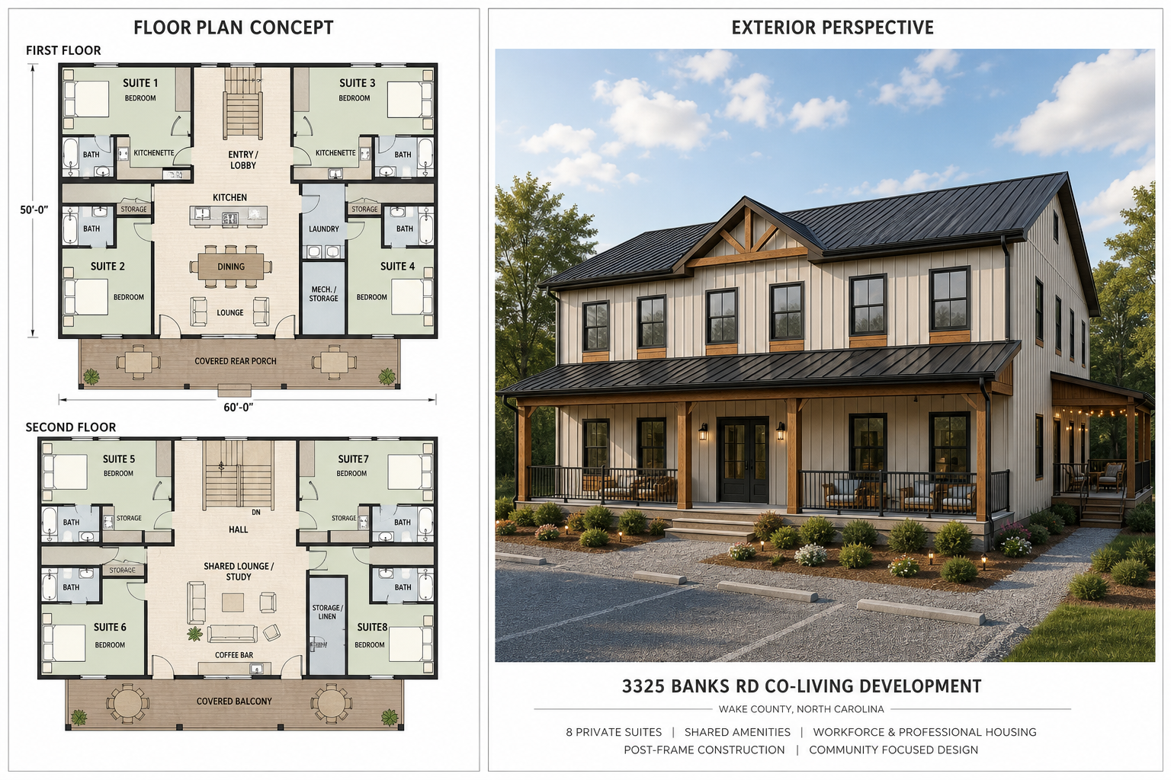
3325 Banks Rd
Co-Living Development with STR Operating Optionality
Wake County near Raleigh, North Carolina
Base residential underwriting remains the control case; short-term rental options are presented as upside operating scenarios.
Investor pitch deck | STR workbook version

Slide 2
OVERVIEW
Investment Thesis
Flexible residential platform first; STR optionality second.
- Sponsor-led co-living residential development in the Triangle market corridor.
- Base case targets workforce housing, graduate/professional co-living, and furnished medium-term renters.
- STR operating scenarios test whether one floor or the whole building can capture weekly group lodging demand.
- Capital recovery strategy relies on stabilization, refinance, and waterfall distributions.
Competitive Advantage
Controlled land position, post-frame construction strategy, sponsor equipment and crew capacity, private-bath suite design, and the ability to operate by suite, floor, or building.
Current Status
STR workbook model with rent options, participant returns, refinance timing, sale timing, and waterfall distribution assumptions under active refinement.

Slide 3
ASSET
Development Program
Two-floor, 8-suite residential platform designed for multiple rental strategies.
1.1 AC
6,000 SF
8
Post-frame
Site area
Building area
Private suites
Construction
Floor Configuration
Shared Amenities
Each floor includes two premium suites and two co-living suites. Premium suites include private bedroom, bathroom, kitchenette, and storage. Co-living suites include private bedroom, bathroom, and storage with shared common amenities.
Communal kitchen, dining, lounge/living space, laundry, storage/mechanical areas, and covered outdoor gathering areas.

Slide 4
DESIGN
Concept Design Direction
Concept image for discussion only. Final dimensions, code compliance, accessibility, fire/life-safety, wastewater, and engineering requirements remain subject to professional design and permitting.

Slide 5
MARKET
Base Rent Positioning
Base case uses the co-living / medium-term rent schedule as the control underwriting case.
Rent Case | Premium Suites | Co-Living Suites | Monthly Gross | Annual Gross
Low / Year 1 | 1,350 x 4 | 850 x 4 | 8,800 | 105,600
Medium / Year 2 | 1,600 x 4 | 1,100 x 4 | 10,800 | 129,600
High / Year 3+ | 1,750 x 4 | 1,250 x 4 | 12,000 | 144,000
- Premium suites are positioned near compact furnished studio / one-bedroom alternatives.
- Co-living suites remain below standalone apartment replacement cost.
- Stabilized occupancy assumption: 93.0%.
- Base case remains viable without short-term rental execution.

Slide 6
OPERATIONS
Operating Model
The STR workbook keeps residential underwriting visible while testing weekly-rental alternatives.
12,000
93.0%
46.9%
6.0%
Base stabilized monthly gross rent
Stabilized occupancy
Selected operating expense ratio
Management fee rate
Expense Budget
Management Income
Operating Expense Budget includes taxes, completed property insurance, management/admin, utilities, repairs, wastewater maintenance, reserve funding, and compliance items.
Management income is dynamic and based on 6.0% of effective gross income, so it changes as operating scenarios change.

Slide 7
CAPITAL
Capitalization and Cost Case
Class A and Class B member capital fund development/build completion.
847,500
300,000
547,500
100,000
Selected project cost
Class A capital
Class B capital
Sponsor property payment
Capital Source Rule
Sponsor Execution
No construction loan is currently modeled. Member capital funds the development path; the only new debt modeled is the stabilization refinance/takeout loan.
Post-frame construction, sponsor equipment/crew capacity, and scope discipline are central to cost feasibility.

Slide 8
REFINANCE
Refinance Takeout Structure
Refinance is modeled as a stabilization/takeout event, not construction debt.
194,000
732,276
538,276
Year 3
Existing debt payoff
Refi loan amount
Net after existing debt
Refi timing
- Refinance loan is limited by the current model rule and stabilized value constraints.
- Existing debt includes first mortgage and private debt assumptions.
- Refi proceeds flow through the waterfall with Class A and Class B capital recovery before residual splits.
- Current sale/exit timing in the STR workbook: Year 5.

Slide 9
RETURNS
Base Case Returns Snapshot
Base Co-Living / Medium-Term remains the investor control case.
Participant | Capital | Total Profit | ROI | IRR
Class A | 300,000 | 219,799 | 73.3% | 16.3%
Class B | 547,500 | 234,783 | 42.9% | 9.0%
Sponsor | 136,283 | 327,148 | 240.1% | 58.5%
- Sponsor residual share: 50%.
- Class A residual share: 18%; Class B residual share: 32%.
- Class A and Class B shares are proportional to their relative capital investment within the investor residual pool.
- Returns separate capital investment from sponsor property payment/basis.

Slide 10
RISK
Key Risks and Mitigants
STR upside does not remove the core development and operating risks.
Wastewater / Septic
STR Regulation
Risk: engineered system cost or density constraint. Mitigation: early soil, septic, wastewater engineering, and Wake County coordination.
Risk: weekly rental use may face jurisdictional limits or operating constraints. Mitigation: confirm treatment before relying on STR income.
Construction Cost
Lease-Up / Operations
Risk: budget creep above sponsor-controlled range. Mitigation: post-frame system, owner equipment/crew, scope discipline, and contingency.
Risk: occupancy and pricing vary by strategy. Mitigation: preserve base co-living use and test STR as operating upside.

Slide 11
TIMELINE
Execution Path
Base delivery path remains unchanged; STR validation is layered into operations and marketing.
- Entitlement + Engineering: confirm zoning, occupancy treatment, parking, soil/septic/wastewater feasibility, and private utility path.
- Capital Formation: finalize Class A, Class B, trust/member documents, and sponsor contribution assumptions.
- Design + Permit: advance architecture, civil, wastewater, and construction pricing to permit-ready package.
- Build + Stabilize: deliver post-frame building, lease suites, test STR demand, refinance, and execute waterfall.
Current model: refinance year 3; exit year 5.

Slide 12
STR OPTIONS
Rent Option Comparison
STR scenarios are positioned behind the base case as upside comparisons, not the starting underwriting case.
Scenario | Year 1 Gross | Stabilized Gross | Use in Model
Base | 105,600 | 144,000 | Control case
One-floor STR | 95,440 | 173,400 | Upside test
Whole-building STR | 70,798 | 183,040 | Highest upside
Interpretation
Base Co-Living / Medium-Term is the control case. One Floor STR + Co-Living is the preferred operational test. Whole Building STR is the highest-upside case but requires booking validation and stronger operating discipline.

Slide 13
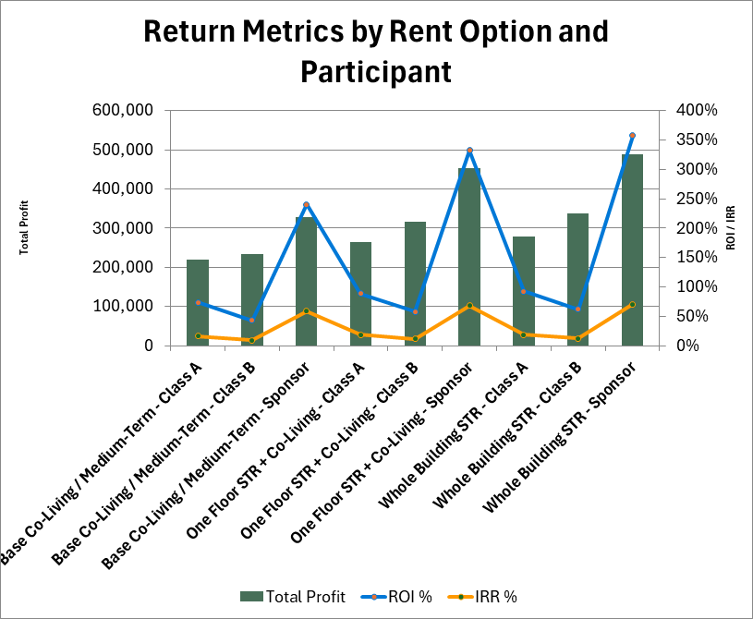
STR OPTIONS
Participant Return Comparison
The STR workbook compares total profit, ROI, and IRR by participant across the rent options.
Chart reflects the current STR workbook comparison table. Base case is retained for comparison against one-floor and full-building STR upside.

Slide 14
DISCUSSION
Next Steps
Use STR as a tested option, not an unverified requirement.
- Keep base co-living / medium-term rental as the control underwriting case.
- Validate one-floor STR with live comp set and regulatory review before adopting as a primary strategy.
- Confirm wastewater engineering path and reserve field requirements.
- Refine schematic floor plan with dimensions, code/accessibility review, and stacked plumbing strategy.
- Update investor package as workbook assumptions change.
Planning model only. Not tax, legal, securities, lending, engineering, or investment advice.

