Slide 1
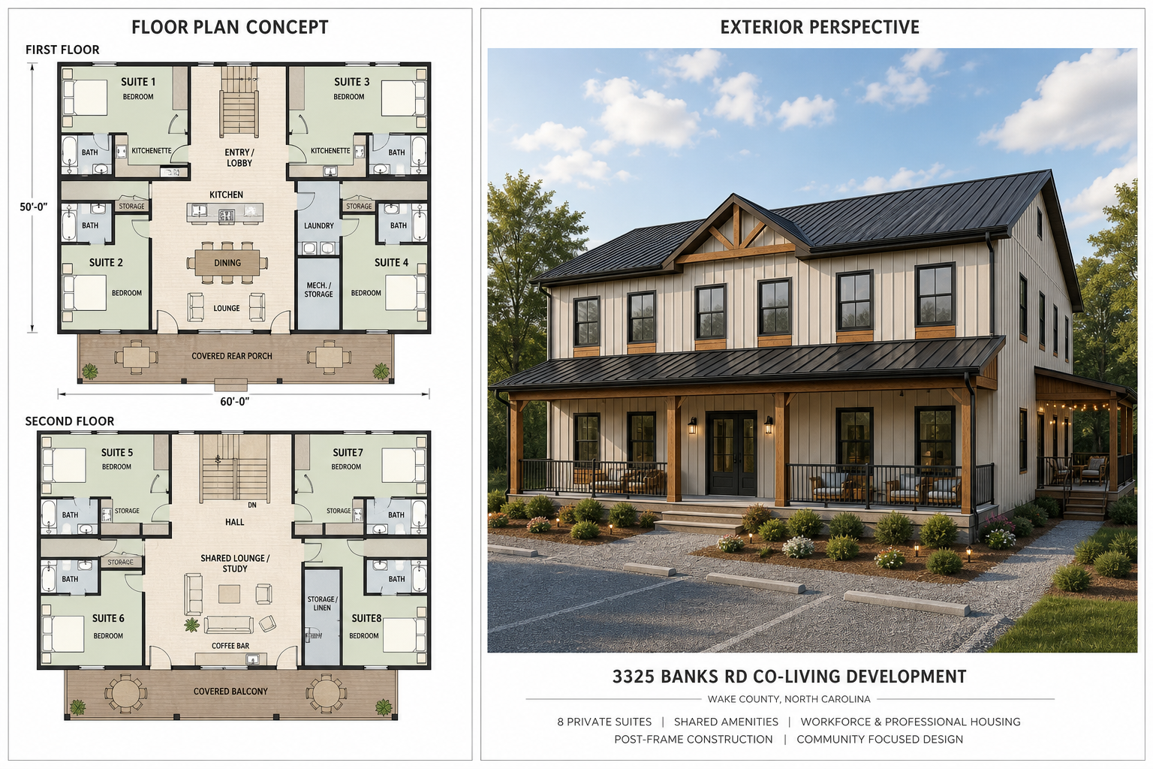
3325 Banks Rd
Co-Living Residential Development with STR Operating Optionality
Wake County near Raleigh, North Carolina
Base residential underwriting remains the control case; one-floor and whole-building STR are presented as upside operating scenarios.
Investor pitch deck | STR workbook version

Slide 2
OVERVIEW
Investment Thesis
Sponsor-led co-living residential development in the Triangle market corridor.
Base case targets workforce housing, graduate/professional co-living, and furnished medium-term renters.
STR scenarios test one-floor and whole-building weekly rental upside.
Capital recovery strategy relies on stabilization, refinance, and operating cash flow.
Competitive Advantage
Controlled land position, 6,000 SF post-frame construction strategy, sponsor equipment and crew capacity, and flexible floor-by-floor rental configuration.
Current Status
STR workbook model with base-case underwriting, rent options, participant returns, refinance timing, sale timing, and waterfall assumptions under active refinement.

Slide 3
ASSET
Development Program
1.1 AC
6,000 SF
8
Post-frame
Site Area
Building Area
Residential Suites
Construction
First + Operating Flexibilitys
2 premium suites and 2 co-living suites. Floor plan exhibits should preserve scale against the 6,000 SF building assumption.
Operating Flexibility
2 premium suites and 2 co-living suites. Matching floor mix supports operating flexibility, including a possible one-floor short-term rental scenario.
Shared amenities include communal kitchen, dining, lounge, laundry, storage/mechanical areas, and covered outdoor gathering areas.

Slide 4
DESIGN
Concept Design Direction
Concept image for discussion only. Final dimensions, code compliance, accessibility, fire/life-safety, wastewater, and engineering requirements remain subject to professional design and permitting.

Slide 5
MARKET
Rent Positioning
Premium Suites
Co-Living Suites
Gross Monthly Rent
Low: 8,800
Medium: 10,800
High: 12,000
Low: 1,350 / mo
Medium: 1,600 / mo
High: 1,750 / mo
Low: 850 / mo
Medium: 1,100 / mo
High: 1,250 / mo
- Current model uses escalating, table driven rent schedule; low begins Year 1, medium Year 2, high Year 3.
- Stabilized occupancy assumption: 93.0%.
- Refinance-year rent scenario currently uses 12,000 monthly gross rent.

Slide 6
OPERATIONS
Operating Model
12,000
93.0%
46.9%
8,035
Stabilized Monthly Gross Rent
Stabilized Occupancy
Selected OpEx Ratio
Management Fee
Expense Budget
Management Income
Operating Expense Budget currently uses the calculated budget ratio of 46.9%. Budget includes property taxes, completed property insurance, management/admin, utilities, repairs, wastewater maintenance, reserves, and compliance items.
Current analysis calculates management income dynamically as 6.00% of each year effective gross income.

Slide 7
CAPITAL
Capitalization and Cost Case
847,500
300,000
547,500
100,000
Selected Project Cost
Class A Capital
Class B Capital
Sponsor Property Payment
Sponsor-Controlled Cost Range
Capital Source Rule
Current sponsor-controlled bridge: 847,500 low / 1,585,000 high. Case assumes post-frame construction, sponsor equipment/crew capacity, disciplined finish scope, and 100,000 payment to sponsor for property.
Class A and Class B member’s capital fund development/build completion. No construction loan is currently modeled.

Slide 8
REFINANCE
Refinance Takeout Structure
194,000
732,276
538,276
13,812
Existing Debt Payoff
Refi Loan Amount
Net After Existing Debt
Existing Annual Debt Service
- Only new loan currently modeled is the stabilization refinance/takeout loan.
- Refinance loan is the lesser of 70% of stabilized value or existing debt plus Class A plus Class B capitalization.
- Operating cash and refinance proceeds flow through the waterfall according to the selected timing and priority rules.

Slide 9
RETURNS
Waterfall and Returns Snapshot
Class A
Class B
Sponsor
Capital Investment: 300,000
Total Profit: 219,799 | IRR: 16.34%
Capital Investment: 547,500
Total Profit: 234,783 | IRR: 8.98%
Capital Investment: 136,283
Property Payment/Basis: 100,000 | Total Profit: 327,148
- Sponsor residual share is currently 50%.
- The remaining 50% residual pool is split between Class A and Class B based on their relative capital investments; current result is Class A 18% and Class B 32%.
- Waterfall priority: reserve funding, Class A capital, Class B capital, accrued Class A preferred return, then residual split.

Slide 10
RISK
Key Risks and Mitigants
Wastewater / Septic
Utilities / Entitlement
Construction Cost
Risk: engineered system cost or density constraint. Mitigation: early soil, septic, wastewater engineering and Wake County coordination.
Risk: no planned municipal water/sewer extension. Mitigation: proceed with private utility and onsite wastewater feasibility as base case.
Risk: budget creep above sponsor-controlled range. Mitigation: post-frame system, owner equipment/crew, scope discipline, contingency.
Lease-Up / STR Operations
Risk: co-living rent acceptance, STR booking depth, and occupancy pace. Mitigation: flexible furnished medium-term and workforce/professional tenant positioning.

Slide 11
TIMELINE
Execution Path
1. Entitlement + Engineering
2. Capital Formation
3. Design + Permit
4. Build + Stabilize
Confirm zoning classification, occupancy treatment, parking, soil/septic/wastewater feasibility, and private utility path.
Finalize trust/member documents, Class A capital, Class B completion capital, and sponsor contribution assumptions.
Advance architecture, civil, wastewater, and construction pricing to permit-ready package.
Deliver post-frame building, lease suites, stabilize occupancy, refinance, and execute waterfall.
- Current model stabilization/refinance year: Year 3.
- Current sale/exit year: Year 5.

Slide 12
STR OPTIONS
Rent Option Comparison
STR scenarios are positioned behind the base case as upside comparisons, not as the starting underwriting case.
Scenario | Year 1 Gross | Stabilized Gross | Use in Model
Base Co-Living / Medium-Term | 105,600 | 144,000 | Control case
One Floor STR + Co-Living | 95,440 | 173,400 | Upside test
Whole Building STR | 70,798 | 183,040 | Highest upside
Interpretation
- Base Co-Living / Medium-Term remains the control case.
- One Floor STR + Co-Living is the preferred operational test.
- Whole Building STR is the highest-upside case but requires booking validation and stronger operating discipline.

Slide 13
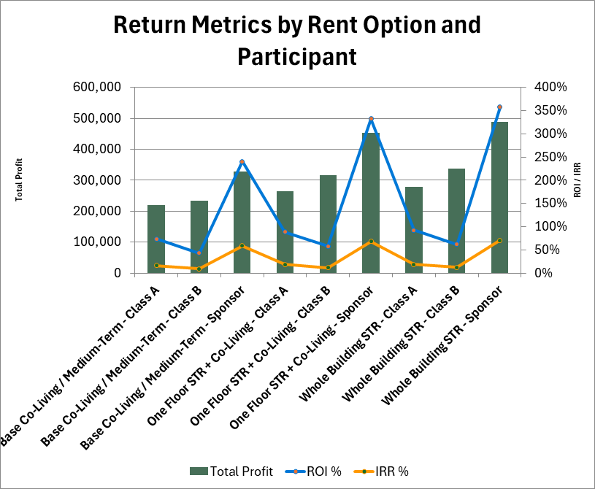
STR OPTIONS
Participant Return Comparison
Total profit, ROI, and IRR by participant across the rent options.
Chart reflects the current STR workbook comparison table. Base case is retained for comparison against one-floor and full-building STR upside.

Slide 14
DISCUSSION
Next Steps
Use STR as a tested option, not an unverified requirement.
Keep base co-living / medium-term rental as the control underwriting case.
Validate one-floor STR with live comp set and regulatory review before adopting as a primary strategy.
Confirm wastewater engineering path and reserve field requirements.
Refine schematic floor plan with dimensions, code/accessibility review, and stacked plumbing strategy.
Update investor package as workbook assumptions change.
Planning model only. Not tax, legal, securities, lending, engineering, or investment advice.

