Slide 1

Project Name: Personal Portfolio Website Student: Buyantugs ID: 616440
Date: 2024-04-26
University: MIU

Slide 2

Problem statement
The website will include essential features such as:
About Page: A homepage that introduces the user and provides an overview of their skills and expertise.
Resume Page: A page displaying the user's resume, including their education, work experience, skills, and achievements.
Projects Page: A page showcasing the user's projects, including descriptions, technologies used, and links to project repositories or demos.
Contact Page: A page with a contact form and the user's contact information for visitors to reach out to them.
User Authentication: Token-based authentication will be implemented.
Database Integration: Store user information, resume details, project data, and contact information in a MySQL database.
Implement CRUD RESTful APIs

Slide 3
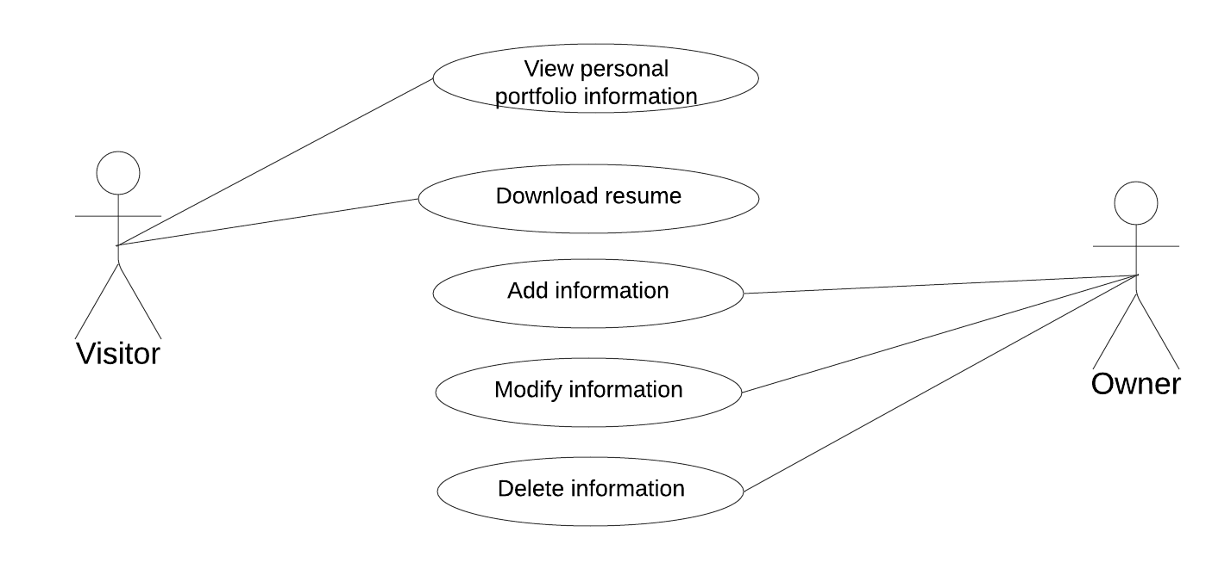
UML – use case diagram

Slide 4
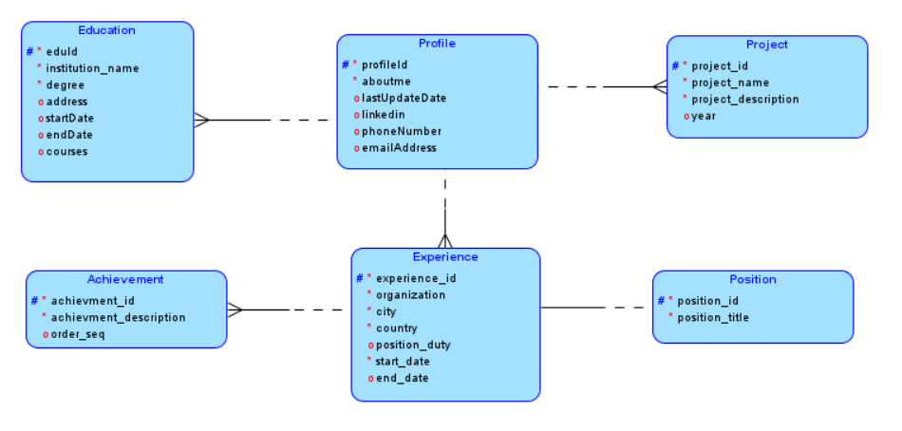
ER – logical diagram

Slide 5
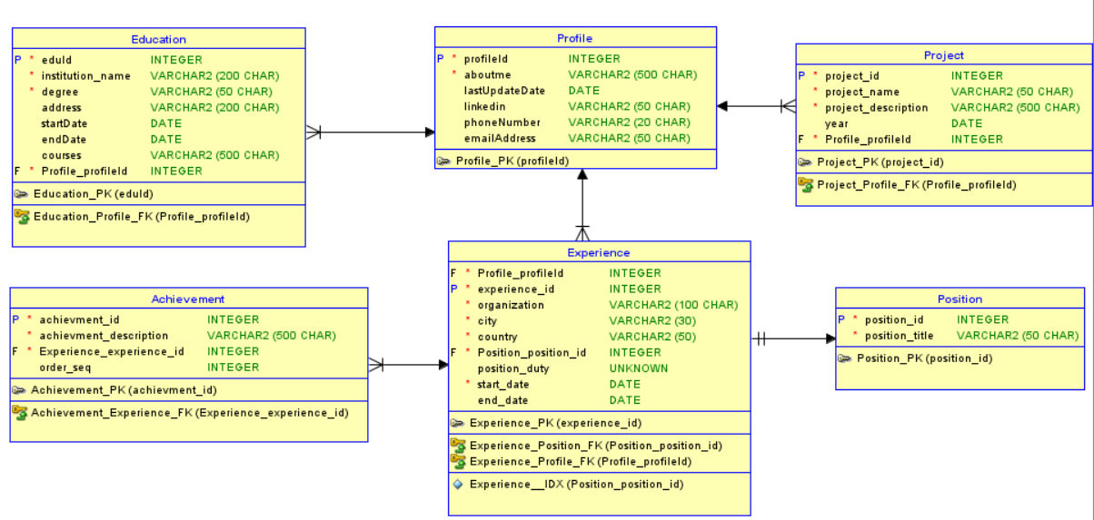
ER – physical diagram

Slide 6



Architecture and Technologies
User Interface (Responsive Web)
Presentation Layer
Application Layer
Components
Middleware
Token key
Token key
Communication Layer
Web Service / RESTful API
User/pass
Data Layer

Slide 7
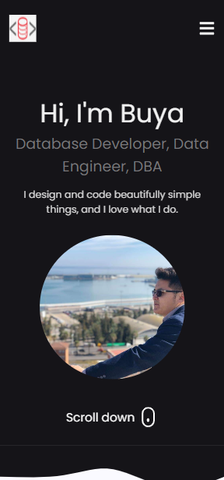
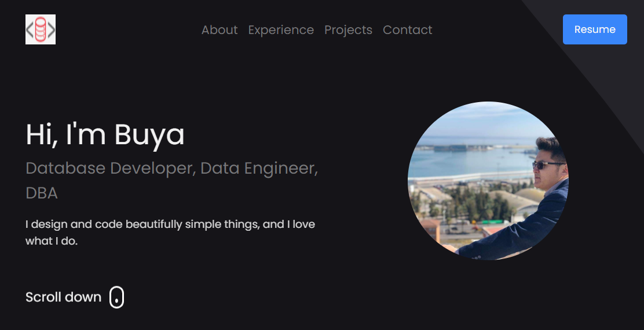
Responsive Interface (UI)

Slide 8
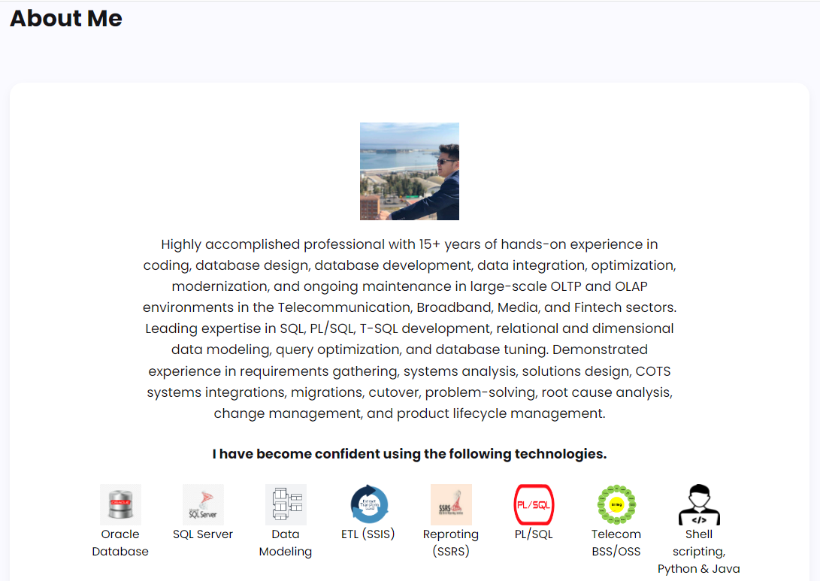
Responsive Interface (UI)

Slide 9
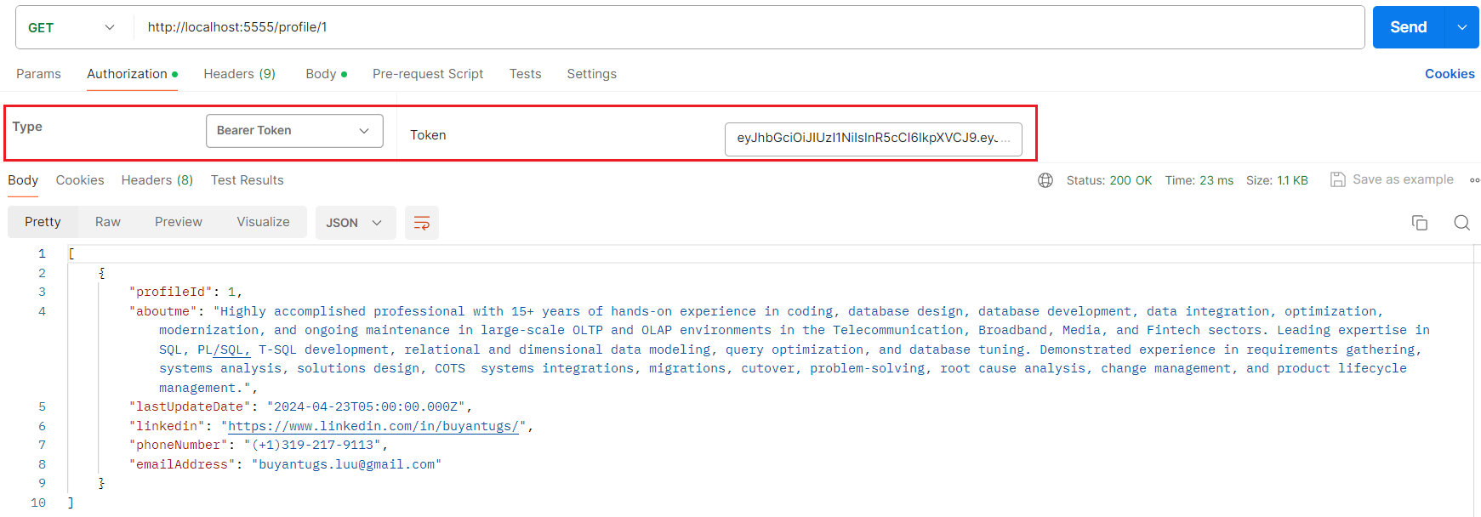
CRUD Operation – READ

Slide 10
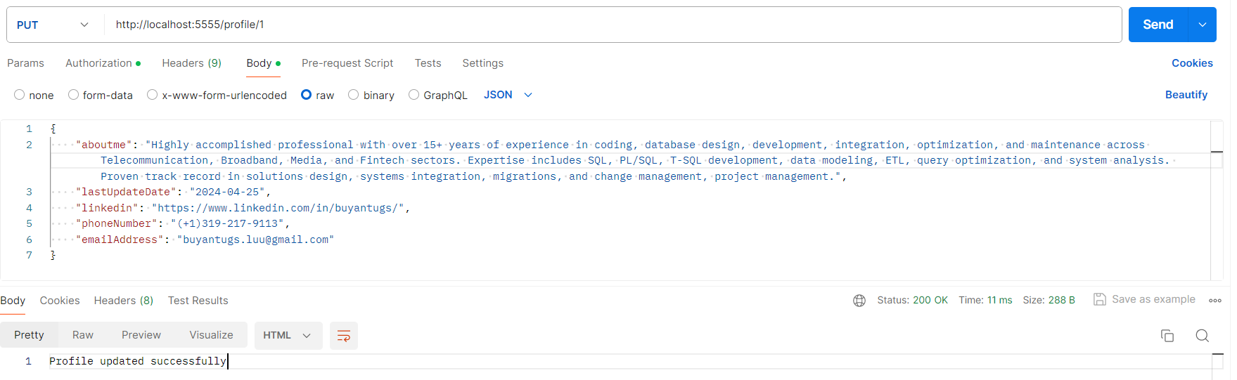
CRUD Operation – UPDATE

Slide 11
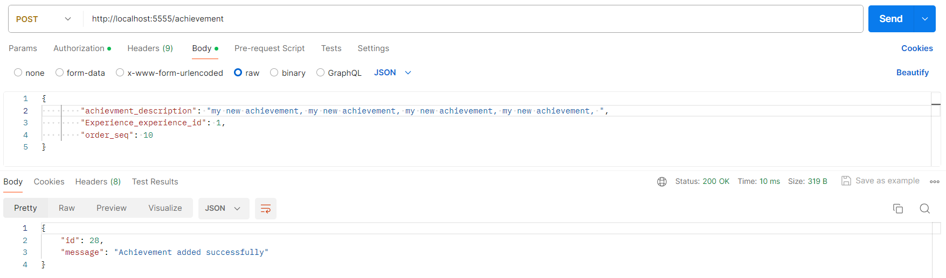
CRUD Operation – ADD

Slide 12
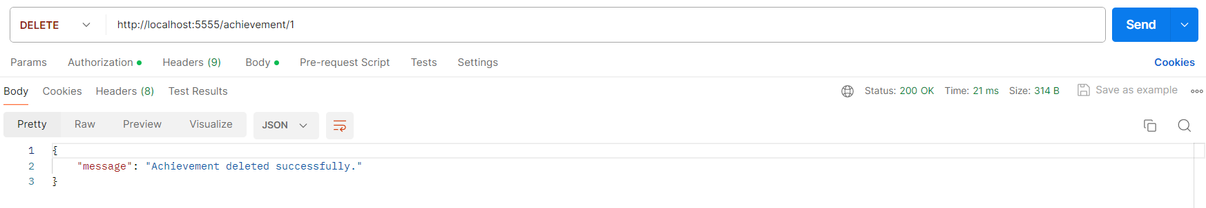
CRUD Operation – DELETE

Slide 13
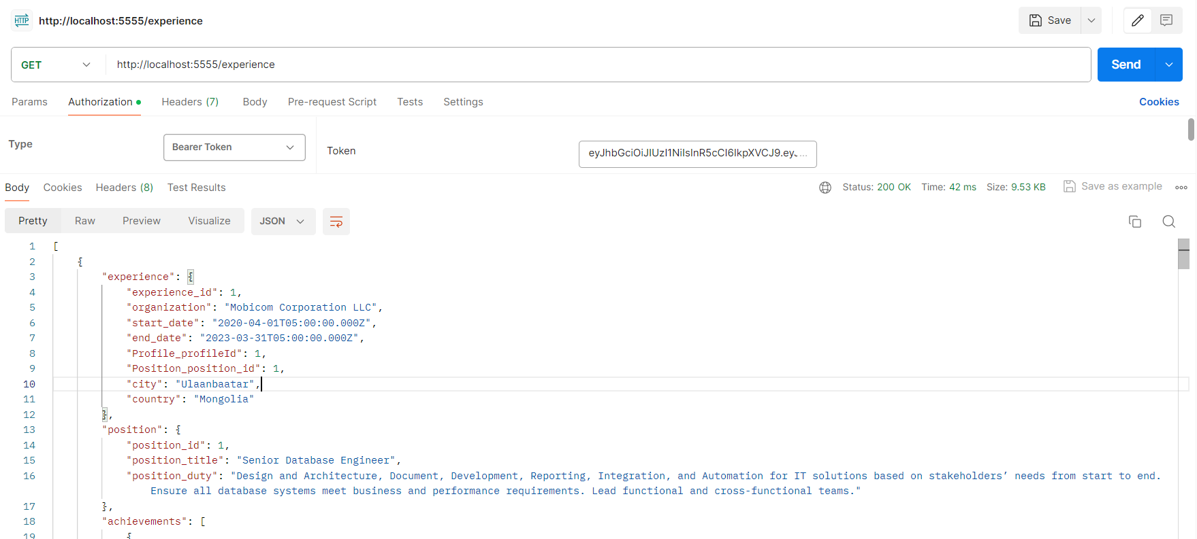
CRUD Operation – READ

Slide 14
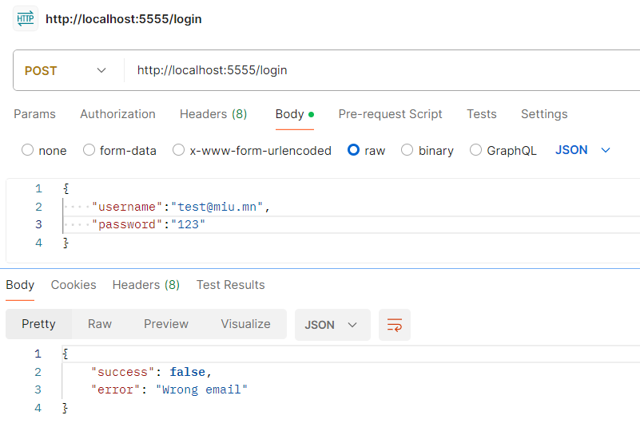
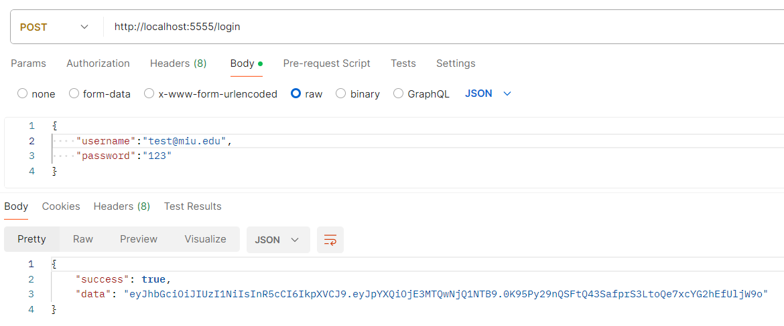
CRUD Operation – Authentication layer

Slide 15
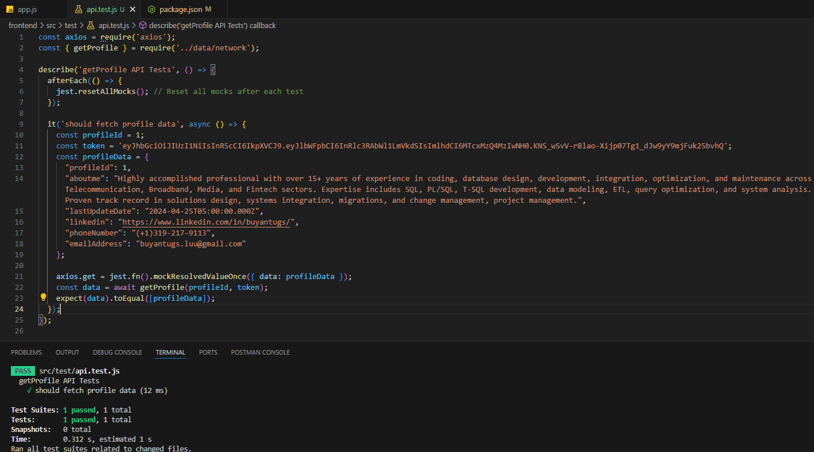
Unit & Integration Test

Slide 16
Thank you

