Slide 1


Interactive Brokers
AVAILABLE CASH
12’320
(+1’200 since previous month)
TRANSACTIONS BY MONTH
CASH AS % OF WEALTH

Slide 2



Slide 3


Slide 5


Slide 7

eToro
AVAILABLE CASH
12’320
(+1’200 since previous month)
TRANSACTIONS BY MONTH
CASH AS % OF WEALTH

Slide 8



Slide 12


Slide 15

Banque cantonale de Genève
AVAILABLE CASH
12’320
(+1’200 since previous month)
TRANSACTIONS BY MONTH
CASH AS % OF WEALTH

Slide 16



Slide 17


Slide 18


Slide 19


Slide 23

Revolut
AVAILABLE CASH
12’320
(+1’200 since previous month)
TRANSACTIONS BY MONTH
CASH AS % OF WEALTH

Slide 24



Slide 25


Slide 30

Kraken
AVAILABLE CASH
12’320
(+1’200 since previous month)
TRANSACTIONS BY MONTH
CASH AS % OF WEALTH

Slide 33


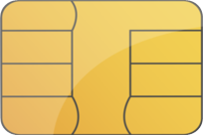
Cash Balance
13’496
3.0% of assets
Interactive Brokers

Slide 34

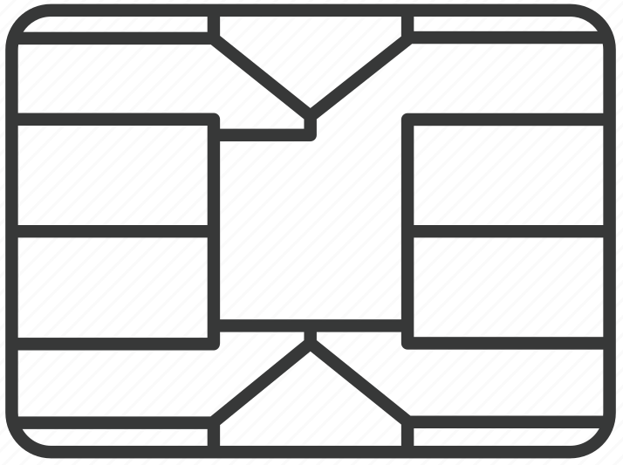
Interactive Brokers
AVAILABLE CASH
12’320
(+1’200 since previous month)
TRANSACTIONS BY MONTH
CASH AS % OF WEALTH

Slide 35


Slide 36
eToro
AVAILABLE CASH
12’320
(+1’200 since previous month)
TRANSACTIONS BY MONTH
CASH AS % OF WEALTH

Slide 37

Banque cantonale de Genève
AVAILABLE CASH
12’320
(+1’200 since previous month)
TRANSACTIONS BY MONTH
CASH AS % OF WEALTH

Slide 38

Revolut
AVAILABLE CASH
12’320
(+1’200 since previous month)
TRANSACTIONS BY MONTH
CASH AS % OF WEALTH

Slide 39

Kraken
AVAILABLE CASH
12’320
(+1’200 since previous month)
TRANSACTIONS BY MONTH
CASH AS % OF WEALTH

Slide 42
AVAILABLE CASH
12’320
(+1’200 since previous month)
# TRANSACTIONS LAST MONTH
0
PLATFORM NAME
Interactive Brokers

