Slide 1
THE NATURAL LANGUAGE DECATHLON:
MULTITASK LEARNING AS QUESTION ANSWERING
Bryan McCann, Nitish Shirish Keskar,
Caiming Xiong, Richard Socher
Salesforce Research
‘Under review as a conference paper at ICLR 2019’
Presenter: Happy Buzaaba
Notes:
The big focus in this paper is multi-task learning and the Natural language decathlon is the dataset used and the framework in which multitask learning is cast and made easy to understand as a question answering.

Slide 2
What is Next for Natural Language Processing?
Deep learning has improved performance on many NLP tasks individually.
Single-task learning: Great performance improvement in
recent years given {dataset, task, model and metric}
As long as data is plentiful, we can hill-climb to local optima
Notes:
So in recent years, There has been a lot of improvement in many NLP tasks but most of these tasks revolves around single task learning
And what happens in single task learning is that you have a team or an individual designing a model for a specific dataset or task with a metric that they can optimize and basically focus on that.
And there is a lot of impressive work that sometimes when a dataset is released it gets solved before its even published.

Slide 3
What is Next for Natural Language Processing?
Deep learning has improved performance on many NLP tasks individually.
Limits of Single-task learning
New task with dataset and metric
New Model
Train (almost) from scratch
Repeat
However, general NLP models cannot emerge within a paradigm that
focuses on the particularities of a single metric, dataset, and task.
Notes:
But this has some limits in a long run, every time you have a new task, or you get a new dataset, usually we have to go through the same cycle of designing a new model and train from scratch and the cycle repeats. And if we want to have general NLP models it would be hard because they cannot emerge by focusing on particular single NLP tasks.
So this was the main trend that they were looking at and they wanted to try and build a single multi-task model that generalizes different NLP tasks and try to make it better.

Slide 4
What is Next for Natural Language Processing?
Multi-task learning:
Question Answering
Machine Translation
Summarization
Natural language Inference
Sentiment analysis
6. Semantic role labeling
7. Relation extraction
8. Goal oriented dialogue
9. Semantic parsing
10. Commonsense pronoun resolution
Think of which ones might form a basis set of tasks that would help the model understand many different features of language and allow them to design a model that is not particular to any task but can solve all the tasks they want it to work on.
Notes:
So what this paper does is to look at as many tasks as they can in NLP and think of which ones might form a basis set of tasks that would help the model understand many different features of language and allow them to design a model that is not particular to any task but can solve all the tasks they want it to work on.
And in this paper 10 different NLP tasks were considered.

Slide 5
Motivation
Why a single Multi-task learning model:
Step towards general AI/NLP models and Ideas
Model can decide how to transfer knowledge
Easier deployment in production
Easy to adopt new tasks
Lowering the bar for any body to solve their NLP tasks
Notes:
So as we become more and more general and we can share weights of these models then we would be making progress towards general AI and NLP models
Again it is believed that with multi-task learning, a model can look at all the tasks and decide which knowledge to share rather than me saying that task A is important for task B the decision is entirely made by the model.
And for example in model deployment if you can deploy a single model that can do multiple tasks at a time
And also with a unified multitask model, it could be taught to adapt to new tasks
And they also hope that by open sourcing the project it would bring down the bar of solving NLP tasks.

Slide 6
Main Contribution
Introduce the Natural Language Decathlon (decaNLP), a challenge that
spans 10 tasks
Cast all tasks as question answering over a context.
Present a new multitask question answering network (MQAN) that jointly
learns all tasks in decaNLP without any task-specific modules or
parameters more effectively than seq2seq and reading comprehension
baselines.
Notes:
The paper Introduces decaNLP in order to explore models that generalize to many different kinds of NLP tasks. So this decaNLP encourages a single model to simultaneously optimize for ten tasks.
All the 10 tasks are framed as question answering with a context, question and answer.
The paper also presents a new multi-task MQAN that jointly learns all tasks in decaNLP without any task-specific modules or parameters more effectively than seq2seq and reading comprehension baselines.

Slide 7
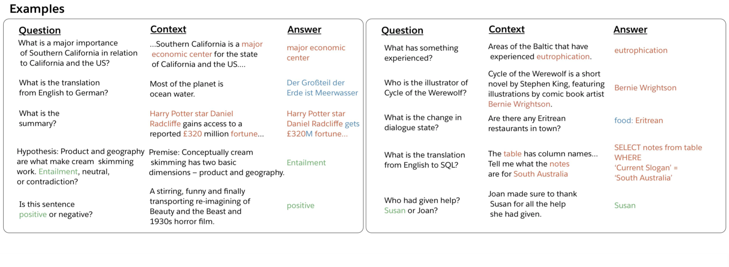
Natural Language Decathlon (decaNLP) Overview
Dataset with one example from each decaNLP task. Each task is framed as a form of QA. Answer words in red, generated by pointing to the context, in green from the question and in blue if they are generated from the classifier over the full output vocabulary.
Notes:
And here is the overview of all kinds of questions that they would like to ask,
For example you could pose question on a specific Wikipedia paragraph or page and then you extract the answer as a phrase from that context. And this is the kind of traditional question answering that we have seen a lot of progress being made on SQuAD the Stanford question answering dataset for instance.
But in this case they want the same model to be able to have translation questions for example what is the translation from English to Germany, and then the context is here is most of the planet is ocean water
And the answer here in Germany. And in blue here you basically have a lot of new words (in other words blue here shows the words that are generated that didn’t come from either question or the context and are just newly generated). And they want to have a QA system that has that capability.
And also they want to ask, what is the summary and end up in summarization where some words are from the context and some words are generated and new.
And here we are trying to do commonsense pronoun resolution.
So essentially these are the tasks this paper tries to address.
Another interesting task is what they call entailment (relationship between two statements when for one to be true, the other must also be true) which is more like natural language inference. Where you have a hypothesis and you want to understand whether its in a specific entailment, neutral or contradictory relationship to this premise.
Again sentiment analysis is also a sub community but here it can also be cast as a question answering problem. And what’s import here is that in the question they include what used to be a label or the class.
But its just a word and has a word vector like anything else and that’s very crucial because that way you can translate and point to those words that you have not seen,
There are many other NLP tasks like zero-shot semantic role labeling.
And we can see here they translate natural language English questions into SQL instead of languages like Germany or French. This is actually a very interesting idea and its one of the task that this model was randomly able to achieve state of art results.

Slide 8
Task definition: Multitask Learning as Question Answering
Meta-Supervised Learning: From {x, y} to {x, t, y} (t is the task)
Use a question, q, as a natural description of the task, t, to
allow the model to use linguistic information to connect tasks
y is the answer to q and x is the context necessary to answer q
Notes:
Now traditional NLP examples have inputs x and output y, and the underlying task t is provided through explicit modeling constraints.
The paper uses an approach called meta-learning which includes the task t in the training dataset to orient the model to the correct task. Which allows single models to effectively multi-task, it makes them more suitable as pretrained models, and allows the model to generalize to completely new tasks through different but related contexts and questions.
So this is the set up and the question here is used as the natural description of the task t, to allow the model to use linguistic information to connect tasks,
Y is the answer to the question and x the context necessary to answer the question.

Slide 9
Task definition: Designing a model for decaNLP
Specifications:
No task-specific modules or parameters because we assume
the task ID is not available
Must be able to adjust internally to perform desperate tasks
Should leave open the possibility to zero-shot inference for un
seen tasks
Notes:
So designing this model that can do 10 different tasks, a couple of specifications had to be aligned with, since the model had to do multiple tasks,
So what they do is that for each task, the model is not told which kind of task it is, it is instead designed in such a way that it is able to do all the tasks and learn when its doing which one.
And be able to adjust internally to perform desperate tasks so that it keeps on getting smarter.
And they also wanted to have the possibility of zero-shot inference on unseen tasks.

Slide 10
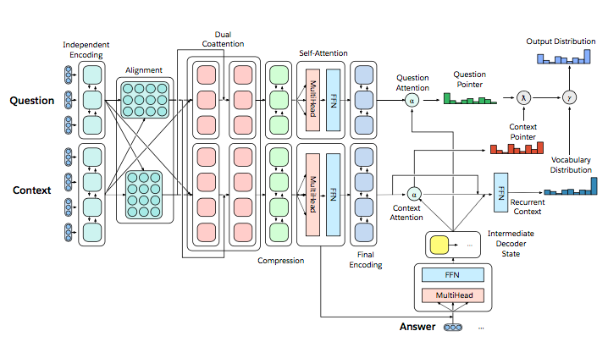
Multi-task Question Answering Network (MQAN) for decaNLP)
Fixed Glove+Character n-gram embeddings linear Shared BiLSTM with skip connection

Slide 11
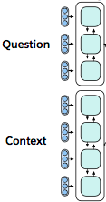
Multi-task Question Answering Network (MQAN) for decaNLP)
Input matrices
Projected to a common d
Q ∈ R ^{m×demb}
QW₁ = Q_{proj} ∈ R ^{m×d}
C ∈ R ^{l×demb}
CW₁ = C_{proj} ∈ ^{R l×d}
Final BiLSTM layer for both question and context
BiLSTM_{ind}(Q_{proj} ) = Q_{ind} ∈ R ^{m×d}
BiLSTM_{ind}(C_{proj} ) = C_{ind} ∈ R ^{l×d}
Fixed Glove+Character n-gram embeddings linear Shared BiLSTM with skip connection
Notes:
It basically starts with a question and context represented with fixed glove pretrained word vectors, they add character n-gram embeddings to them so that they can have vectors for words that are not in glove or any other vectors and we basically have a shared BiLSTM layer for both question and context.

Slide 12
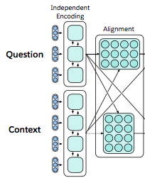
Multi-task Question Answering Network (MQAN) for decaNLP)
Add trained dummy embeddings
C_{ind} ∈ R ^{(l+1)×d}
Avoid forcing tokens
To align with any token
in other sequence
Q_{ind} ∈ R ^{(m+1)×d}
Alignments
softmax (Q_{ind}C⏉_{ind}) = S_{qc} ∈ R ^{(m+1)×(l+1)}
softmax (C_{ind}Q⏉_{ind}) = S_{cq} ∈ R ^{(l+1)×(m+1)}
We obtain coattended representations by first aligning encoded representations of each sequence
Notes:
Now they align the sentence representation of the question and the context to be able to obtained coattended representations
by normalizing dot-product similarity scores between representations of one sequence with those of the other We obtain alignments:

Slide 13
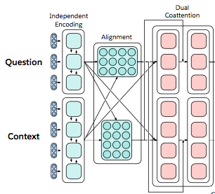
Multi-task Question Answering Network (MQAN) for decaNLP)
Weighted summations
S⏉_{qc}Q_{ind} = Q_{sum} ∈ R ^{(l+1)×d}
S⏉_{cq}C_{ind} = C_{sum} ∈ R ^{(m+1)×d}
Transfer alignment info to original sequence
S⏉_{qc}C_{sum} = C_{coa} ∈ R ^{(l+1)×d}
S⏉_{cq}Q_{sum} = Q_{coa} ∈ R ^{(m+1)xd}
Drop dummy embedding
Q_{coa} ∈ R^{mxd} C_{coa} ∈ R^{l×d}
Attention summations from one sequence to the other and back again with skip connections
Notes:
So idea of coattention is that, if I ask you a question, and I give you the paragraph, its likely that you are going to read the question and then read the paragraph to figure out quickly where the context is going to be.
It basically maps the two sequences together to see if there is alignment and uses the alignment to create a softer attention on all the words that align. So makes the job very easy for down stream layers to use this information.
And These alignments are used to compute weighted summations of the information from one sequence that is relevant to a single token in the other
The coattended representations use the same weights to transfer information gained from alignments back to the original sequence
The first column of the summation and coattentive representations correspond to the dummy embedding it is dropped because it is not necessary.

Slide 14
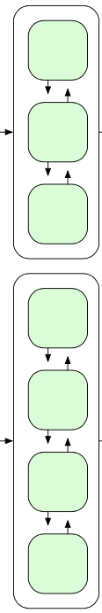
Multi-task Question Answering Network (MQAN) for decaNLP)
Compression
Concatenate all seq representations
BiLSTM_{com}Q ([Q_{proj} ; Q_{ind}; C_{sum}; Q_{coa}]) = Q_{com} ∈ R^{lxd}
BiLSTM_{com}C ([C_{proj} ; C_{ind}; Q_{sum}; C_{coa}]) = C_{com} ∈ R^{lxd}
we concatenate all four prior representations for each sequence along the last dimension and feed into separate BiLSTM
Notes:
Information from dual coattention is compressed back to the more manageable dimension.
We concatenate all four prior representations for each sequence along the last dimension and feed into separate BiLSTM

Slide 15
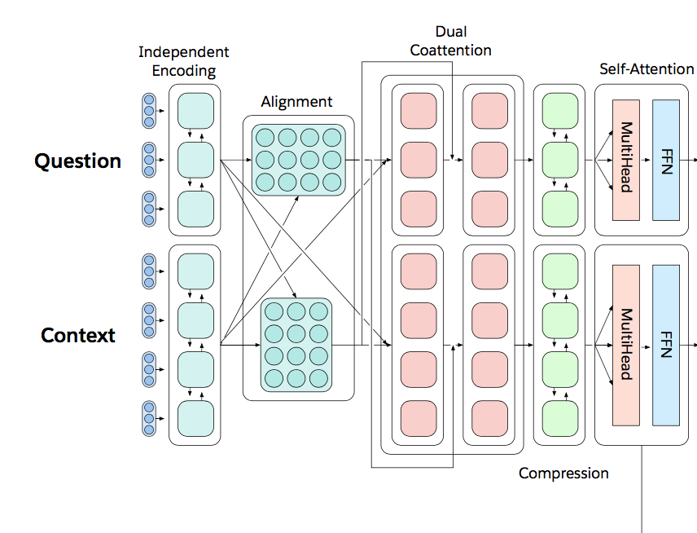
Multi-task Question Answering Network (MQAN) for decaNLP)
Notes:
Information from dual coattention is compressed back to the more manageable dimension.
We concatenate all four prior representations for each sequence along the last dimension and feed into separate BiLSTM

Slide 16
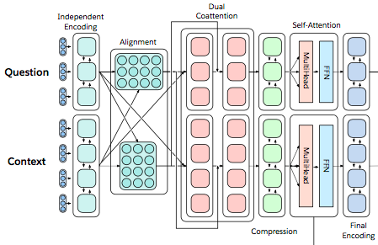
Multi-task Question Answering Network (MQAN) for decaNLP)
Separate BiLSTMS to reduce dimensionality, two transformer layers, another BiLSTM
Notes:
There are skip connections to allow smooth gradient flow
They then add 2 BiLSTMs to reduce dimensionality and they add two transformers, transformers have shown good performance recently on a lot of tasks including language modeling and translation.
And they end up with a final BiLSTM layer to finish up the encoding.
And that’s the encoder side, which gives the entire question and the context in a couple of vectors.

Slide 17
Multi-task Question Answering Network (MQAN) for decaNLP)
Auto-regressive decoder uses fixed GloVe and character n-gram embeddings, two transformer layers and an LSTM layer that attend to outputs of the last three layers of the encoder
Notes:
Then there is a decorder layer that starts with the answer which also uses the glove and n-gram embeddings, two transformer layers and an LSTM layer that attends to the outputs of the last three layers of the encoder.

Slide 18
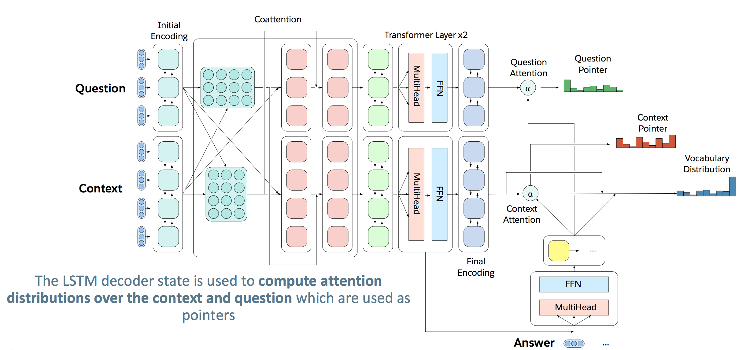
Multi-task Question Answering Network (MQAN) for decaNLP)
Notes:
Now the most interesting part here is that there are three choices to come up with the answer, one is that you have to have the ability to generate from a vocabulary, because that’s the only way to do translation,
You have to have the ability to point at the context because that’s the only way to do question answering and
You have to have the ability to point to the question because that’s the only way to do classification.
So to allow those three we have three choices and the model is making all these decisions because everything is end to end.

Slide 19
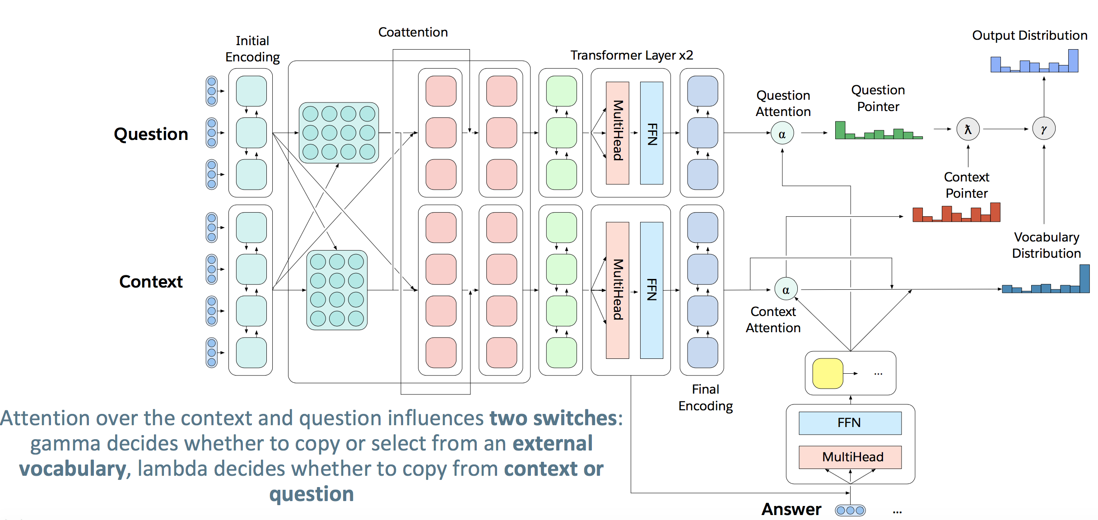
Multi-task Question Answering Network (MQAN) for decaNLP)
Notes:
And once you have all this you have this final out put distribution, you put a softmax on top, put a crossentrope ontop and backbrop all the way through the layers and essentially go through the training.

Slide 20
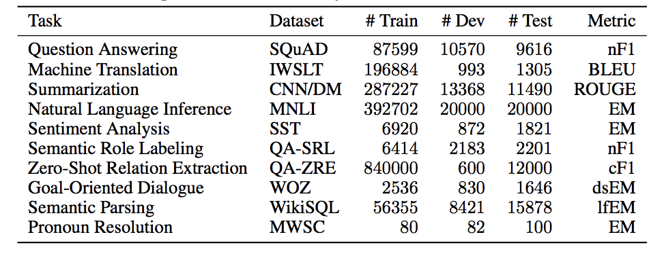
Evaluation
Datasets: Different metrics for different tasks
nF1: normalized F1 that strips out articles and punctuation
ROUGE: Average of ROUGE-1, 2, and L
EM : exact match comparison (text classification: accuracy)
dsEM: turn-based dialogue state exact match
lfEM: logical forms exact match
cF1: corpus level metric (takes into account that some questions are unanswerable)
Notes:
The idea is that all these metrics are community specific and so we are trying to make each community happy but at the same time, all of these are scaled from 0 to 1 or zero to 100.
What happens is that if they are all composed by a sum, that’s what is called a decascore.

Slide 21
Evaluation
Datasets: Different metrics for different tasks
Natural Language Decathlon decascore
decascore = sum of task-specific metrics
Notes:
The idea is that all these metrics are community specific and so we are trying to make each community happy but at the same time, all of these are scaled from 0 to 1 or zero to 100.
What happens is that if they are all composed by a sum, that’s what is called a decascore.
I personally think its unfair, Because this is more like saying that a certain improvement in sentiment analysis would ne the same as in machine translation. I don’t know what you think
But may be they do this to avoid reviewer controversy.
Besicaly if you improve all of them at the same time, you get a better score and if you improve one and don’t hurt others, that’s fair too.

Slide 22
Evaluation
Datasets: Different metrics for different tasks
S2S: is the sequence to sequence baseline
(+Satt): S2S + self Attention in encoder
(+Catt): S2S + self Attention and coattention in the encoder
Notes:
So the first thing they do is train all of them using the three arm proposed model, And the results they get are interesting, squad has 70.8 and so on and so forth, and its interesting that they get good results that other models are not able to get for example the vanilla S2S model and there is a significate difference gap
Now they go ahead and make an increament, for example they take a S2S model and add transformers you see improvement, if you add coattention you also see continued improvement. You for example see that co attention tends to help squad a lot,
IWSLT benefits from having more complexity in the network
The other thing they do is single task performance. And they use the same model but train it on each individual task to see how well it does.
And again you can see a significant difference, for example if you take squad and train it alone you get 75.3 and if you train it with other stuff you get 70.8.
And ofcourse this expected, but again this become a problem because this what they set to solve.
There is some more interesting analysis in the paper

Slide 23
Evaluation
Datasets: Different metrics for different tasks
Transformer layers, yield benefits in single-task and multitask setting
Notes:
So if we try to make some observation, we see that Transformer layers and self attention yield benefits in both single task and multitask setting.

Slide 24
Evaluation
Datasets: Different metrics for different tasks
Transformer layers, yield benefits in single-task and multitask setting
Question answering and semantic role labeling have a strong connection.
Notes:
Another observation is that when squad works well then semantic role labeling also works well.
So we can go on and analysis these numbers but there is a good analysis in the paper about the numbers.

Slide 25
Evaluation
Datasets: Different metrics for different tasks
Transformer layers, yield benefits in single-task and multitask setting
Question answering and semantic role labeling have a strong connection.
There is a gap between the combined single task models and the ingle multitask model
Notes:
So we can go on and analysis these numbers but there is a good analysis in the paper about the numbers.
But one last one we see here is that there is a gap between the combined single task models and the single multitask model.

Slide 26
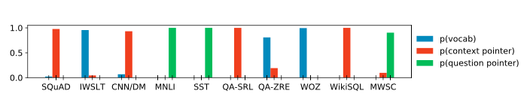
Evaluation
- Answers are correctly copied from either context or question
No confusion over which tasks the model should perform or which output
space to use
Notes:
So here is a bit of an analysis, the model essentially learn how to generate outputs based on the question.
For example in cases like Squad, its designed to get phrases from the context, so all answers in squad are defined as phrases from the original document.
In translation for example words have to be generated because they don’t exist in either the question or the context. But there might be some overlapping words like named entities or names of people that you might not want to translate and they are just copied from the context.
And there are some interesting ones like Zero-shot which actually have a mix.

Slide 27
Evaluation
Notes:
So here is a bit of an analysis, the model essentially learn how to generate outputs based on the question.
For example in cases like Squad, its designed to get phrases from the context, so all answers in squad are defined as phrases from the original document.
In translation for example words have to be generated because they don’t exist in either the question or the context. But there might be some overlapping words like named entities or names of people that you might not want to translate and they are just copied from the context.
And there are some interesting ones like Zero-shot which actually have a mix.

Slide 28
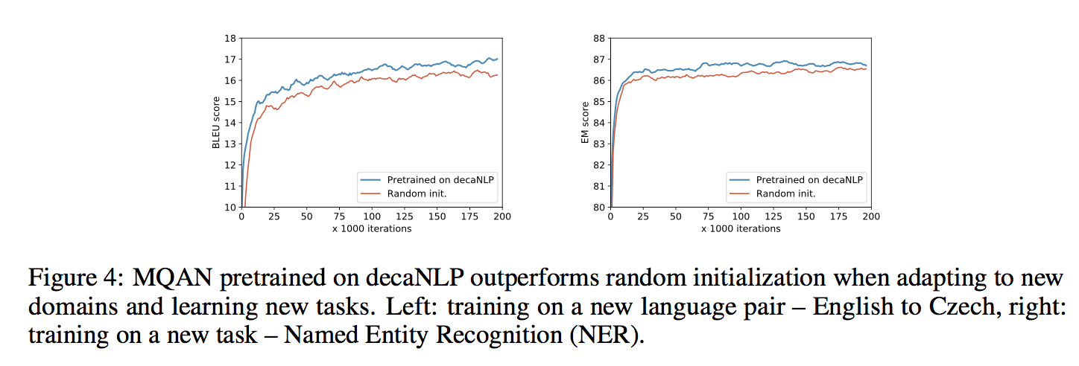
Evaluation
Pretraining on decaNLP improves final performance
An example: Additional IWSLT Language pairs (Left)
New tasks like NER (Right)
Notes:
Now because of the variety of the 10 different tasks in this model, it makes it also useful for a lot of other tasks.
And here there are two tasks one is English to checq translation and the other one is named entity recorgnition,
And as you can see, the model that was pre-trained on decaNLP optimized more quickly and ended up getting a better performance than a randomly initialized model.

