Slide 1
Multi-Task Learning with Multi-View Attention for
Answer Selection and Knowledge Base Question Answering
Yang Deng, Yuexiang Xie, Yaliang Li, Min Yang, Nan Du, Wei Fan, Kai Lei, Ying Shen
School of Electronics and Computer Engineering, Peking University Shenzhen Graduate School Tencent Medical AI Lab
Shenzhen Institutes of Advanced Technology, Chinese Academy of Sciences
(AAAI-19)
Presenter: Happy Buzaaba
University of Tsukuba: KDE Lab Mining Seminar
Date: September 20th, 2019

Slide 2
Outline
Introduction
- Answer Selection & Knowledge Base Question Answering
- Multi-task Learning
Methodology
- Problem Definition
- Multi-Task Learning for Question Answering
- Multi-View Attention Scheme
Experiment
- Multi-Task Learning Results
- Ablation Analysis of Multi-View Attention
- Case Study of Multi-View Attention
Summary

Slide 3
Outline
Introduction
- Answer Selection & Knowledge Base Question Answering
- Multi-task Learning
Methodology
- Problem Definition
- Multi-Task Learning for Question Answering
- Multi-View Attention Scheme
Experiment
- Multi-Task Learning Results
- Ablation Analysis of Multi-View Attention
- Case Study of Multi-View Attention
Summary
Notes:
Okay lets start with the introduction

Slide 4
Introduction
Answer Selection (AS)
Problem: Given a question, answer selection aims to pick out a correct
Answer from a set of candidates.
Current Study: Deep Learning , Attention mechanisms, External Knowledge
Knowledge Base Question Answering (KBQA)
Problem: Given a question, KBQA aims to pick out a fact from a given
Knowledge base to answer the question
Current study: Semantic parsing, Deep Learning, Contextual Information
Existing methods solve these two tasks separately. This requires large number
of repetitive work and neglects the rich correlation information between tasks.
Notes:
Now answer selection and knowledge base question answering are two important tasks in question answering systems.
In answer selection for example given a question, answer selection aims to pick out a correct answer from a set of candidate answers to answer the question.
On the other hand, the KBQA aims to pick out a fact from a given KB to answer the question.
Now many existing methods whether semantic parsing methods or deep learning models solve these two tasks separately, which brings about a lot of repetitive work and neglects the rich correlation information between the tasks.

Slide 5
Introduction
Multi-Task Learning (MTL)
Multi-task learning aims to jointly learn different related tasks
Note: In this paper, we tackle answer selection (AS) and KBQA tasks
Simultaneously via multi-task learning.
Motivation:
- Both AS & KBQA can be regarded as a ranking problem, with one
at text-level while the other at knowledge level.¹
- Both tasks can benefit each other: AS can incorporate external
knowledge from the knowledge base, while KBQA can be improved
by learning contextual information from AS.²
¹Savenkov, D., and Agichtein, E. 2017. Evinets: Neural networks for combining evidence signals for factoid question answering. In ACL, 299–304.
²Sorokin, D., and Gurevych, I. 2018. Modeling semantics with gated graph neural networks for knowledge base question answering. In COLING, 3306– 3317.
Notes:
So different from many existing works, this paper tries to solve AS and KBQA tasks together using the concept of multi-task learning.
And the motivation of doing this is that, both AS and KBQA can be regarded as a ranking problem with one at text-level, while the other one at Knowledge level.
And also both tasks can benefit each other.
Because AS can incorporate in the candidate answers external knowledge from the knowledge base, while the KBQA can be improved by learning contextual information from AS,

Slide 6
Main Contribution
Multi-Task Question Answer Scheme
Propose a novel multi-task learning scheme that utilizes multi-view attention
learned from various perspectives to enable these tasks to interact with each
other as well as learn more comprehensive sentence representations.
Summary of contribution:
We explore multi-task learning approaches for answer selection and knowledge
base question answering.
We propose a novel multi-task learning scheme that leverages multi-view
attention mechanism to bridge different tasks.
Experimental results show that multi-task learning of answer selection
and KBQA outperforms state-of-the-art single-task learning methods.
Besides, the multi-view attention based MTL scheme further enhance
the performance.
Notes:
So to full fill the goal of jointly learning the two tasks, the paper proposes a novel multi-task learning scheme, that utilizes multi-view attention learned from various perspectives to enable interaction between the two tasks as well as learn more comprehensive sentence representations.
Because Answer selection task can be improved by KBQA task in knowledge-level, while KBQA task can be enhanced by answer selection task in word-level.
which integrates the important information of the task-specific layers into the shared layers as well as enables the model to interactively learn word-level and knowledge-level representations.

Slide 7
Outline
Introduction
- Answer Selection & Knowledge Base Question Answering
- Multi-task Learning
Methodology
- Problem Definition
- Multi-Task Learning for Question Answering
- Multi-View Attention Scheme
Experiment
- Multi-Task Learning Results
- Ablation Analysis of Multi-View Attention
- Case Study of Multi-View Attention
Summary
Notes:
In the next slides I will talk about the Proposed method.

Slide 8
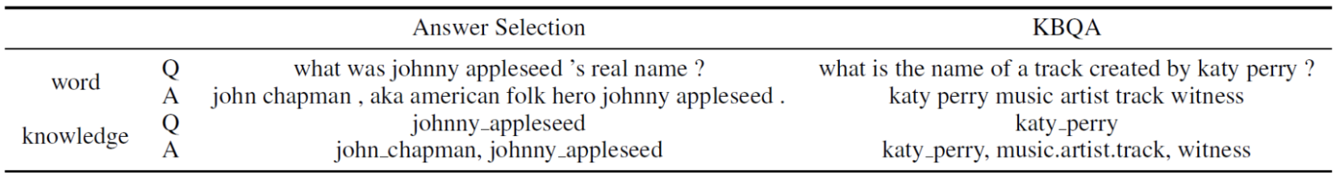
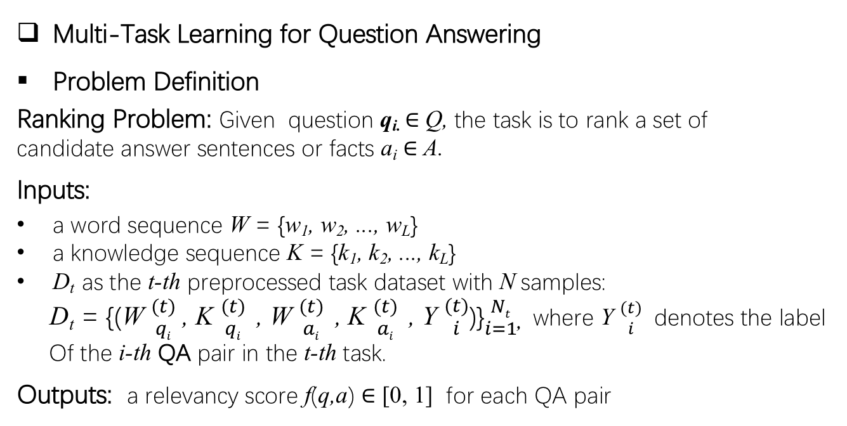
Methodology
Multi-Task Learning for Question Answering
Problem Definition
Ranking Problem: Given question q_{i.} ∈ Q, the task is to rank a set of
candidate answer sentences or facts a_{i} ∈ A.
Inputs:
a word sequence W = {w₁, w₂, ..., w_{L}}
a knowledge sequence K = {k₁, k₂, ..., k_{L}}
D_{t} as the t-th preprocessed task dataset with N samples:
D_{t} = {(W ${(t) \atop qi}$ , K ${(t) \atop qi}$ , W ${(t) \atop ai}$ , K ${(t) \atop ai}$ , Y ${(t) \atop i}$)}${Nt \atop i=1}$, where Y ${(t) \atop i}$ denotes the label
Of the i-th QA pair in the t-th task.
Outputs: a relevancy score f(q,a) ∈ [0, 1] for each QA pair
Table 1: Examples of AS and KBQA Data
Notes:
The task of AS and KBQA can typically be regarded as a ranking problem.
So given a question the task is to rank a set of candidate answer sentences or facts
A word sequence and knowledge sequence are prepared for each question and candidate answer. As shown in the table 1.
# For the question and answer in answer selection and the question in KBQA. The knowledge of the sentence is derived by entity linking # # (Savenkov & Agichtein 2017).
# For the answer fact in KBQA a word sequence is obtained from the tokenized entity name and the relation name (Yu et al. 2017).
So since it is a multi-task scenario, the aim is to rank candidate answers for each question from T related tasks and Dt here is the t-th preprocessed task dataset with N-samples. And Yi denotes the label of the i-th QA pair in the t-th task.
And the output should be a relevancy score for each QA-pair.

Slide 9
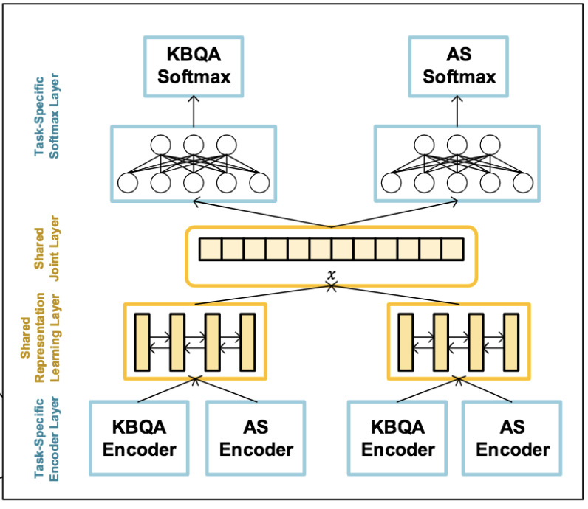
Methodology
Multi-Task Learning for Question Answering
Multi-Task QA network (MTQA-net)
Figure 1: Basic multi-task QA Network
Guo, H.; Pasunuru, R.; and Bansal, M. 2018. Soft layer-specific multi-task summarization with entailment and question generation. In ACL
Notes:
This figure Illustrates the basic architecture of the multi-task QA network for Answer selection (AS) and knowledge base question answering (KBQA)
And this is a deep neural network that adopts layer specific sharing mechanism from ((Guo, Pasunuru, and Bansal 2018) which shares some high level information across different tasks and the remained layers are parallel and independent to learn task-specific low-level information.
So each of these layers plays a role and I will go in details for each one of them in the following slides.

Slide 10
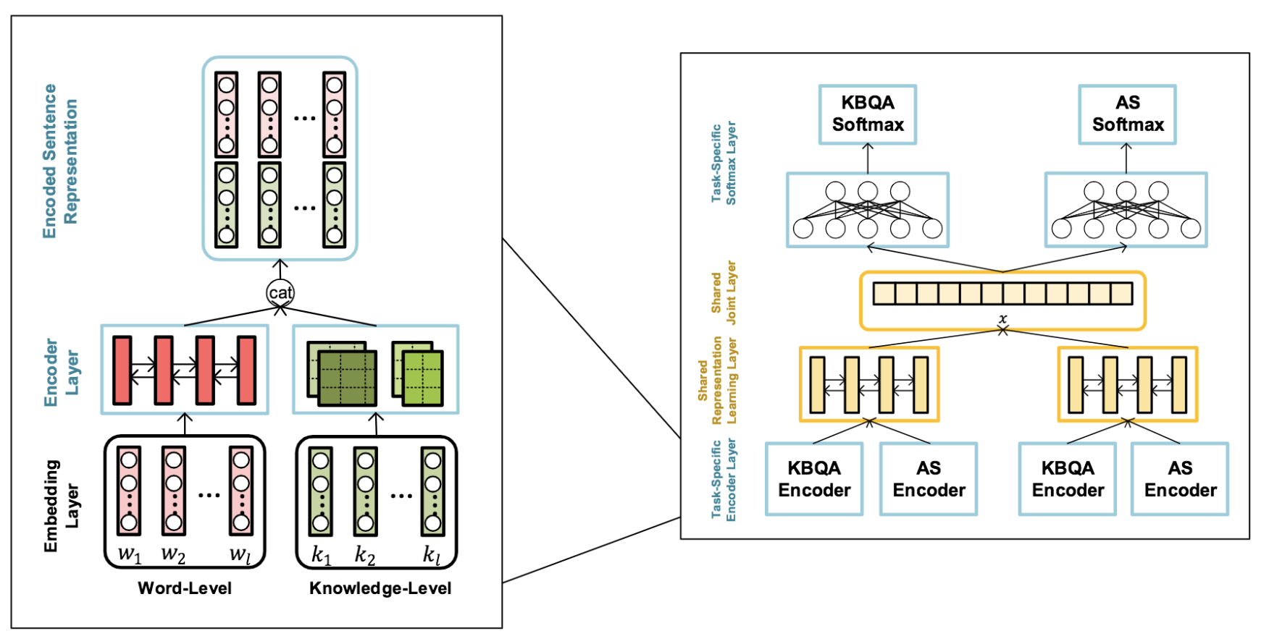
Methodology
Multi-Task QA network (MTQA-net)
Task-specific Encoder layer
Notes:
Lets start with the task-specific encoder, Now the preprocessed sentences are encoded into distributed vector representations.
# Now each task is equipped with a task-specific siamese encoder for both questions and answers,
And each task specific-encoder contains a word encoder and a Knowledge encoder to learn the intergral sentence representations.

Slide 11
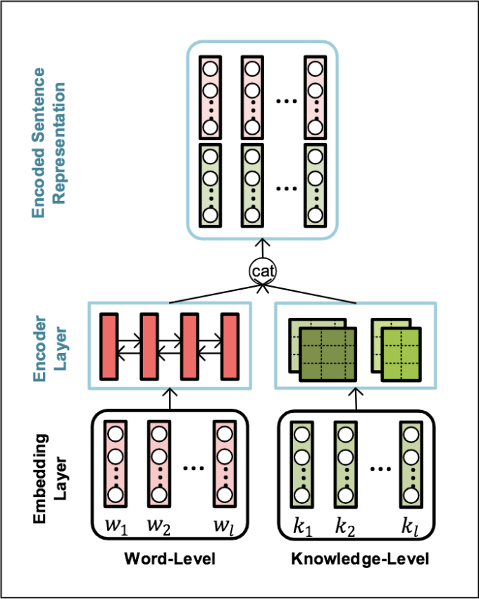

Methodology
Task-specific Encoder layer
Word Encoder
E_{W} = {e_{w1}, e_{w2}, ..., e_{wL}} Word embeddings
$hl=\vec{hl}:\overset{⃖}{hl }$ l-th word hidden representation
H_{W} ∈ R ^{L x d}h : Sentence representation
L : length of sentences
d_{h} : size of hidden units
H_{Wq} =BiLSTM (E_{wq}); H_{Wa} =BiLSTM (E_{wa})
Word-level
Question sentence representation
Word-level
answer sentence representation
Notes:
As mentioned the task specific encoder layer contains a word-level encoder and a Knowledge-level encoder.
The Input of the word-level encoder module is a sequence of word embeddings
Then a BiLSTM is employed to capture the context information (or the hidden state) from both the head-to-tail and tail-to-head context.
And the output at every time step constitutes of both the forward and back word network.
So given the pair of question and answer sequences the word-level based sentence representation for both the question and answer is generated.

Slide 12
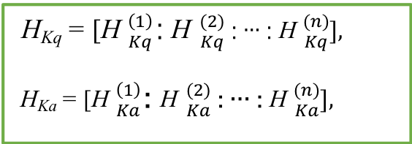
Methodology
Task-specific Encoder layer
Knowledge Encoder
E_{K} = {e_{k1}, e_{k2}, ..., e_{kL}} knowledge embeddings
Sliding filters
h_{l} = tanh(W_{c}x_{l}+b_{c}): hidden layer vector
Wc : convolutional kernel
bc : bias
{H⁽¹⁾, H⁽²⁾, …, H^{(n)} : H^{(i)} i-th filter output vector
H_{K} ∈ R ^{L x d}f : Sentence representation
L : length of sentences
d_{f} : total filter sizes of CNN
H_{Kq} = [H ${\left(1\right) \atop Kq}$: H ${(2) \atop Kq}$ : … : H ${(n) \atop Kq}],$
H_{Ka} = [H ${\left(1\right) \atop Ka}$: H ${(2) \atop Ka}$ : … : H ${(n) \atop Ka}],$
Notes:
Now different from word encoder, a sequence of knowledge embeddings is input into a knowledge encoder.
Now the knowledge sequence is composed of series of tokenized entity or relation, to get the knowledge representation a CNN is applied on the sequence.
Filters of size n slide over the knowledge embedding matrix to capture the local n-gram features
And each move computes the hidden layer vector as:
Wc and bc are convolutional kernel and bias vectors to be learned.
Now because, the length of entities might vary, (uncertain) several filters are employed to obtain different output vectors. And Hi here denotes the output vector of the ith filter.
So these out put vectors are then passed into a fully connected layer to get the Knowledge-based sentence representation. Where L is the length of the sentence, and df the total filter size of the CNN.
So given the question q and the answer a the Knowledge based sentence representations are:

Slide 13
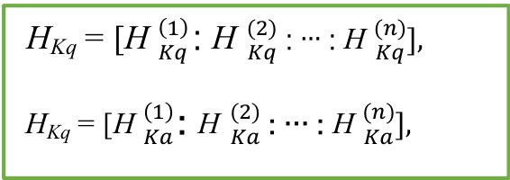
Methodology
Task-specific Encoder layer
Concatenated representations
H_{q} = [H_{Wq} : H_{Kq}] and H_{a} = [H_{Wa} : H_{Ka}]
Knowledge-based Encoder
H_{Kq} = [H ${\left(1\right) \atop Kq}$: H ${(2) \atop Kq}$ : … : H ${(n) \atop Kq}],$
H_{Kq} = [H ${\left(1\right) \atop Ka}$: H ${(2) \atop Ka}$ : … : H ${(n) \atop Ka}],$
Word-based Encoder
H_{Wq} =BiLSTM (E_{wq}); H_{Wa} =BiLSTM (E_{wa})
Notes:
After obtaining the word-based and Knowledge based sentence representations, they are then concatenated into the encoded sentence representation.
The Knowledge based question representation and the knowledge based answer representation are vectors in the order of words in a sentence.
And since the fully connected layer concatenates the outputs from all the filters, in the dimension of the feature instead of the sequence, so the order of knowledge based representations is consistent with the order of word based representations.
Okay, so that’s the task specific encoder layer.

Slide 14
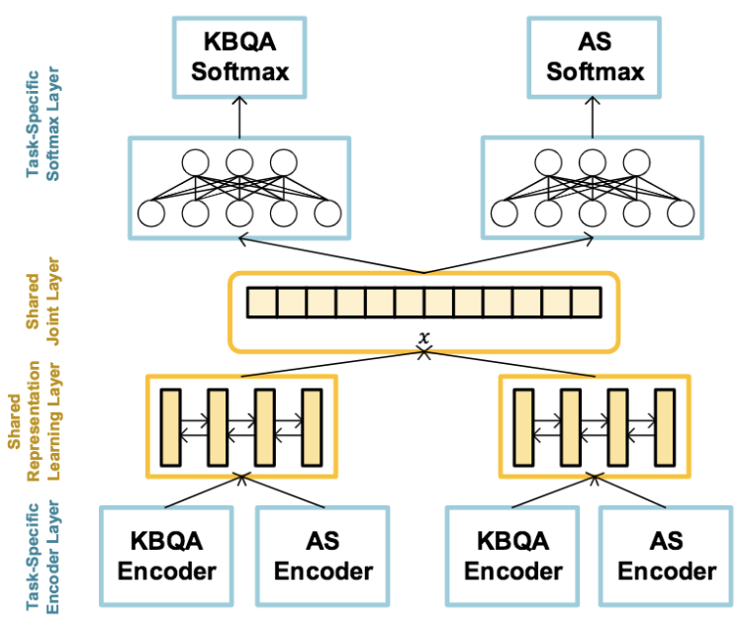
Methodology
Shared Representation Learning Layer.
overlap features:
word overlap score
non-stop word overlap score
weighted word overlap score
non-stop weighted word overlap score
knowledge overlap score
weighted knowledge overlap score
Final QA representation
S_{q} =BiLSTM (H_{q}); S_{a} =BiLSTM (H_{a})
s_{q} =Average (S_{q}); s_{a} =Average (S_{a})
x_{ol} ∈ R⁶ : overlap features ³
x = [s_{q,} s_{a,} x_{ol}] : final feature space
³Severyn, A., and Moschitti, A. 2015. Learning to rank short text pairs with convolutional deep neural networks. In SIGIR, 373–382
³Tay, Y.; Phan, M. C.; Tuan, L. A.; and Hui, S. C. 2017. Learning to rank question answer pairs with holographic dual lstm architecture. In SIGIR.
Notes:
Now after encoding sentences into vector representations with the the task specific encoder, the shared representation learning layer is used to share
High-level information across different tasks.
At this point the sentence representations contains richer semantic meaning and share more similar distributions with other tasks.
So they integrate the encoded vectors from all the tasks and pass them through a high level shared Siamese Bi-LSTM to generate the final QA representations.
One other thing they do here is applying average pooling over the BiLSTM output:
They also incorporate some word and knowledge overlap features to form the final feature space for binary classification.

Slide 15
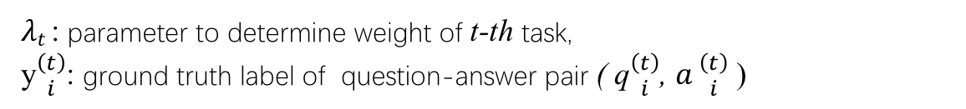
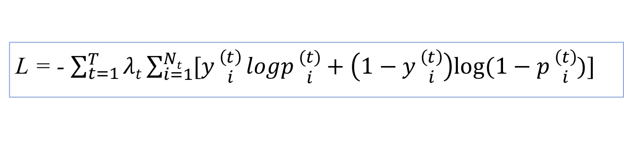
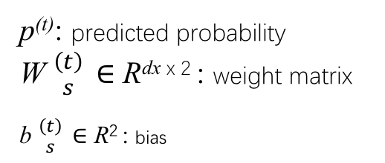


Methodology
Task Specific Softmax Layer.
q ${\left(t\right) \atop i} ,$ a ${(t) \atop i}$ & y ${(t) \atop i}$ : k-th task
p^{(t)} = softmax (W ${\left(t\right) \atop s}$ x + b ${\left(t\right) \atop s}$ )
p^{(t)}: predicted probability
W ${\left(t\right) \atop s}$ ∈ R^{dx x 2} : weight matrix
b ${\left(t\right) \atop s}$ ∈ R² : bias
Multi-Task Learning.
L = - $\sum_{t=1}^{T}{λt}\sum_{i=1}^{Nt}{[y}{\left(t\right) \atop i}logp{(t) \atop i}+\left(1−y{\left(t\right) \atop i}\right)log⁡(1−p{\left(t\right) \atop i})]$
$λt$: parameter to determine weight of t-th task,
y${\left(t\right) \atop i}$: ground truth label of question-answer pair ( q${\left(t\right) \atop i}$, $a{\left(t\right) \atop i}$ )
Notes:
So for a question q answer a pair and its label y in the k-th task, the final feature representation is fed into the task specific softmax layer for binary classification.
Where p is the predicted probability, W and b are the task-specific weight matrix and bias vector in the hidden layer.
And the overall multi-task learning model is trained to minimize the cross-entropy loss function.
In practice, the same weight is assigned to all tasks.
So that’s multi-task learning.

Slide 16
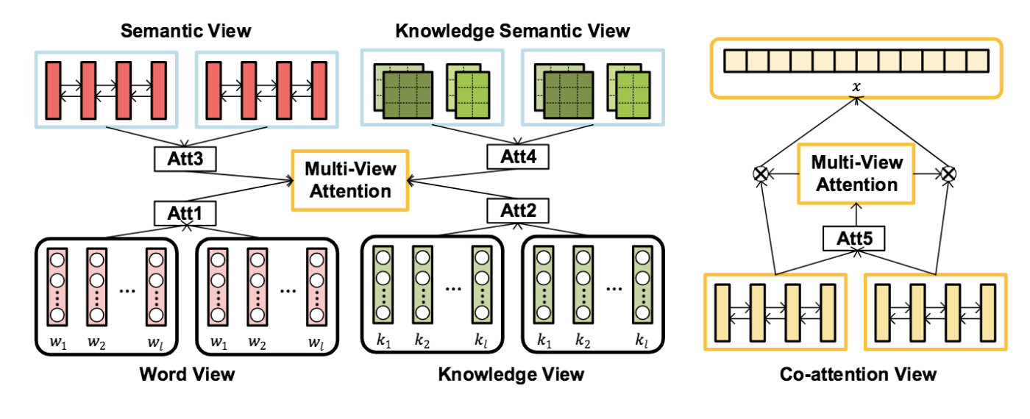
Methodology
Multi-View Attention Scheme.
Notes:
Now multi-task learning with multi-view attention
So in order to enhance the interaction between different tasks they propose multi-view attention mechanism to fetch important information from task specific layers as well as shared layers.
So there are five attention views computed in this model;
Word view
Knowledge view
Semantic view
Knowledge semantic view
Co-attention view

Slide 17
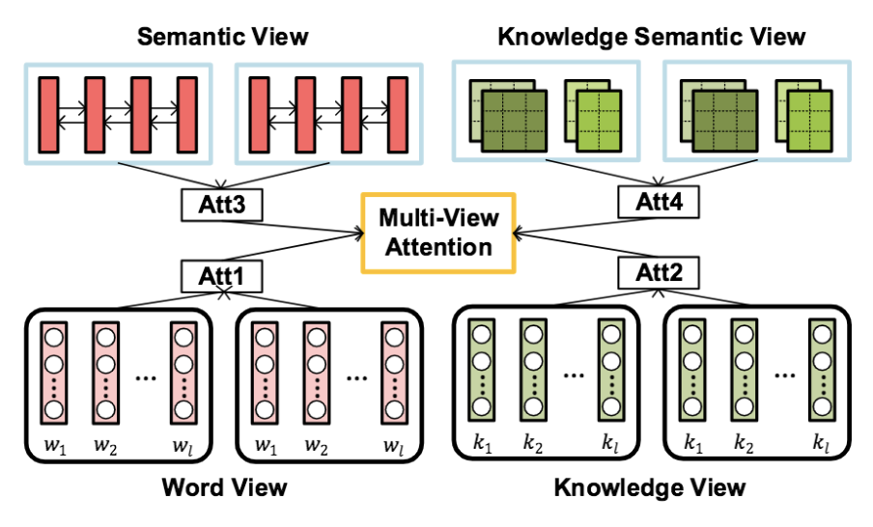


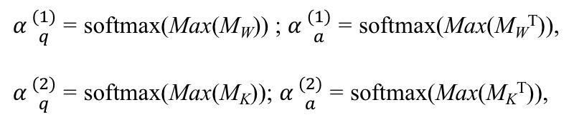
Methodology
Multi-View Attention Scheme: Word and Knowledge view
M_{W} =tanh (E ${T \atop Wa}$U_{W} E_{Wa}); M_{K} =tanh (E ${T \atop Ka} UK$E_{Ka}); attention weights from embeddings
U_{W} ∈ R^{dew x dew} , U_{K} ∈ R^{dek x dek}: Matrices
d_{ew} : dimension of word embedding
d_{ek} : dimension of knowledge embedding
$α{(1) \atop q}$= softmax(Max(M_{W})) ; $α{(1) \atop a}$= softmax(Max(M_{W}^{T})),
$α{(2) \atop q}$= softmax(Max(M_{K})); $α{(2) \atop a}$= softmax(Max(M_{K}^{T})),
$α{(1) \atop q}$ & $α{(1) \atop a} :$ attention weights from word view
$α{(2) \atop q}$ & $α{(2) \atop a} :$ attention weights from knowledge view
dos Santos, C. N.; Tan, M.; Xiang, B.; and Zhou, B. 2016. Attentive pooling networks. CoRR, abs/1602.03609
Notes:
They first adopt a two way attention mechanism from this paper to interactively model a pair of question answer sentences.
And here they attend to corresponding important information in two sentences.
And so they collect attention weights from both the word and the knowledge embeddings
Where Uw and Uk are parameter matrices to be learned. And the d here is the embedding dimension.
Then to obtain the the word and knowledge view attention weights from question and answer they apply max pooling on the attention weights from the embedding.
And alpha 1 and 2 here are attention weights for the word view and knowledge view.

Slide 18
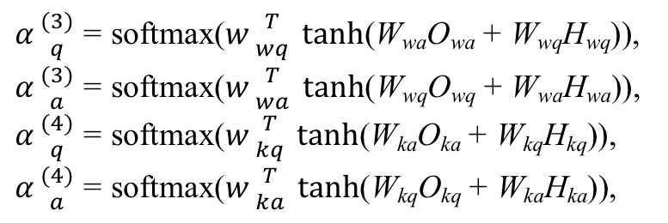

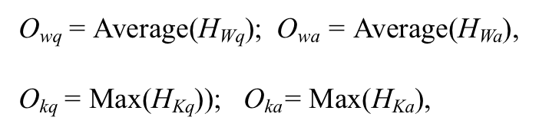
Methodology
Multi-View Attention Scheme: Semantic and Knowledge sematic view
O_{wq} = Average(H_{Wq}); O_{wa} = Average(H_{Wa}),
O_{kq} = Max(H_{Kq})); O_{ka}= Max(H_{Ka}),
$α{(3) \atop q}$= softmax($w{T \atop wq} tanh$(W_{wa}O_{wa} + W_{wq}H_{wq})),
$α{(3) \atop a}$= softmax($w{T \atop wa} tanh$(W_{wq}O_{wq} + W_{wa}H_{wa})),
$α{(4) \atop q}$= softmax($w{T \atop kq} tanh$(W_{ka}O_{ka} + W_{kq}H_{kq})),
$α{(4) \atop a}$= softmax($w{T \atop ka} tanh$(W_{kq}O_{kq} + W_{ka}H_{ka})),
W_{wq,} W_{wa} ∈ R^{dh x dh} , w_{wq,} w_{wa} ∈ R^{dh} , W_{kq,} W_{ka} ∈ R^{df x df,} w_{kq,} w_{ka} ∈ R^{df} : attention parameters to be learned
$α{(3) \atop q}$ & $α{(3) \atop a} :$ attention weights from semantic view
$α{(4) \atop q}$ & $α{(4) \atop a} :$ attention weights from knowledge semantic view
Notes:
For semantic view and knowledge semantic view
In this case they exploit the overall context semantic information as the attention source over all the elements in the sentence.
So they apply both mean and max pooling over the output of the task specific encoder layer to obtain the overall semantic information of the sentence.
# So here the results show that average pooling on word level and max pooling on knowledge level achieves best performance.
So the attention mechanism considers the semantic information because it is expected to capture the correlation between question words and answer words.

Slide 19
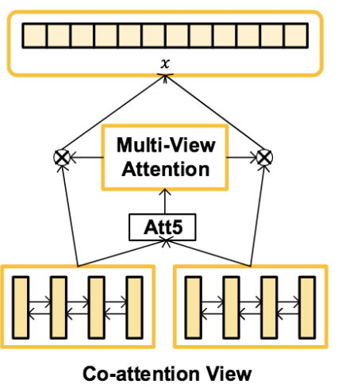
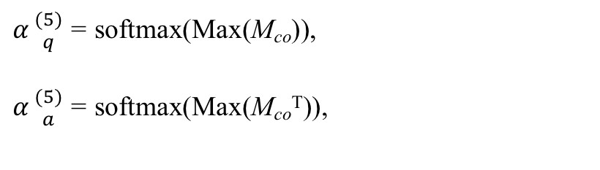
Methodology
Co-attention View
M_{co} =tanh (S${T \atop q}$Us S_{a}) ; S_{q} & S_{a} : final question and answer representations
$α{(5) \atop q}$= softmax(Max(M_{co})),
$α{(5) \atop a}$= softmax(Max(M_{co}^{T})),
U_{W} ∈ R^{ds x ds} : attention parameter matrix to be learned
ds : dimension of final QA representation
$α{(5) \atop q}$ & $α{(5) \atop a} :$ co-attention weights for question & answer
Notes:
For co-attention they also employ a two way attention mechanism to generate the co-attention between the final representations of the question and answer.

Slide 20
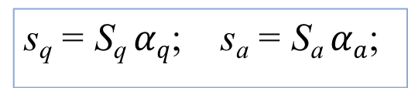
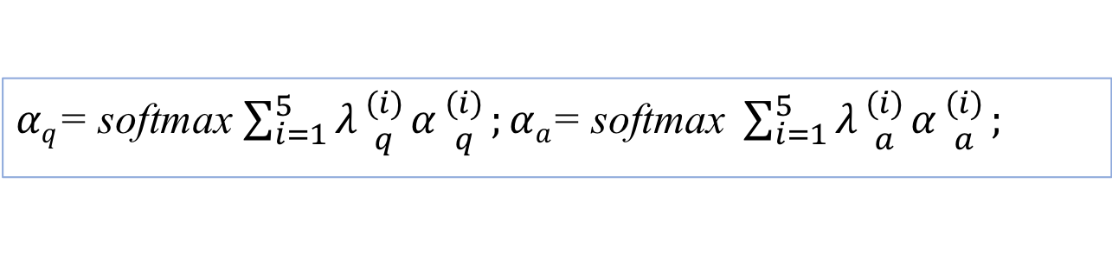
Methodology
Multi-View Attentive Representation
$αq$= softmax $\sum_{i=1}^{5}{λ{(i) \atop q}α{(i) \atop q}};αa\text{= }\text{softmax} \sum_{i=1}^{5}{λ{(i) \atop a}α{(i) \atop a}};$
$λ{(i) \atop q}$ & $λ{(i) \atop a}:$ hyper parameters that determine the weights of the five kinds of attentions.
Final attentive question answer representation:
s_{q} = S_{q} $αq$; s_{a} = S_{a} $αa$;
Notes:
So the over all multi view-attention fusion from: word-view, knowledge-view, semantic view, knowledge semantic view and co-attention views is defined as
In order to observe the contribution of each each view of attention the same weight is assigned to all views of attention in the experiment.
An the final attentive question answer representations will be

Slide 21
Outline
Introduction
- Answer Selection & Knowledge Base Question Answering
- Multi-task Learning
Methodology
- Problem Definition
- Multi-Task Learning for Question Answering
- Multi-View Attention Scheme
Experiment
- Multi-Task Learning Results
- Ablation Analysis of Multi-View Attention
- Case Study of Multi-View Attention
Summary
Notes:
Okay lets start with the introduction

Slide 22
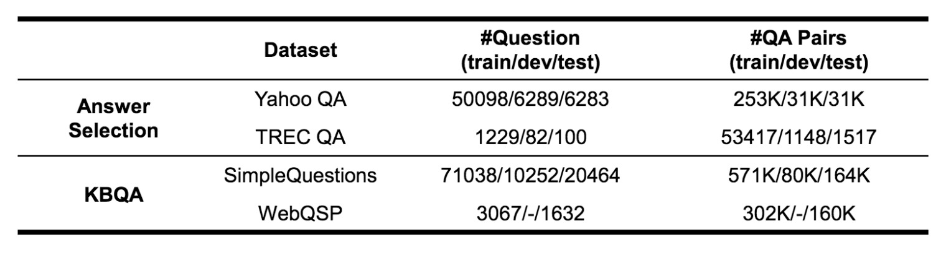
Experiment
Dataset
Experiment setting:
Word embeddings: 300 dimension pre-trained Glove
Knowledge embedding: TransE used to generate knowledge embeddings
LSTM hidden layer size: 200
Convolutional filter width: 2 and 3
Features maps: 100
Learning rate: 0.0005, dropout rate: 0.5
Batch size: 128
Notes:
For answer selection task they use: Yahoo QA and and TREC QA datasets, for KBQA task they use simple questions and WebQSP datasets with the default splits as provided in the initial papers.
YahooQA1 An open-domain community-based dataset collected from Yahoo Answers
TREC QA A widely-adopted factoid question answering dataset
SimpleQuestions A single-relation KBQA dataset
WebQSP A multi-relation KBQA dataset

Slide 23
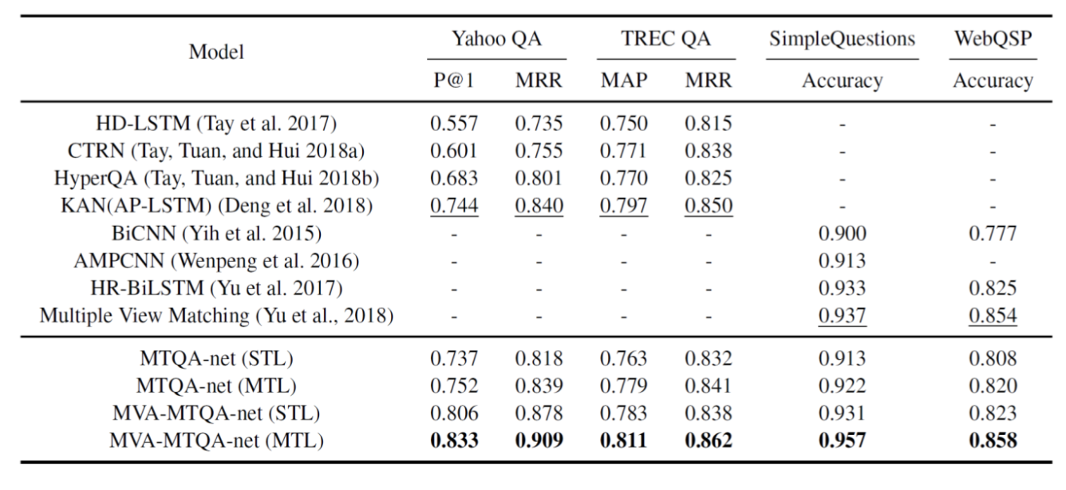
Experiment
Multi-task Learning Results
MVA-MTQA-net(MTL) outperforms state of art results by a noticeable margin on all datasets
In both MVA-MTQA-net and its basic model (MTQA-net), multi-task learning(MTL) methods
can significantly improve the performance of all four datasets compared with single-task
learning (STL)
Notes:
For answer selection task, four methods listed achieve state-of-the-art results in Yahoo QA and TREC QA datasets.
The first three methods (Tay et al. 2017; Tay, Tuan, and Hui 2018a; Tay, Tuan, and Hui 2018b) are traditional single-task learning methods,
while Deng et al. (2018) employs transfer learning method to pre-train the model with a large-scale dataset and leverages external knowledge from KB to improve the sentence representational learning.
For KBQA task, they compare the proposed method to four single-task learning state-of-the-art methods.
# Note that we start with the same entity linking results as Yu et al. (2017).
In general, the proposed multi-view attention based MTL method, MVA-MTQA-net (MTL), outperforms the state-of the-art results by a noticeable margin on all the datasets.
For instance, on the YahooQA and SimpleQuestions dataset, the proposed method improves about 8% and 2% on the metrics over these baselines.
In both MVA-MTQA-net and its basic model (MTQAnet), multi-task learning (MTL) methods can significantly improve the performance of all four datasets compared with single-task learning (STL), which demonstrates the effectiveness of combining answer selection and knowledge base question answering to conduct multi-task learning

Slide 24
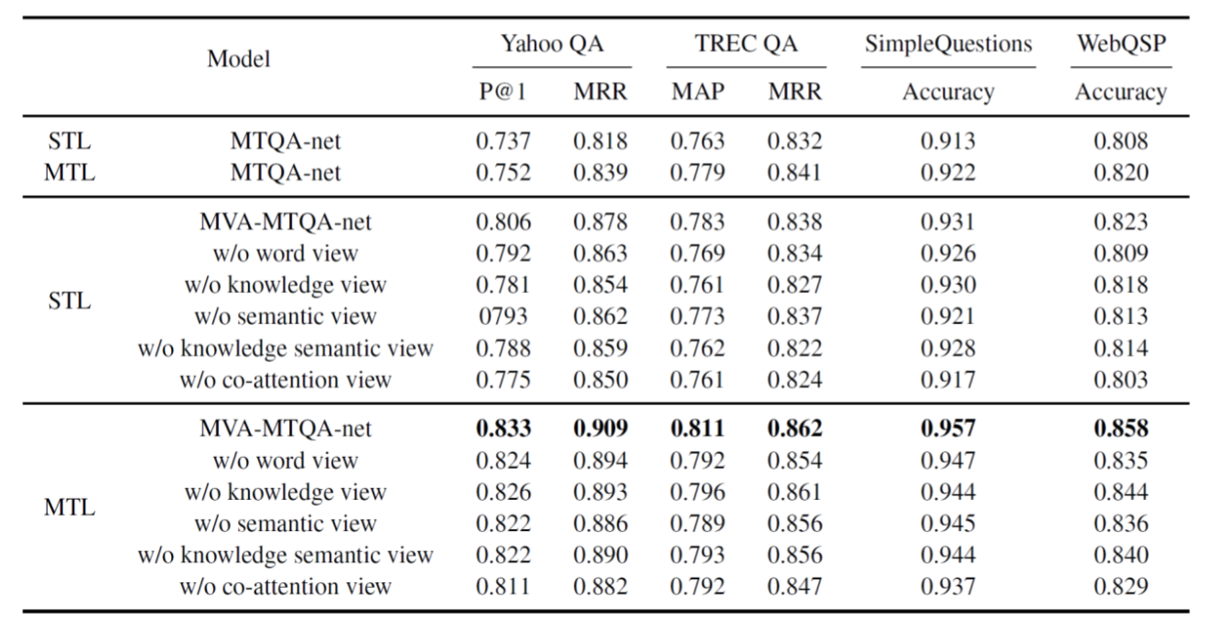
Experiment
Ablation Analysis of Multi-View Attention
All kinds of view contribute more or less performance boost to the model.
Co-attention view attention makes the most contribution to the improvement
For STL , knowledge and knowledge semantic view attentions are more distinguishable than
word view and semantic view in two answer selection tasks, while the word view and semantic
attentions contribute more in the KBQA tasks.
For MTL, we observe that each view of attention makes similar contribution to the
Improvement in four tasks.

Slide 25
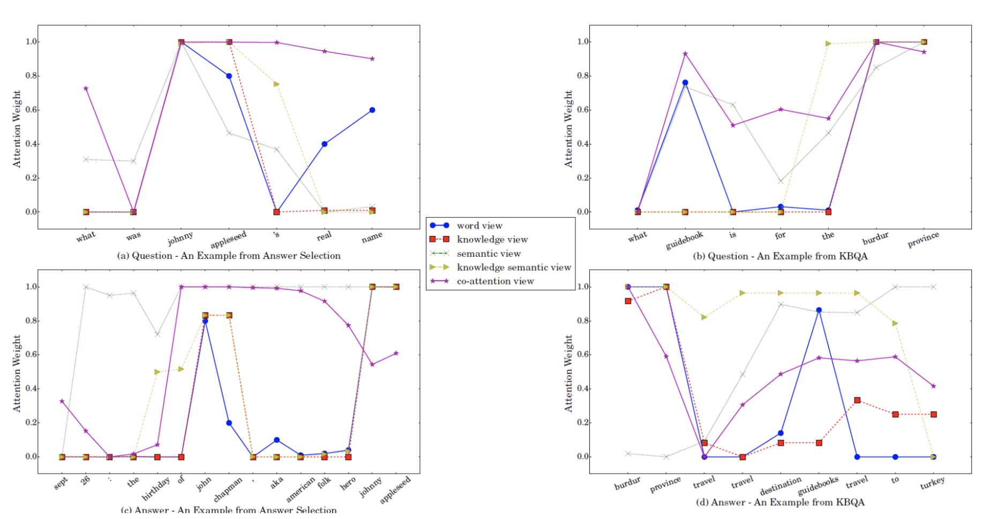
Experiment
Case Study of Multi-View attention
Notes:
Multi-view attention scheme provides an intuitive way to inspect the importance of each word in the question and answer by visualizing the attention weight from each kind of view.
For example here is a Question answer pair from AS and KBQA.
These are attention weights predicted by the MTV-MTQA-net
(Each view of attention weights is normalized for easy differentiation)
For attention weights from word-view, words with rich information like like Jonny appleased in both question and answer receive receive high weights.
For attention weights from knowledge-view, entity with valuable information like John chapman are assigned with high weights.
And in semantic view not only similar words but also related sentence elements like aka American folk hero.
And for co-attention there is a more synthetical attention distribution over all the words.
For the example in b here, for the question we observe kinda a similar distribution with attention weights in question a. because the form of question in KBQA is in accord with that in AS task.
But for the answer, the word view, attention compensate for the insufficiency of the knowledge level attentions. Eg guidbooks which is neglected in the knowledge level attention due to the incompleteness of the KG.
So the results in general demonstrate the effectiveness of combining word-level and knowledge-level information in the KBQA task.

Slide 26
Summary
We explore multi-task learning approaches for answer selection
and knowledge base question answering.
We propose a novel multi-task learning scheme that leverages multi-
view attention mechanism to bridge different asks.
Experimental results show that multi-task learning of answer selection
and KBQA outperforms state-of-the-art single-task learning
methods
Notes:
Okay lets start with the introduction

