Slide 1

Neural Network-based Question Answering over Knowledge Graphs On Word and Character Level
Denis Lukovnikov, Asja Fischer, Jens Lehmann, Sören Aue University of Bonn
WWW 2017, April 3–7, 2017, Perth, Australia
ACM 978-1-4503-4913-0/17/04.
Happy Buzaaba
D1 KDE-LAB
University of Tsukuba
Notes:
Question answering systems over knowledge graphs automatically answer natural language questions using facts contained in the knowledge graph.

Slide 2
OUTLINE
Introduction
Traditional Question Answering Pipeline
Recurrent Neural Network Architecture
Question, Word, Subject and Predicate Representation
Experimental Setup
Results and Comparison with other approaches
Conclusion

Slide 3
Introduction
A neural network is trained to answer simple questions in an end-to-end manner, leaving all the decisions to the model.
Model learns to rank subject-predicate pairs to enable the retrieval of relevant facts given a question.
Notes:
Simple questions : Are questions which can be answered by extraction of a single fact from the KB.
And these kind of questions constitute a large part of questions asked on the web.
Now in our traditional question answering pipeline the question has to go through a series of modules before it outputs the answer.
And since this is related to my research I would like to briefly take you through a traditional question answering pipeline and how we can use neural networks to replace it.

Slide 4
Who wrote the song
“Kiss from a Rose”?
Seal
Question Analysis:
POS/Parsing/NER..
Answer Type Selection
Final Ranking
Query Formulation/Template Extraction
Evidence retrieval/Candidate Scoring
Knowledge Base Search/
Candidate Answer Generation
Notes:
So here is an example of a question that we might want to answer?
So in our traditional question answering pipeline we first pass this natural language question through a series of modules before it outputs the answer.
So for example we might want to do some analysis of the question like POS, parsing, named entity recognition and so on.
POS: assigning part of speech to each word such as noun, verb, adjective etc.
Parsing: coming up with the grammatical structure of a sentence for example which group of words go together as phrases, and which words are the
subject or object of a verb… and so on
NER: seeks to locate and classify named entities in the text into predefined categories such as names of persons, organizations, locations and so on
And once we are done with all this we can move on to the next part which might be if we have a large KB for example we might want to construct
a query and then run the query over the KB to gain a set of candidate answers.
And the next step would be taking each of these candidates and sort of regrate them based on evidence that you retrieve from a nother knowledge base.
So now you have a score for each of your candidates and one other thing you might want to do is to see what type of answer the question is looking for.
So in this case you obviously would want to answer with a person specifically a singer.
And we put all these sources of information in our final ranking module which out puts the correct answer seal.
And this is just an example of a typical ky way pipeline.
You can see that in this case there are six different modules and each of these has to be tuned individually there lots of hyperparameters
And can lead to a very large and complicated code base.
And what want to do is replace this entire pipeline with a single neural network.

Slide 5
Can we replace all these modules with a single neural network?
External Knowledge
Neural Network
Classifier
Who wrote the song
“Kiss from a Rose”?
Seal
Notes:
So input the natural language question, who wrote the song Kiss from a Rose and then we pass that through a neural network and feed the resulting representation in a
classifier which outputs seal. And if we have some external knowledge we can feed that into the end classifier as well.
So this is our goal and this forms the basis of the task.
And so before going into the details of the paper I would like to briefly introduce the architecture of recurrent neural network that was used in this paper.

Slide 6




Recurrent Neural Network Architecture
More Complex Variants:
LSTMs, GRUs
Softmax: Predict answer
Hidden
layer
Word
Embedding
Who
directed
Predator
?
c₁
c₂
c₃
c₄
Notes:
So we have a question here “Who directed Predator ?” and there four word embedings and the goal is to get a vector out of these embedding.
And so the first thing is to project these embeddings from left to right into a hidden space. What this means is we call this a hidden layer
Besicaly the input to this function that computes the hidden layer is the word embedding at our current position as well as the previous hidden
state and so at this first time step there is no previous hidden state but at the next time step there is and so you can see that the input at this time step
Is the word embedding forward directed as well as the hidden state from the previous time step.
And so this is how recurrent neural network works it goes reading the question from left to right until we finally reach the end of the question.
And so this final hidden state h4 here represents the content of the entire question.
And of course the out put layer which Softmax classifier which will predict the answer given the last hidden state.
And its also worth mentioning that there are complex variants like LSTMs and GRUs that most people use.

Slide 7
Set Up of “SIMPLEQUESTION” task
Formal definition:
Let G be a set of triples
G = {(s_{i}, p_{i}, o_{i})}
Where:
G; Background knowledge graph
s_{i}; Subject entity
p_{i}; Predicate/relation
o_{i}; Object entity
The task of SimpleQA
- Given a natural language question q,
q = {w1, …..,wT},
Find a triple
Such that the intended answer for q is
For example: “Who created the character Harry Potter”
(HarryPotter, CharacterCreatedBy, J.K.Rowling)
Notes:
So this particular paper restricts their work on simple questions which require the retrieval of a single fact/subject-predicate pair to be answered.
And what does this mean? Given a KB with a set of triples that is to say;
Subject entity
Predicate
And Object entity,
So the task of SimpleQA given a natural language question in this case expressed as a sequence of words is to find a triple that belongs to the knowledge graph
where the Object entity is the answer
As a typical example, the question “Who created the Character Harry Potter” can be answered with the single fact

Slide 8
Existing Approaches
Z. Dai, L. Li, and W. Xu. Cfo: Conditional focused neural question answering with large-scale knowledge bases. Proceedings of the 54th Annual Meeting of the ACL, pages 800–810, Berlin, Germany, August 7-12, 2016. 2016 ACL
D. Golub and X. He. Character-level question answering with attention. Proceedings of the 2016 Conference on Empirical Methods in Natural Language Processing, pages 1598–1607, Austin, Texas, November 1-5, 2016. 2016 ACL
W. Yin, M. Yu, B. Xiang, B. Zhou, and H. Schu ̈tze. Simple question answering by attentive convolutional neural network. In COLING 2016, 26th International Conference on Computational Linguistics, Proceedings of the Conference: Technical Papers, 11-16 December 2016, Osaka, Japan, ACL 2016.
Notes:
There are already existing approaches that try to address this kind of problem:
English oxford dictionary has over 171,476 words
There are 26 characters in English word
For example this paper Conditional focused natural language question answering with large-scale knowledge bases.
This paper also focuses on single-fact questions and applies word-level RNN-based approach.
In this work the question is encoded on word level and trained on freebase-specific predicate and entity representation.
And so this approach is highly specific for freebase and can less easily be transferred to other KGs. CMU and Baidu
The other approach which also achieves good results is “Character level question answering with attention mechanism”
This particular one proposes character level approach based on attention-enhanced encoder decoder architecture developed for machine translation.
Now the character level approach results into longer input sequence which is reasonable for machine translation but for simple QA where only two predictions
need to be made for every input sequence it is of less importance. University of washington and Microsoft
Another approach is Simple question answering by attentive convolutional neural network, which employs CNNs,
In this case the question is first split into entity mention and relation pattern, The entity mention is encoded using character level and the relation is encoded using a separate word-level CNN with max-pooling and matched against a word level encoded predicate URI.
So in this case attention mechanism is applied to obtain better matches of predicate.
Center for information and language Processing (Germany) and IBM

Slide 9
Contribution
A simple neural match-based model for answering simple questions, that;
a) Merges word- and character-level representations of words modeling of the question to exploit the advantages of both.
b) Learns to generate knowledge base-independent representations of entities and relations that are built only from textual information associated with the entities or relations.
- Custom negative sampling procedure
Notes:
- So the contribution of this paper is proposing a simple neural network which does not employ attention mechanism to answer simple questions
And the innovation here is that it uses both character and word level information from the question to benefit from out of Vocabulary word handling abilities by character level and rich semantics of word-level.
Custom negative sampling procedure, in other words it can be adopted for other knowledge bases.

Slide 10
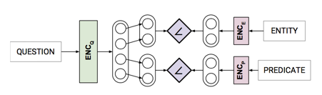
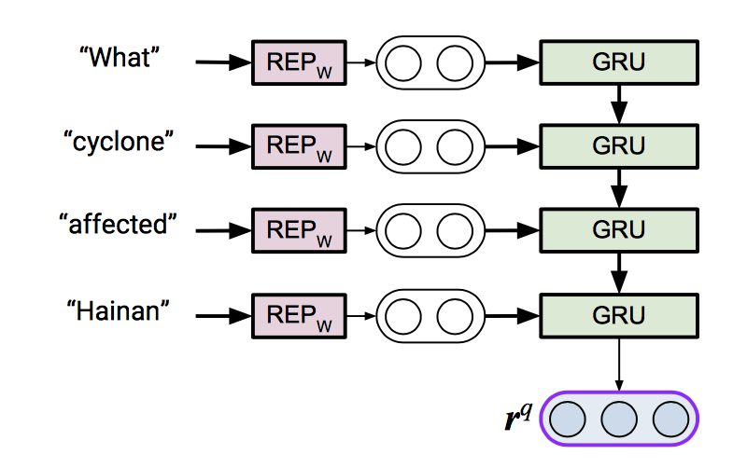

Question representation
Given a question q
“What cyclone affected Hainan?”
With C_{s} = {s₁, . . . , s_{n}} ,
C_{p} = {p₁, . . . , p_{m}}
Maps question q to r_{q} = (r_{q}^{s,} r_{q}^{r})^{T}
where r_{q}^{s,} and r_{q}^{r} subject and relation
specific encodings of the question
Notes:
So given a question q together with sets of candidate subject entities and relations respectively,
Then the model returns subject and predicate that matches the question best.
And this is done by mapping the question to the subject and relation specific encodings of the question.
So in details the question encoder first uses the word representation function to generate vector representations of all words
which are subsequently fed to the RNN until all words have been seen.
So starting with the initial hidden state the GRU updates the hidden state after processing each word and the fine hidden state
Is returned as the question representation.

Slide 11
GRU (Simplified)
softmax
C^{<t>}
= a^{<t>}
C^{<t-1>}
C^{<t>}
=a^{<t-1>}
=a^{<t>}
Ĉ^{<t>}
Γ_{u}
Ĉ^{<t> =} tanh(W_{c}[C^{<t-1>}, x^{<t>}] + bc)
tanh
σ
Γ_{u} = σ(W_{u}[C^{<t-1>}, x^{<t>}]+b_{u})
C^{<t> =} Γ_{u}*Ĉ^{<t>} + (1-Γ_{u})*C^{<t-1>}
X^{<t>}
Γ_{u}= 1
Γ_{u}= 0
Γ_{u}= 0
Γ_{u}= 0
…
C^{<t>}= 1
………………………….
= 1
The cat, which already ate …, was full.
Notes:
So given a sentence, as we read the sentence from left to right, the GRU unit is going to have a new variable called the memory cell which provides a bit
Of memory to remember for example whether a cat was singular or plural so that when it gets further into the sentence it can still tell whether the subject of
The sentence was a singular or plural.
And so at time step t the GRU will output an activation function a equivalent to the memory cell at the time step.
So these are the equations that govern the GRU unit.
At every time step, a candidate memory cell is computed as tanh of Wc a parameter to be learned, passed to the previous time step as well as the current input value plus the bias.
And the key important idea of the GRU is that we have a gate and this u stands for update gate(value between 0 – 1) which is computed with a sigmoid function
And so since we have come up with a candidate value and we are thinking of updating the memory cell C, then the gate will decide whether we update it or not
So this is the specific equation used for the GRU which is that the actual value of the memory cell is equal to this gate, times the candidate value, plus one minus the gate time the old value of the memory cell.
And the way to think about it is that may be this value of the memory cell is going to be set to 0 or 1 in other words whether the word we considering as a subject is singular or prlural.
The GRU will memorise this value all the way untill here and this tells it the word was singular.
And the Job of the gate gamma u is to decide when to up date it.
So for example if the value of the gate is equal to 1 that’s over here, set the new value of the memory cell to the candidate value, so besically go ahead and update that gate and then for all these other other values in the middle you should have the gate equal to zero and what that is saying don’t update the memory cell just hang on to the old value. So because gamma u is zero this becomes zero and 1-zero gives us the old value.
And one other equation that I did not include here is the reset/relevant gate which is used to tell how relevant is the previous memory cell to the current memory cell.

Slide 12
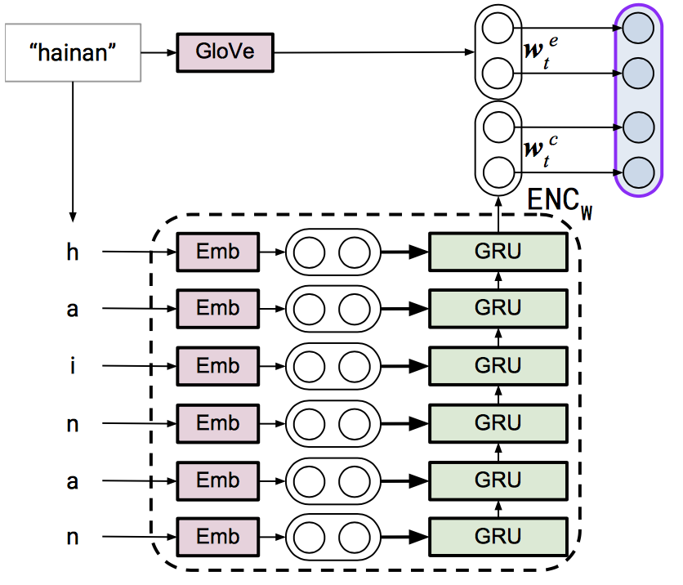
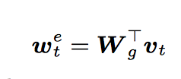


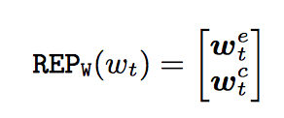
Word Representation
Notes:
In order to exploit both the word and character-level information of the question, the pre-trained word embeddings are concatenated with the RNN based encoding on character-level.
For Word embeddings Glove vectors are used, these pre-trained embeddings are based on distributional semantic hypothesis
Ie words with similar meanings occur in the same context.
These pre-trained word embeddings allow to find better matches between words in the question and subject labels or predicate URIs.
And also allows in testing to handle words that were not seen during training.
So the word embedding resulting into an e-dimensional vector representation can be described as
The provided pre-trained word embedding matrix (for vocabulary of size Vg) and the one-hot vector representation of the word.
The encoding of the character level is based on the RNN encoder and what happens inside the encoder is that the characters are first embedded by the character embedding matrix learned during training and the one-hot vector representation of the character and then the sequence of characters is fed on to the GRU network which takes its final state as the character level word encoding.
So this added character level-encoding provides information necessary for matching question words with entity labels as well as providing distinguishable representation for OOV words.
And finally to get the word vector representation, the word embedding and the character-level encoding are concatenated.

Slide 13
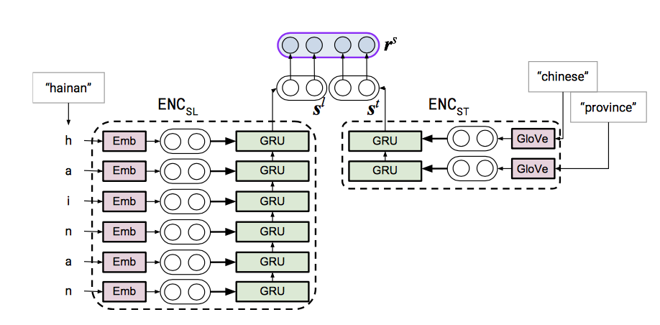
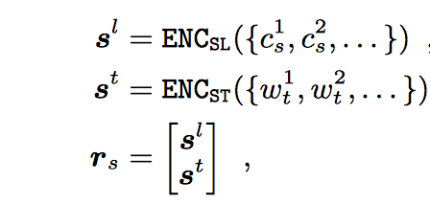
Subject Representation
“What cyclone affected Hainan?”
entity: m.0166br “Hainan”
Relation fr:meteorology/affected_area/cyclone
Notes:
So we must remember that given a question what cyclone affected Hainan? Requires finding a freebase entity representing the Chinese province Hainan and the relation or predicate.
The entity representing Hainan has the label “Hainan” and a notable type with the label chinese province.
So to build subject representation, the entity label and the type label of the entity in the knowledge graph is used.
Entity labels are encoded on character level because of the high prevalence of OOV words, on the other hand OOV words are rare in type labels and so type labels are encoded on word level.
And so the character level entity label encoding is concatenated with the word-level type label encoding to produce the subject representation vector.

Slide 14
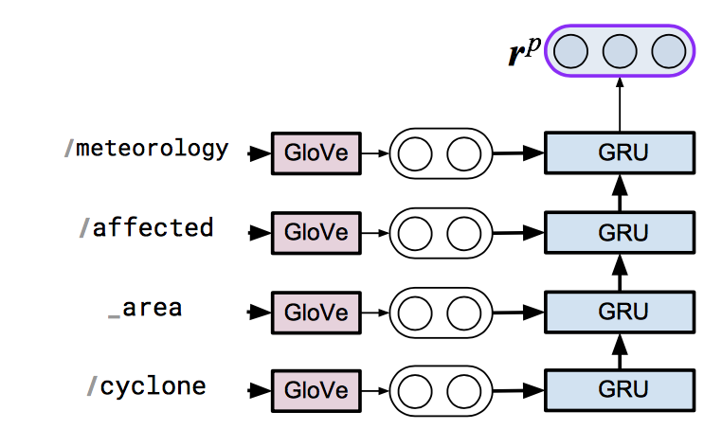

Predicate Representation
Notes:
And to build the latent predicate representation, the predicate URIs provided by the KG are used.
In this case the freebase relation provided for the question what cyclone affected Hainan?
Was meteorology affected area cyclone and so the predicate URI is first split into words and each word embedded and the word
embeddings are fed into a GRU based encoder that takes the final state as predicate representation.

Slide 15
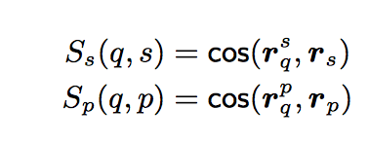

Matching Scores
NB: The model described is trained with a ranking training approach.
Notes:
So given the question encoding vector, the latent vector representation of the relation and the latent representation of the subject entity.
Two matching scores are computed;
One between the question and the subject entity
And two between the question and and predicate.
Where cos is the cosine similarity given by this equation.
And so the model is trained with a ranking training approach which drives the model to output a high score for question-entity and question
predicate pairs contained in the training set while producing lower score for implausible pairs.

Slide 16
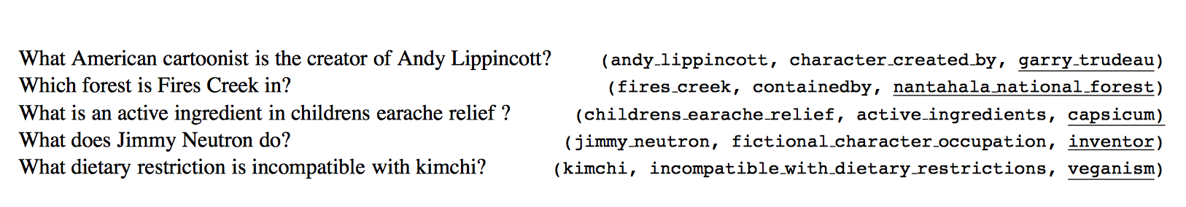
Experimental Setup
SimpleQuestions | Train_set | Valid_set | Test_set
108,442 | 70% | 10% | 20%
A. Bordes, N. Usunier, S. Chopra, and J. Weston. Large-scale simple question answering with memory networks. CoRR, abs/1506.02075, 2015.
Notes:
The model is trained on Simplequestion a dataset released by this paper in 2015. This data set consist of over 100,000 simple questions and the corresponding freebase triples providing the answer.
This is how the dataset looks like with a question and a corresponding facts.
So the questions in this dataset were written by english speaking annotators each paired with a corresponding fact from freebase.

Slide 17
Candidate Generation
Option1:
Generate subject candidates Cs
Score each entity in Cs and take top-scored one as prediction
Generate predicate candidates Cp based on the top subject entity
Score each predicate in Cp and take top-scored one as prediction
Option2:
Generate subject candidates Cs
Score each entity in Cs
Generate predicate candidates Cp based on the top subject label
Score each predicate in Cp and take top-scored one
Prune Cs based on the predicted predicate and take the top-scoring entity from
the filtered Cs as subject prediction
NB: Pruning refers to removing all entities that do not appear as subject in any of the triples in G having the predicted relation as predicate
Notes:
Two options are explored for generating predictions;
The second option allows to correct wrong subject predictions by adding a pruning step known as subject pruning.

Slide 18
Results
# Candidates | Subject pruning | Accuracy%
5 | no | 69.3
10 | no | 70.1
400 | no | 70.2
5 | yes | 70
10 | yes | 70.9
400 | yes | 71.2
#Candidates | Recall%
5 | 85.5
10 | 88.4
400 | 93.7
Table1: Candidate generation recall
for subjects over the test set
Table2: Test accuracy for different
Candidate generation settings
Notes:
Table 1 is the candidate generation recall for subjects over test set.
In this case recall is defined as the percentage of test questions for which the expected entity is retrieved during the candidate generation.
Table2: Is test accuracy for different candidate generation settings and as it can be seen pruning subjects after relation prediction provides an improvement of the model.
And it can also be seen that a larger number of candidates translates to a higher accuracy due to higher candidate generation recall.

Slide 19
Comparison
Approach | Setting | Test Accuracy
Bordes et al. [4] | end-to-end | 62.7
Yin et al. [26] | end-to-end | 68.3
Dai et al. [8] | end-to-end | 62.6
Golub and He [12] | end-to-end | 70.9
Our approach | end-to-end | 71.2
Dai et al. [8] | active linking | 75.7
Yin et al. [26] | focused pruning | 76.4
Table 3: Comparison with state-of-art systems.
Notes:
This approach achieves competitive results in an end-to-end setting. It was able to beat bordes et al. baseline results by a high margin, it outperforms the CNN-based approach of Yin et al. and manages to match and surpass the attention-enhanced encoder-decoder approach of Golub and He.
This model however was out-matched by these two approaches when they applied a separately trained segmentation model.
Now am not sure about the separate segmentation model because I have not read these two papers yet but this paper mentions that including
A similar segmentation model could improve the results.

Slide 20
Conclusion
In this article, we presented an end-to-end, neural network based approach for answering simple questions over large- scale knowledge graphs, leveraging a hierarchical word- and character-level question encoder.
We also investigate the use of type information for better subject disambiguation. While keeping the model simple by refraining from using attention mechanisms or separate segmentation models, the proposed approach achieves competitive results when compared to other end-to-end approaches.
As our model does not learn KG-specific symbol representations, we believe it to be easily portable to other knowledge graphs and suitable for KG’s that change over time (such as DBpedia Live). However, we leave an evaluation of its portability for future work.
In future work, the investigation of implicit [12] or ex- plicit [26, 8] segmentation modeling should improve subject prediction by better candidate pruning and reduce the noise for better learning of predicate patterns.

Slide 21
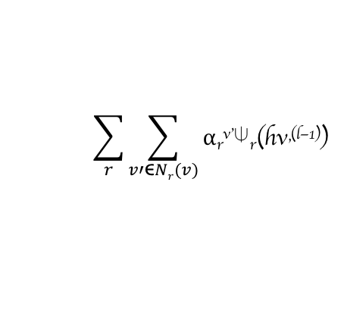
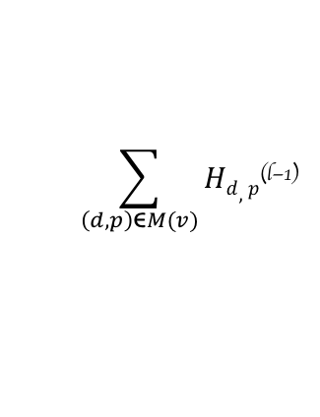
Update rule for the Model
Q. Who voiced Meg in Family Guy?
h_{q}^{(l-1)}
h_{v}^{(l-1)}
H_{d,p1}^{(l-1)} + H_{d,p2}^{(l-1)}
h_{q}^{(l-1)}
⍺_{r}^{v’}⍦_{r}(h_{v’}^{(l-1)})
$$\sum_{r}{\sum_{v′\text{ϵ}Nr(v)}{\text{⍺}\text{r}\text{v}\text{’⍦}\text{r}\text{(}\text{hv}\text{’}\text{(}\text{l}\text{−1))}}}$$
Lacey Chabert
h_{v}^{(l)} = FFN
v
$$\sum_{\left(d,p\right)\text{ϵ}M(v)}{Hd,p\text{(}\text{l}\text{−1)}}$$
_{hv’}^{(l-1)}
h_{v}^{(l-1)}
H_{d}^{(l-1)}
LSTM
CVT1
v’
….. Voiced by Lacey Chabert during …..
d
Entity Node updates
February 20, 2019
Notes:
The Graft-net model is graph based classification task and the graph consists of:
Heterogenous nodes;
Some nodes in the graph correspond to KB entities
And others correspond to textual document
And this task is also conditioned on the question

