Slide 1
A Unified Architecture for Natural Language Processing: Deep Neural Networks with Multitask Learning
Happy Buzaaba
KDE

Slide 2
Motivation
Many systems possess few characteristics that would help develop a unified architecture:
- (i) they are shallow in the sense that the classifier is often linear
- (ii) for good performance with a linear classifier they must incorporate many hand-engineered features specific for the task;
- (iii) they cascade features learnt separately from other tasks, propagating errors

Slide 3
Motivation
The objective of this paper is to define a unified architecture for Natural Language Processing
- Learn features that are relevant to the task at hand given very limited prior knowledge
- achieved by training a deep neural network, building upon work by (Bengio and Ducharme, 2001) and (Collobert & Weston, 2007)
All the tasks except the language model are supervised tasks with labelled training data. The language model is trained in an unsupervised fashion on the entire Wikipedia website. That is Semi-supervised learning.

Slide 4
Motivation
Multitask Learning: Learn features from one task and use them as features from another task.
Include shared parameter, sharing hidden nodes or creating a common set of features.

Slide 5
NLP Tasks in this paper
Part-of-Speech Tagging (POS): syntactic roles (noun, adverb)
Chuncking: syntactic constituents (noun phrase, verb phrase…)
Name Entity Recognition (NER): person/company/location
Semantic Role Labeling: giving a semantic rile to a syntactic constituent of a sentence.
Language Models: A language model traditionally estimates the probability of the next word being w in a sequence.
Semantically Related Words: Predicting whether two words are semantically related (synonyms, holonyms, hypernyms…)

Slide 6
Multitask Learning in NLP
Cascading Features: The most obvious way to achieve MTL in NLP
Train one task and use it as features for another task.
Shallow joint training
- Hand-craft features, train on all task at the same time. Crf and statistical parsing models for POS, NER, chunking and relation extraction. Problem: joint labeling requirement
- Learn independently by using different sets but leveraging predictions jointly. Problem: Not using shared tasks at training
- SRL by joint inference and semantic parsing. Problem: Not state of the art

Slide 7
Multitask Learning in NLP
Multitask Learning: Learn features from one task and use them as features for another task.
Include shared parameter, sharing hidden nodes or creating a common set of features.
Cascading Features: Good or bad? Error propagation, extract hand made feature for each task.
How about an End-to-END system that learns features completely implicitly? That is the motivation of this paper.

Slide 8
The Most Intuitive Way
Craft a Deep Architecture
Blah Blah Blah
Feature Space 1
Embedding
Local features
Global Features
Feature Space 2
Tags
Train everything by back-propagation. (End-to-End)

Slide 9
How the system evolves?
Train all tasks jointly
Blah Blah Blah
Sharing part
Embedding
Local features
Local features
Local features
Global Features
Global Features
Global Features
Tags
Tags
Tags
Can gain performance on all tasks and fully exploits the potentials of the shared features.

Slide 10
The implementation of the intuitive way
Input Sentence
Text the cat sat on the
Word of interest
Blah Blah Blah
indices
S(1)s(2)s(3)s(4)s(5)
Lookup Table
LT_{w}
Word of interest Mapping
Embedding
Feature vectors of size defined a priori
HardTanh
Linear
Concatenating feature vectors and feed to NN
Global features
HardTanh
Problem: For SRL to tag a word such as a verb, full sentence must be seen at the same time. The higlight of this paper, solves this problem
Linear
Softmax
Tags

Slide 11
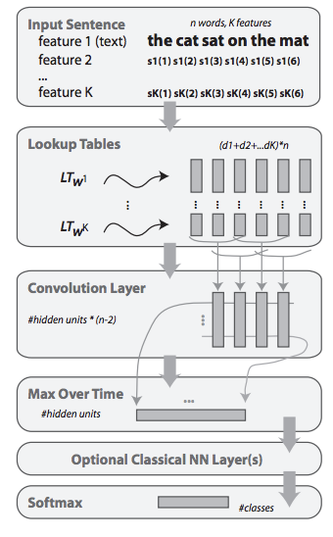
The General Deep NN Architecture

Slide 12
How to represent a word using a common way
The first layer has to map words into real-valued vectors for processing by subsequent layers.
Each word is embedded into a d-dimensional space using a lookup table:
LT_{w}(i) = W_{i.} i ∈ D
It considers words as indices in a finite dictionary of words D.
W is a matrix of parameter to be learnt and its size dX|D|. W_{i} is the i^{th} column of W and d is the word vector size (wsz) to be chosen by the user.
An input sequence S₁, …, S_{n} of n words in the dictionary D is transformed into a sequence of vectors W_{s1}, …, W_{sn}
Pre-processing, eg. Steming, lower case, capitalization as a new feature.

