Slide 1
Q
A
Simple Question Answering
(Presented by Happy Buzaaba)

Slide 2
Outline
Q
A
Introduction
Task definition
Approach
Different Methods
Conclusion

Slide 3
Approach
Q
A
Decomposing the QA problem into different Components
Entity detection
Entity Linking
Relation Prediction
End-to-end evidence integration

Slide 4
Entity detection
Q
A
Methods
CRF
LSTM
LSTM-CRF
Data sets
Annotated Corpus for NER (Kaggle)
Twitter Dataset (Recognizing NE on Twitter)
Simple Questions Dataset

Slide 5
Conditional Random Field (CRF)
Q
A

Slide 6
Introduction
Q
A
Definition (Open Domain QA)
The task to automatically answer questions asked in natural language on any topic or in any domain.
Look up in large scale structured knowledge bases (KBs)
Two main approaches:
- Semantic parsing (Berant et al., ‘13; Berant and Liang ’14)
Information retrieval (Yao and Van Durme, ‘14)
A lot of human supervision involved: grammars, lexicon, KB schema …
Notes:
Presents a system which learns to automatically answer questions from any topic or domain based on large scale knowledge bases.
The Open domain QA task can be classified into two main classes:
- Semantic parsing based: which focuses on the correct interpretation of the meaning of the question by semantic parsing and some work has been done by
Information retrieval based : which first retrieve a broad set of candidate answers by querying the search API of KBs and then uses fine grained heuristics to identify the exact answer.
The above approaches have shown ability to handle large scale KBs, but they still involve a lot hand-crafting of grammars, lexicon to be effective.

Slide 7
Introduction
Q
A
Embedding model
The system learns representations as low-dimensional vectors of words and KBs constituents
Main contribution:
richer representation of the answers which encodes QA path and surrounding Subgraph of the KB)
More sophisticated inferences approach that is both efficient and can consider longer paths
Notes:
This paper presents an embedding model which learns representations as low dimensional vectors of words and KBs elements.
The main contributions of this paper is the representation of answers which encodes the question answer path and the surrounding subgraph of the KB.
It requires less human supervision
It also has the ability to answer more complicated questions
And a more sophsiticated inference procedure that is both efficient and consider longer paths.

Slide 8
Outline
Q
A
Introduction
Task definition
Embedding Questions and Answers
Experiments
Conclusion

Slide 9
Task Definition
Q
A
FREEBASE
Based on freebase as the KB of general facts
Database of 14million triplets:
Subject
Object
Connected by type1.type2.predicate
Automatically turned into question answer pairs for training:
“What is the predicate of the type2 subject? (object)”
“What is the nationality of the person Baraka_Obama? (United_states)”
Notes:
The datasets used in this paper were based on freebase as the knowledge base of facts
since triple structure doesn't correspond to any structure one could find in language the triples are automatically turned into question answer pairs for training.

Slide 10
Task Definition
Q
A
WEBQUESTIONS
Dataset of 5,810 question answer pairs built from FREEBASE
Questions from: Google suggest
Answer from:
One freebase entity identified from (natural) question using string matching:
“What degrees did Baraka Obama get? (bachelor_of_arts, juris_doctor)”
Notes:
Webquestions is one of them,
It was created by crawling questions from Google suggest API and answers from amazon mechanicalturk
All answers are defined as freebase entities and one freebase entity was identified in each question using string matching
Between words of the question and entity names in Freebase.
When the same string matches multiple entities only the most popular entity is kept.
here is the example of questions

Slide 11
Task Definition
Q
A
CLUEWEB
- Provided by (Lin et al., ’12)
2 million extractions
(Subject, “text string”, object)
“Where Baraka Obama was allegedly bear in? (Hawaii)”
Notes:
Another dataset used is ClueWeb introduced by Lin et al, this was used because Freebase questions have a fixed lexcon and vocaburaly
So to counter this Clueweb was used and using string matching 2m triple extractions were generated with both subject and object linked to freebase.
And these triples were converted into questions using simple patterns and freebase types. An example is:
It was created by crawling questions from Google suggest API and answers from amazon mechanicalturk
All answers are defined as freebase entities and one freebase entity was identified in each question using string matching
Between words of the question and entity names in Freebase.
When the same string matches multiple entities only the most popular entity is kept.
here is the example of questions

Slide 12
Task Definition
Q
A
Paraphrases
There are some issues with automatically generated questions:
semi-automatic wording
rigid syntax
often unnatural
Pairs of question paraphrases:
On WIKIANSWERS (users have options to tag rephrasing's of questions)
2 million distinct questions
350,000 paraphrase clusters
Notes:
The automatically generated questions to connect freebase triples and natural language, do not provide satisfactory modeling
Of natural language because of their semi-automatic wording and rigid syntax.
So the training data is supplemented by an indirect supervision signal made of pairs of question paraphrases collected from WIKIANSWERS website
This was introduced by Feder et al., ‘13

Slide 13
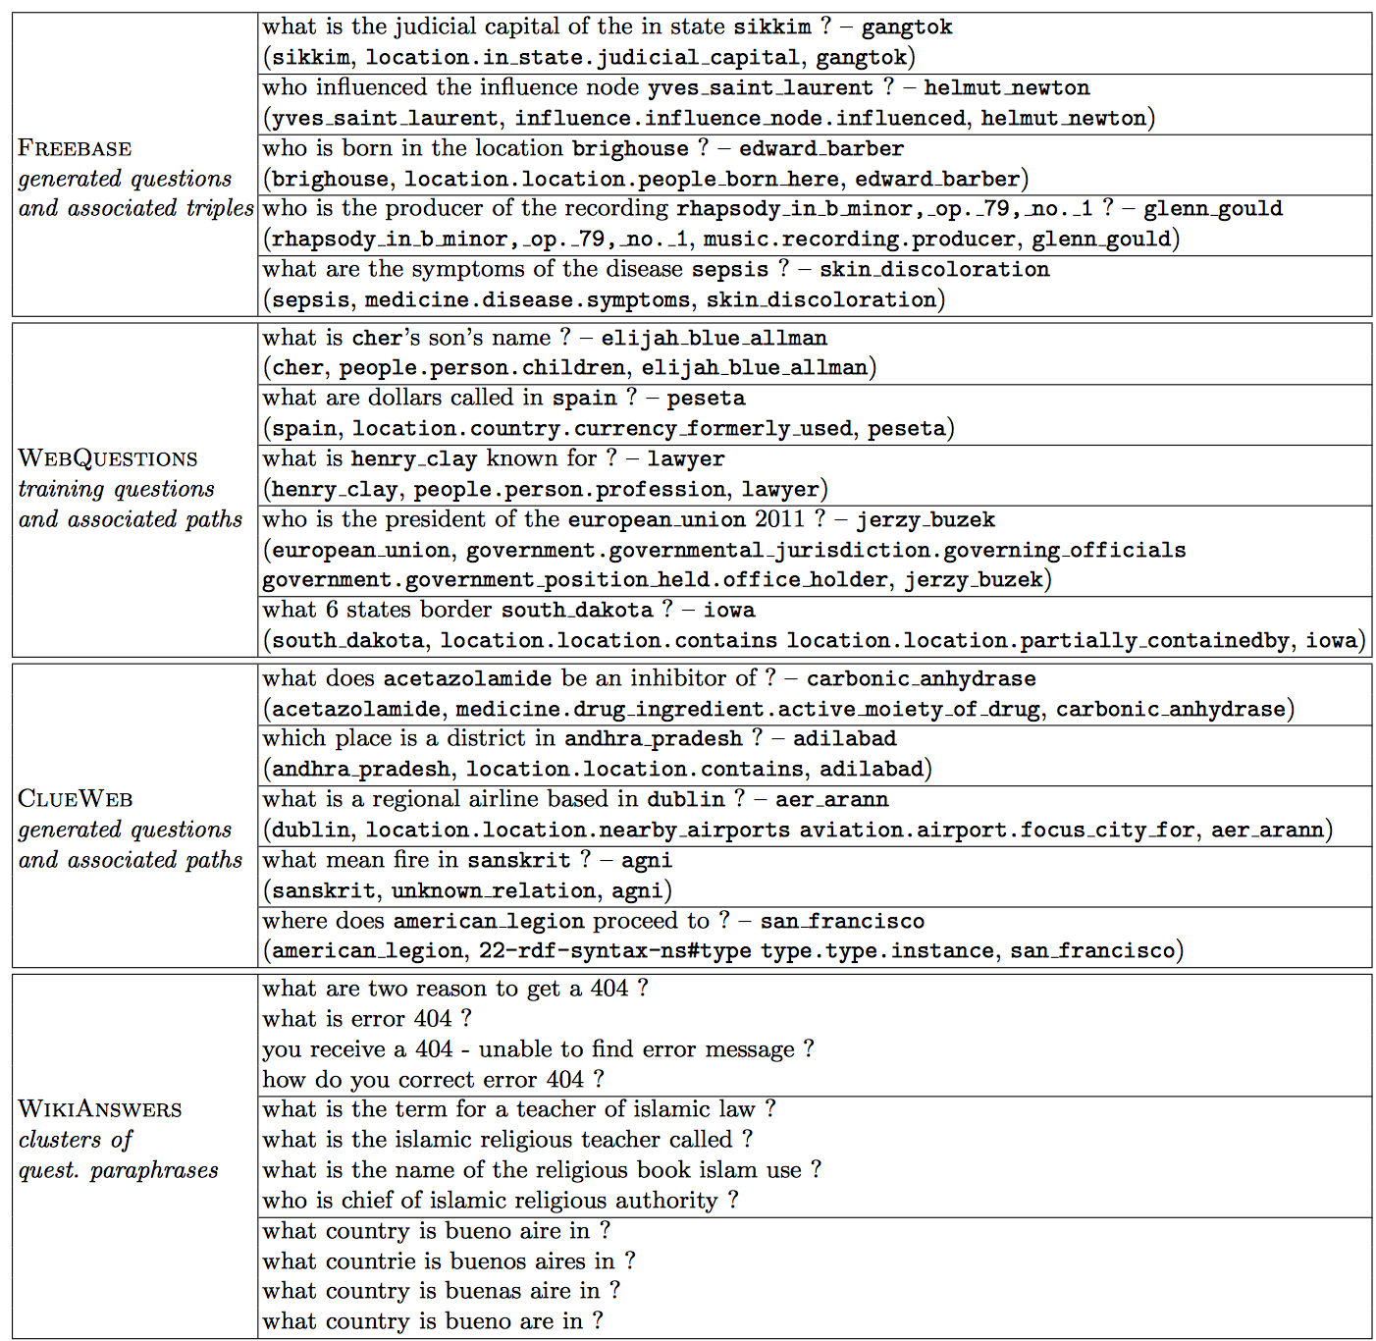
Task Definition
Q
A
Examples of questions, answer paths and paraphrases used
Notes:
The automatically generated questions to connect freebase triples and natural language, do not provide satisfactory modeling
Of natural language because of their semi-automatic wording and rigid syntax.
So the training data is supplemented by an indirect supervision signal made of pairs of question paraphrases collected from WIKIANSWERS website
This was introduced by Feder et al., ‘13

Slide 14
Outline
Q
A
Introduction
Task definition
Embedding Questions and Answers
Experiments
Conclusion

Slide 15
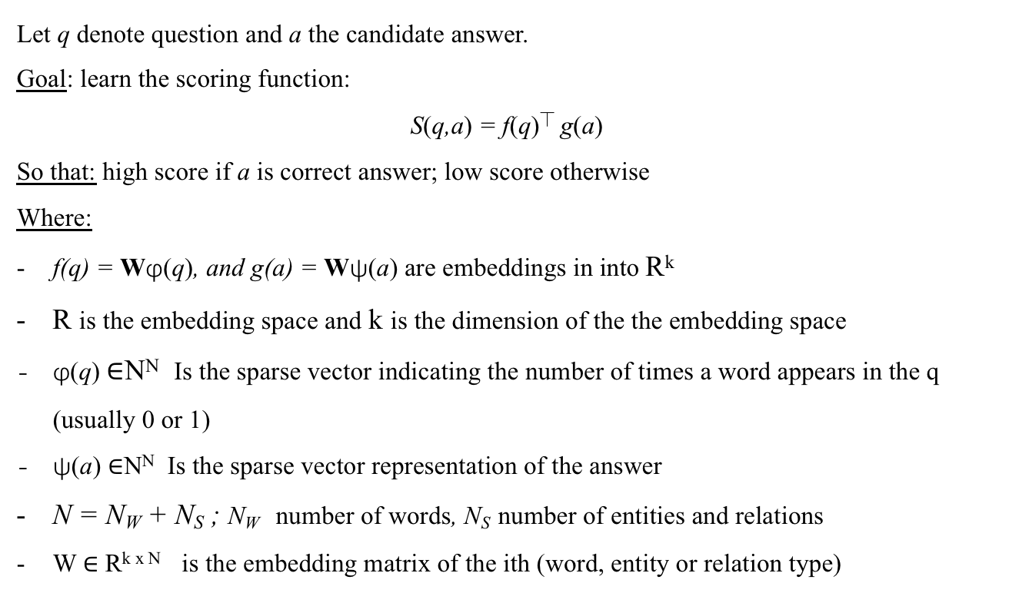
Embedding questions and answers
Q
A
Scoring function
Let q denote question and a the candidate answer.
Goal: learn the scoring function:
S(q,a) = f(q)⏉ g(a)
So that: high score if a is correct answer; low score otherwise
Where:
f(q) = Wφ(q), and g(a) = Wψ(a) are embeddings in into R^{k}
R is the embedding space and k is the dimension of the the embedding space
φ(q) ∈N^{N} Is the sparse vector indicating the number of times a word appears in the q (usually 0 or 1)
ψ(a) ∈N^{N} Is the sparse vector representation of the answer
N = N_{W} + N_{S} ; N_{W} number of words, N_{S} number of entities and relations
W ∈ R^{k x N} is the embedding matrix of the ith (word, entity or relation type)
Notes:
Learning embeddings is achieved by learning a scoring function S(q,a)

Slide 16
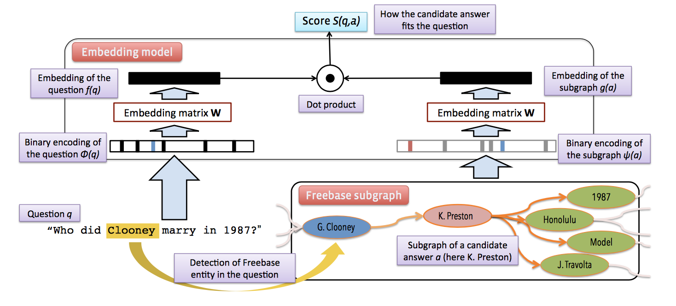
Embedding questions and answers
Q
A
Over view
Notes:
Learning embeddings is achieved by learning a scoring function S(q,a)

Slide 17
Embedding questions and answers
Q
A
Representing Candidate answers
- Single-entity:
1-of- N_{S} coded vector with 1 corresponding to the entity of the answer and 0 else where
Path representation:
3-of- N_{S} or 4-of- N_{S} 1-hop or 2-hop path from question entity to answer entity using relation type (but not entities) in between.
Example: (baraka_obama, people.person.place_of_birth, honololu)
(baraka_Obama, people.person.place_of_birth, location.location.containedby, Hawaii)
Subgraph representation:
Path representation + the entire subgraph of entities connected to the candidate answer entity
Double the size of entities and relations N = N_{W} + 2N_{S}
Notes:
Learning embeddings is achieved by learning a scoring function S(q,a)

Slide 18
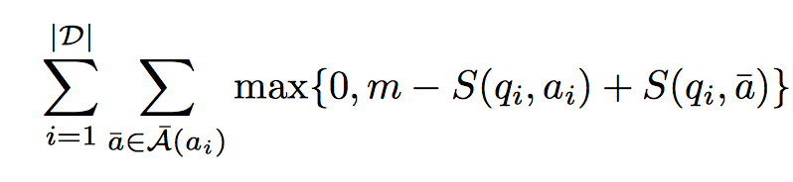

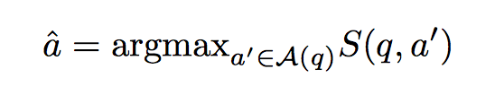
Embedding questions and answers
Q
A
Training and Ranking the Loss Function
Let D = {(qi, ai) : i = 1, ….|D|} be the training set of QA pairs.
Goal: minimize
So that: the score of a question paired with a correct answer is greater than with any incorrect answer by at least m. m is the mergin (fixed to 0.1)
Inference:
Trained model predicts the answer by;
Where Aq is the candidate answer set for each question chosen as;
Whole KB (slow and implicise!)
C₁ Only freebase triplates involving the question entity
C₂ additional triplates (neighbors of neighbors to the question entity)
Notes:
Learning embeddings is achieved by learning a scoring function S(q,a)

Slide 19
Outline
Q
A
Introduction
Task definition
Embedding Questions and Answers
Experiments
Conclusion

Slide 20
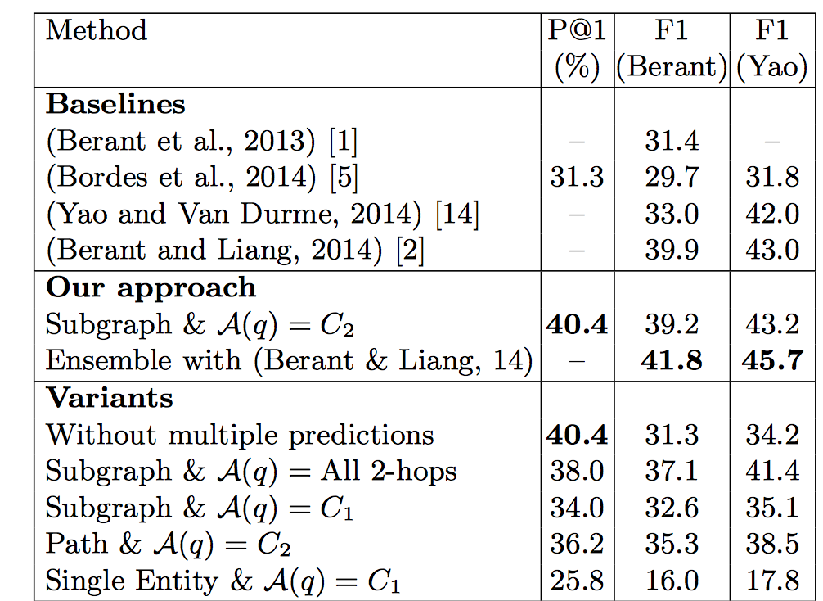
Experiments
Q
A
Results on WEBQUESTIONS test set

Slide 21
Conclusion
Q
A
Training uses only QA pairs and KB
Low-dimension embeddings
Exploiting richer structure of the answers, which is provided by their local neighborhood in the knowledge graph
Promising performance of the WEBQUESTIONS
Notes:
Learning embeddings is achieved by learning a scoring function S(q,a)

Slide 22
Thank you
Time for human Question Answering! 😉

