Slide 1



בס"ד
סביבת וריפיקציה
Functional Verification Environment
פרויקט גמר
2016/2017
בת ציון ניסנבוים

Slide 2

בס"ד

Slide 3
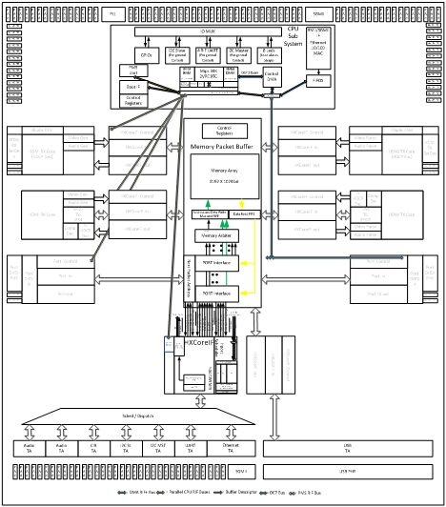
בס"ד
VS3000

Slide 4


Slide 5

בס"ד
We Have so Many Cables
Just Cables, Cables, Cables Everywhere

Slide 6
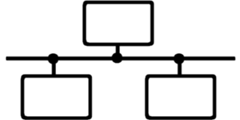


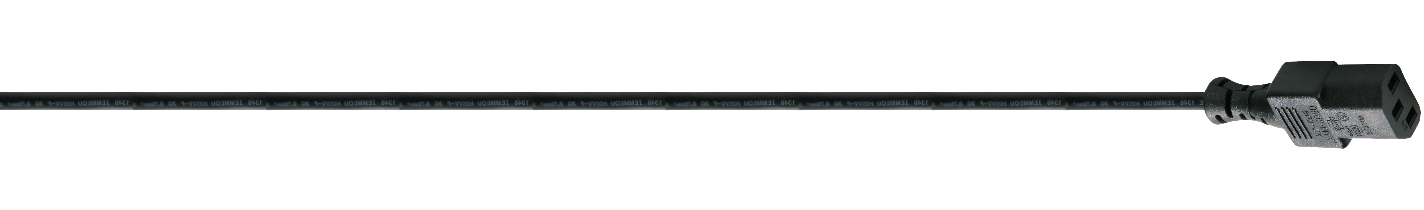



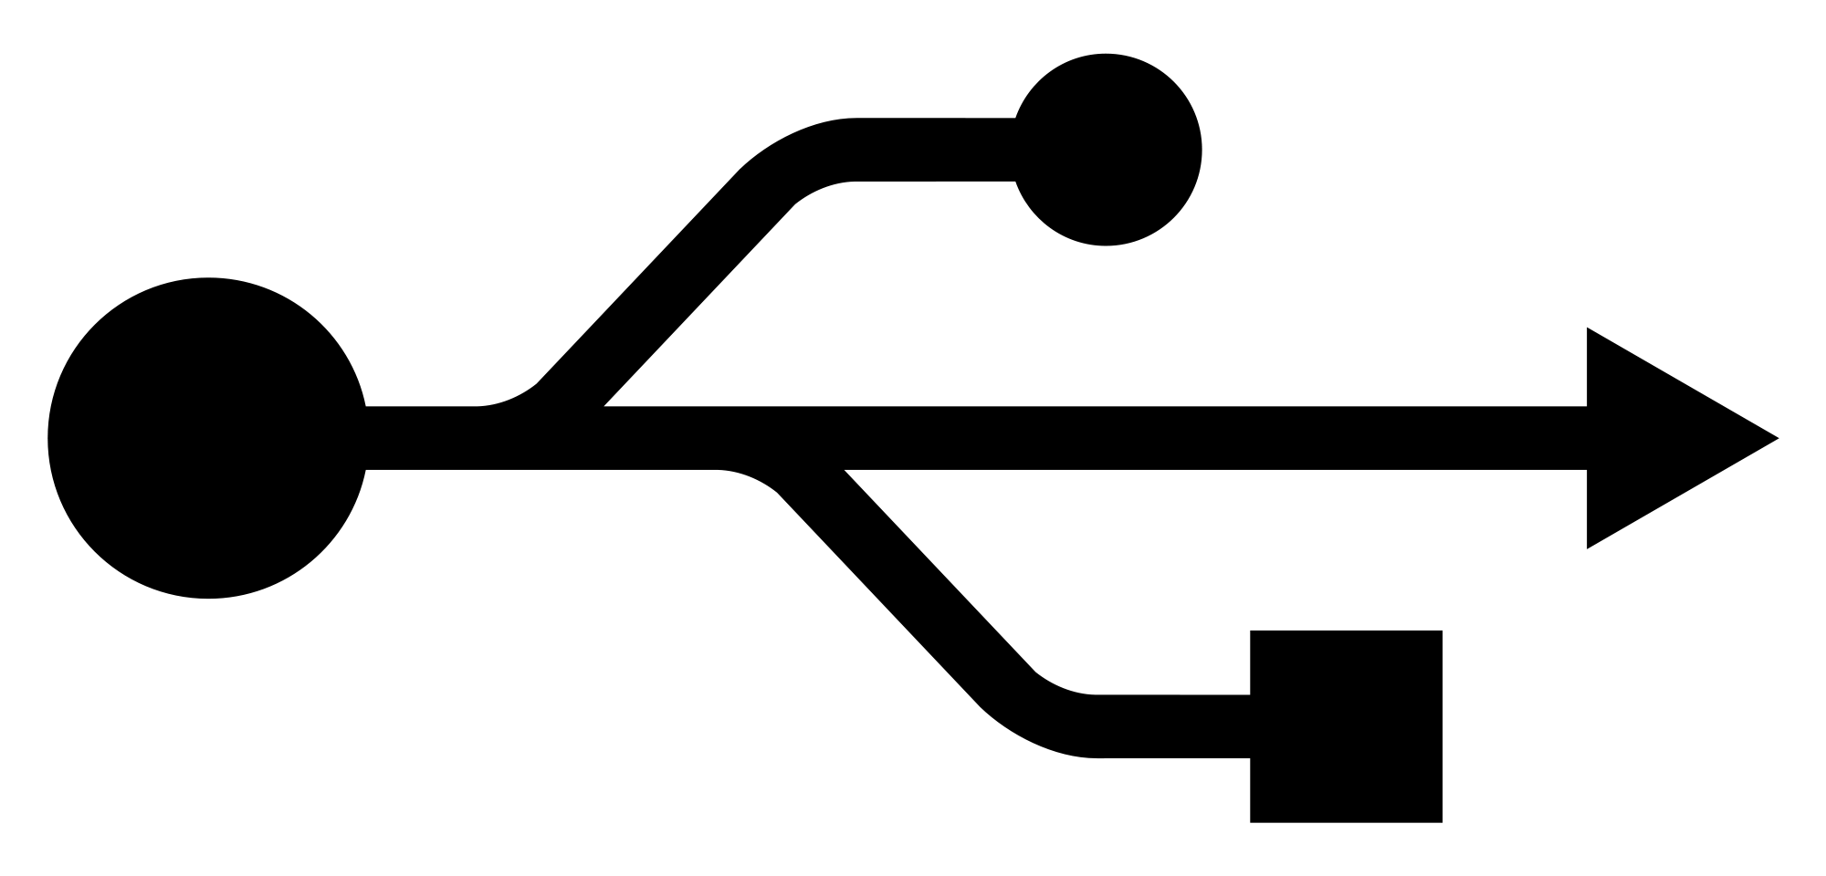
בס"ד

Slide 7

בס"ד

Slide 8
בס"ד
The New Standard of Digital Connectivity
On the Ultimate Cable

Slide 9
בס"ד

Slide 10



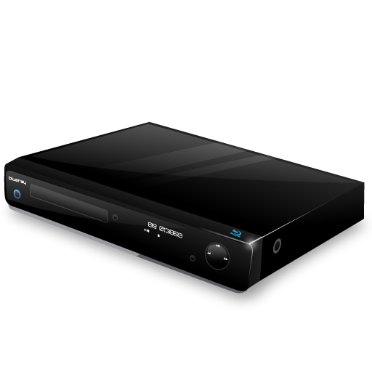
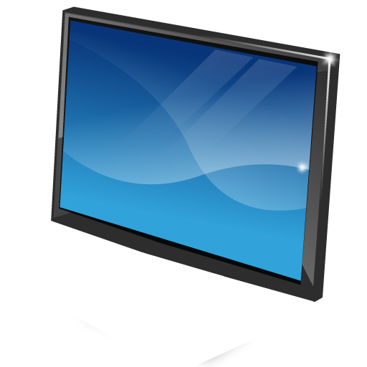
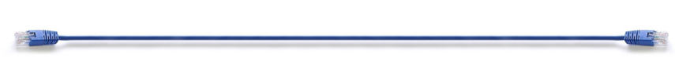
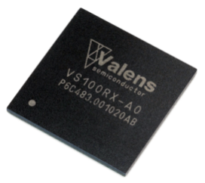



5Play™ Over a Single Cable
בס"ד
Video
Ethernet
Power
HDBaseT
Source
HDBaseT
Display
100m/328ft Cat5e Cable
Audio
Control
HD Video, Audio, Ethernet, Power and Controls on 100m LAN Cable

Slide 11
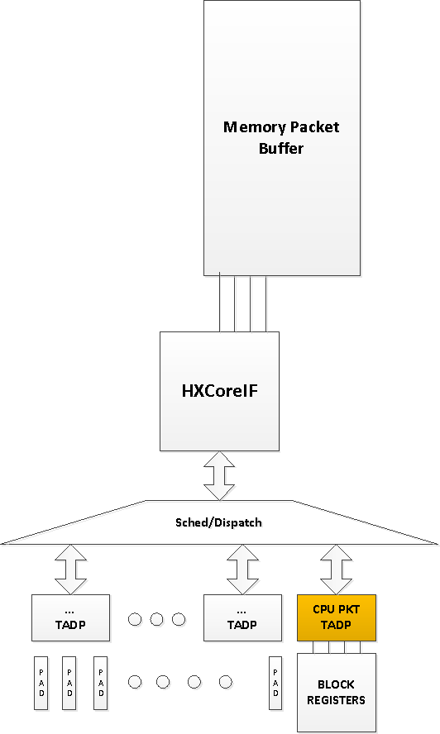
בס"ד
CPU_PKT_TADP

Slide 12
בס"ד
CpuPktTadp – Block Diagram

Slide 13
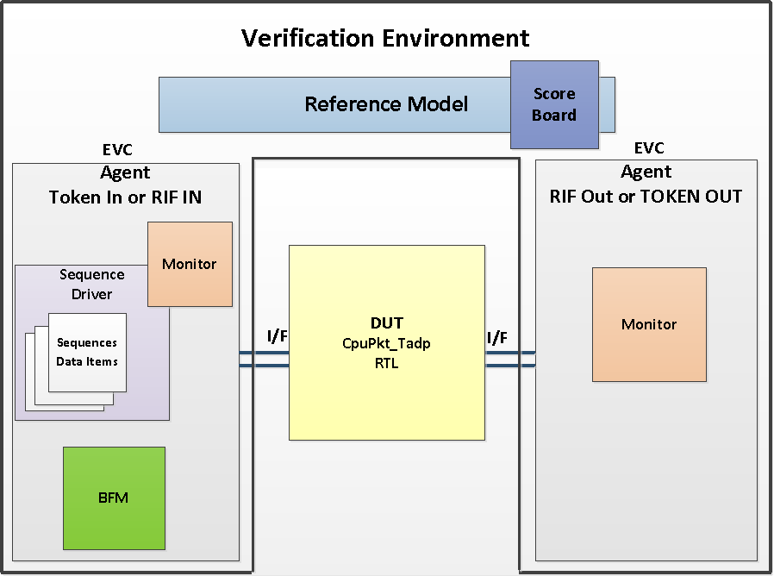
בס"ד

Slide 14
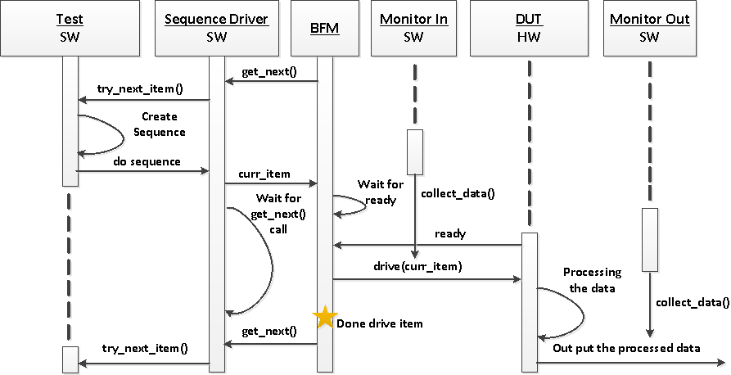
בס"ד
The Verification Process

Slide 15
בס"ד
Main challenges in my project…
Understanding the verification process.
Learning the verification environment,
and how to develop a new one.
Introducing the CpuPkt_Tadp:
Protocols
Requirements
Synchronization with clock
and times.
Interface

Slide 16
בס"ד
Thank you
For your attention…

