Slide 1
Untitled

Slide 2
Quarto
Quarto enables you to weave together content and executable code into a finished document. To learn more about Quarto see https://quarto.org.

Slide 3
Running Code

Slide 4
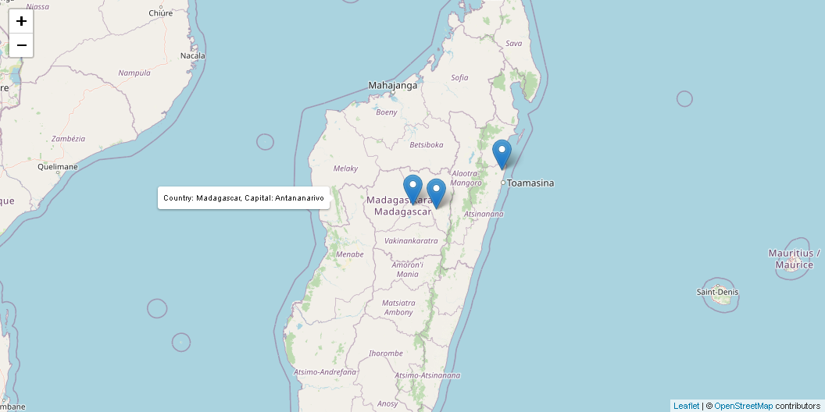
interactive map

Slide 5
The echo: false option disables the printing of code (only output is displayed).

Slide 6
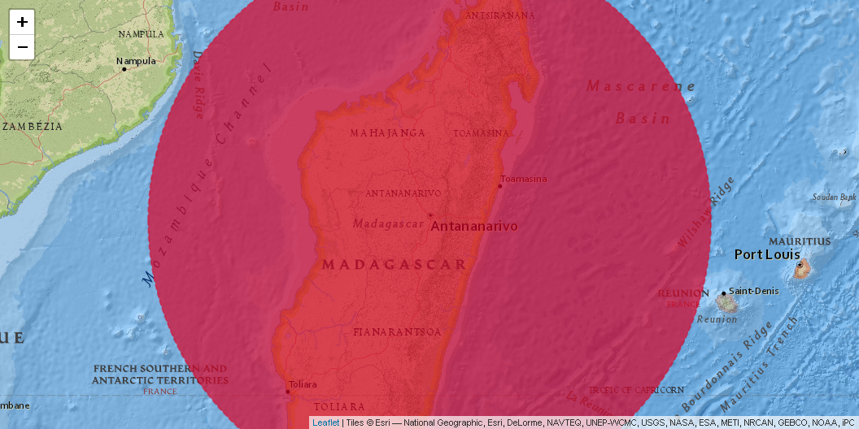
Scope of Madagascar

Slide 7
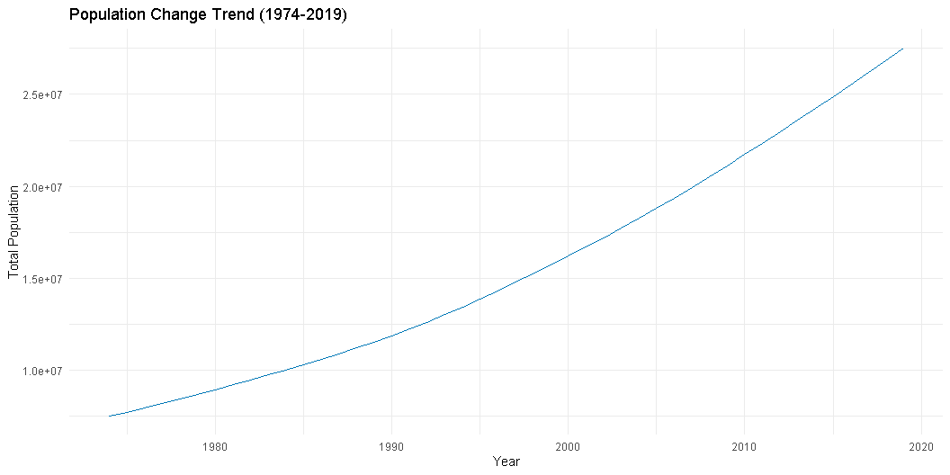
Economic and demographic analysis

Slide 8
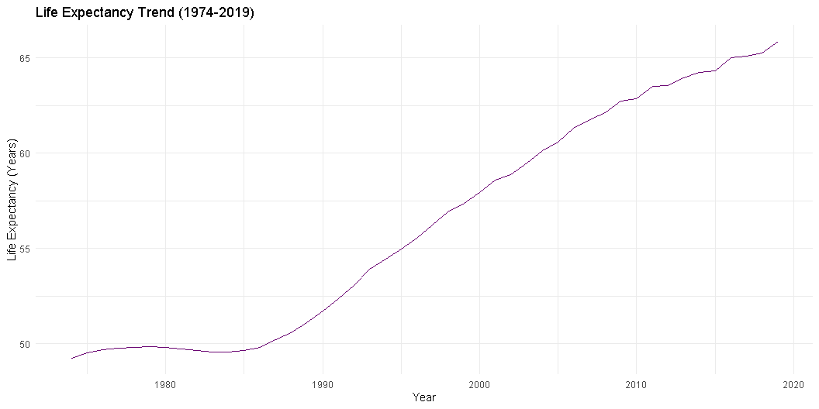

Slide 9
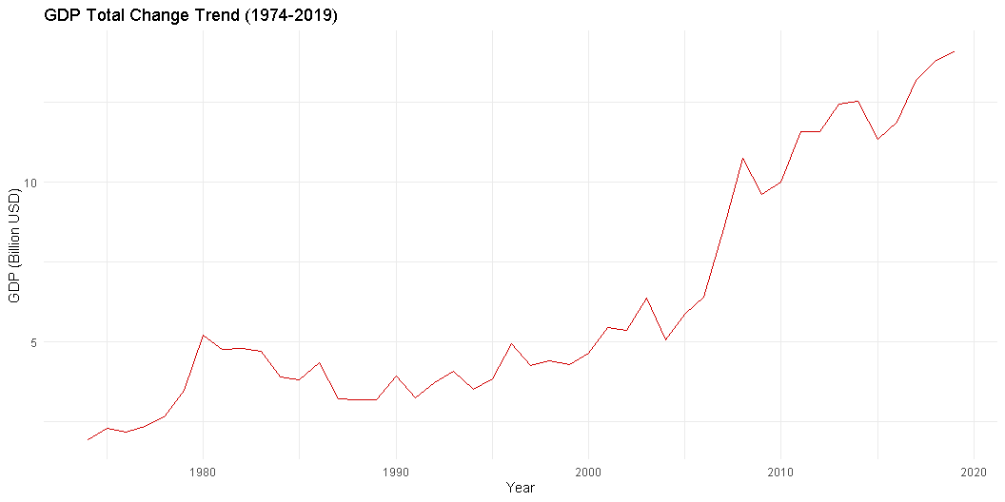

Slide 10
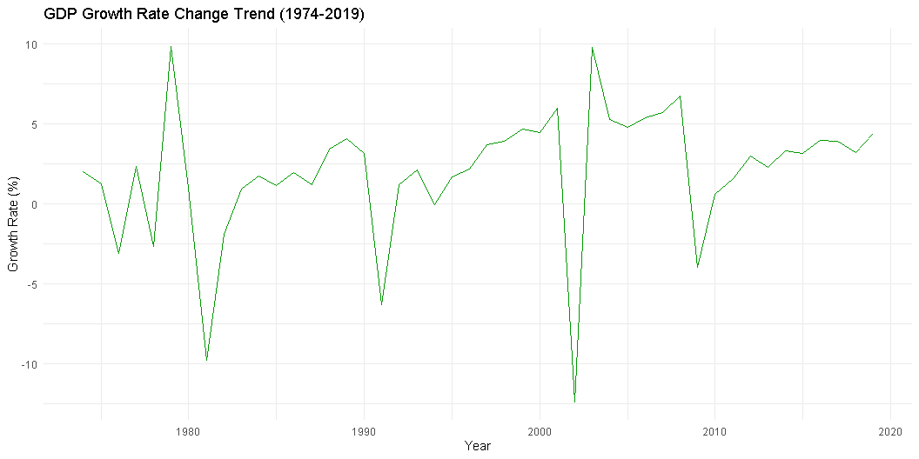

Slide 11
