Slide 1
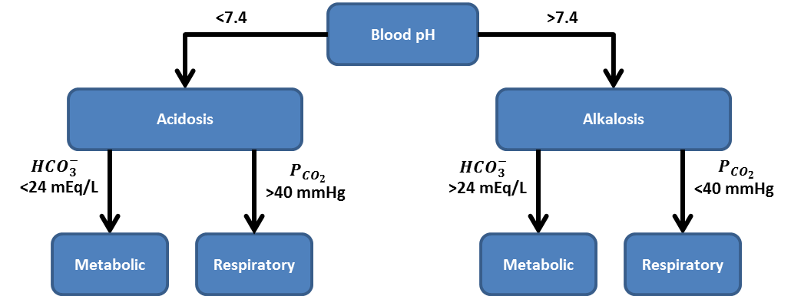




Low
Blood pH
High
Acidosis
Alkalosis
$$HCO_{3}^{−}$$
Low
$$P_{CO_{2}}$$
High
$$HCO_{3}^{−}$$
High
$$P_{CO_{2}}$$
Low
Metabolic
Respiratory
Metabolic
Respiratory

Slide 2
O₂
CO₂
Pulmonary
Veins
Arteries
Capillaries
CO₂
O₂

