Slide 1
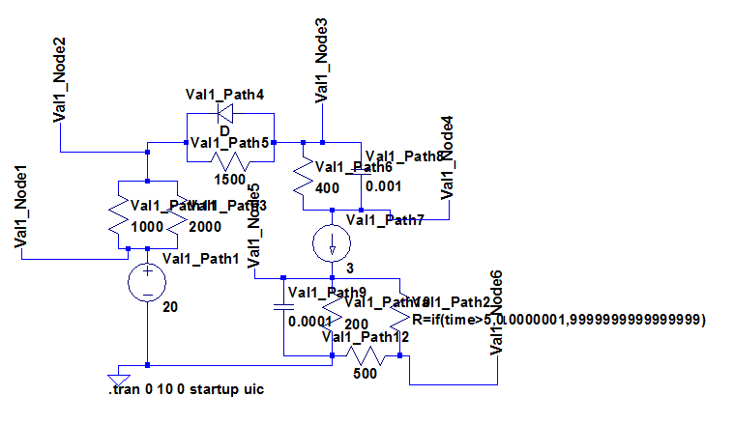
ValidationComprehensive1

Slide 2
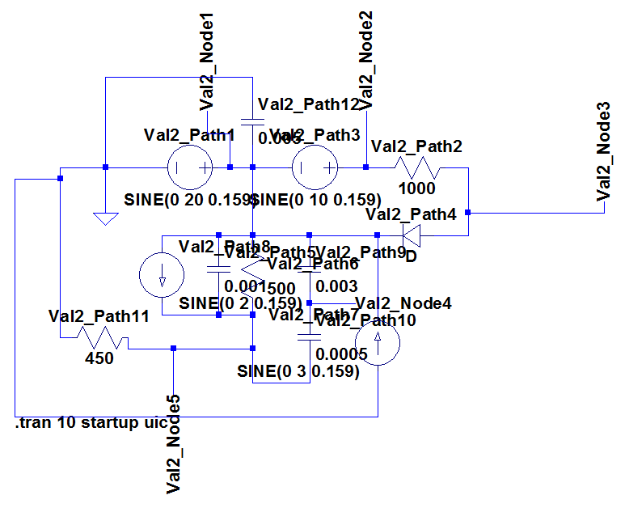
ValidationComprehensive2

Slide 3





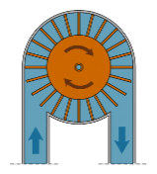
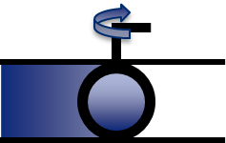

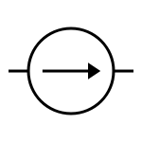

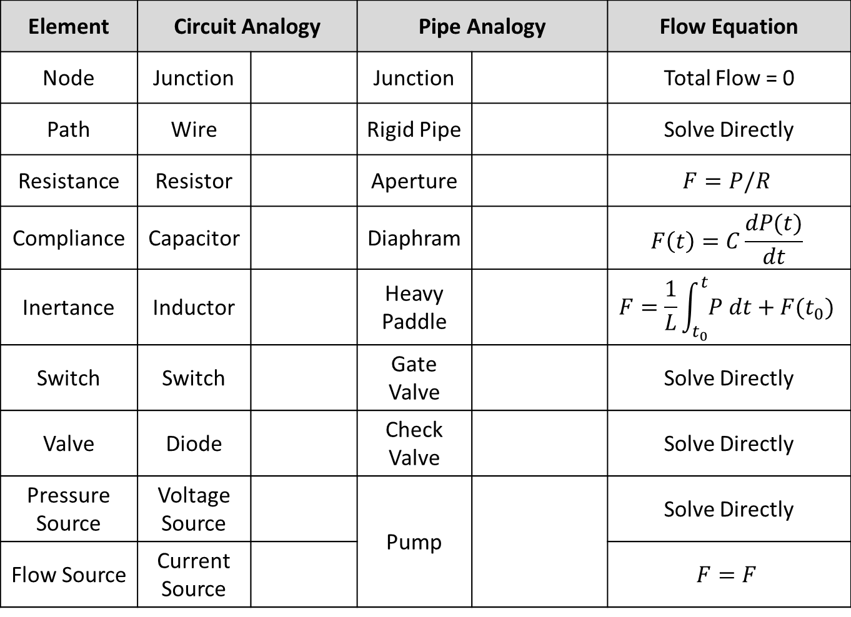
Element | Circuit Analogy |  | Pipe Analogy |  | Flow Equation
Node | Junction |  | Junction |  | Total Flow = 0
Path | Wire |  | Rigid Pipe |  | Solve Directly
Resistance | Resistor |  | Aperture |  | $$F=P/R$$
Compliance | Capacitor |  | Diaphram |  | $$F\left(t\right)=C\frac{dP(t)}{dt}$$
Inertance | Inductor |  | Heavy Paddle |  | $$F=\frac{1}{L}\int_{t_{0}}^{t}{P dt}+F(t_{0})$$
Switch | Switch |  | Gate Valve |  | Solve Directly
Valve | Diode |  | Check Valve |  | Solve Directly
Pressure Source | Voltage Source |  | Pump |  | Solve Directly
Flow Source | Current Source |  |  |  | $$F=F$$

Slide 4
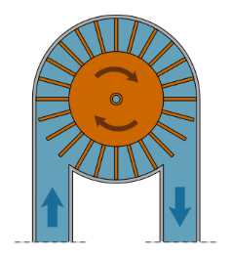





Slide 5
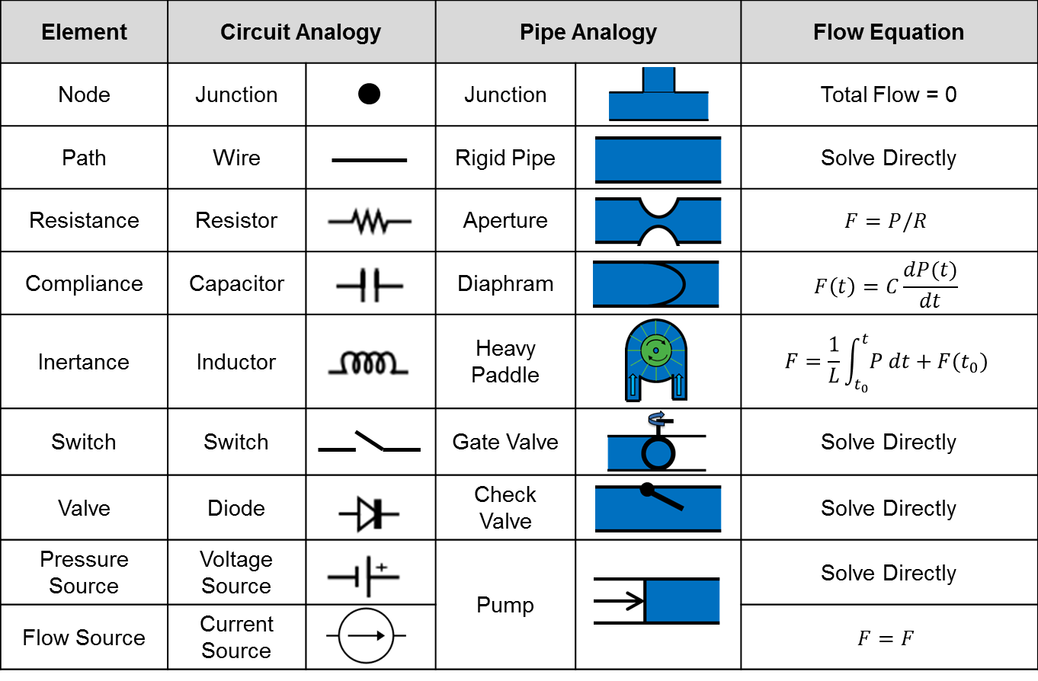

Slide 6
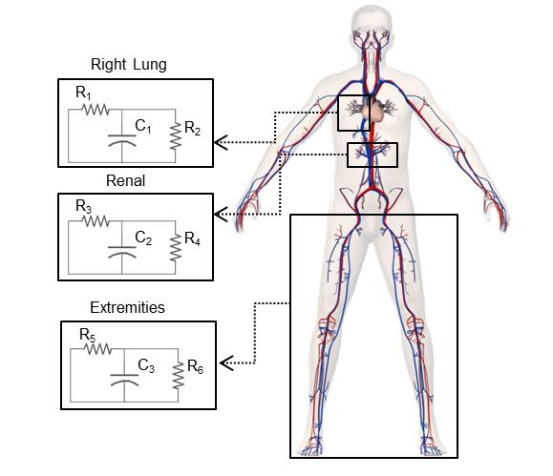
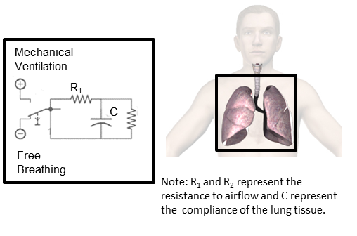

Slide 7
Legend:
Node
Path
Element

Slide 8
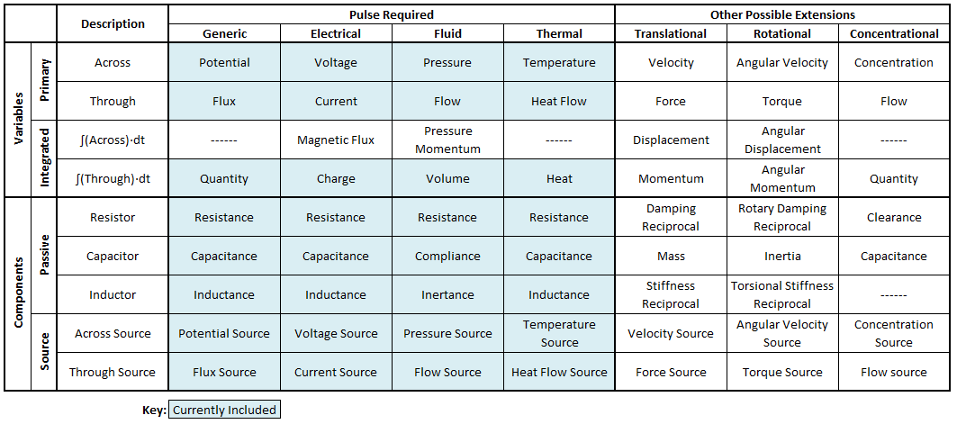

Slide 9
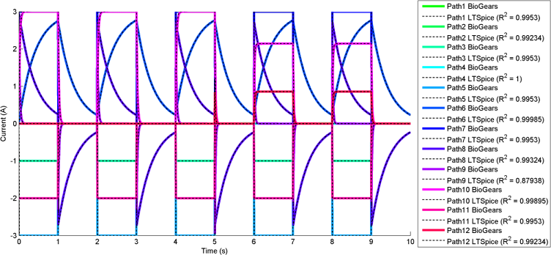
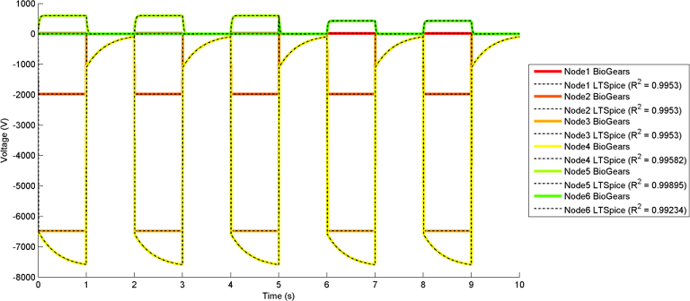
Pulse
Pulse
Pulse
Pulse
Pulse
Pulse
Pulse
Pulse
Pulse
Pulse
Pulse
Pulse
Pulse
Pulse
Pulse
Pulse
Pulse
Pulse

Slide 10
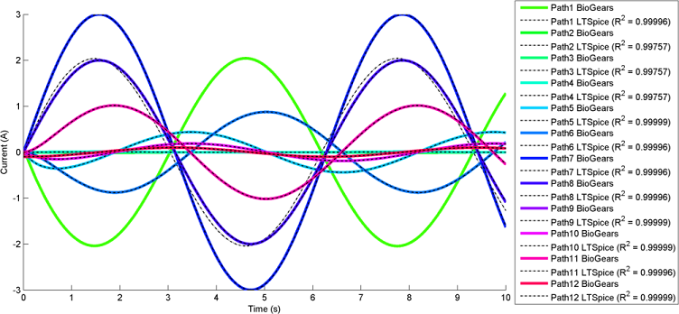
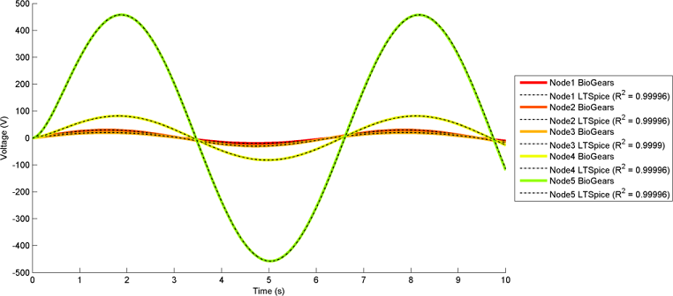
Pulse
Pulse
Pulse
Pulse
Pulse
Pulse
Pulse
Pulse
Pulse
Pulse
Pulse
Pulse
Pulse
Pulse
Pulse
Pulse
Pulse

Slide 11
Solve
New
Time-Step
Parse In
Input Matrix Equation
Compute SparseLU
Modify Nonlinear States
Solve
Good Solution?
Yes
No
Parse Out
Compute FullPivLu
Calculate Fluxes
Good Solution?
Yes
Return Result
No
Pass Nonlinear Check?
Compute Direct Solution
No
Yes
Good Solution?
Advance Time
Calculate Quantities
Log Error
No
Yes

Slide 12
Source Node
Black Box Element
Target Node
Black Box Boundary
Source Node/Potential
Source Path/Flux
Target Path/Flux
Target Node/Potential
Middle (Internal) Node/Potential/Quantity

Slide 13
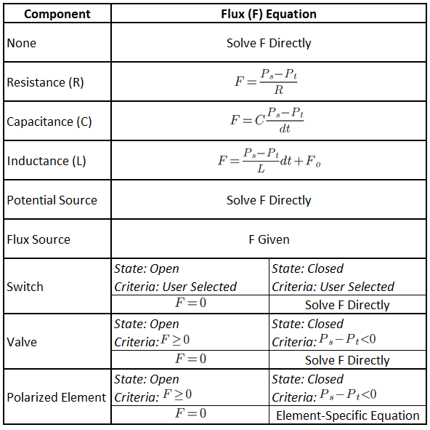

Slide 15
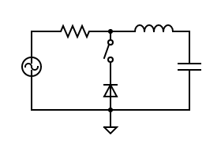
.
P2
P3
.
N1
N2
N3
.
P5
P1
P4
N4
P6
Ground

Slide 16
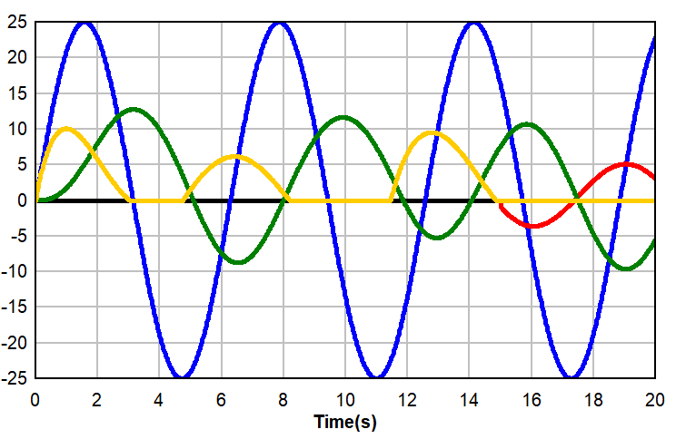
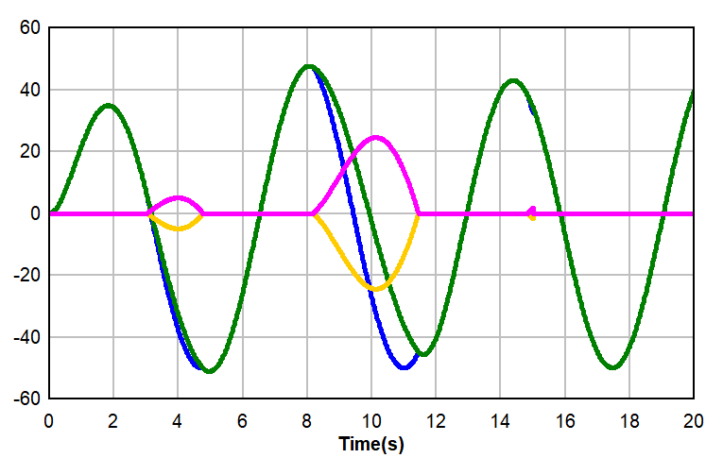
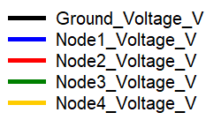
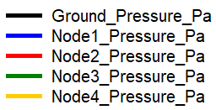
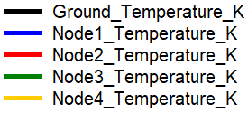
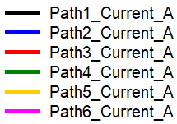
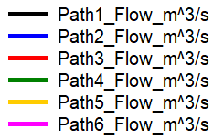
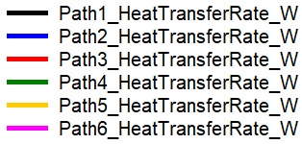
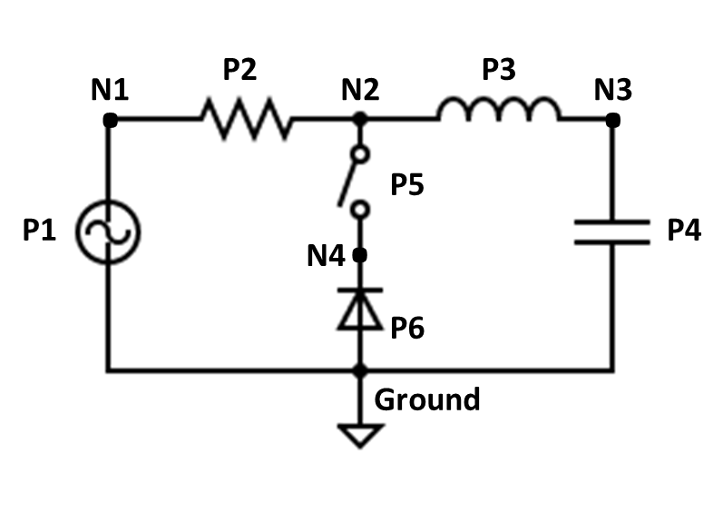
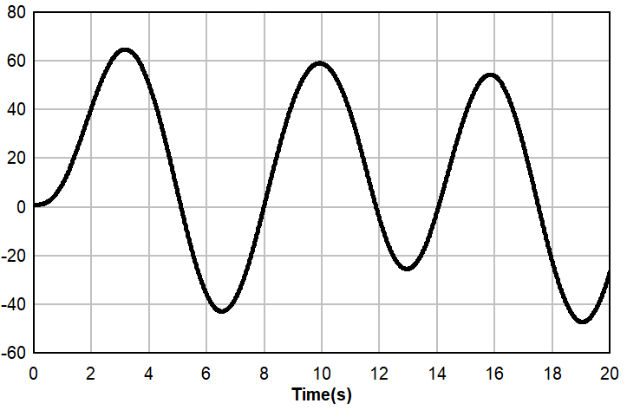

Potentials
Fluxes
Circuit
Quantities

