Slide 1
Conditions
LobarPneumonia
UpdateAlveoliCompliance
UpdateGasDiffusionSurfaceArea
COPD
UpdatePulmonaryCapillaryResistance
UpdateAlveoliCompliance
UpdateGasDiffusionSurfaceArea
ImpairedAlveolarExchange
Assessments
CalculatePulmonaryFunctionTest
Preprocess
UpdatePleuralCompliance
ProcessAerosolSubstances
AirwayObstruction
UpdateObstructiveResistance
BronchoConstriction
BronchoDilation
Intubation
Pneumothorax
DoLeftNeedleDecompression
DoRightNeedleDecompression
ConsciousRespiration
ProcessConsciousRespiration
MechanicalVentilation
RespiratoryDriver
UpdateIERatio
VolumeToDriverPressure
Apnea
Process
ProcessCircuit
TansportGraph
CalculateVitalSigns
PostProcess
PostProcessCircuit

Slide 2
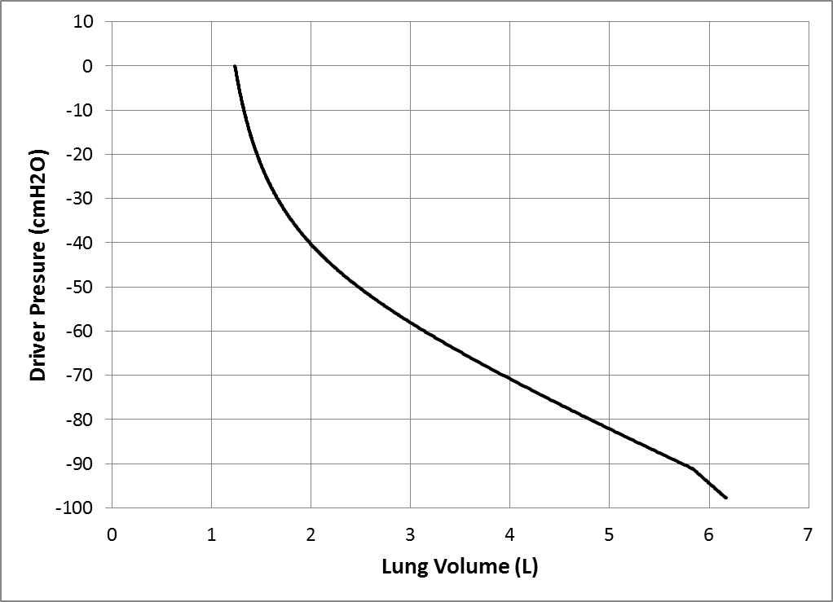
Figure 4

Slide 3
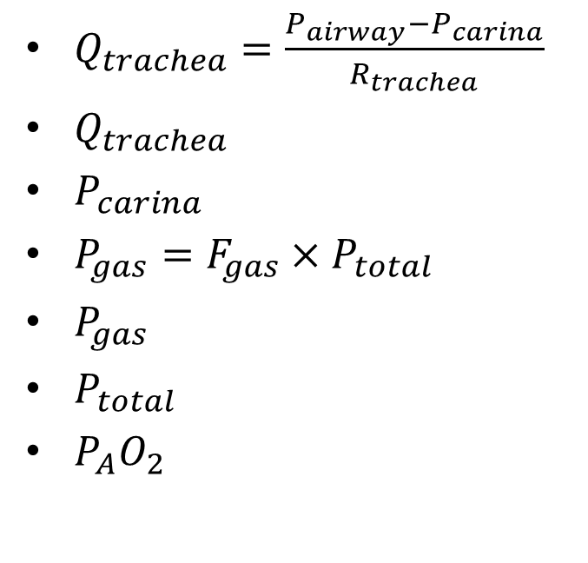
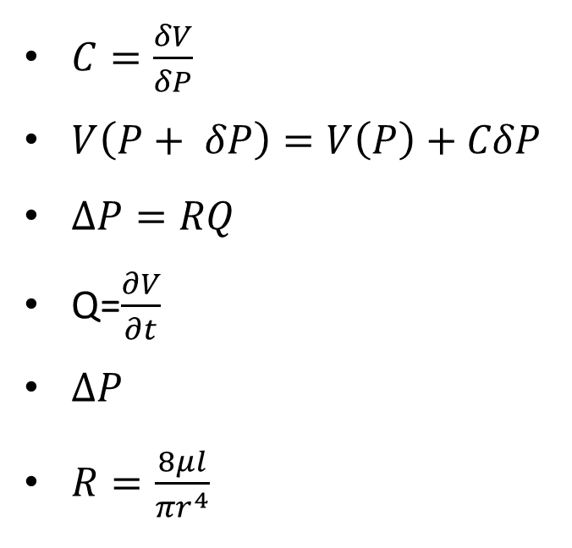
$C=\frac{δV}{δP}$
$V\left(P+ δP\right)=V\left(P\right)+CδP$
$∆P=RQ$
Q=$\frac{∂V}{∂t}$
$∆P$
$R=\frac{8μl}{{πr}^{4}}$
$Q_{trachea}=\frac{P_{airway}−P_{carina}}{R_{trachea}}$
$Q_{trachea}$
$P_{carina}$
$P_{gas}=F_{gas}×P_{total}$
$P_{gas}$
$P_{total}$
$P_{A}O_{2}$

Slide 4
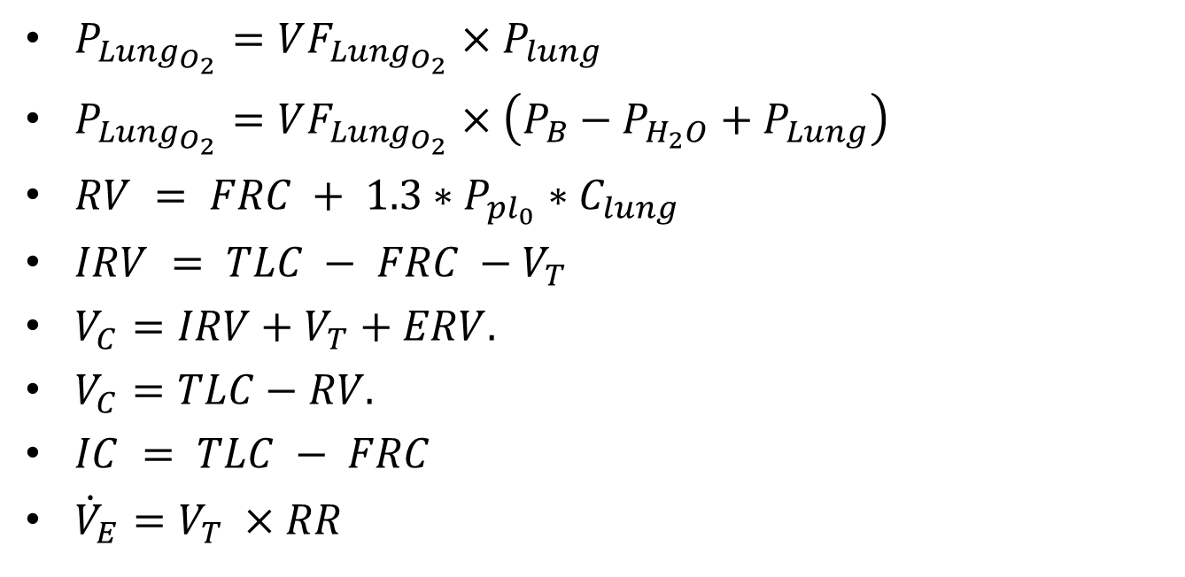
$P_{Lung_{O_{2}}}=VF_{Lung_{O_{2}}}×P_{lung}$
$P_{Lung_{O_{2}}}=VF_{Lung_{O_{2}}}×\left(P_{B}−P_{H_{2}O}+P_{Lung}\right)$
$RV = FRC + 1.3∗P_{pl_{0}}∗C_{lung}$
$IRV = TLC − FRC −V_{T}$
$V_{C}=IRV+V_{T}+ERV.$
$V_{C}=TLC−RV.$
$IC = TLC − FRC$
${\dot{V}}_{E}=V_{T} ×RR$

Slide 5

$ERV=FRC−RV$
$Q_{trachea}=\frac{P_{airway}−P_{carina}}{R_{trachea}}$
$P_{gas}=F_{gas}×P_{total}$

Slide 6
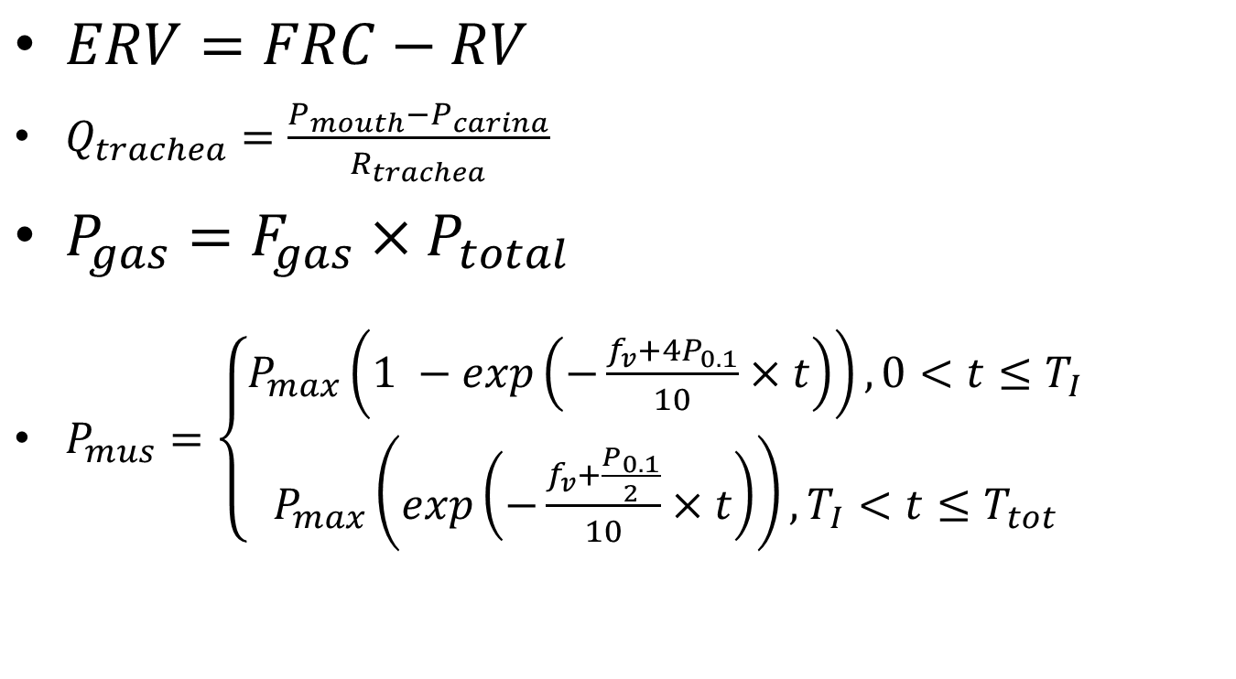
$ERV=FRC−RV$
$Q_{trachea}=\frac{P_{mouth}−P_{carina}}{R_{trachea}}$
$P_{gas}=F_{gas}×P_{total}$
$P_{mus}=\left\{\begin{aligned}P_{max}\left(1 −exp\left(−\frac{f_{v}+4P_{0.1}}{10}×t\right)\right), 0<t≤T_{I} \\ P_{max}\left(exp\left(−\frac{f_{v}+\frac{P_{0.1}}{2}}{10}×t\right)\right), T_{I}<t≤T_{tot}\end{aligned}\right.$

Slide 7

$f_{v}(≡\frac{1}{T_{tot}}$)
$P_{0.1}$
𝑃_{𝑚𝑎𝑥}=−0.3743𝑉⁵+7.4105𝑉⁴−57.076𝑉³+214.11𝑉² − 409.97𝑉+262.22
$P_{max}$
$T_{I}$
$T_{tot}$
$\frac{T_{I}}{T_{tot}}=0.0125f_{v}+0.125$
$f_{v}$

Slide 8
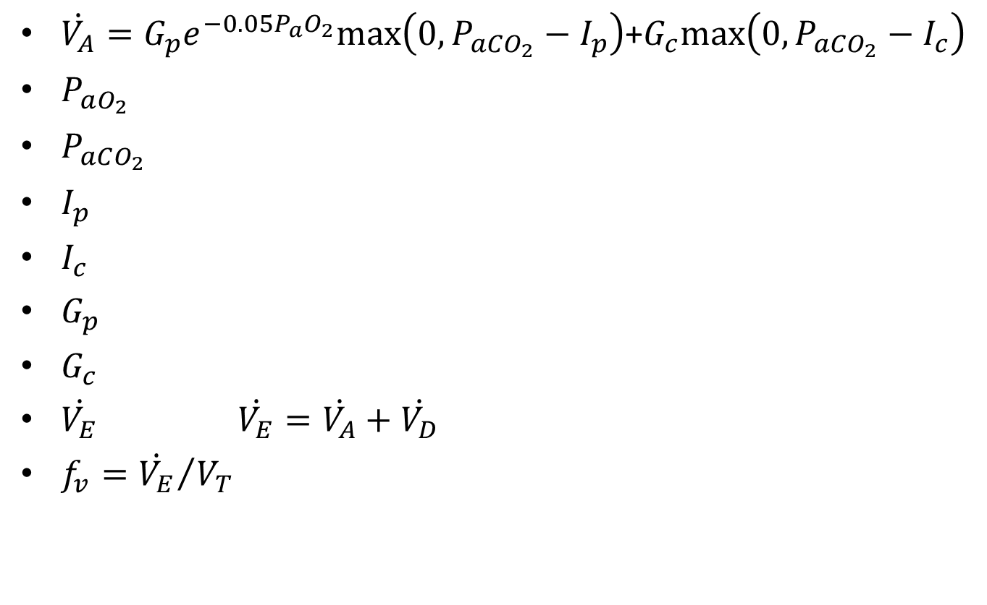
$\dot{V_{A}}=G_{p}e_{}^{−0.05P_{a}O_{2}}max\left(0, P_{aCO_{2}}−I_{p}\right)$+$G_{c}max\left(0, P_{aCO_{2}}−I_{c}\right)$
$P_{aO_{2}}$
$P_{aCO_{2}}$
$I_{p}$
$I_{c}$
$G_{p}$
$G_{c}$
$\dot{V_{E}}$ $\dot{V_{E}}=\dot{V_{A}}+\dot{V_{D}}$
$f_{v}={\dot{V_{E}}}/{V_{T}}$

Slide 9

$V_{T}= \left\{\begin{aligned}c+\dot{V_{E}}/m, if V_{T}≤V_{c} \\ 0.5∗V_{c}, if V_{T}>V_{c}\end{aligned}\right.$
$R_{pulm}=\frac{P_{mouth}−P_{alveoli}}{Q_{trachea}}$
$C_{pulm}=\frac{V_{T}}{P_{pleu}(max)−P_{pleu}(min)}$
$\dot{V_{E}}=m\left(V_{T}−c\right)$

Slide 10
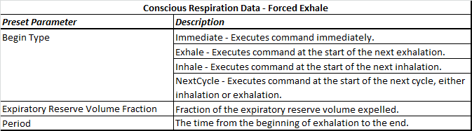
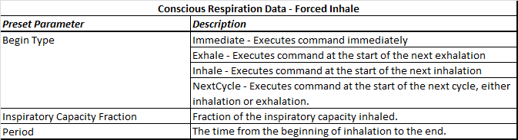
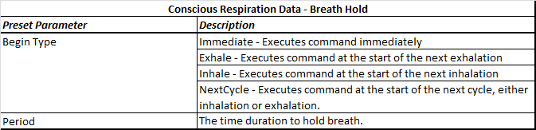
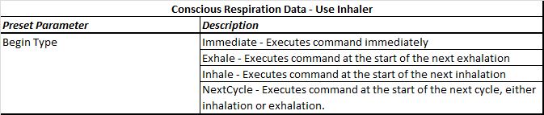

Slide 11
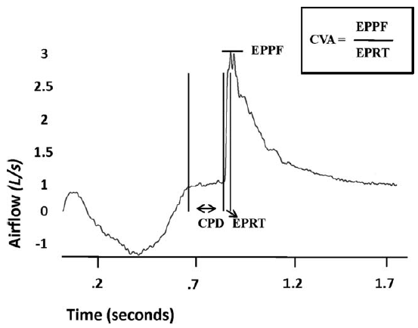

Slide 12
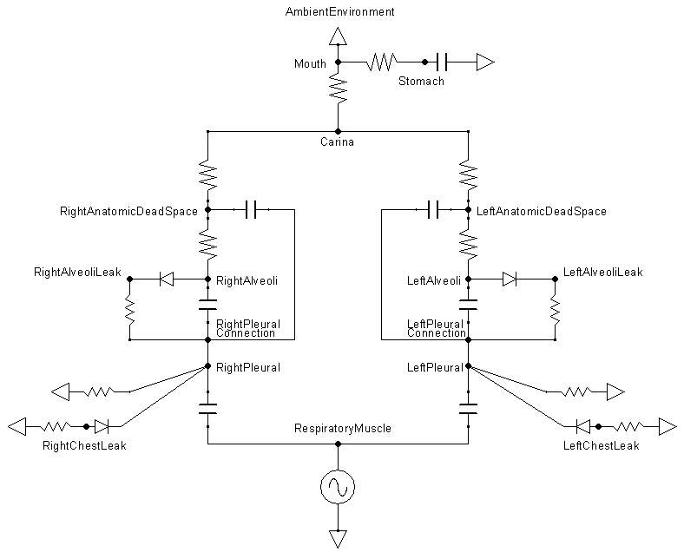

Slide 13
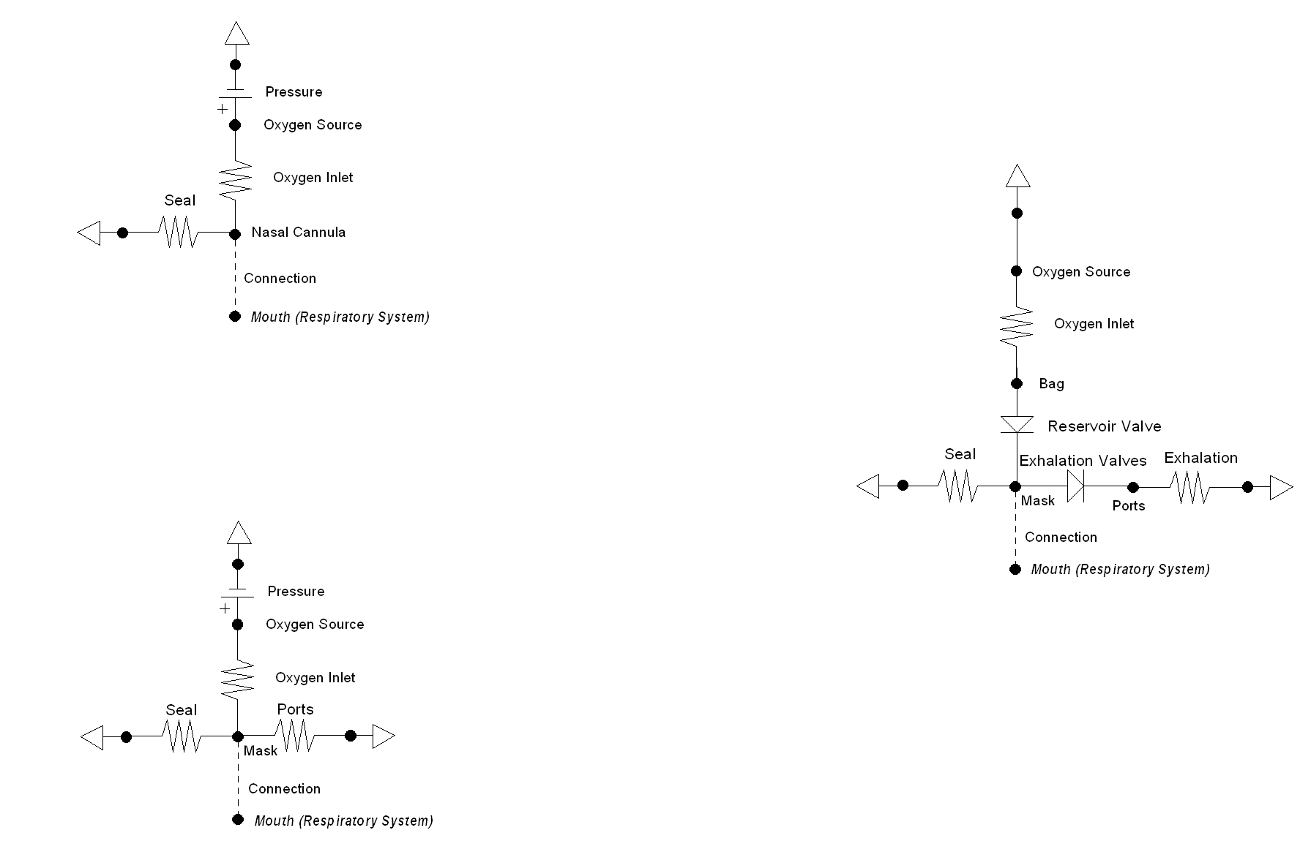
Nasal Cannula
Simple Mask
Nonrebreather Mask

