Slide 1
Assessments
Complete Blood Count
Metabolic Panel
Process
Set all blood substance concentrations and blood gas levels based on compartment values
Calculate blood cell counts, hematocrit, and plasma volume
Check blood gas levels in specific compartments and set events and irreversible states as needed
Preprocess
PostProcess

Slide 2
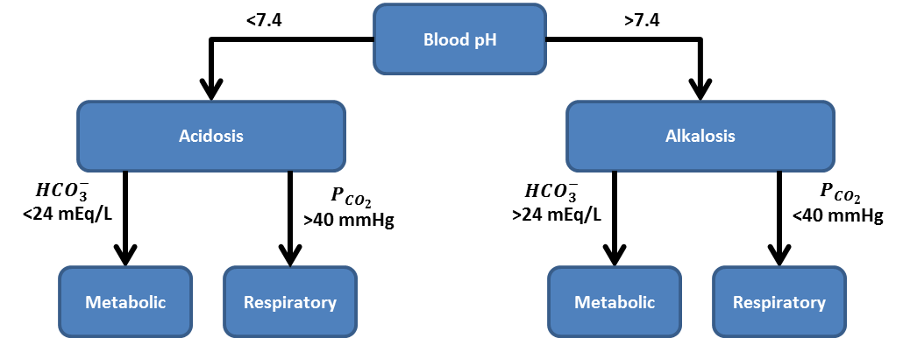




Low
Blood pH
High
Acidosis
Alkalosis
$$HCO_{3}^{−}$$
Low
$$P_{CO_{2}}$$
High
$$HCO_{3}^{−}$$
High
$$P_{CO_{2}}$$
Low
Metabolic
Respiratory
Metabolic
Respiratory

Slide 3
O₂
CO₂
Pulmonary
Veins
Arteries
Capillaries
CO₂
O₂

