Slide 1
Conditions
Future: will enable starvation and dehydration conditions
Process
Combined Circuit Solved by Cardiovascular
CalculateMetabolicConsumptionAndProduction
CalculatePulmonaryCapillarySubstanceTransfer
CalculateDiffusion
PerfusionLimitedDiffusion
MoveMassByInstantDiffusion
MoveMassBySimpleDiffusion
MoveMassByFacilitatedDiffusion
MoveMassByActiveTransport
CalculateBloodGasDistribution
CalculateVitals
Preprocess
ProduceAlbumin
PostProcess
Combined Circuit Time Advanced by Cardiovascular

Slide 2
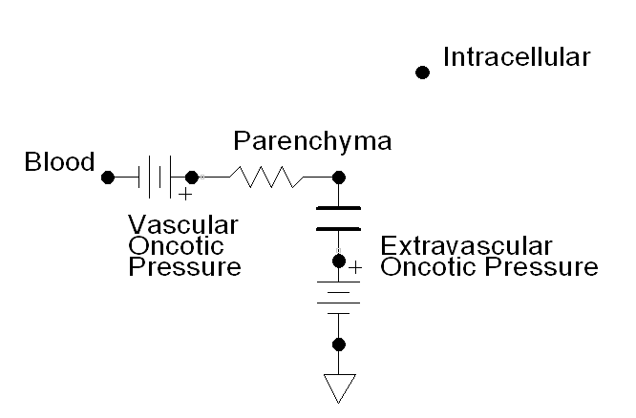

Slide 3
Please do not delete this.
Time = 0
Time = 10

Slide 4
Alveolar Air
Water
Barrier
Blood
Alveolar Diffusion
P_{O2}
[O₂]
[O₂]
[O₂] + Bound O₂

Slide 5
Blood Compartment
Tissue Compartment
Extracellular Fluid
Intracellular Fluid
Parenchyma
Active Transport
Active Transport
Instant Diffusion
Instant Diffusion
Facilitated Diffusion
Facilitated Diffusion
Perfusion Limited Diffusion

