Slide 1
Preprocess
CalculateWork
CalculateFatigue
UpdateChestWallCompliances
UpdateVolumes
UpdateResistances
UpdateAlveolarCompiances
UpdateInspiratoryExpiratoryRatio
UpdateDiffusion
UpdatePulmonaryCapillary
ProcessAerosolSubstances
Pneumothorax
DoLeftNeedleDecompression
DoRightNeedleDecompression
ConsciousRespiration
ProcessConsciousRespiration
MechanicalVentilation
SupplementalOxygen
RespiratoryDriver
VolumeToDriverPressure
SetBreathCycleFractions
ModifyDriverPressure
Assessments
CalculatePulmonaryFunctionTest
Process
ProcessCircuit
TansportGraph
CalculateVitalSigns
PostProcess
PostProcessCircuit

Slide 2
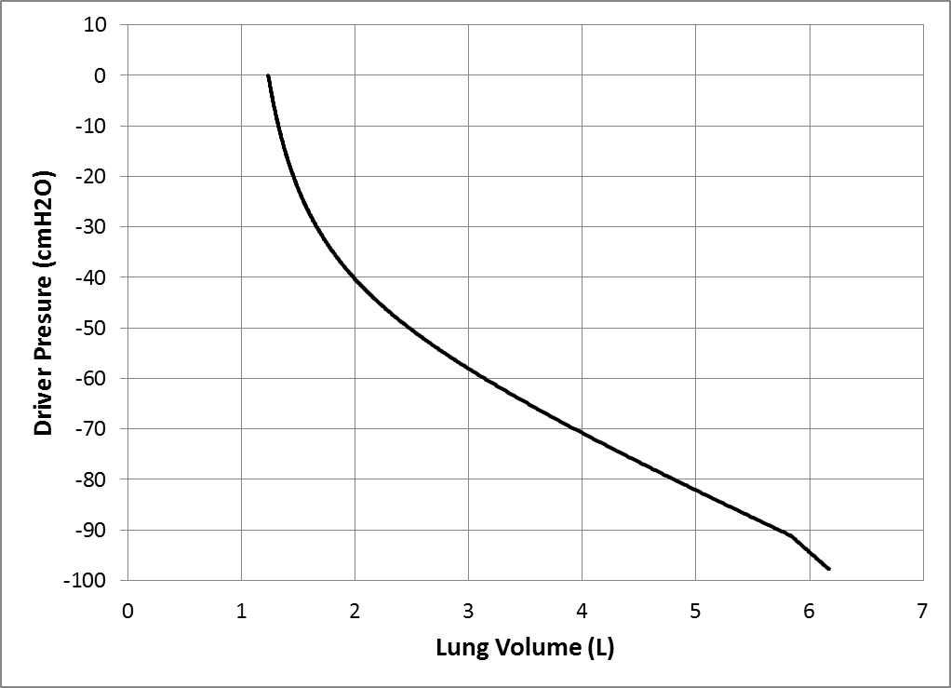
Figure 4

Slide 3
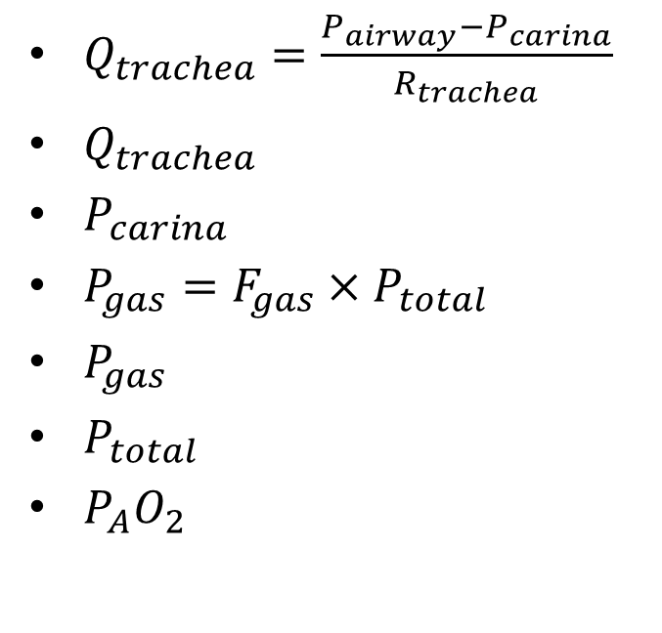
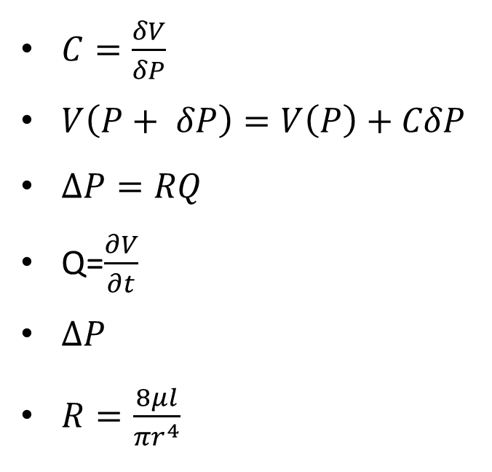
$C=\frac{δV}{δP}$
$V\left(P+ δP\right)=V\left(P\right)+CδP$
$∆P=RQ$
Q=$\frac{∂V}{∂t}$
$∆P$
$R=\frac{8μl}{{πr}^{4}}$
$Q_{trachea}=\frac{P_{airway}−P_{carina}}{R_{trachea}}$
$Q_{trachea}$
$P_{carina}$
$P_{gas}=F_{gas}×P_{total}$
$P_{gas}$
$P_{total}$
$P_{A}O_{2}$

Slide 4
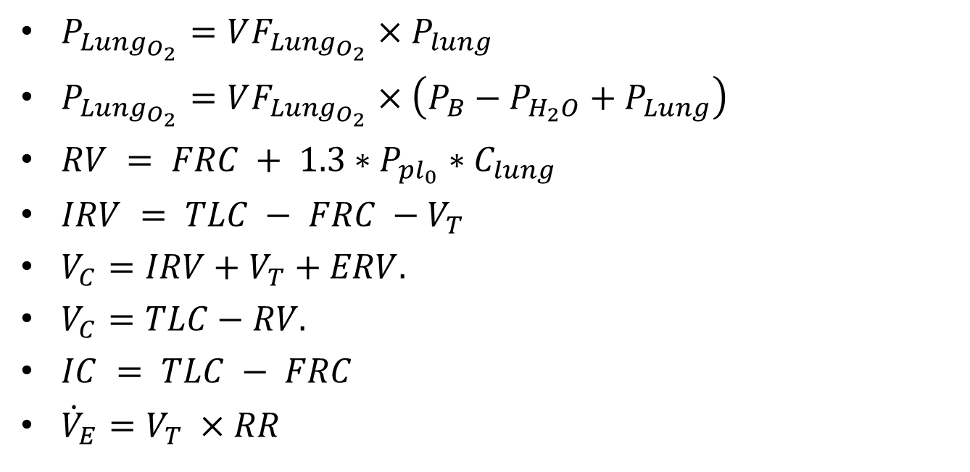
$P_{Lung_{O_{2}}}=VF_{Lung_{O_{2}}}×P_{lung}$
$P_{Lung_{O_{2}}}=VF_{Lung_{O_{2}}}×\left(P_{B}−P_{H_{2}O}+P_{Lung}\right)$
$RV = FRC + 1.3∗P_{pl_{0}}∗C_{lung}$
$IRV = TLC − FRC −V_{T}$
$V_{C}=IRV+V_{T}+ERV.$
$V_{C}=TLC−RV.$
$IC = TLC − FRC$
${\dot{V}}_{E}=V_{T} ×RR$

Slide 5

$ERV=FRC−RV$
$Q_{trachea}=\frac{P_{airway}−P_{carina}}{R_{trachea}}$
$P_{gas}=F_{gas}×P_{total}$

Slide 6
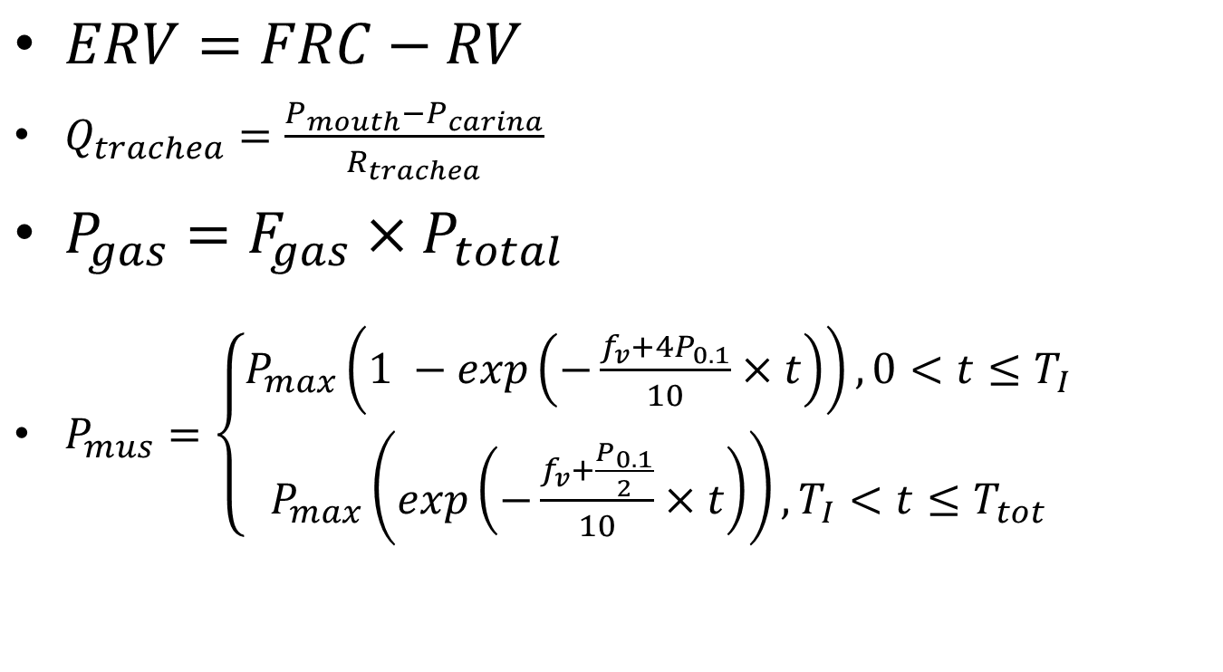
$ERV=FRC−RV$
$Q_{trachea}=\frac{P_{mouth}−P_{carina}}{R_{trachea}}$
$P_{gas}=F_{gas}×P_{total}$
$P_{mus}=\left\{\begin{aligned}P_{max}\left(1 −exp\left(−\frac{f_{v}+4P_{0.1}}{10}×t\right)\right), 0<t≤T_{I} \\ P_{max}\left(exp\left(−\frac{f_{v}+\frac{P_{0.1}}{2}}{10}×t\right)\right), T_{I}<t≤T_{tot}\end{aligned}\right.$

Slide 7

$f_{v}(≡\frac{1}{T_{tot}}$)
$P_{0.1}$
𝑃_{𝑚𝑎𝑥}=−0.3743𝑉⁵+7.4105𝑉⁴−57.076𝑉³+214.11𝑉² − 409.97𝑉+262.22
$P_{max}$
$T_{I}$
$T_{tot}$
$\frac{T_{I}}{T_{tot}}=0.0125f_{v}+0.125$
$f_{v}$

Slide 8
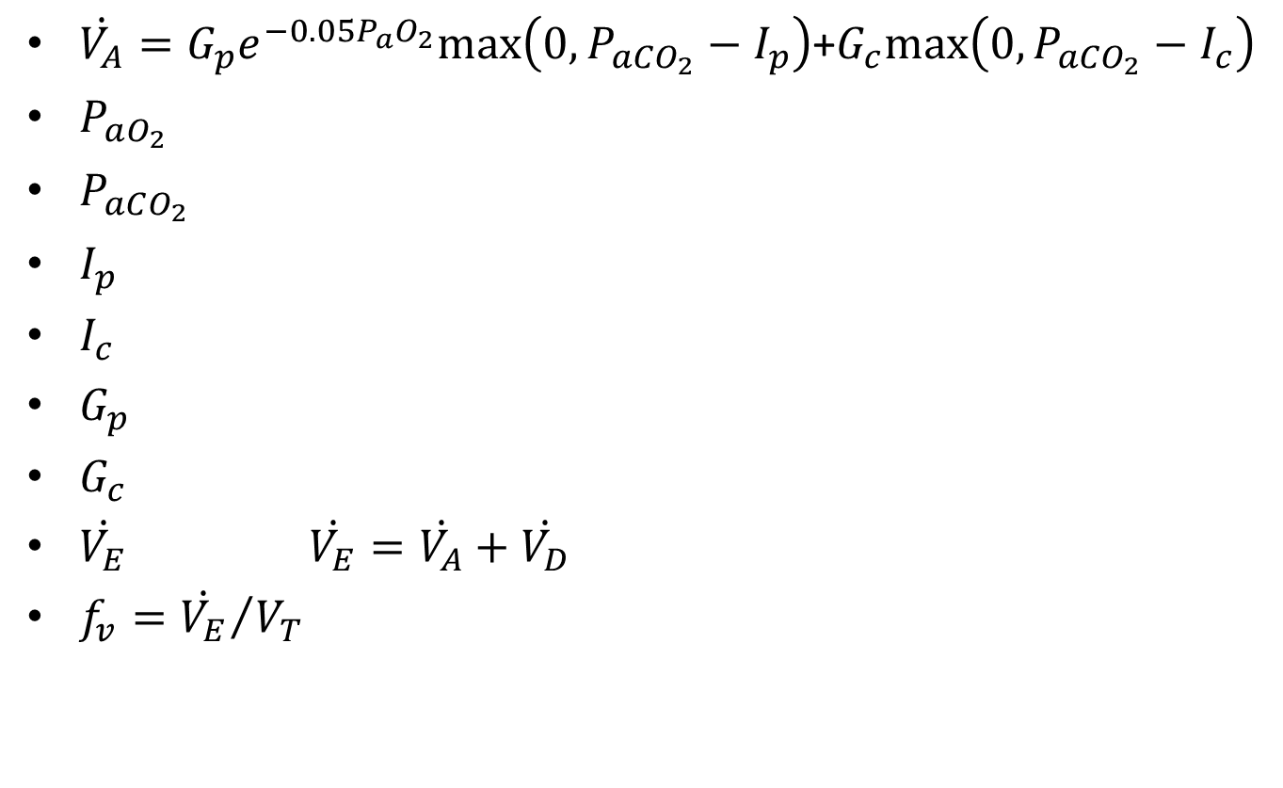
$\dot{V_{A}}=G_{p}e_{}^{−0.05P_{a}O_{2}}max\left(0, P_{aCO_{2}}−I_{p}\right)$+$G_{c}max\left(0, P_{aCO_{2}}−I_{c}\right)$
$P_{aO_{2}}$
$P_{aCO_{2}}$
$I_{p}$
$I_{c}$
$G_{p}$
$G_{c}$
$\dot{V_{E}}$ $\dot{V_{E}}=\dot{V_{A}}+\dot{V_{D}}$
$f_{v}={\dot{V_{E}}}/{V_{T}}$

Slide 9

$V_{T}= \left\{\begin{aligned}c+\dot{V_{E}}/m, if V_{T}≤V_{c} \\ 0.5∗V_{c}, if V_{T}>V_{c}\end{aligned}\right.$
$R_{pulm}=\frac{P_{mouth}−P_{alveoli}}{Q_{trachea}}$
$C_{pulm}=\frac{V_{T}}{P_{pleu}(max)−P_{pleu}(min)}$
$\dot{V_{E}}=m\left(V_{T}−c\right)$

Slide 10
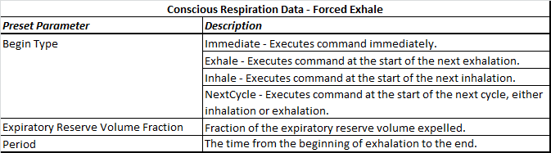
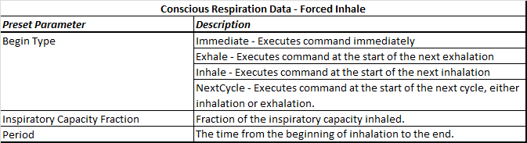
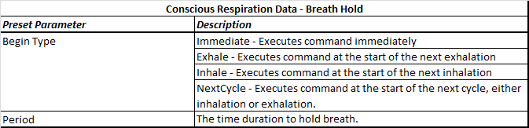
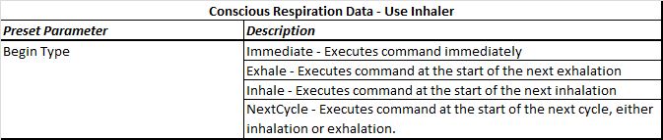

Slide 11
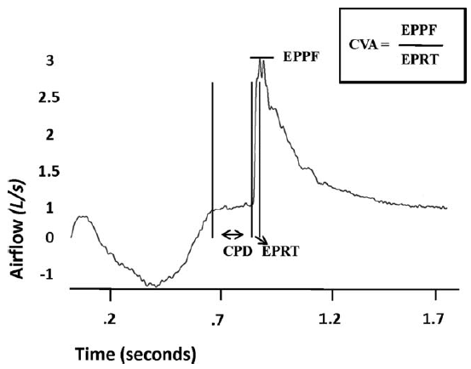

Slide 12
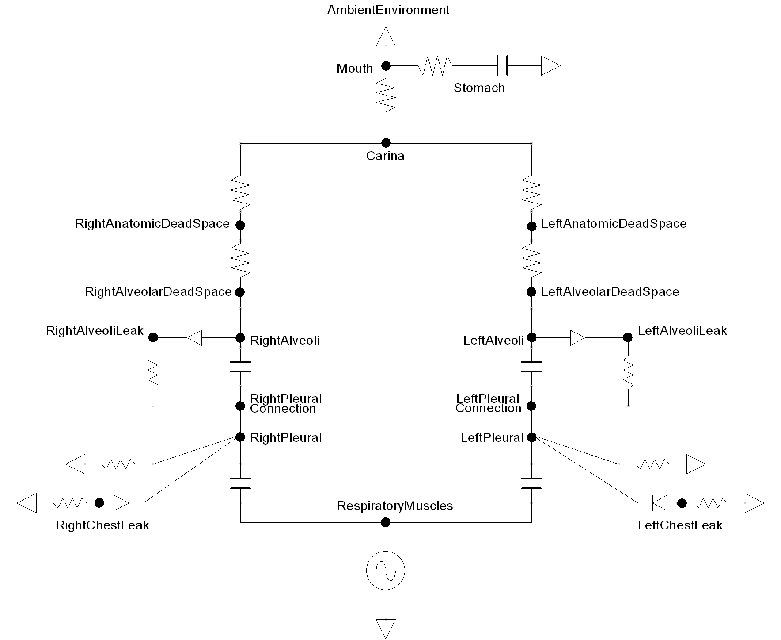

Slide 13
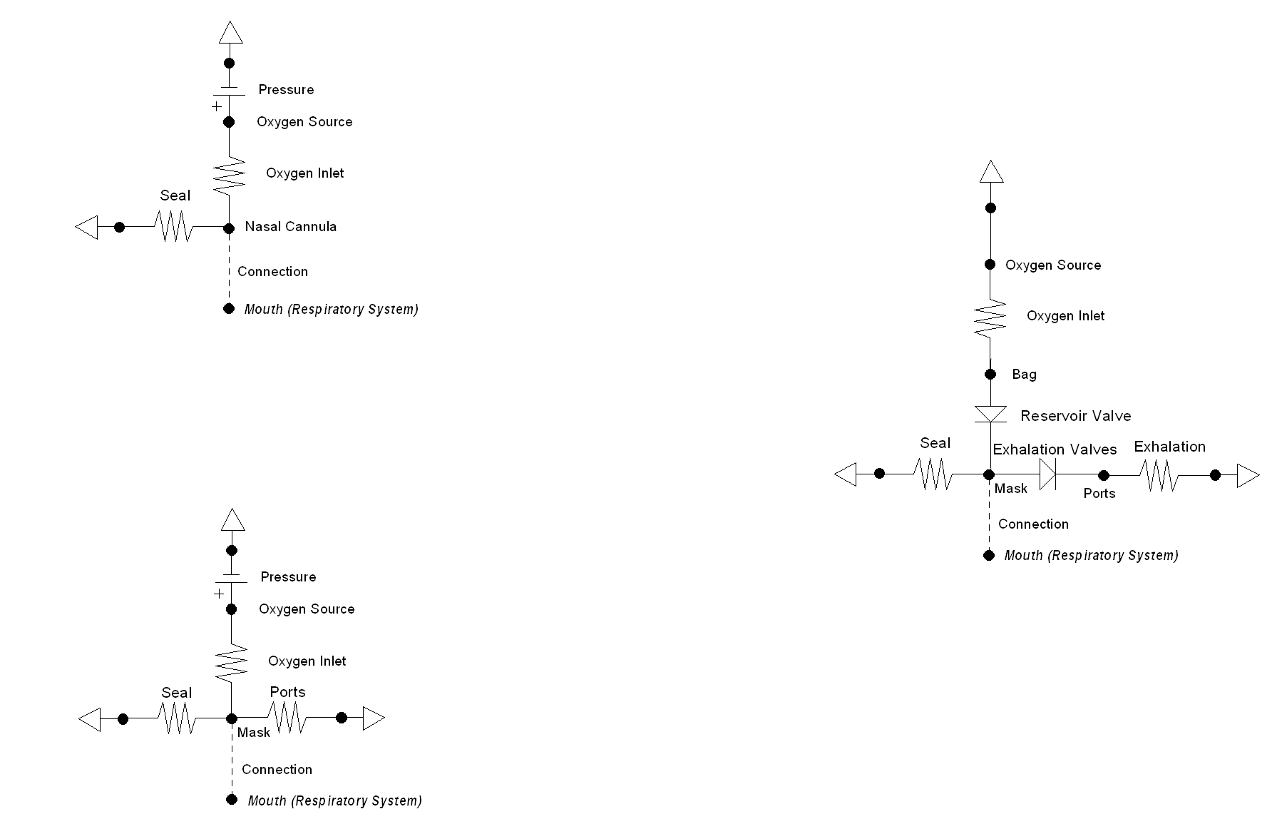
Nasal Cannula
Simple Mask
Nonrebreather Mask

