Slide 1
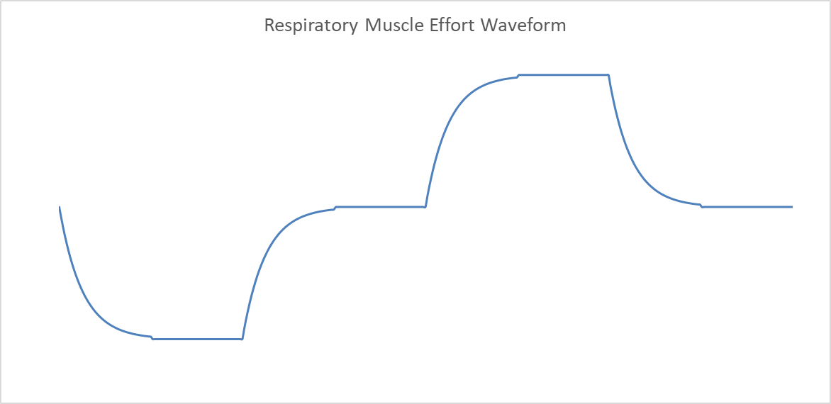
Pressure
P_{max}
Exhale
0
Time
Inhale
P_{min}
1
2
3
4
5
6
7
8

Slide 3
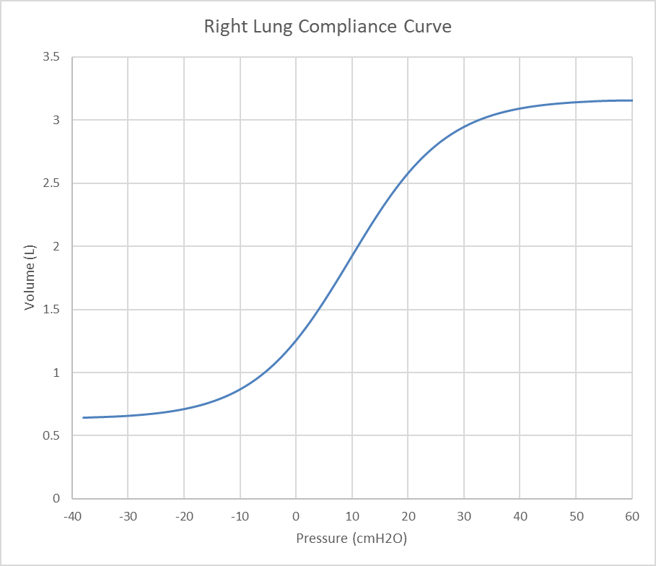
TLC
VC
FRC
RV
P_{cl}
P_{cu}
C_{baseline}

Slide 6
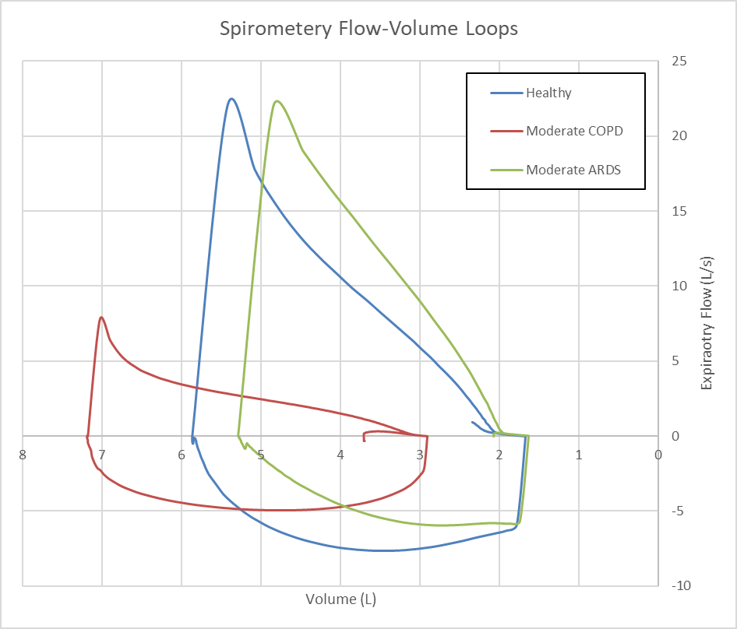

Slide 7
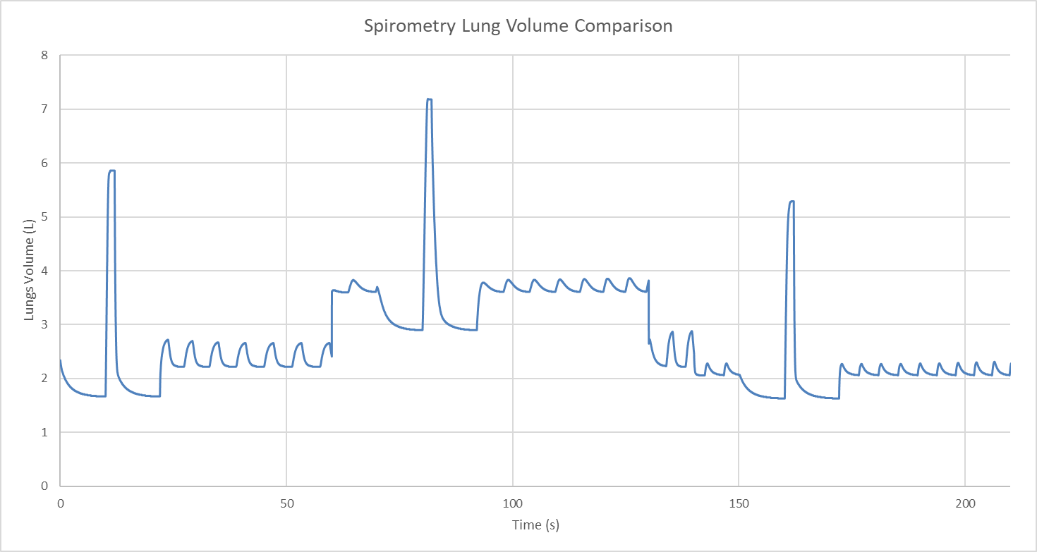
Healthy
Moderate COPD
Moderate ARDS

Slide 8
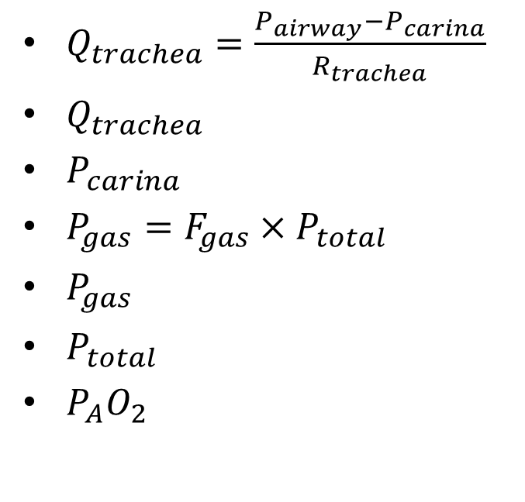
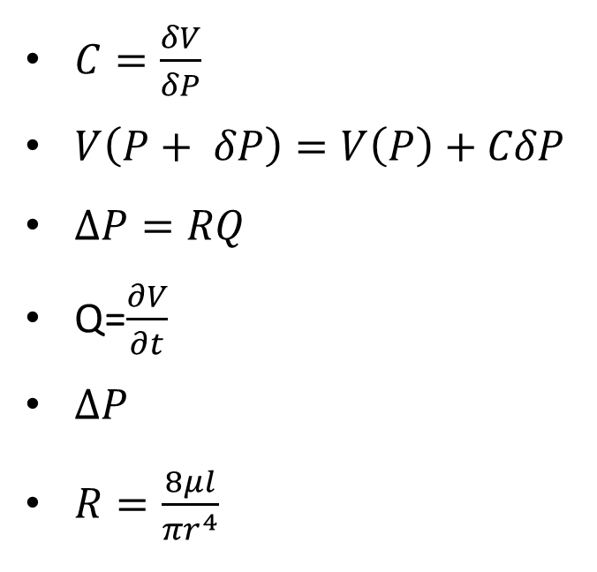
$C=\frac{δV}{δP}$
$V\left(P+ δP\right)=V\left(P\right)+CδP$
$∆P=RQ$
Q=$\frac{∂V}{∂t}$
$∆P$
$R=\frac{8μl}{{πr}^{4}}$
$Q_{trachea}=\frac{P_{airway}−P_{carina}}{R_{trachea}}$
$Q_{trachea}$
$P_{carina}$
$P_{gas}=F_{gas}×P_{total}$
$P_{gas}$
$P_{total}$
$P_{A}O_{2}$

Slide 9
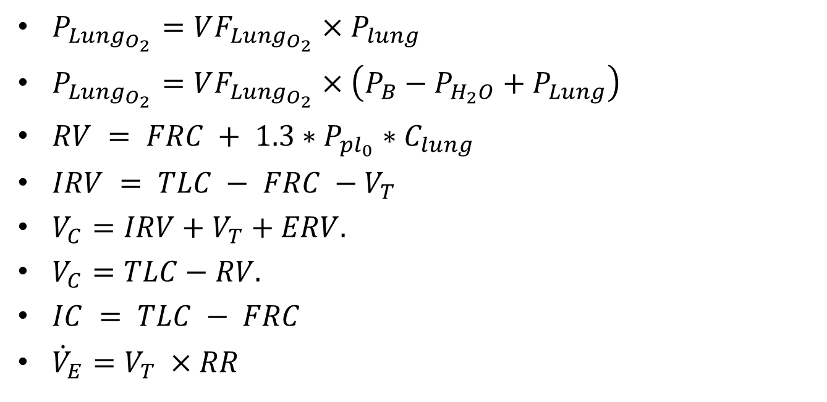
$P_{Lung_{O_{2}}}=VF_{Lung_{O_{2}}}×P_{lung}$
$P_{Lung_{O_{2}}}=VF_{Lung_{O_{2}}}×\left(P_{B}−P_{H_{2}O}+P_{Lung}\right)$
$RV = FRC + 1.3∗P_{pl_{0}}∗C_{lung}$
$IRV = TLC − FRC −V_{T}$
$V_{C}=IRV+V_{T}+ERV.$
$V_{C}=TLC−RV.$
$IC = TLC − FRC$
${\dot{V}}_{E}=V_{T} ×RR$

Slide 10

$ERV=FRC−RV$
$Q_{trachea}=\frac{P_{airway}−P_{carina}}{R_{trachea}}$
$P_{gas}=F_{gas}×P_{total}$

Slide 11
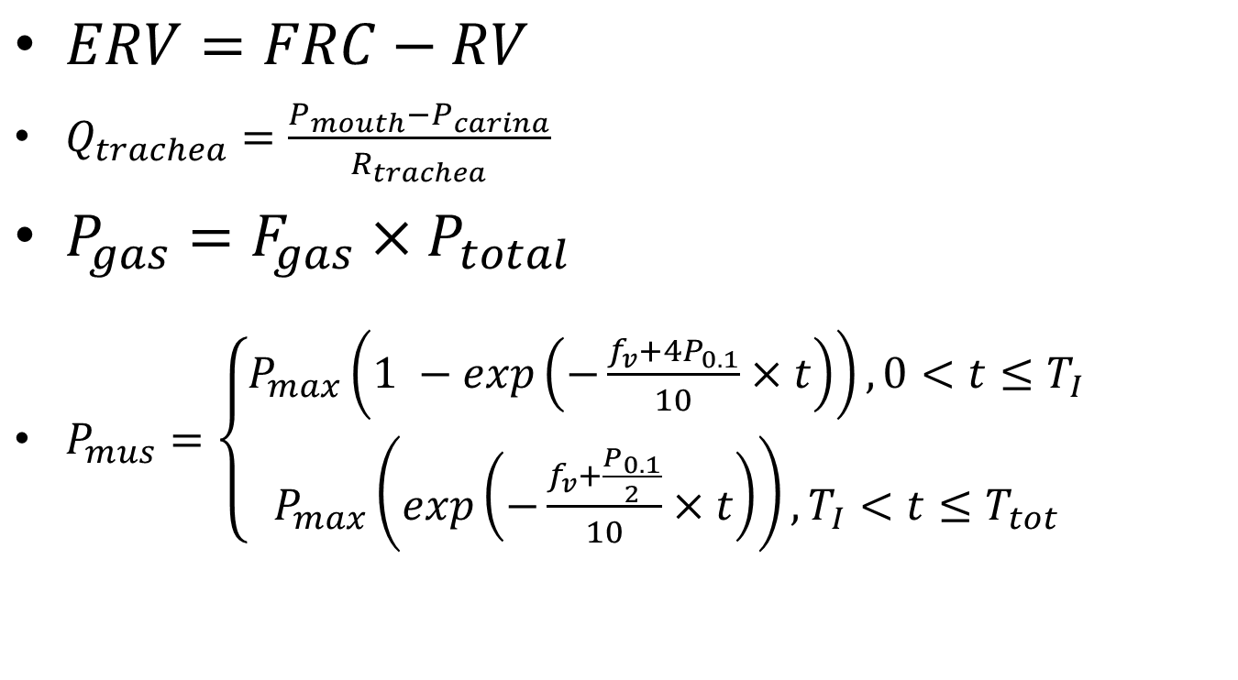
$ERV=FRC−RV$
$Q_{trachea}=\frac{P_{mouth}−P_{carina}}{R_{trachea}}$
$P_{gas}=F_{gas}×P_{total}$
$P_{mus}=\left\{\begin{aligned}P_{max}\left(1 −exp\left(−\frac{f_{v}+4P_{0.1}}{10}×t\right)\right), 0<t≤T_{I} \\ P_{max}\left(exp\left(−\frac{f_{v}+\frac{P_{0.1}}{2}}{10}×t\right)\right), T_{I}<t≤T_{tot}\end{aligned}\right.$

Slide 12

$f_{v}(≡\frac{1}{T_{tot}}$)
$P_{0.1}$
𝑃_{𝑚𝑎𝑥}=−0.3743𝑉⁵+7.4105𝑉⁴−57.076𝑉³+214.11𝑉² − 409.97𝑉+262.22
$P_{max}$
$T_{I}$
$T_{tot}$
$\frac{T_{I}}{T_{tot}}=0.0125f_{v}+0.125$
$f_{v}$

Slide 13
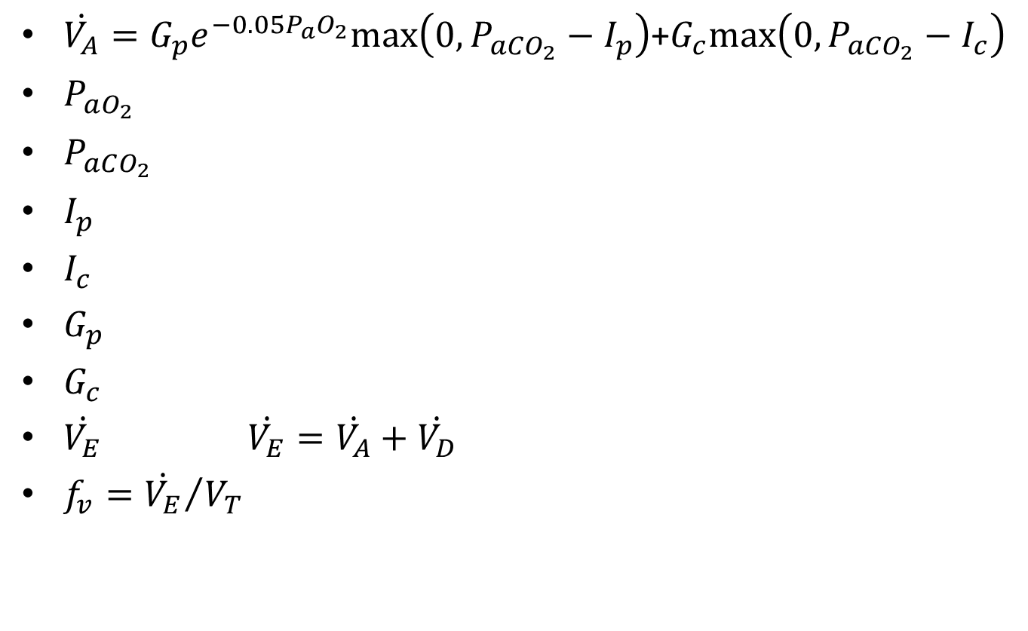
$\dot{V_{A}}=G_{p}e_{}^{−0.05P_{a}O_{2}}max\left(0, P_{aCO_{2}}−I_{p}\right)$+$G_{c}max\left(0, P_{aCO_{2}}−I_{c}\right)$
$P_{aO_{2}}$
$P_{aCO_{2}}$
$I_{p}$
$I_{c}$
$G_{p}$
$G_{c}$
$\dot{V_{E}}$ $\dot{V_{E}}=\dot{V_{A}}+\dot{V_{D}}$
$f_{v}={\dot{V_{E}}}/{V_{T}}$

Slide 14

$V_{T}= \left\{\begin{aligned}c+\dot{V_{E}}/m, if V_{T}≤V_{c} \\ 0.5∗V_{c}, if V_{T}>V_{c}\end{aligned}\right.$
$R_{pulm}=\frac{P_{mouth}−P_{alveoli}}{Q_{trachea}}$
$C_{pulm}=\frac{V_{T}}{P_{pleu}(max)−P_{pleu}(min)}$
$\dot{V_{E}}=m\left(V_{T}−c\right)$

Slide 15
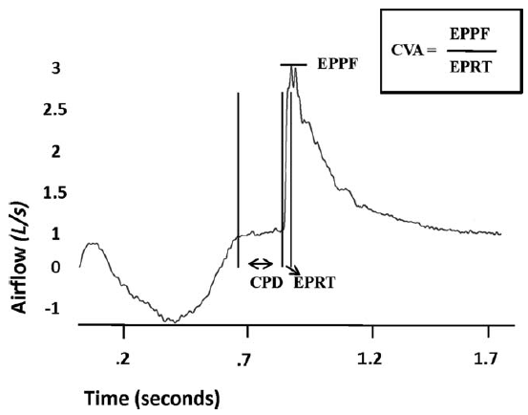

Slide 16
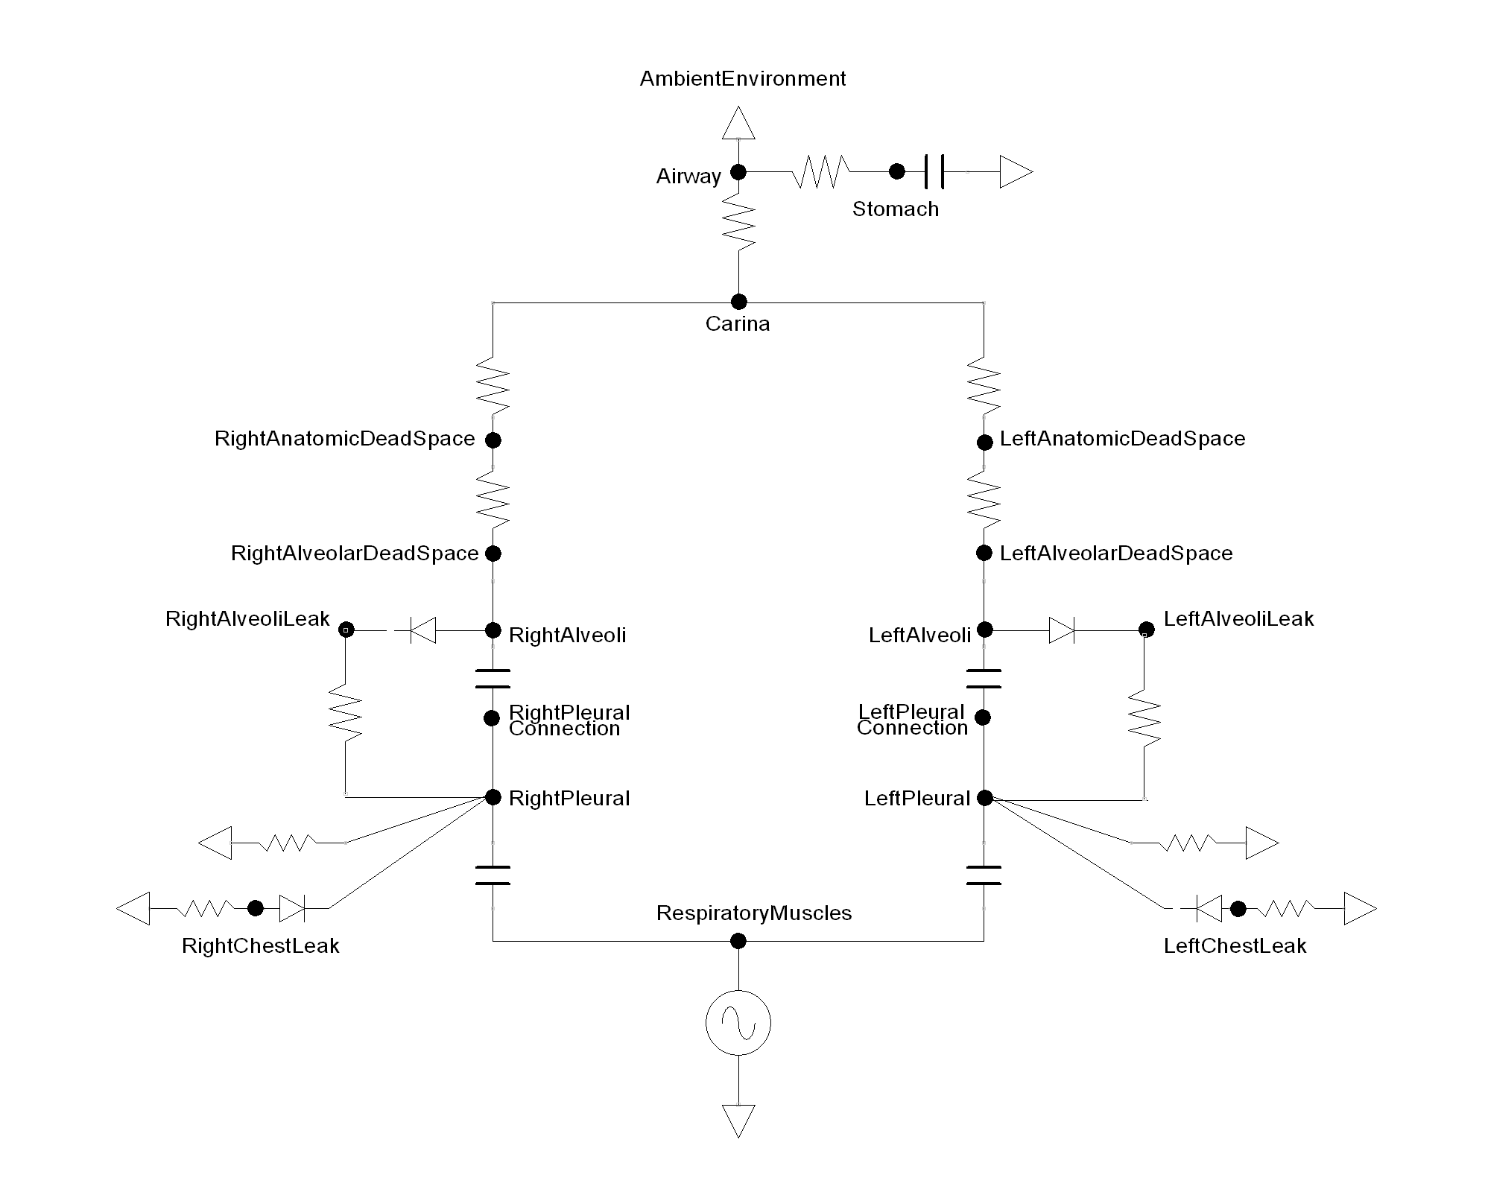

Slide 17
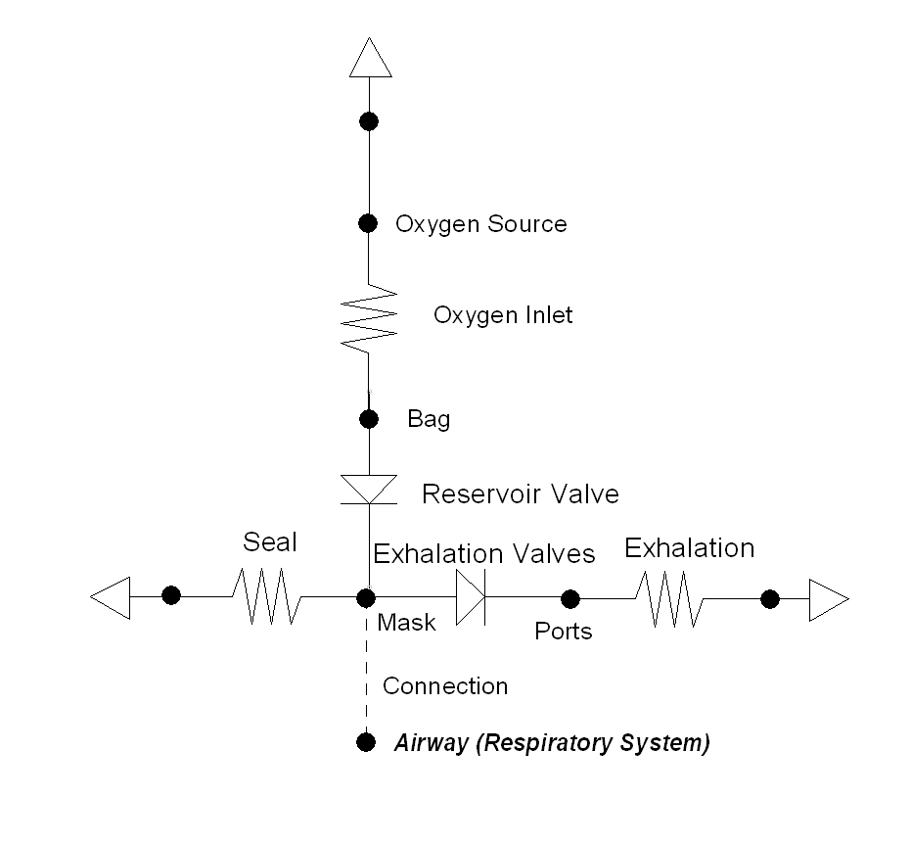
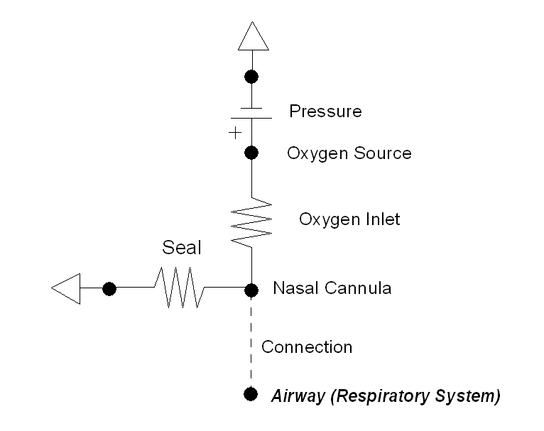
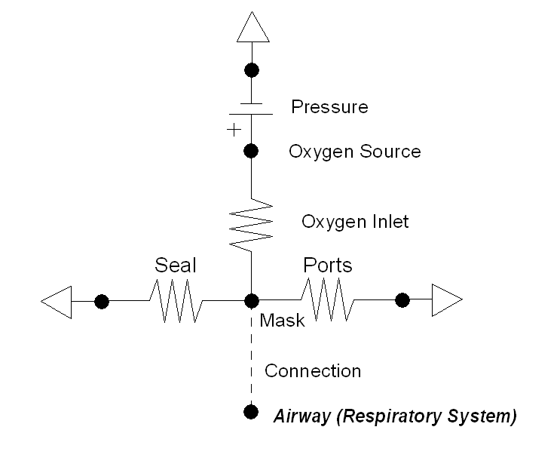
Nasal Cannula
Simple Mask
Nonrebreather Mask

