Slide 1
Stabilization
Simulation Time = 0
Initial
Secondary
Active
Initial | All values are initialized prior to beginning calculations, system parameters are modified to meet the patient file values. The engine executes until all specified stabilization criteria are satisfied. The result is the patient’s resting homeostatic state.
Secondary | After initial stabilization has been achieved, chronic conditions and certain feedback mechanisms (e.g., baroreceptors) are applied. Any patient parameters, environmental settings, or model values are updated to represent the specified condition. The engine executes until all specified stabilization criteria are satisfied.
Active | After the patient physiology is stable, the remainder of the scenario executes. All feedback mechanisms are active. Further modifications are performed through actions.

Slide 2
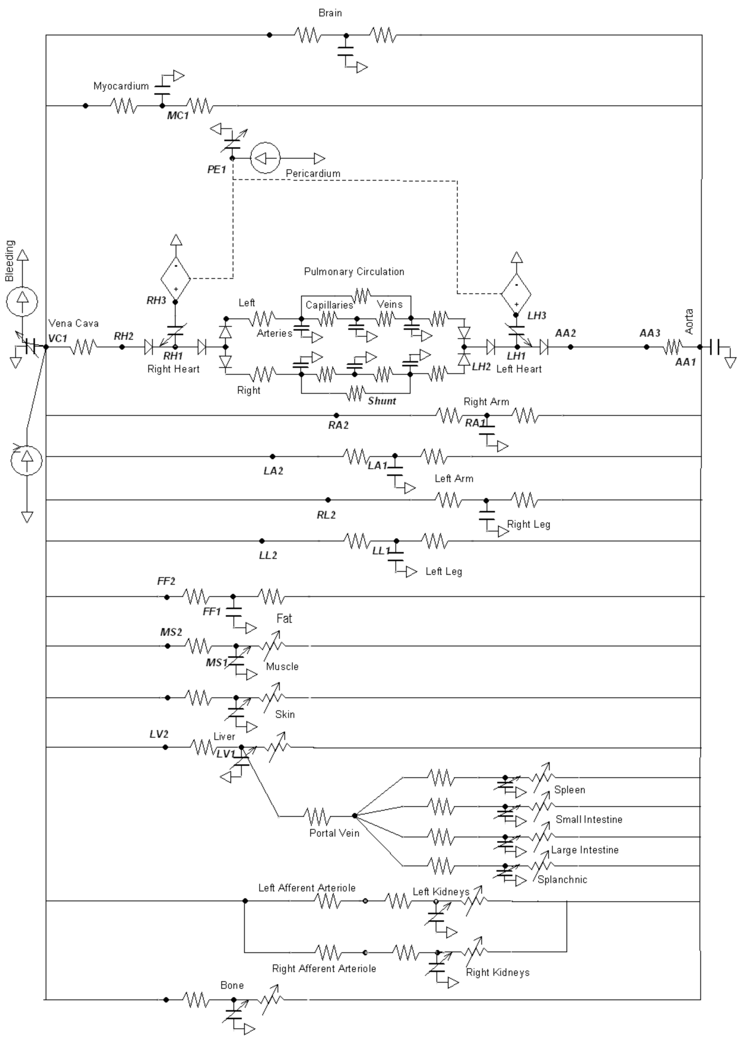
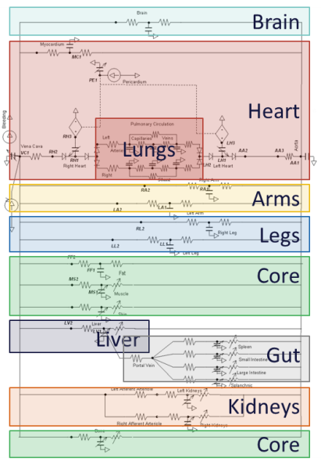
Brain
Heart
Lungs
Arms
Legs
Core
Liver
Gut
Kidneys
Core

Slide 3
Environment
Ambient
Anesthesia Machine
Inhaler
Vaporizer
Aerosolizer
Drugs
Drug Effect
Respiratory
Gastrointestinal
Bolus/Infusion
Chemoreceptor
Drug Effect
Nervous
Baroreceptor
Cardiovascular
Tissue
Blood Chemistry
Production/
Consumption
Hormone
Release
Metabolic
Response
Endocrine
Connection Type:
Advection (Fluid/Thermal)
Diffusion
Property Modifier
Renal
Energy

Slide 4
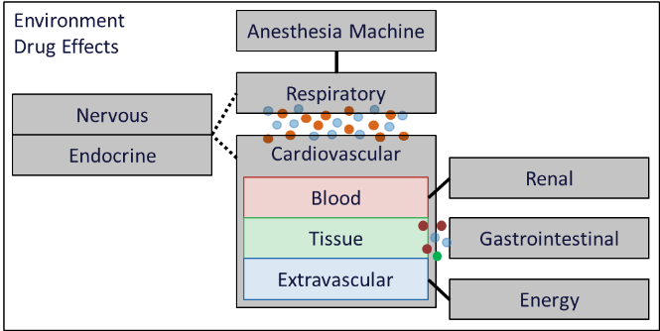
Environment
Drug Effects
Anesthesia Machine
Respiratory
Nervous
Endocrine
Cardiovascular
Renal
Blood
Tissue
Gastrointestinal
Extravascular
Energy

Slide 5





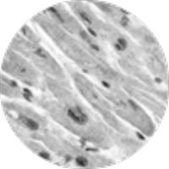


Current Fidelity
Possible Extensions
Body
Systems
Organs
Tissues
Cells
Proteins
Genes

Slide 6
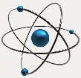




Ecology
Cell Biology
Physiology
Molecular Biology
Chemistry
Atoms
Molecules
Cells
Tissues
Organs
Systems
Organism
Population
Ecosystem
Biosphere
Extensions
Extensions
Pulse Fidelity

Slide 7
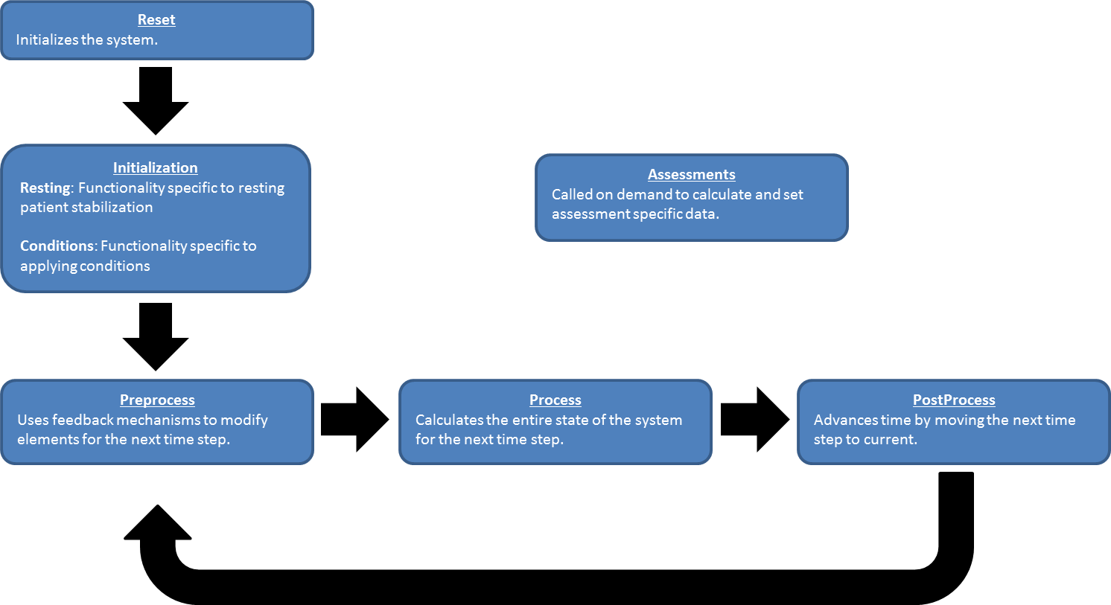
Reset
Initializes the system.
Initialization
Resting: Functionality specific to resting patient stabilization
Conditions: Functionality specific to applying conditions
Assessments
Called on demand to calculate and set assessment specific data.
Preprocess
Uses feedback mechanisms to modify elements for the next time step.
Process
Calculates the entire state of the system for the next time step.
PostProcess
Advances time by moving the next time step to current.

