Slide 1
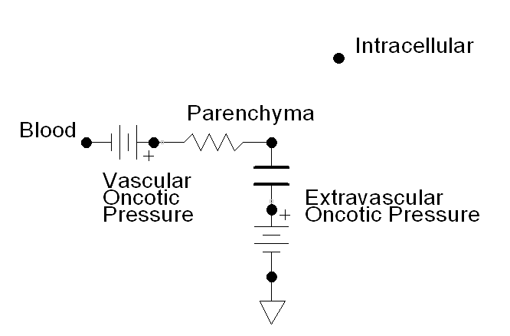

Slide 2
Please do not delete this.
Time = 0
Time = 10

Slide 3
Alveolar Air
Water
Barrier
Blood
Alveolar Diffusion
P_{O2}
[O₂]
[O₂]
[O₂] + Bound O₂

Slide 4
Blood Compartment
Tissue Compartment
Extracellular Fluid
Intracellular Fluid
Parenchyma
Active Transport
Active Transport
Instant Diffusion
Instant Diffusion
Facilitated Diffusion
Facilitated Diffusion
Perfusion Limited Diffusion

Slide 5
