Slide 1
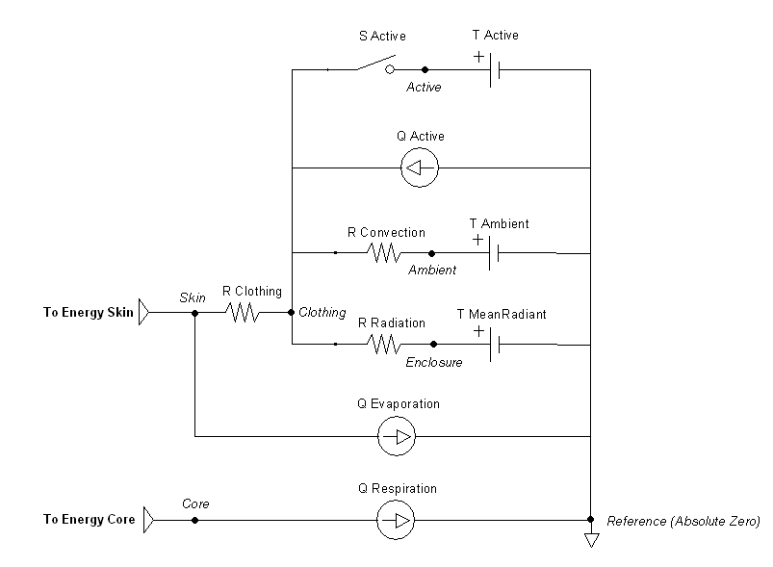

Slide 2
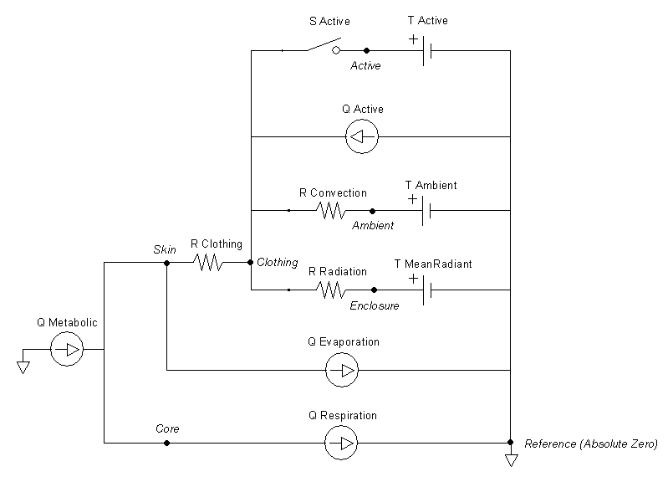
Verification Metabolic Rate Addition

Slide 3
Radiation
Convection
Evaporation
Body
Sweat
Skin
Respiration
Clothing
Surroundings
Mean Radiant Surface

Slide 4
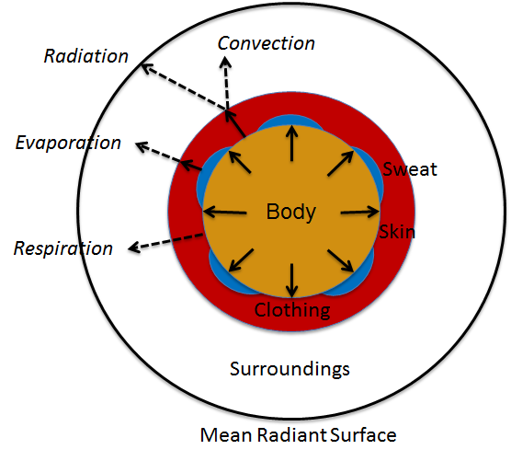

Slide 5
Conditions
Resting:
Use Standard Environment
Conditions:
InitialEnvironment
Preprocess
ProcessActions
CalculateSupplementalValues
AntioneEquation
CalculateRadiation
CalculateConvection
CalculateEvaporation
CalculateRespiration
Process
Combined Circuit Solved by Energy
PostProcess
Combined Circuit Time Advanced by Energy

Slide 6
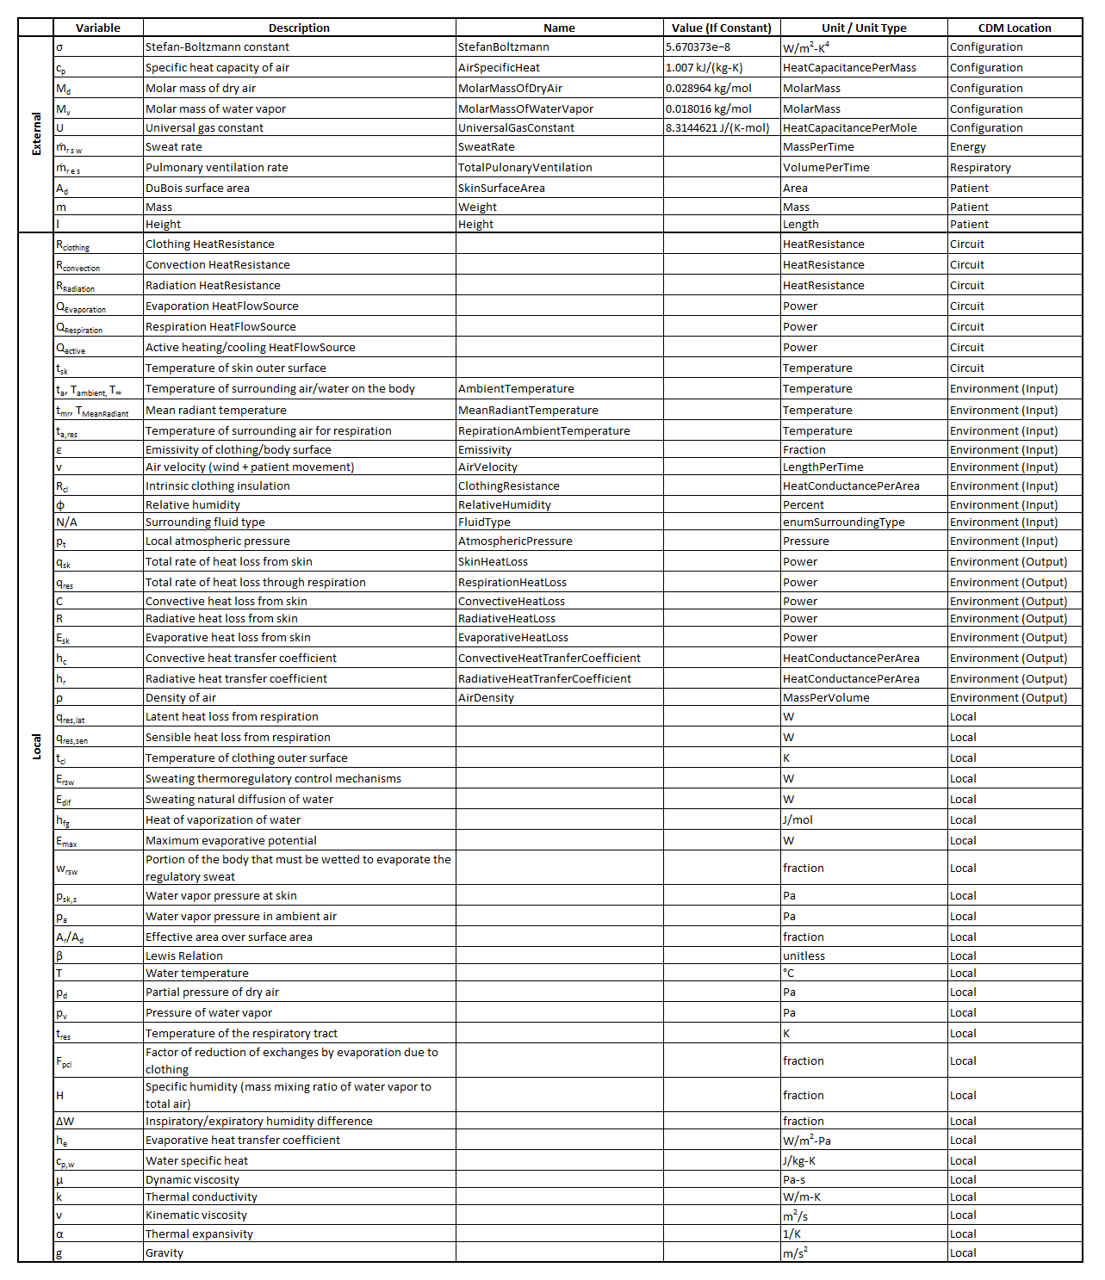

Slide 7
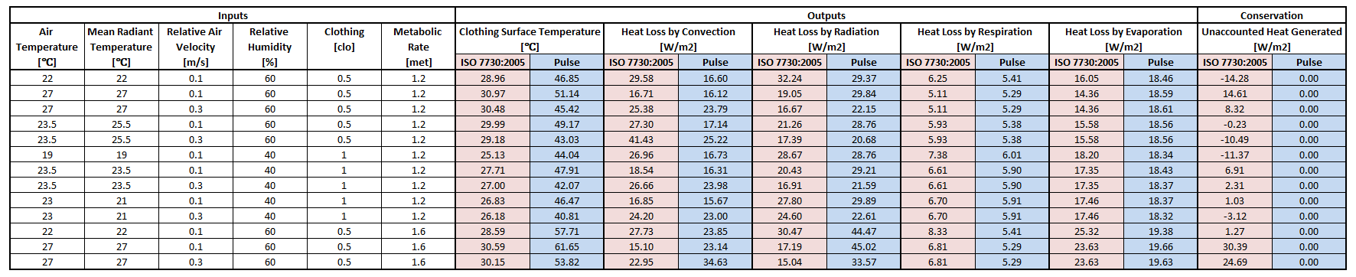

Slide 8
A
B
C
D

Slide 9
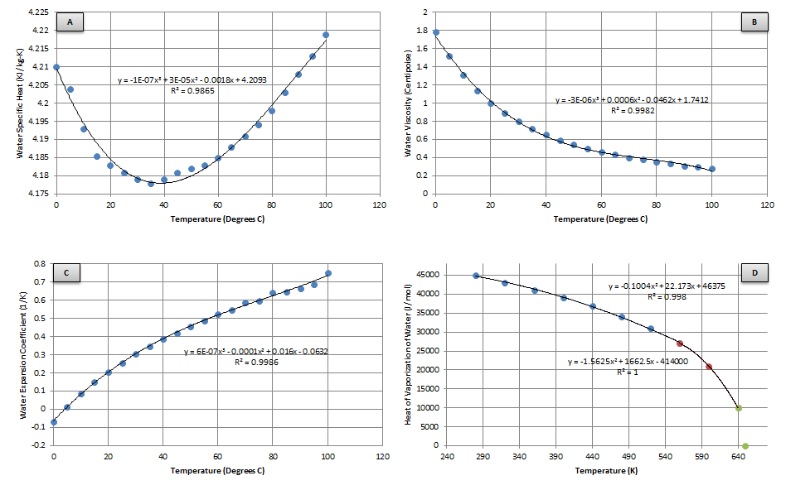

Slide 10




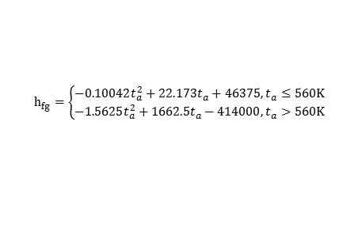




ASHRAE Handbook of Fundamentals
$$β=\frac{1}{ρc_{p}}$$
http://www.thermopedia.com/content/923/
$c_{p,w}$ = -1E-07$T_{∞}^{3}$+ 3E-05$T_{∞}^{2}$ - 0.0018$T_{∞}$ + 4.2093
$$ρ=\frac{p_{d}M_{d}+p_{v}M_{v}}{Ut_{a}}$$
$μ$ = -3E-06$T_{∞}^{3}$ + 0.0006$T_{∞}^{2}$ - 0.0462$T_{∞}$ + 1.7412
http://wahiduddin.net/calc/density_altitude.htm
$α$= 6E-07$T_{∞}^{3}$ - 0.0001$T_{∞}^{2}$ + 0.016$T_{∞}$ - 0.0632
$$p_{v}=ϕp_{a}$$
http://wahiduddin.net/calc/density_altitude.htm
$$p_{d}=p_{t}−p_{v}$$
http://wahiduddin.net/calc/density_altitude.htm
$$h_{fg}=\left\{\begin{aligned}−0.10042t_{a}^{2}+22.173t_{a}+46375, t_{a}≤560K \\ −1.5625t_{a}^{2}+1662.5t_{a}−414000, t_{a}>560K\end{aligned}\right.$$
Antoine Equation (for water):
$$p={10}^{\left(A−\frac{B}{C+t}\right)}$$
For p_{sk,s} and p_{a}
A | B | C | t_{min} (°C) | t_{max} (°C)
8.07131 | 1730.63 | 233.426 | 1 | 100
8.14019 | 1810.94 | 244.485 | 99 | 374

Slide 11



Note: R_{clothing} remains constant, unless modified by the user – doesn’t automatically take into account sweat saturation, etc.
$$h_{r}=4εσ\frac{A_{r}}{A_{D}}{\left(\frac{t_{cl}+t_{mr}}{2}\right)}^{3}$$
ASHRAE Handbook of Fundamentals
$$R_{Rad}=\frac{A_{d}}{h_{r}}$$
$$t_{mr}$$

Slide 12




$$h_{c}=10.3v^{0.6}$$
Dear, et al
$$R_{Conv}=\frac{A_{d}}{h_{c}}$$
$$R_{clothing}=\frac{R_{cl}}{A_{d}}$$
$$t_{a}$$

Slide 13








$$w_{rsw}=\frac{E_{rsw}}{E_{max}}$$
ASHRAE Handbook of Fundamentals
$$E_{sk}=E_{rsw}+E_{dif}$$
ASHRAE Handbook of Fundamentals
$$E_{max}=h_{e}F_{pcl}\left(p_{sk,s}−p_{a}\right)$$
http://www.ilocis.org/documents/chpt42e.htm
$$E_{rsw}={\dot{m}}_{rsw}h_{fg}$$
ASHRAE Handbook of Fundamentals
$$F_{pcl}=\frac{1}{1+2.22h_{c}R_{cl}}$$
$$E_{dif}=\left(1−w_{rsw}\right)0.06E_{max}$$
ASHRAE Handbook of Fundamentals
http://www.ilocis.org/documents/chpt42e.htm
$$h_{e}=βh_{c}$$
ASHRAE Handbook of Fundamentals
$${Q_{Evaporation}=A_{d}E}_{sk}$$

Slide 14









$$h_{c}=0.09\left(Gr−Pr\right)0.275$$
Boutelier et. al
$$Gr=\frac{gα\left(T_{s}−T_{∞}\right)D^{3}}{ν^{2}}$$
$$Pr=\frac{c_{p,w}μ}{k}$$
$$ν=\frac{μ}{ρ}$$
$$T=\frac{T_{∞}}{298.15}$$
$$k=0.6065\left(−1.48445 +4.12292 T+−1.63866 T^{2}\right)$$
Ramires, et al
$$R_{Conv}=\frac{A_{d}}{h_{c}}$$
Assumes water pressure of 0.1 MPa (sea level)
R_{cl} for submerged – different than in air
Like a wet suit
I have a paper with wet suit values
$R_{cl}$ when saturated
$$R_{Rad}=∞$$
Assumes radiation and evaporation are negligible
$$E_{sk}=0$$

Slide 15






Same for air and submerged
Assumes head above water when breathing
Should work for RR=0
$$q_{res}=q_{res,lat}+q_{res,sen}$$
Shitzer & Eberhart
$$q_{res,sen}={\dot{m}}_{res}ρc_{p}\left(t_{res}−t_{a,res}\right)$$
Shitzer & Eberhart
$$q_{res,lat}=h_{fg}{\dot{m}}_{res}∆W$$
Shitzer & Eberhart
(°F)
$$∆W=0.02645+0.0000361t_{a}−0.798H$$
McCutchan & Taylor
(K)
$$H=\frac{100ϕ}{0.263p_{t}}e^{\left(\frac{17.67\left(t_{a}−273.16\right)}{t_{a}−29.65}\right)}$$
http://earthscience.stackexchange.com/questions/2360/how-do-i-convert-specific-humidity-to-relative-humidity
$$q_{res}$$

Slide 16
Applied Temperature
Heating (positive)
and/or
Cooling (negative)

Slide 17
\[\beta \mathrm{=}\frac{\mathrm{1}}{\rho c_p}\]
\[\rho \mathrm{=}\frac{p_dM_d\mathrm{+}p_vM_v}{Ut_a}\]
\[p_v\mathrm{=}\mathrm{\phi }p_a\]
\[p_d\mathrm{=}p_t\mathrm{-}p_v\]
\[p\mathrm{=}{\mathrm{10}}^{\left(A\mathrm{-}\frac{B}{C\mathrm{+}t}\right)}\]
\[{\mathrm{h}}_{\mathrm{fg}}\mathrm{=}\left\{ \begin{array}{c}
-0.10042t^2_a+22.173t_a+46375,~t_a\mathrm{\le }\mathrm{560K} \\
-1.5625t^2_a+1662.5t_a-\mathrm{414000,}~t_a\mathrm{>560K} \end{array}
\right.\]
\[{\mathrm{c}}_{\mathrm{p,w}}=-1e^{-7}{\mathrm{T}}^{\mathrm{3}}_{\mathrm{\infty }}+3e^{-5}{\mathrm{T}}^{\mathrm{2}}_{\mathrm{\infty }}-0.0018{\mathrm{T}}_{\mathrm{\infty }}+4.2093\]
\[\mu \mathrm{\ }=-3e^{-6}{\mathrm{T}}^{\mathrm{3}}_{\mathrm{\infty }}+0.0006{\mathrm{T}}^{\mathrm{2}}_{\mathrm{\infty }}-0.0462{\mathrm{T}}_{\mathrm{\infty }}+1.7412\]
\[\mathrm{\alphaup }\mathrm{\ }=6e^{-7}{\mathrm{T}}^{\mathrm{3}}_{\mathrm{\infty }}+0.0001{\mathrm{T}}^{\mathrm{2}}_{\mathrm{\infty }}+0.016{\mathrm{T}}_{\mathrm{\infty }}-0.0632\]
\[{\mathrm{h}}_r\mathrm{=4}\varepsilon \sigma \frac{A_r}{A_D}{\left(\frac{t_{cl}\mathrm{+}t_{mr}}{\mathrm{2}}\right)}^{\mathrm{3}}\]
\[{\mathrm{h}}_c\mathrm{=10.3}v^{\mathrm{0.6}}\]
\[E_{sk}\mathrm{=}E_{rsw}\mathrm{+}E_{dif}\]
\[E_{rsw}\mathrm{=}{\dot{m}}_{rsw}{\mathrm{h}}_{fg}\]
\[E_{dif}\mathrm{=}\left(\mathrm{1-}w_{rsw}\right)\mathrm{0.06}E_{max}\]
\[w_{rsw}\mathrm{=}\frac{E_{rsw}}{E_{max}}\]
\[E_{max}\mathrm{=}{\mathrm{h}}_eF_{pcl}\left(p_{sk,s}\mathrm{-}p_a\right)\]
\[F_{pcl}\mathrm{=}\frac{\mathrm{1}}{\mathrm{1+2.}\mathrm{22}{\mathrm{h}}_cR_{cl}}\]
\[{\mathrm{h}}_e\mathrm{=}\beta {\mathrm{h}}_c\]
\[{\mathrm{h}}_c\mathrm{=0.09}\left(Gr\mathrm{-}Pr\right)\mathrm{0.275}\]
\[Gr\mathrm{=}\frac{g\mathrm{\alphaup }\left(T_s\mathrm{-}T_{\mathrm{\infty }}\right)D^{\mathrm{3}}}{{\mathrm{\nuup }}^{\mathrm{2}}}\]
\[Pr\mathrm{=}\frac{c_{p,w}\mu }{k}\]
\[\nu \mathrm{=}\frac{\mu }{\rho }\]
\[T\mathrm{=}\frac{T_{\mathrm{\infty }}}{\mathrm{298.15}}\]
\[k\mathrm{=0.6065}\left(\mathrm{-}\mathrm{1.48445}~\mathrm{+4.12292}~T\mathrm{+-1.63866}~T^{\mathrm{2}}\right)\]
\[q_{res}\mathrm{=}q_{res,lat}\mathrm{+}q_{res,sen}\]
\[q_{res,sen}\mathrm{=}{\dot{m}}_{res}\rho c_p\left(t_{res}\mathrm{-}t_{a,res}\right)\]
\[q_{res,lat}\mathrm{=}{\mathrm{h}}_{fg}{\dot{m}}_{res}\mathrm{\Delta }W\]
\[\mathrm{\Delta }W\mathrm{=0.02645+0.0000361}t_a\mathrm{-}\mathrm{0.798}H\]
\[\mathrm{H=}\frac{\mathrm{100}\mathrm{\phi }}{\mathrm{0.263}p_t}e^{\left(\frac{\mathrm{17.67}\left(t_a\mathrm{-}\mathrm{273.16}\right)}{t_a\mathrm{-}\mathrm{29.65}}\right)}\]

Slide 18
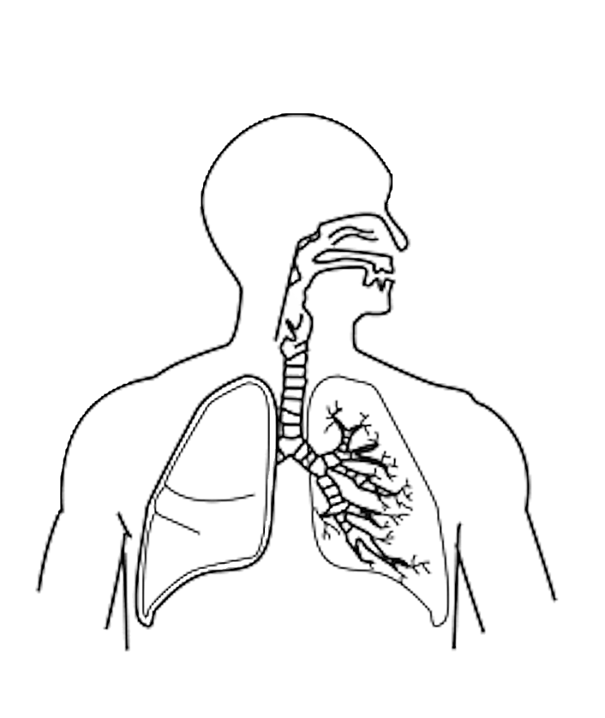
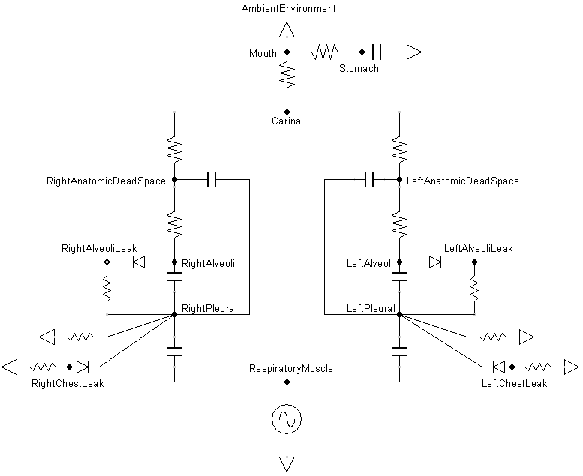
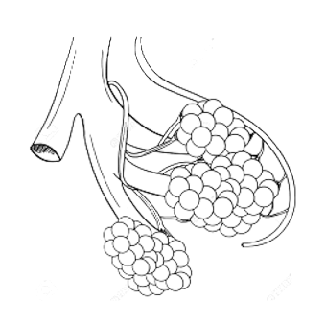
Deposition
Air Flow Resistance
Inflammation
A
A
B
Deposition
Air Flow Resistance
Inflammation
T
B
C
Tissue Damage
Permeability to fluid and Protein
T
Air Flow Resistance
C
Permeability to fluid and Protein
Symbol | Description
A | Mouth-to-Carina path
B | Carina-to-Left(Right)AnatomicDeadSpace Path
C | Left(Right)AnatomicDeadSpace-to-Left(Right)Alveoli Path
T | Left(Right) Lung Tissue
Inflammation
Deposition
Tissue Damage
Alveolar Gas Permeability
T

Slide 19
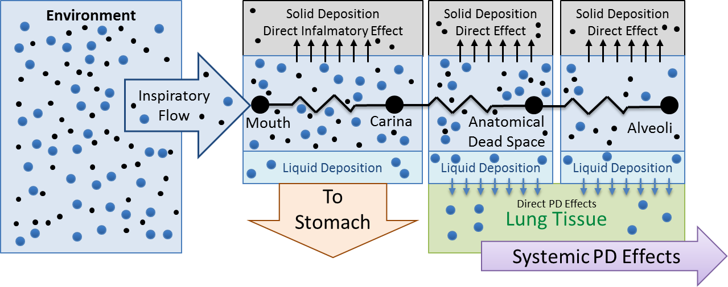
Environment
Solid Deposition
Direct Infalmatory Effect
Solid Deposition
Direct Effect
Solid Deposition
Direct Effect
Inspiratory Flow
Mouth
Carina
Anatomical Dead Space
Alveoli
Liquid Deposition
Liquid Deposition
Liquid Deposition
To Stomach
Lung Tissue
Direct PD Effects
Systemic PD Effects

