Slide 2
Example Pressure Source Driver
[2] Inspiration Phase
[3] Expiration Phase
[3a] Trigger
[2a] Cycle
[3a] Trigger
[2c] Period
[2d] Target /
[2e] Limit
Pressure
[2b] Waveform
[3b] Waveform
[3d] Baseline
Time

Slide 3
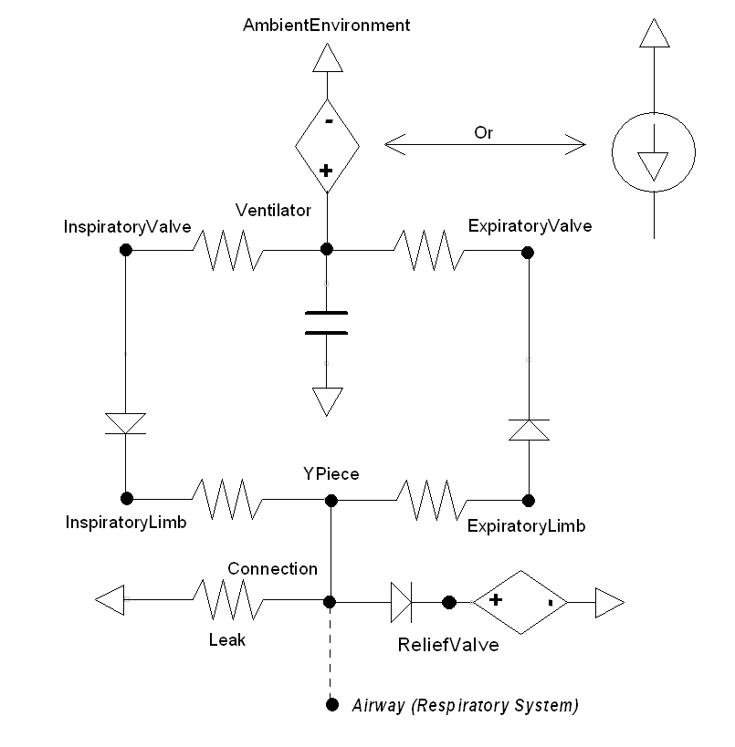
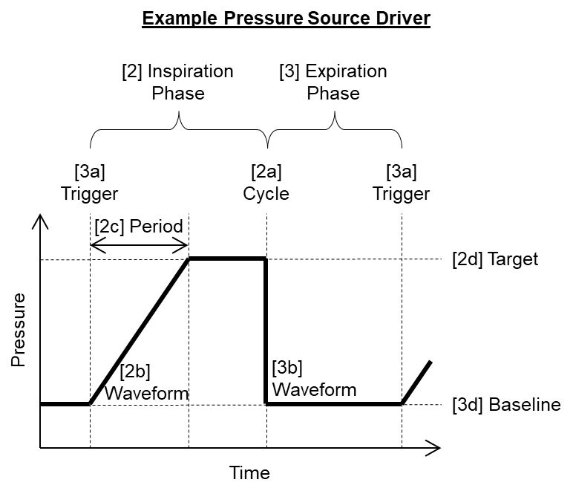
or
[5]
[7b]
[7c]
[6b]
[8]
[6d]
[6a]
[6c]
[7a]
[7e]
[7d]
[7f]
[9]
[1]

Slide 4
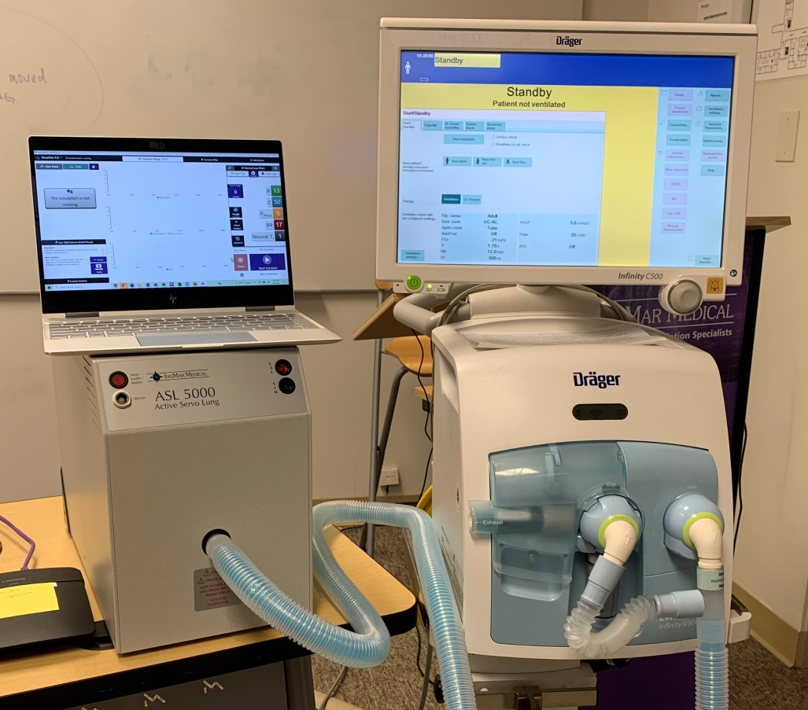
Dräger
Control/Display
RespiSim® Controller/Display
Dräger
Ventilator
ASL 5000™
Virtual Lung

Slide 5
Transition to Inspiration [2]
Transition to Expiration [3]
Yes
Cycle Achieved? [2a]
Pause Period Reached? [2f]
Trigger Achieved? [3a]
Step Time
Yes
Step Time
Yes
No
No
No
Limit Reached? [2e]
Hold Driver (Constant)
Apply Limit to Driver (Constant) [2e]
Yes
Apply Waveform to Driver (Function) [3b]
Yes
Waveform Period Reached? [3c]
No
No
Apply Target to Driver (Constant) [2d]
Yes
Waveform Period Reached? [2c]
Step Time
Apply Baseline to Driver (Constant) [3d]
No
Apply Waveform to Driver (Function) [2b]

Slide 6
No Breathing Simulator Image

