Slide 1
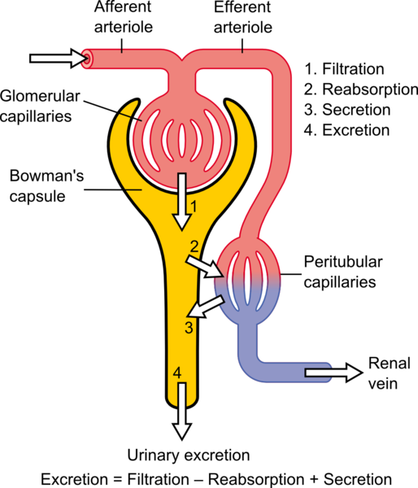
https://commons.wikimedia.org/wiki/File:Physiology_of_Nephron.png

Slide 2
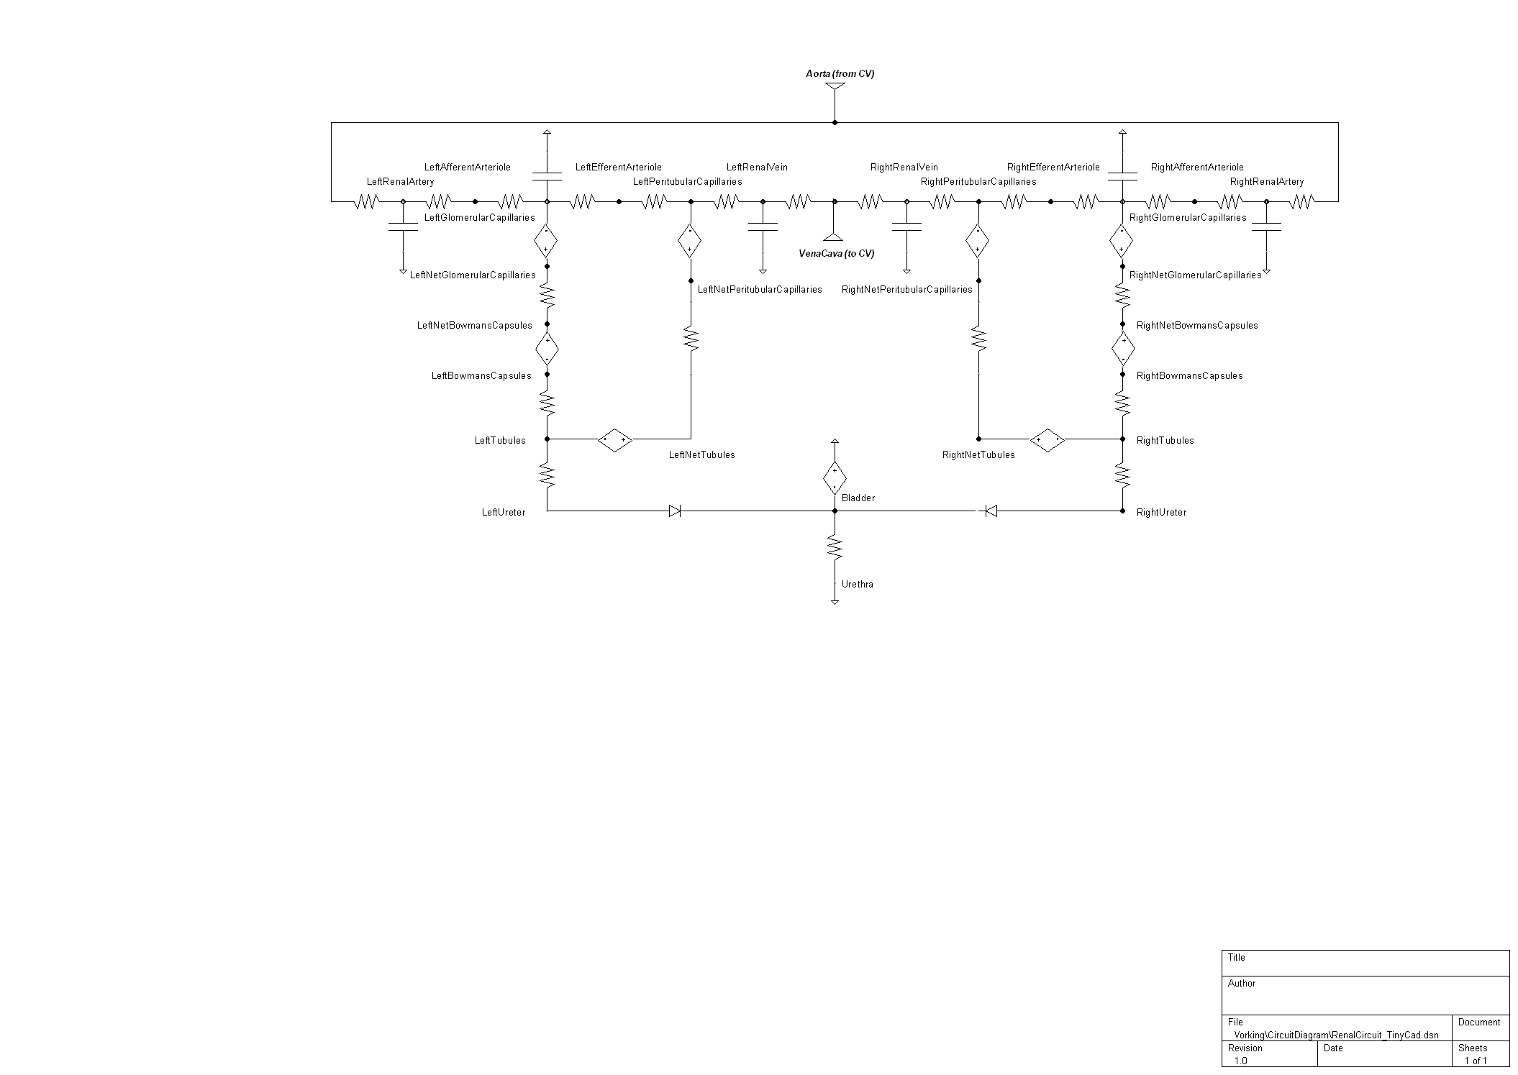
Blood
Reabsorption
T
T
T
T
Filtration
Excretion
Urine
T = Manual (i.e. active) transport; all others generic (i.e. passive)

Slide 3
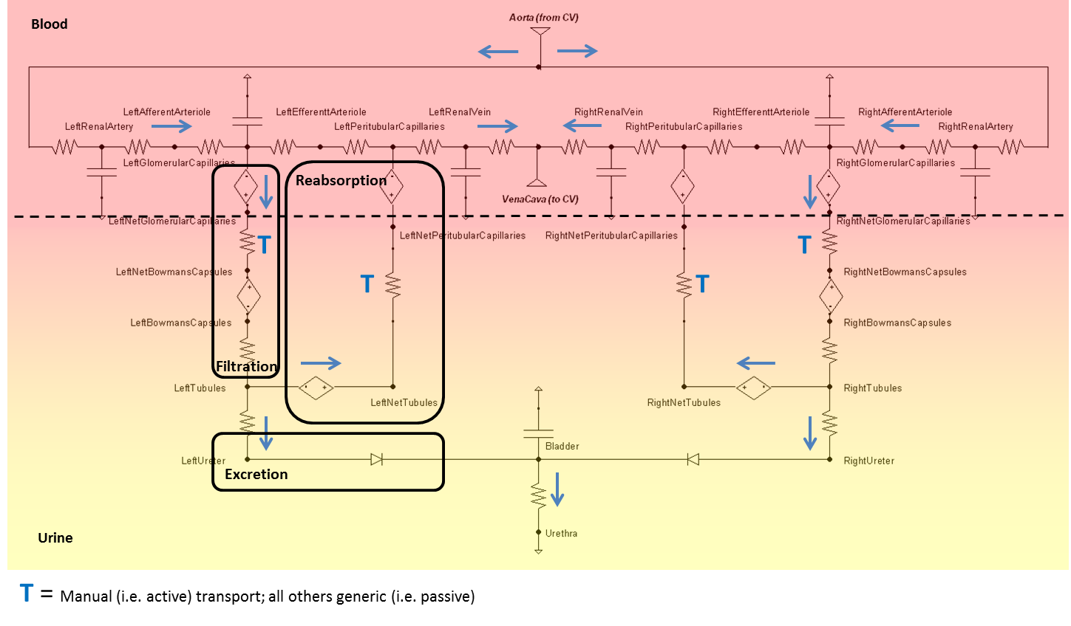

Slide 4
1
2
3
4
5
6
7
8
10
9
11
12

Slide 5
1
4
2
3

Slide 6

$$R_{Filt}$$

Slide 7


$$R_{Aff}$$
$${S_{F}}^{x}$$

Slide 8

Guyton
Pressure Increase
Mean Arterial Pressure
Pressure Decrease
Water Deficit
Plasma Fluid
Excess Water
Renal Blood Flow
Plasma Osmolarity
(Sodium Concentration)
Glomerular Filtration Rate
Tubules Permeability
Delivery of Sodium to Macula Densa
Water Reabsorption
Constriction
Afferent Arteriole Change
Dilation
Water Excreted
(Urine Production)
Tanner
$$k_{P}∗=\frac{{C_{SP}}^{x}}{{C_{SP,Set}}^{x}}$$

Slide 9
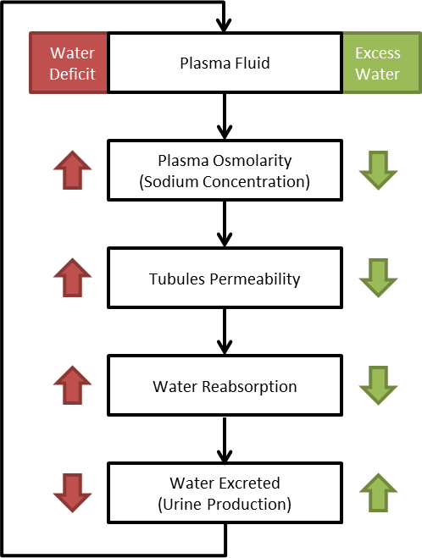
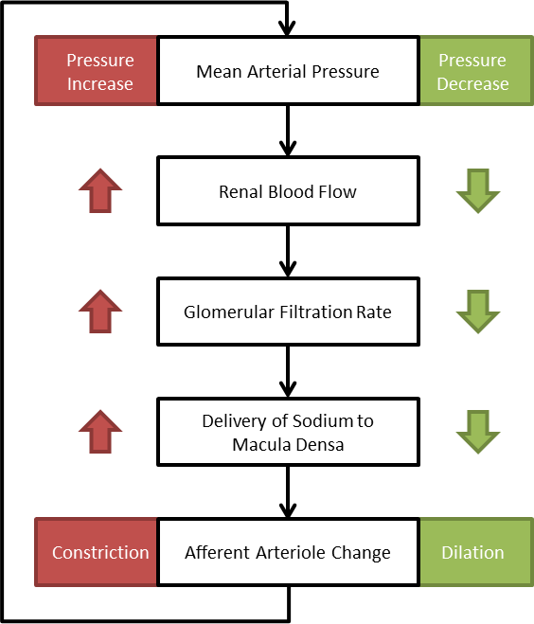

Slide 10
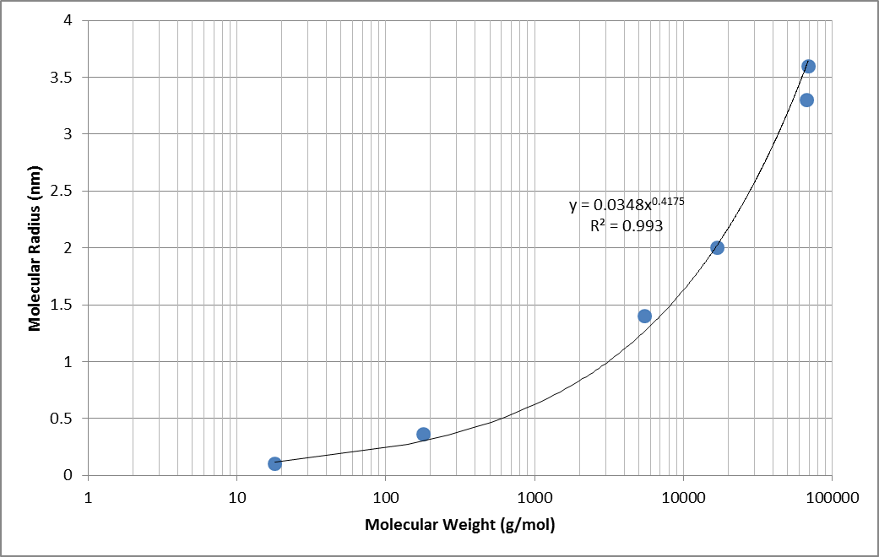
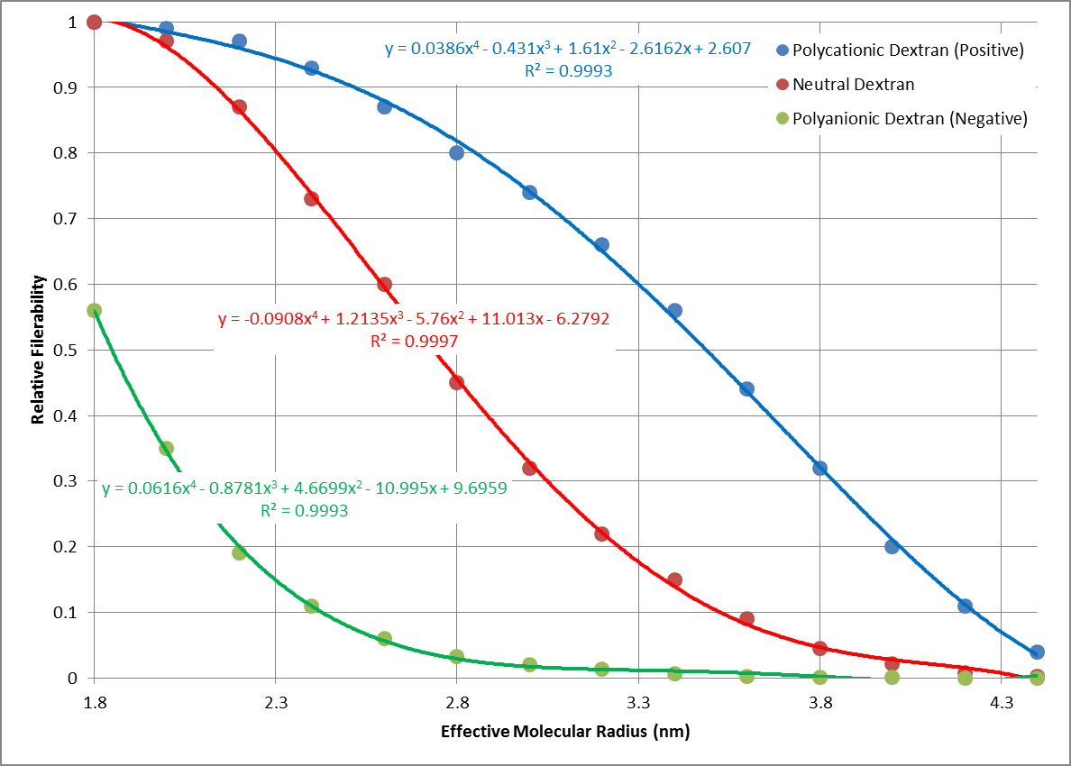
Boherer
Guyton & Tanner (2 references)
Note: Dog data, but widely accepted for humans (Guyton & Valtin)

