Slide 1
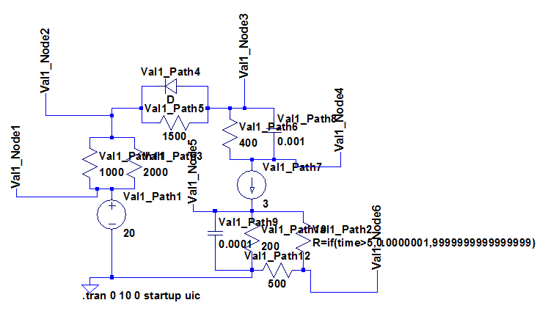
ValidationComprehensive1

Slide 2
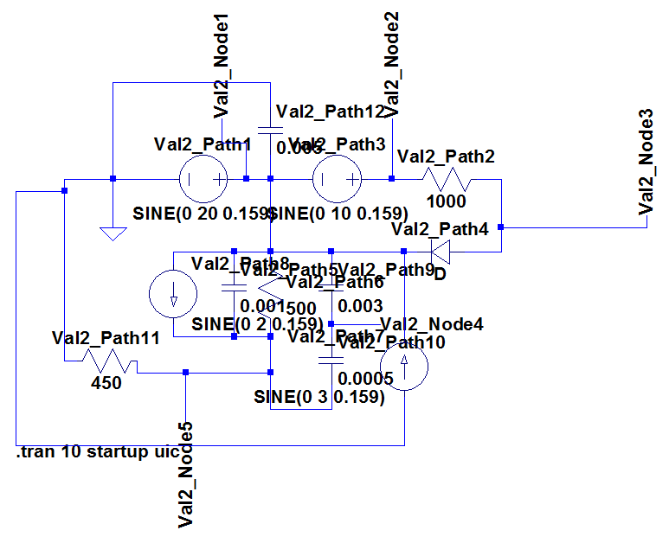
ValidationComprehensive2

Slide 3

Preprocess
Modified Nodal Analysis
Setup/Modify Next Values
Calculate Fluxes
Process
Modify Valve States
No
Valves Pass?
Yes
Advance Time
Calculate Quantities
Postprocess

Slide 4
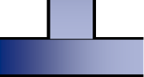




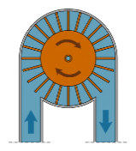
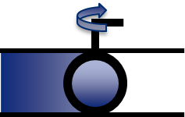

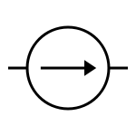

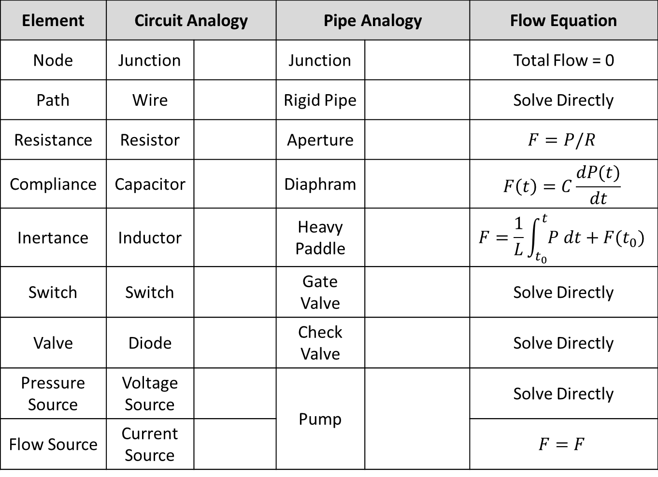
Element | Circuit Analogy |  | Pipe Analogy |  | Flow Equation
Node | Junction |  | Junction |  | Total Flow = 0
Path | Wire |  | Rigid Pipe |  | Solve Directly
Resistance | Resistor |  | Aperture |  | $$F=P/R$$
Compliance | Capacitor |  | Diaphram |  | $$F\left(t\right)=C\frac{dP(t)}{dt}$$
Inertance | Inductor |  | Heavy Paddle |  | $$F=\frac{1}{L}\int_{t_{0}}^{t}{P dt}+F(t_{0})$$
Switch | Switch |  | Gate Valve |  | Solve Directly
Valve | Diode |  | Check Valve |  | Solve Directly
Pressure Source | Voltage Source |  | Pump |  | Solve Directly
Flow Source | Current Source |  |  |  | $$F=F$$

Slide 5
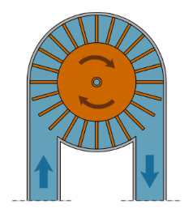





Slide 6
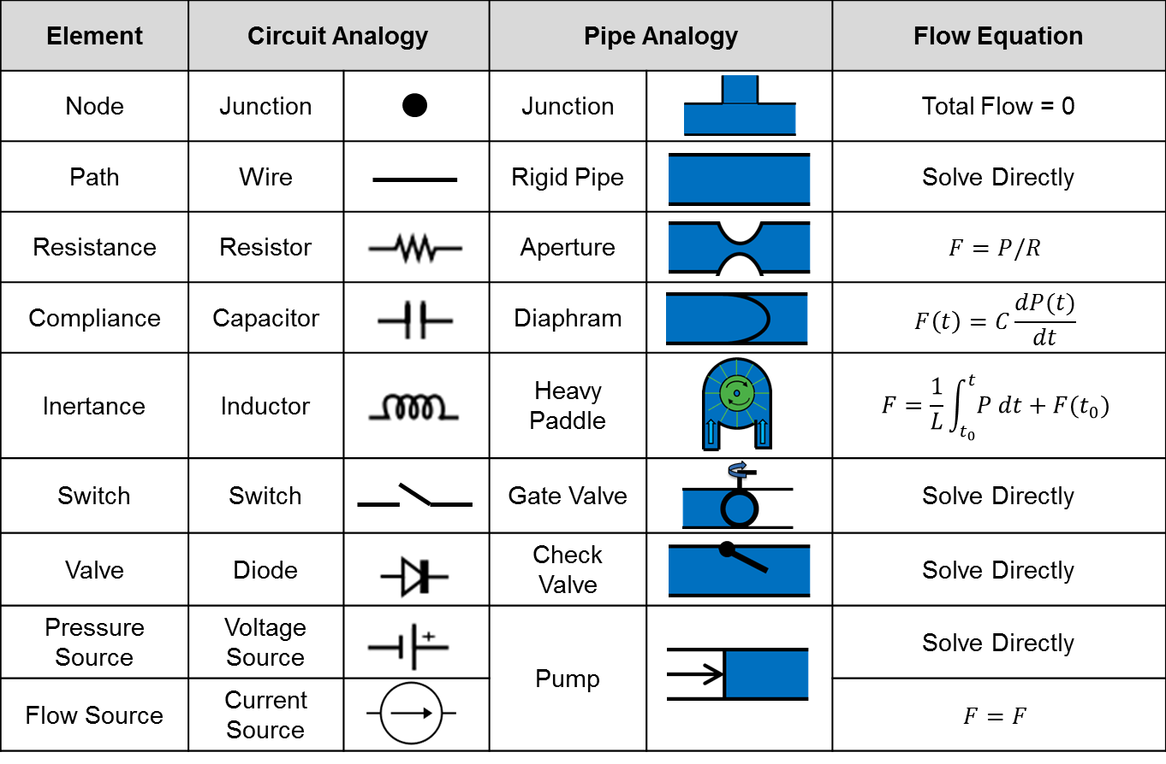

Slide 7

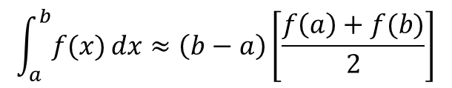

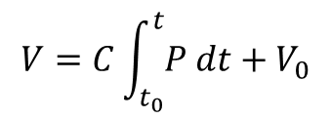
$$A=P^{−1}{LUQ}^{−1}$$
$$V=C\int_{t_{0}}^{t}{P dt+V_{0}}$$
$$\int_{a}^{b}{f(x)}dx≈\left(b−a\right)\left[\frac{f\left(a\right)+f(b)}{2}\right]$$
Q$\left(t\right)=C∙V(t)$

Slide 8
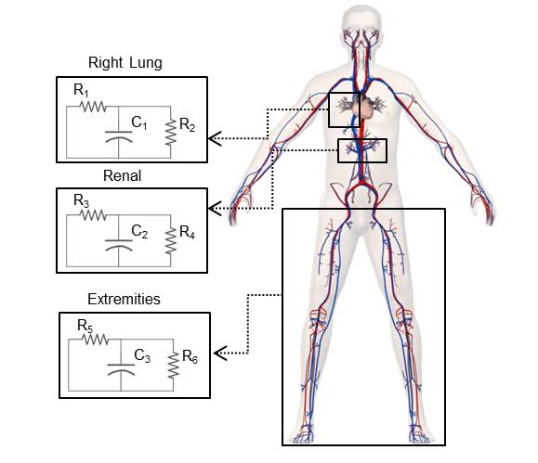
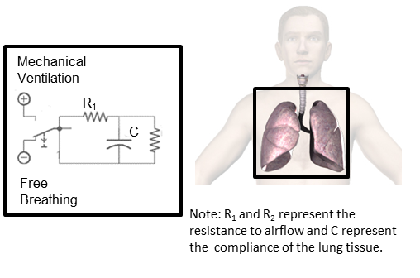

Slide 9
Legend:
Node
Path
Element

Slide 10
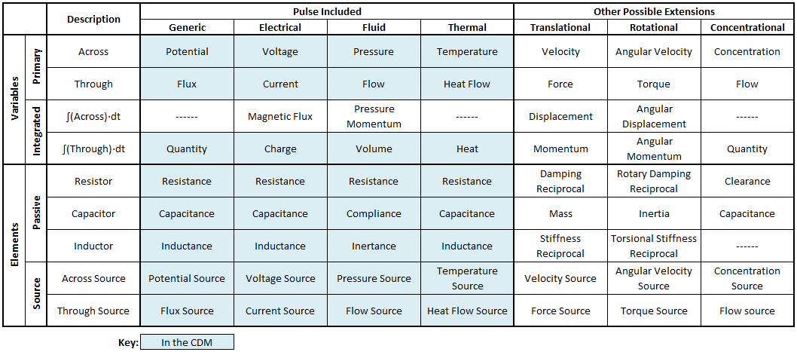

Slide 11
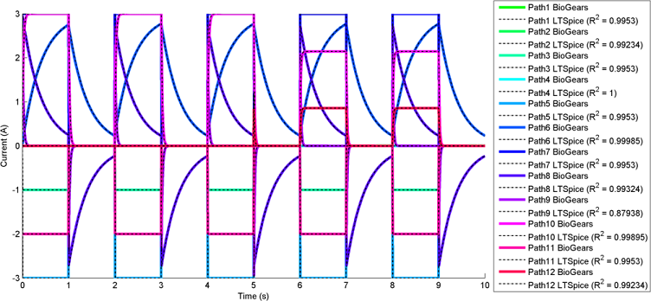
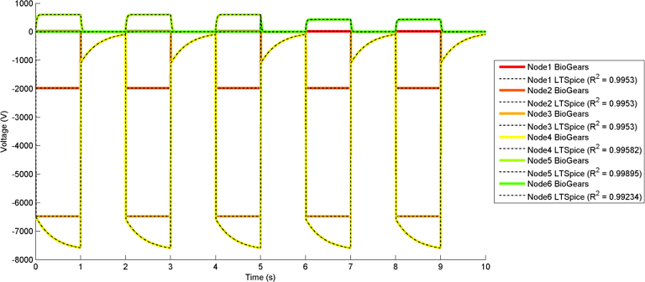
Pulse
Pulse
Pulse
Pulse
Pulse
Pulse
Pulse
Pulse
Pulse
Pulse
Pulse
Pulse
Pulse
Pulse
Pulse
Pulse
Pulse
Pulse

Slide 12
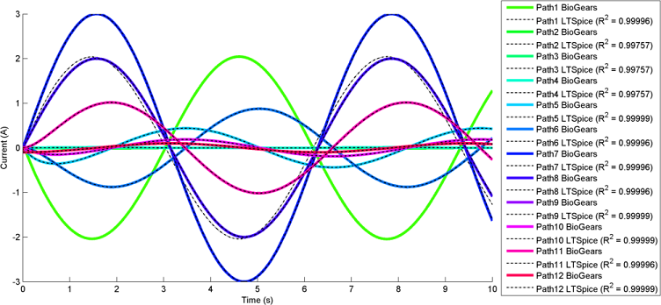
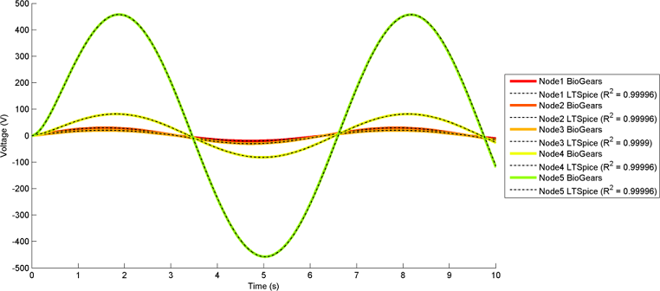
Pulse
Pulse
Pulse
Pulse
Pulse
Pulse
Pulse
Pulse
Pulse
Pulse
Pulse
Pulse
Pulse
Pulse
Pulse
Pulse
Pulse

Slide 13
Source Node
Black Box Element
Target Node
Black Box Boundary
Source Node/Potential
Source Path/Flux
Target Path/Flux
Target Node/Potential
Middle (Internal) Node/Potential/Quantity

