Slide 1
Conditions
Anemia
RenalStenosis
VentricularSystolicDysfunction
PericardialEffusion
Preprocess
HeartDriver
BeginCardiacCycle
CalculateHeartElastance
ProcessActions
TraumaticBrainInjury
Hemorrhage
PericardialEffusion
CPR
CardiacArrest
UpdateHeartRhythm
CalculatePleuralCavityVenousEffects
Process
Solve Circuit
Advective Transport
CalculateVitalSigns
PostProcess
Advance Circuit

Slide 2
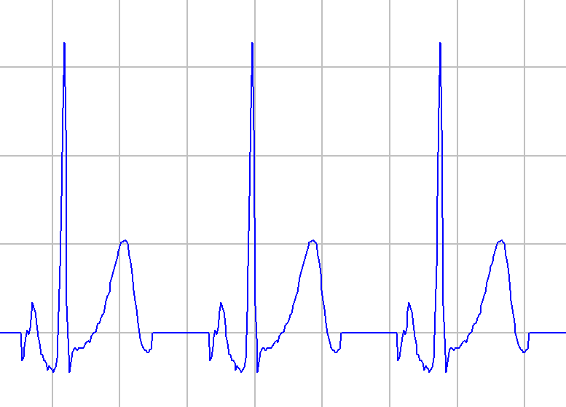
R
R-R
T
P-R
P
Q
S
S-T
Q-R-S
Q-T

Slide 3
