Slide 1
基于无源自适应的医学图像增强

Slide 2
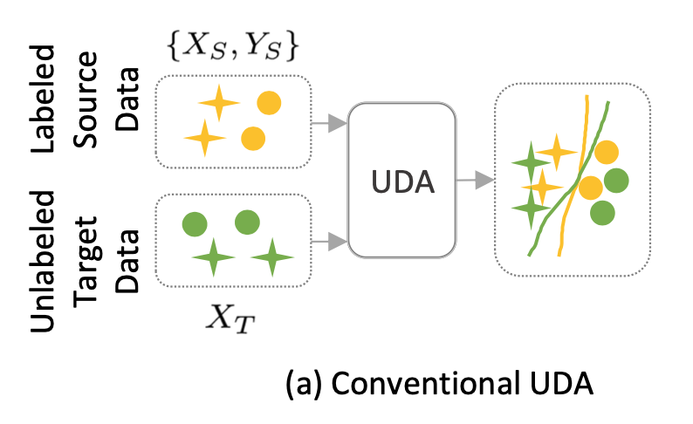
Background
Unsupervised domain adaptation (UDA) is a technique that leverages knowledge from a labeled source domain to perform a task on an unlabeled target domain with different data distributions. UDA can reduce the labeling cost and improve the generalization ability of deep learning models for various tasks such as semantic segmentation, object detection, and node classification

Slide 3
Background
Existing deep learning studies on unsupervised domain adaptation highly depend on the accessibility of source data, which is usually limited in practical scenarios due to the following possible reasons.
Data privacy protection
Data storage and transmission cost
Computation burden

Slide 4
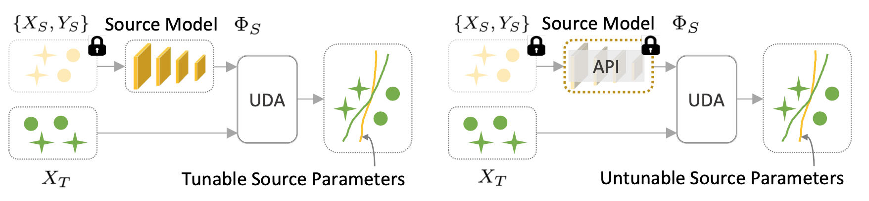
Source-Free Unsupervised Domain Adaptation (SFUDA)
Source-free unsupervised domain adaptation (SFUDA) is a realistic and challenging setting of unsupervised domain adaptation (UDA) that aims to transfer knowledge from a pre-trained source model to an unlabeled target domain without accessing source data. SFUDA methods can be categorized into two groups:
white-box SFUDA
black-box SFUDA

Slide 5
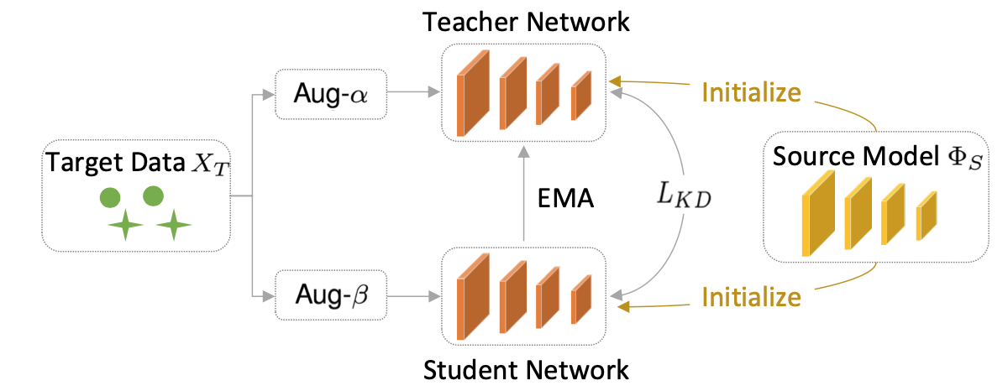
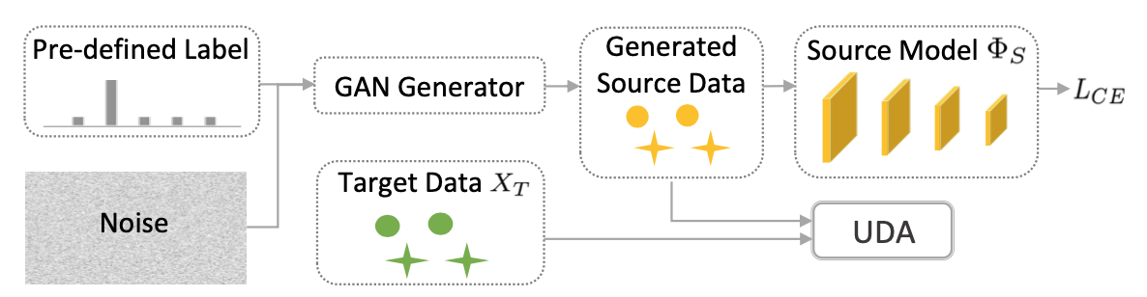
White-box SFUDA
Data Generation
Model Fine-Tuning
Data-based methods aim to generate synthetic data that resemble the target domain data and use them to fine-tune or retrain the source model. For example, some methods use generative adversarial networks (GANs) or variational autoencoders (VAEs) to synthesize realistic target-like images from noise vectors or source images1. Other methods use style transfer or image translation techniques to transform source images into target-like images with preserved semantic content.
Model-based methods aim to improve the source model’s performance on the target domain by adjusting its architecture or parameters. For example, some methods use self-distillation or self-training techniques to enhance the source model’s robustness and generalization. Other methods use adversarial learning or meta-learning techniques to align the source and target domains at different levels of feature representations

