Slide 1




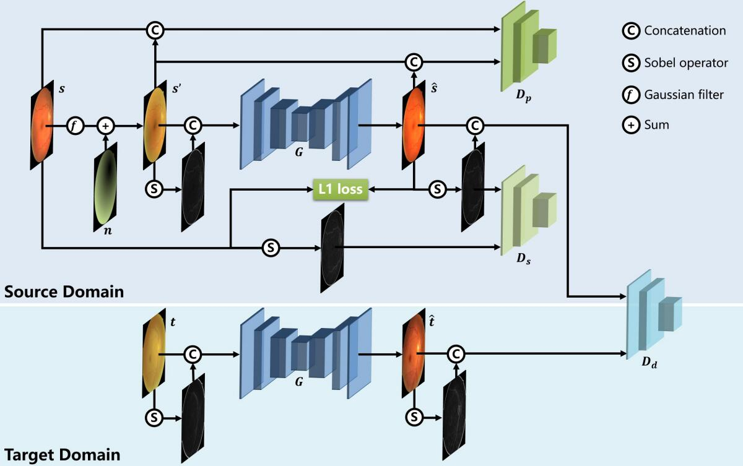
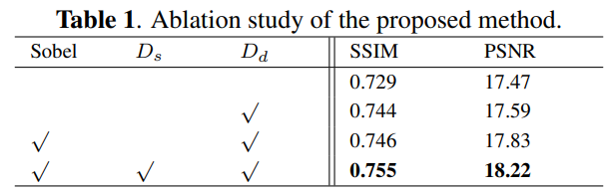
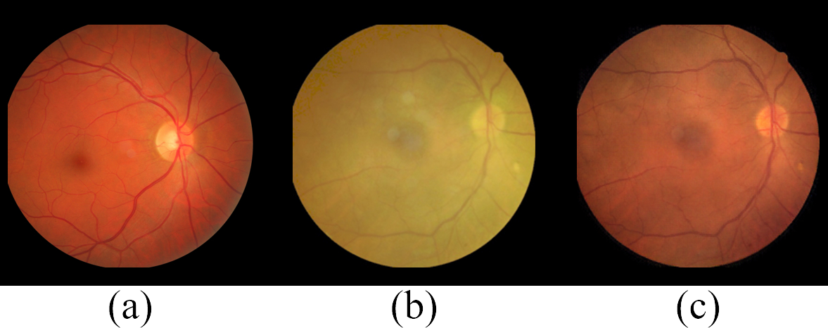
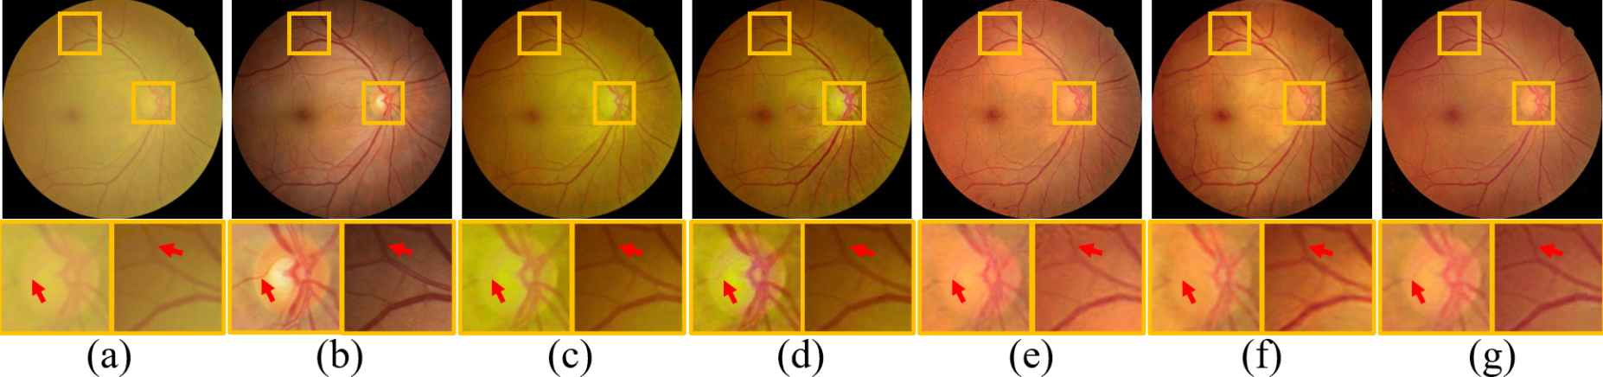
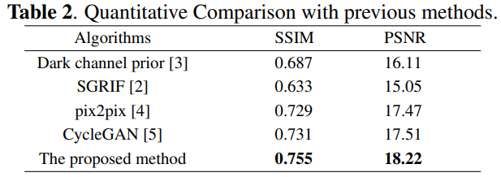
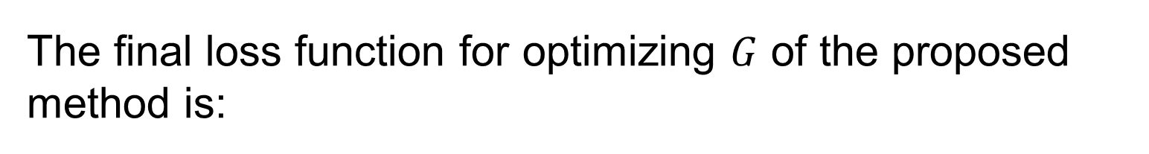




Restoration of Cataract Fundus Images via Unsupervised Domain Adaptation
Heng Li ¹, Haofeng Liu ¹, Yan Hu ^{1 *}, Risa Higashita ², Yitian Zhao ³, Hong Qi ⁴, Jiang Liu ^{1 3 5 *}
1School of Computer Science and Engineering, Southern University of Science and Technology, Shenzhen 518055, China
2Royal Brisbane Hospital, Brisbane, Australia
3Cixi Institute of Biomedical Engineering,Ningbo Institute of Industrial Technology, Chinese Academy of Sciences, Ningbo 315201, China
4Department of Ophthalmology, Peking University Third Hospital, Beijing 100191, China
5Guangdong Provincial Key Laboratory of Brain-inspired Intelligent Computation, Southern University of Science and Technology, Shenzhen 518055, China
Introduction
Cataract is a common disease causing the most vision loss and blindness in the world.
Cataract images paired with after-surgery images are rare and existing conditional GAN-based image-to-image models often damage retinal anatomical structures.
This work proposes an end-to-end unsupervised restoration model to remove artifacts in cataract fundus. The model is trained with simulated data and adapted to real images in an image-to-image translation model.
The code will be released at https://github.com/liamheng/Restoration-of-Cataract-Images-via-Domain-Adaptation.
Method
Results
to $1×{10}^{−4}$for the first 150 epochs and then gradually decayed to zero over the next 50 epochs.
Ablation Study
Based on Pix2pix network, this paper adds Sobel operator, $D_{s}$, and $D_{d}$ to build our model. Table 1 summarizes the results.
Two datasets were adopted in this study:
Simulated images were derived from DRIVE to construct the source domain.
Twenty-six cataract images paired with clear after-surgery images were adopted as the target domain, as well as to evaluate the algorithms.
The evaluation metric of PSNR and SSIM were utilized to quantify the restored image quality.
The proposed model was implemented in PyTorch. The images were resized to $256 ×256$ with a batch size of 8 for each iteration. The learning rate was initialized
Figure 2: Architecture of the proposed algorithm. Cataract-like images were simulated to construct the annotated date for the training of $G$. The Sobel operator and $D_{s}$ preserved the retinal structure. And $D_{d}$generalized the restoration model from the source domain to the unannotated target domain.
Figure 1: Retinal fundus images. (a) from eyes without cataract;(b) from eyes with cataract; (c) restored image from (b).
Cataract-like image simulation
Given a clear fundus image $s$, a cataract-like image $s′$ is simulated to construct the annotated source domain. Additionally, 400 pairs of source data are acquired to training the restoration model.
Image restoration by image-to-image translation
Based on Pix2pix, the model is trained under the supervision of the source domain, optimizing $ℒ_{pGAN}$ with adversarial network and $ℒ_{s}$ with Sobel filter.
Unsupervised domain adaptation
As the restored images and the clear ones should belong to the same domain, we adapt the restoration model via adversarial learning. The restored images $\hat{s}$ from the source domain and $\hat{t}$ from the target one, as well as their structure, were forwarded to a domain discriminator $D_{d}$ using following loss $ℒ_{d}$
AIM
In this paper, we aim to construct an end-to-end unsupervised restoration model for cataract fundus images, to assist the clinical diagnosis of cataract fundus and overcome the impact of the scarcity of annotated data.
Figure 3: Comparison of the restored fundus images. The proposed method correctly preserves and enhances the clinical features. (a) cataract image. (b) clear fundus image after surgery. (c) dark channel prior. (d) SGRIF. (e) pix2pix. (f) CycleGAN. (g) the proposed method.
Comparison with previous methods
The visualized and quantitative comparisons with previous methods are summarized in Fig. 3 and Table 2.
The methods based on image-to-image translation perform more favorably than the dehaze models since they not only enhance the content but also translate the style of the fundus images.
The final loss function for optimizing $G$ of the proposed method is:
$$ℒ_{G}=ℒ_{pGAN}+λ_{1}ℒ_{L_{1}}+λ_{2}ℒ_{s}+λ_{3}ℒ_{d}$$
According to SSIM and PSNR, the proposed method outperforms the previous methods and achieves the highest score in the restored image quality.
From Fig. 3, the Sobel operator and the structure discriminator endowed the proposed method with an eminent ability on preserving and enhancing the clinical structure.
Conclusions
The low quality of retinal fundus image with cataract increases the uncertainty in clinical observation and treatment. This paper proposes an end-to-end unsupervised restoration method to enhance the contrast within cataract fundus images. Cataract-like images are simulated from clear ones to construct an annotated source domain. Subsequently, the proposed model learns the restoration mapping from the source domain and generalizes it to the target domain of real cataract images. The proposed method performs favorably against the previous methods in terms of fidelity and image quality.
References
[1] Wei Wang et al., “Cataract surgical rate and socioeconomics: a global study,” IOVS, vol. 57, no. 14, pp. 5872– 5881, 2016. [2] Jun Cheng et al., “Structure-preserving guided retinal image filtering and its application for optic disk analysis,” IEEE TMI, vol. 37, no. 11, pp. 2536–2546, 2018.
[3] Kaiming He et al., “Single image haze removal using dark channel prior,” IEEE PAMI, vol. 33, no. 12, pp. 2341–2353, 2010.
[4] Phillip Isola et al., “Image-to-image translation with conditional adversarial networks,” in CVPR, 2017, pp. 1125– 1134.
[5] Jun-Yan Zhu et al., “Unpaired image-to-image translation using cycle-consistent adversarial networks,” in ICCV, 2017, pp. 2223–2232.
Acknowledgements
This study is supported by Guangdong Basic and Applied Fundamental Research Fund Committee (2020A1515110286), Ningbo Public Welfare Science and Technology Project (2019C50049), and Ningbo Natural Science Foundation(2019A610354).

