Slide 1
Y
Y
r
X
X
X
X
X
X
X
X

Slide 2
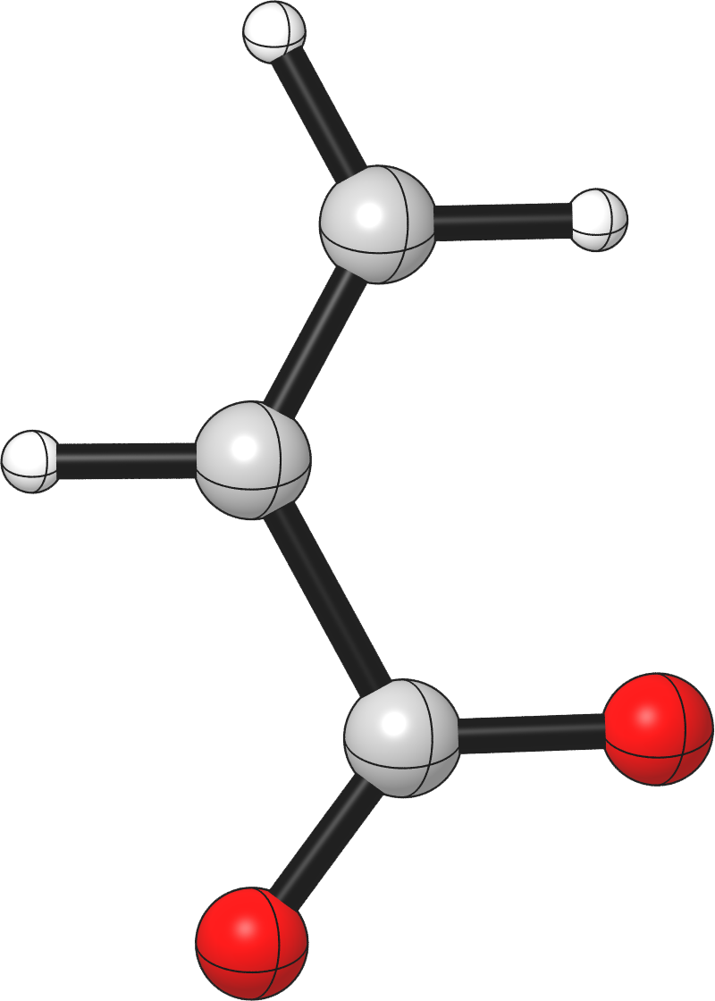


$$r_{i}$$
$$φ_{i}$$

Slide 3
The CAT.Database class
 | /path/to/my/database/files/
Database.close_…() |  | Database.open_…()
 | CAT.Database
Database.update_…() |  | Database.from_…()
 | my_python_object

