Slide 1
Final Project : Dungeon Lord
Benjamin Valenzuela
[CS-131-01]

Slide 2
Program Overview
A simple, text-based, onslaught-style RPG.
User creates a custom adventurer (name & race).
Adventurer races: Elven Archer, Celestial Wizard, Human Knight, Dwarven Warrior.
Objective: Survive and defeat 30 randomized enemies.
Orcs, Spiders, Slimes. Wraiths, and Demons.
Death resets progress and sends user back to main menu

Slide 3




Program Inputs and Outputs
Inputs: Text data entered via keyboard.
Outputs: Console text prompts and results based on user choices.
User interacts with program through menu-based options.
Results determined by user input and game logic.
User input
Game logic
Result

Slide 4
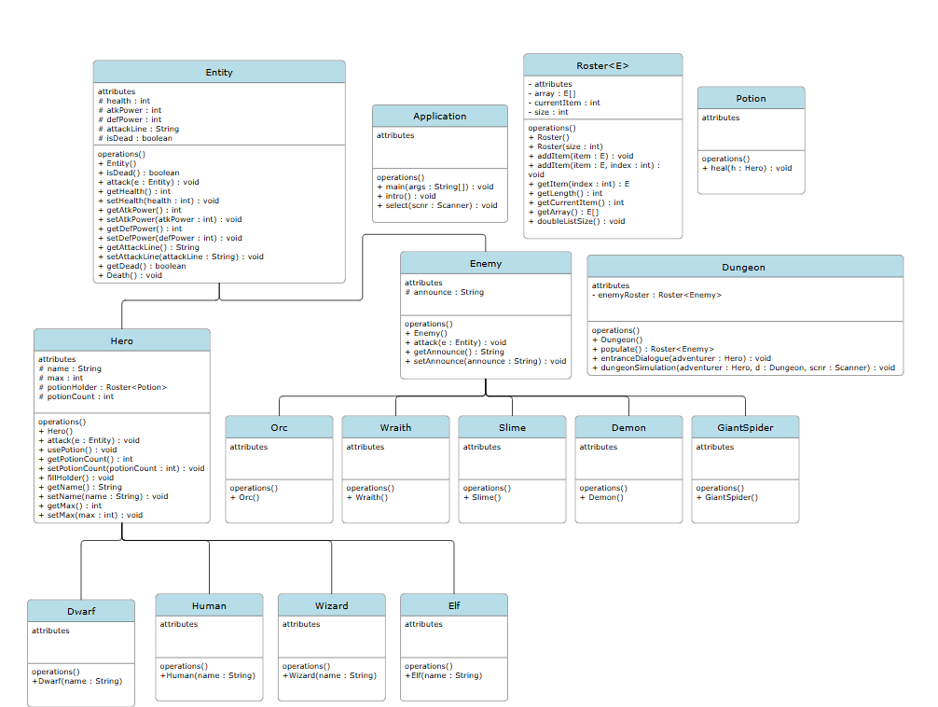
UML Program Structure

Slide 5
Application Class
Main entry point of the game.
Methods: main, intro, select.
Main: Calls intro and select.
Intro: Displays game title and welcome message.
Select: Handles player’s character creation and menu options.
Instantiates Hero and Dungeon objects
Initializes the dungeon simulation by calling methods from dungeon

Slide 6
Base Class Entity
Parent class for all game characters.
Attributes: Health, atkpower, defpower, attackline, isdead.
Methods:
Attack: Calculates and subtracts damage from another entity's health.
Death : Sets isdead boolean to true.

Slide 7
Hero Class
Subclass of Entity
unique attributes: name, max, potionHolder, and potionCount.
Overwrites attack method.
Four subclasses: Elf, Wizard, Human, Dwarf.
Each subclass has distinct set values for attributes:
Health, attack power, defense power, and attack line.
Created based on user input in select method of Application.
Unique methods:
Attack: customized for user attacking enemy class opponents.
UsePotion: heals the user's character.
FillHolder: populates the generic array class potionHolder.

Slide 8
Potion Class
Class representing a health potion that heals the user's character
Method:
Heal : sets the hero object's health to its max value

Slide 9
Enemy Class
Subclass of Entity.
unique attribute: Announce.
Overwrites attack method
Five subclasses: Orc, GiantSpider, Slime, Wraith, Demon.
Each subclass also has distinct set values for attributes:
Health, attack power, defense power, and attack line.
Represents the base class for enemy subclasses that will be fought by the user's character in the dungeon
Unique methods:
Attack is customized for attacking the user's character

Slide 10
Dungeon Class
Manages dungeon simulation and enemy roster.
Attributes: Array of type Enemy
Methods:
Default: Populates dungeon array with a randomized populace of enemies
populate: Randomly fills array with Orcs, Zombies, and Giant Spiders.
EntranceDialogue: Introduces the dungeon adventure.
DungeonSimulation: Manages combat and dungeon progression using a looped menu, counting up to the 30th enemy in the array of enemy objects.
Attack, parry, or heal.

Slide 11
Generic Class Roster
Purpose: Generic class for managing a dynamic roster of elements.
Attributes:
array: Stores elements.
currentItem: Tracks the next available index.
size: Initial size of the array.
Constructors:
Default: Initializes a roster with size 10.
Preffered: Allows custom initial size.
Methods:
addItem(E item): Adds an item to the end and doubles size if full.
addItem(E item, int index): Inserts item at specific index; shifts elements if necessary.
getItem(int index): Retrieves item at a given index.
doubleListSize(): Expands array when full.

Slide 12
Uses Of Polymorphism
In the select method of Application:
A Hero object is declared as a reference to the Hero superclass.
Depending on what race is selected by the user, the reference will point to a subclass instance (Wizard, Elf, Human, or Dwarf).
In the populate method of Dungeon:
An Enemy object is declared as a reference to the Enemy superclass.
A random number points the enemy reference to one of its subclass instances (Orc, Zombie, GiantSpider, Demon, Wraith, or Slime).

Slide 13
Uses of Generics
In the Dungeon class:
The array class that manages all 30 enemy objects to be fought and defeated by the user is a generic of type enemy
In the Hero class:
The array class that manages the potions used by the hero to heal themself is a generic of type potion

Slide 14
Use of Error Handling
In the select method of Application:
Try-catch block wraps the block of code prompting user input for menu options
If user selects an option not on the menu, an exception with the message "Invalid option selected, please try again" is thrown.
Catch block handles thrown exception and reprompts user for their input
Prevents the program from freezing or halting due to invalid menu option selection

