Slide 1


Welcome every one……..
This workshop is tailored for practical, hands on learning to ensure you’re ready to tackle API related challenges in professional settings

Slide 2


WHAT IS NODE.JS?
JavaScript runtime built on Chrome’s V8 engine.
Runs JavaScript outside the browser (server-side). Ideal for building fast & scalable applications.
Why Use Node.js for APIs?
✅ Asynchronous, Non-Blocking – Handles multiple requests efficiently.
✅ Fast Execution – Powered by the V8 engine.
✅ JavaScript Everywhere – Same language for frontend & backend.
✅ Rich Ecosystem – Access to NPM (Node Package Manager).

Slide 3

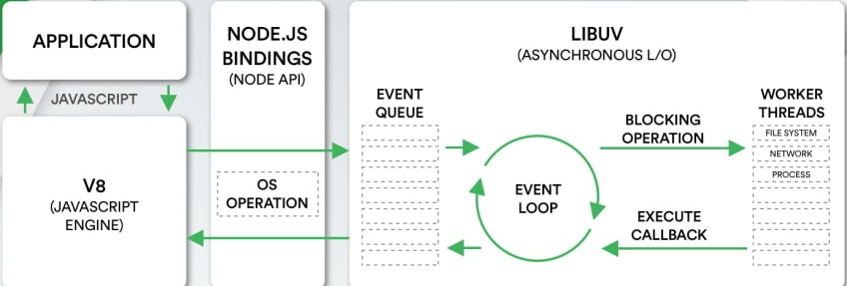
THE NODE JS SYSTEM
How Node.js Works?
Single-Threaded Event Loop manages multiple requests.
Executes I/O operations asynchronously (files, DB, APIs).
Uses callbacks, promises, and async/await for efficiency

Slide 4

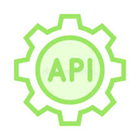
Introduction to API
API Overview
A set of protocols and tools that enable software systems to interact
and exchange data.
How APIs Work:
Enable one app to request data or actions from another app or service.
Types of APIs:
REST: Uses HTTP and returns data in JSON format.
SOAP: A protocol for exchanging structured data.
GraphQL: Allows flexible data queries.
Benefits of Using APIs:
Connects different systems and facilitates data sharing or feature integration.
Real-World Examples:
Social media logins, payment gateways, weather data services.

Slide 5

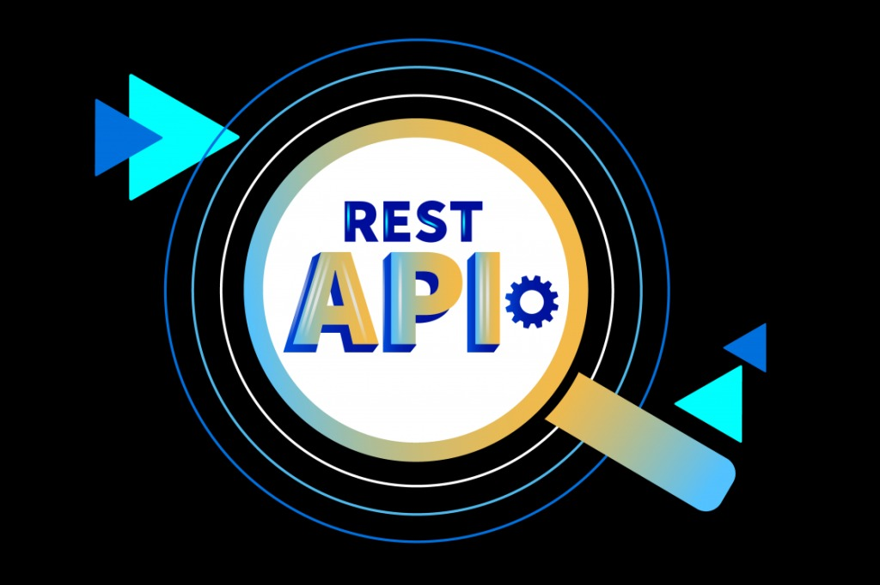
REST (Representational State Transfer) is an architectural style for designing networked applications.
A RESTful API follows REST principles to allow communication between client and server.
Uses stateless HTTP requests to perform operations on data.
Key Characteristics of RESTful APIs
✅ Stateless – Each request is independent; no session is stored on the server.
✅ Client-Server Architecture – The frontend (client) and backend (server) are separate.
✅ Resource-Based (URI) – Each entity is represented by a unique URL (e.g., /users/1).
✅ Uses HTTP Methods – Standard operations like GET, POST, PUT, DELETE.
✅ Supports Multiple Formats – Typically returns JSON or XML responses.
What is a RESTful API?

Slide 6

API Design Best Practices:
What is API Design?
Defines how clients interact with backend systems.Ensures APIs are intuitive, scalable, and secure.
Key Principles:
✅ Consistency – Uniform endpoints (/users/{id}).
✅ Simplicity – Clear, easy-to-use URLs.
✅ Versioning /v1/users for changes.
✅ Security – OAuth, API keys.
✅ Performance – Use caching & pagination.
Best Practices:
Meaningful Resource Names (/users not /getUsers).
Proper HTTP Methods (GET, POST, PUT, DELETE).
Clear Error Messages (404 Not Found, 500 Internal Error).
JSON Responses for easy integration.
Example API end points:
Operation Endpoint Method
Get Users /users GET
Create User /users POST
Update User /users/{id} PUT
Delete User /users/{id} DELETE

Slide 7

WHY API SECURITY?
Prevents data breaches & unauthorized access.
Protects sensitive user information.
Key Security Measures:
✅ Authentication & Authorization – Use OAuth2, JWT for secure access.
✅ API Keys & Rate Limiting – Control access & prevent abuse.
✅ HTTPS Encryption – Secure communication with SSL/TLS.
✅ Input Validation – Prevent SQL Injection & XSS attacks.
✅ Error Handling – Avoid exposing sensitive info (Use proper HTTP status codes).
✅ CORS Policy – Restrict access to trusted domains.
✅ Logging & Monitoring – Detect suspicious activities & threats.
Example: Secure API Authentication (JWT Token)
User logs in → Server issues JWT Token.
Every request includes Authorization: Bearer <token>.
Server validates token → Grants or denies access.
Always prioritize security in API development!

