Slide 1

Seshadri Rao Gudlavalleru Engineering College Department of CSE (Artificial Intelligence & Machine Learning)
Sentiment Analysis for Review-Based Feedback Systems
By
Gujjula Ramya(22481A4234)
Doupati Bala Vardhan Kumar(22481A4230)
Arja Sai Sree(22481A4208)
Abdul Gafoor(23485A4201)
Under the guidance of
Mr. K. AMRUTA SAGAR , M.Tech
Assistant Professor , Dept of CSE(AI&ML)

Slide 2
ABSTRACT:-
In the digital era, user-generated reviews have become a crucial source of feedback for understanding customer satisfaction and improving products or services. This project, titled “Sentiment Analysis for Review-Based Feedback Systems,” focuses on automating the interpretation of textual feedback using machine learning techniques. The system analyzes user reviews and classifies them into positive or negative sentiment categories, enabling organizations to efficiently extract insights from large volumes of feedback data. The proposed model employs text preprocessing techniques such as tokenization, stop-word removal, and lemmatization, followed by feature extraction using the TF-IDF (Term Frequency–Inverse Document Frequency) method. A Logistic Regression algorithm is then trained on the IMDb movie reviews dataset to perform sentiment classification. Experimental results demonstrate an accuracy of approximately 90%, indicating that the model effectively captures sentiment polarity in textual data. This sentiment analysis framework can be integrated into real-world feedback systems to support decision-making, enhance customer relationship management, and monitor public perception automatically and efficiently.

Slide 3
OBJECTIVES:-
To develop an automated sentiment classification system capable of identifying positive and negative opinions from user text reviews using machine learning techniques.
To preprocess textual data by applying operations such as tokenization, stop-word removal, punctuation removal, and lemmatization to improve data quality and model accuracy.
To extract significant textual features using the TF-IDF (Term Frequency–Inverse Document Frequency) technique for effective sentiment representation.
To train and evaluate a Logistic Regression model for sentiment prediction and assess its performance using metrics such as accuracy, precision, recall, and F1-score.
To apply the trained model for real-time feedback analysis, enabling organizations to automatically interpret large volumes of reviews and gain actionable insights into customer sentiment.

Slide 4
RELATED WORK:-
Several studies have focused on analyzing sentiments from text reviews using different machine learning techniques. Pang et al. (2002) and Turney (2002) were among the first to apply algorithms like Naïve Bayes, SVM, and Logistic Regression for movie review classification using Bag-of-Words and TF–IDF features. Later works combined lexicon-based methods and machine learning to improve accuracy and contextual understanding.
With the growth of deep learning, models such as CNN, RNN, and BERT have been used to capture deeper context in text data, achieving high accuracy but requiring large datasets and heavy computation. In comparison, Logistic Regression with TF–IDF, as used in this project, provides a simple, efficient, and accurate solution for binary sentiment classification tasks.

Slide 5
DATASET : IMDB MOVIE REVIEWS.csv (downloaded from Kaggle)
SIZE OF DATASET :
TOTAL RECORDS: 50000
ATTRIBUTES WITH VALUES: 1
DEDICATED EMPTY ATTRIBUTES: 3
TOTAL ATTRIBUTES: 4
TOTAL DATA SIZE: 65 MB

Slide 6
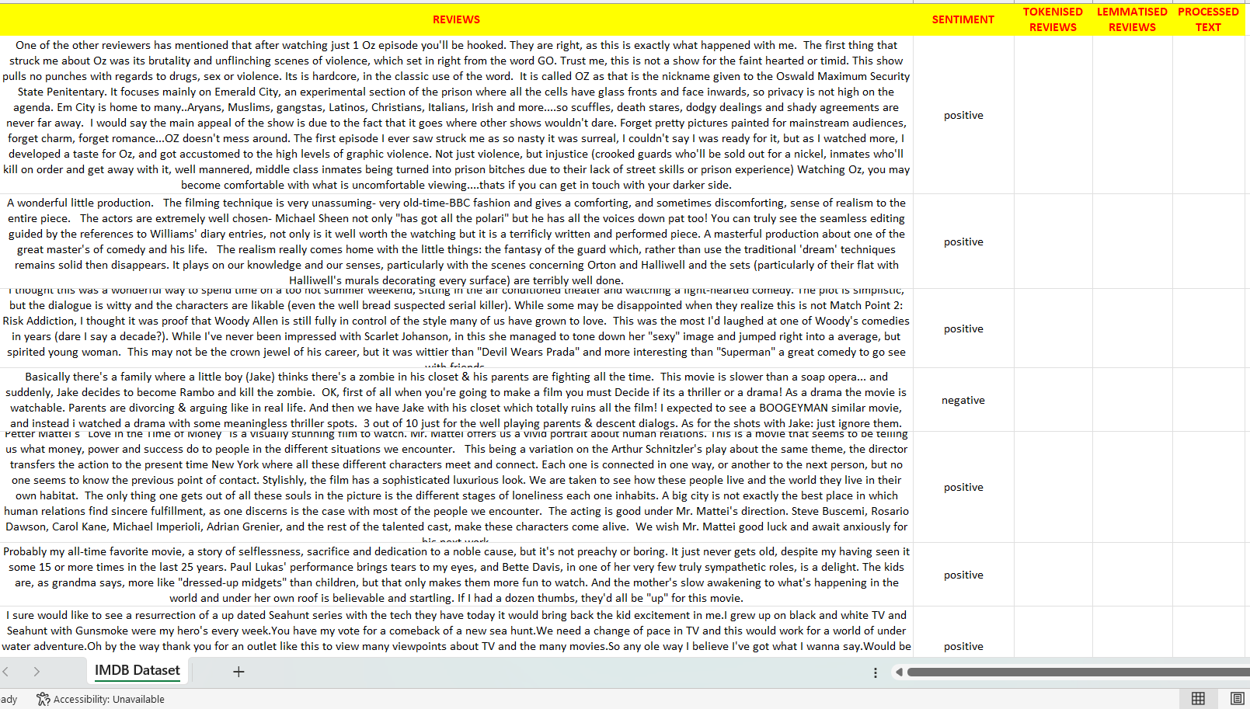

Slide 7
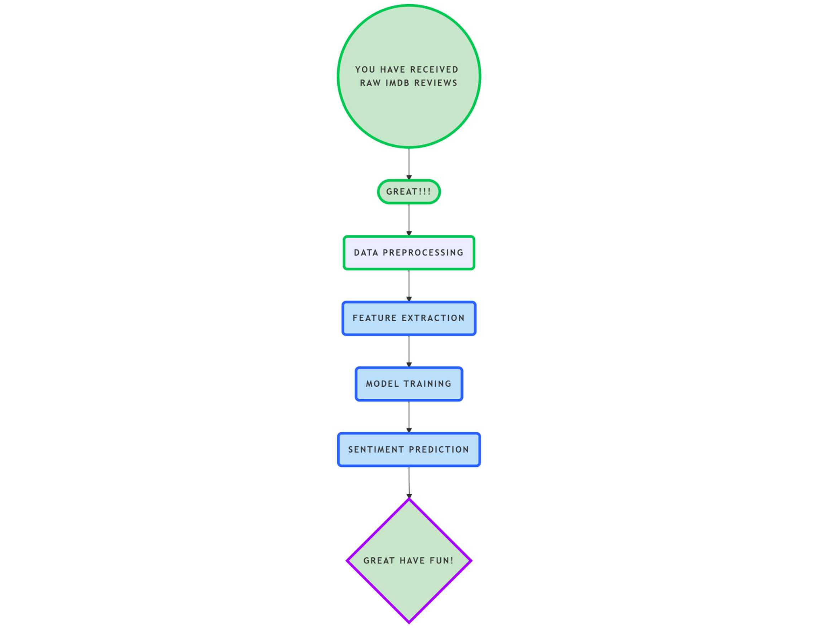
METHODOLOGY:-
Fig-1: FLOW CHART OF METHODOLOGY

Slide 8
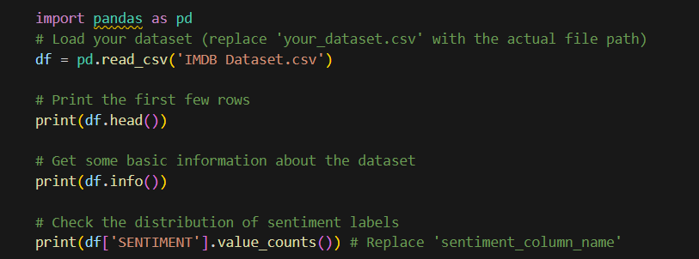
METHODOLOGY:-
Data Collection: The IMDb movie review dataset was used, containing balanced positive and negative reviews. Each review has text data and a sentiment label (positive/negative).

Slide 9
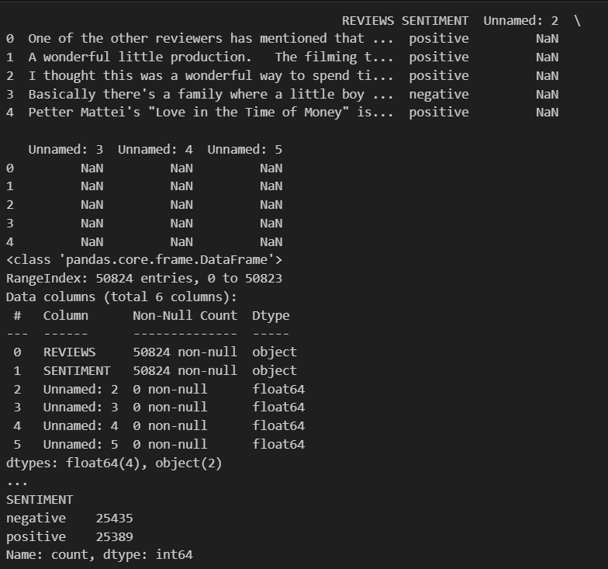
METHODOLOGY:-
OUTPUT :

Slide 10
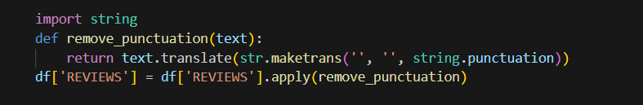
METHODOLOGY:-
Data Preprocessing: Text data was cleaned by converting to lowercase, removing punctuation and stop words. Lemmatization was applied to reduce words to their base form for better consistency.
Step-1: Converting all letters into lower case
Step-2: Removing all punctuations like (“, . ; !) [Data cleaning]

Slide 11
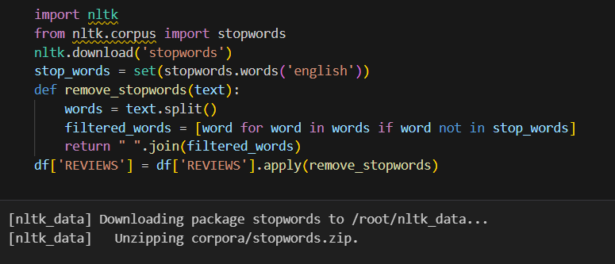
METHODOLOGY:-
Data Preprocessing: Text data was cleaned by converting to lowercase, removing punctuation and stop words. Lemmatization was applied to reduce words to their base form for better consistency.
Step-3: Removing all stop words
Note: Stop words are common words used in English language
such as “a” , “the”, “is”, “in” etc for sentence formation

Slide 12
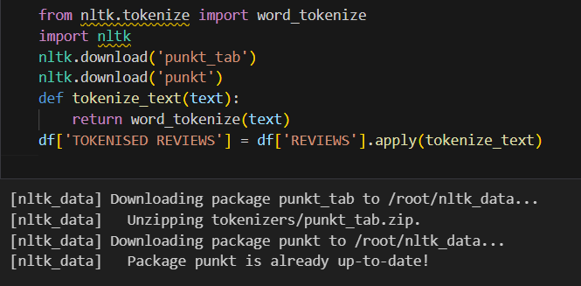
METHODOLOGY:-
Data Preprocessing: Text data was cleaned by converting to lowercase, removing punctuation and stop words. Lemmatization was applied to reduce words to their base form for better consistency.
Step-4: Converting all sentences to tokens [ tokenization ]
Note:
Tokens are the individual
units of text, such as words,
characters, or sub-words,
created by breaking down a
larger piece of text

Slide 13
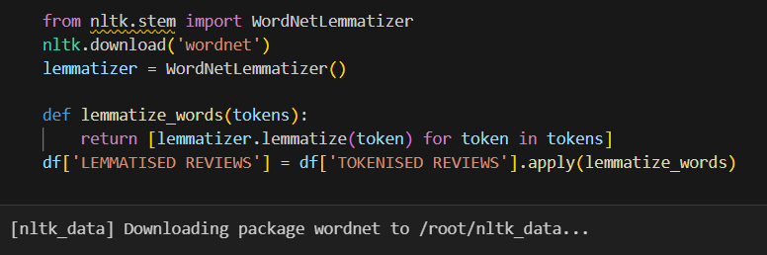
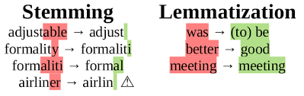
METHODOLOGY:-
Data Preprocessing: Text data was cleaned by converting to lowercase, removing punctuation and stop words. Lemmatization was applied to reduce words to their base form for better consistency.
Step-5: Converting all tokens to lemmas [ lemmatization ]
Note: A lemma in NLP is the base or dictionary form of a word
Example:

Slide 14
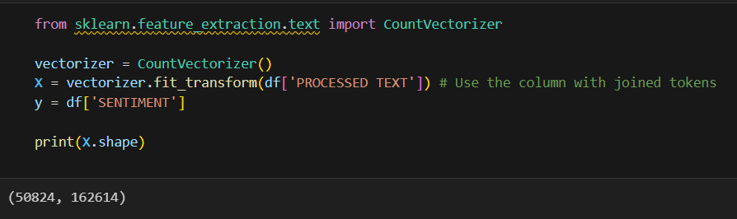
METHODOLOGY:-
Feature Extraction: TF–IDF (Term Frequency–Inverse Document Frequency) was used to convert text into numerical form. This helps highlight important words in each review while reducing noise.
Step-6: Conversion of text into numerical form using Count Vectorization.

Slide 15
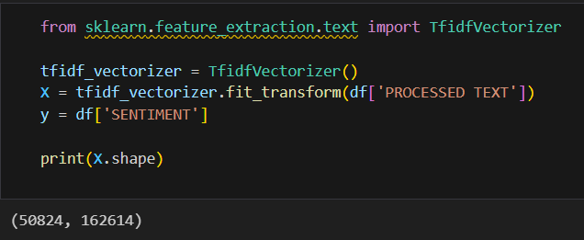
METHODOLOGY:-
Feature Extraction: TF–IDF (Term Frequency–Inverse Document Frequency) was used to convert text into numerical form. This helps highlight important words in each review while reducing noise.
Step-6: Conversion of text into numerical form using TF-IDF Vectorization.
Note: All the 50,824 reviews are feature extracted to numerical form

Slide 16
METHODOLOGY cont….
Model Training: A Logistic Regression model was trained on 80% of the dataset and tested on 20%. It learns patterns from TF–IDF features to classify sentiments accurately.
Model Evaluation: The model was evaluated using Accuracy, Precision, Recall, and F1-Score metrics. It achieved about 89.73% accuracy, showing balanced and reliable performance.
Prediction on New Data: The trained model can predict sentiments for new text reviews. It uses the same preprocessing and TF–IDF steps before making predictions.

Slide 17
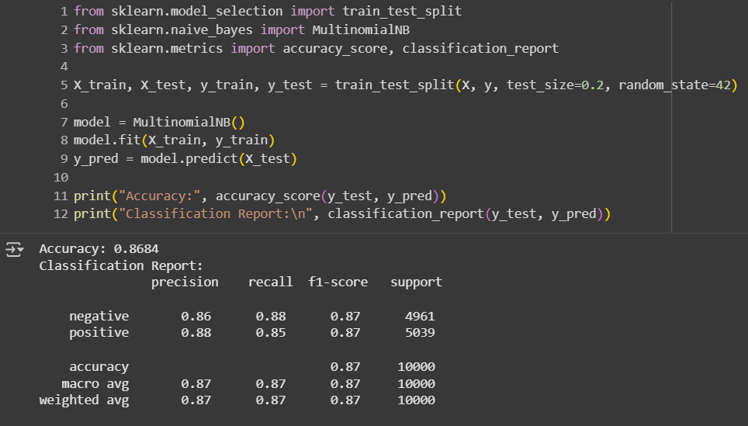
ALGORITHMS USED:
1. NAVIE BAYES - MULTINOMIAL MODEL

Slide 18
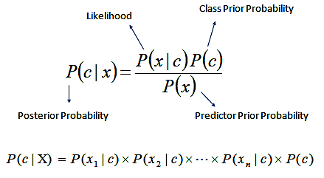
Reasons for Choosing Naïve Bayes Algorithm:
Text data follows a word-frequency pattern: Naïve Bayes assumes feature independence, which works surprisingly well for text data because word occurrences (counts or TF-IDF scores) often behave independently enough.
Very fast to train: It’s simple, efficient, and ideal for large text datasets.
Good baseline: Even though it’s based on simple probability rules, Naïve Bayes can achieve competitive accuracy in sentiment analysis.
Why preferred over others:
It performs remarkably well as a baseline model for sentiment analysis, often achieving accuracy close to Logistic Regression or SVM with minimal computational cost.
It’s more efficient and easier to implement than ensemble methods (like Random Forests or Gradient Boosting).
Works effectively when feature independence approximately holds — which is often true for text represented through bag-of-words or TF-IDF models.

Slide 19
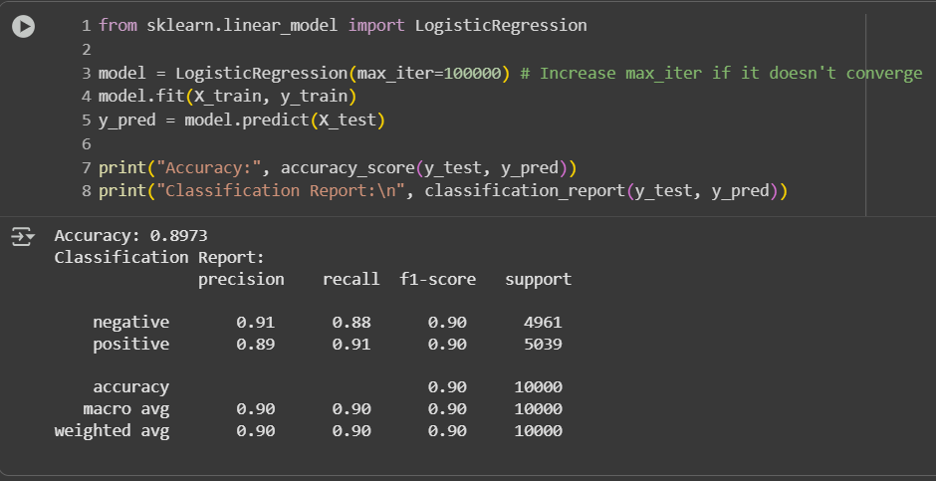
2. LOGISTIC REGRESSION - SIGMOID FUNCTION

Slide 20
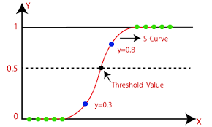
Reasons for Choosing Logistic Regression:-
Binary classification: Logistic Regression is inherently designed for two-class problems (like positive vs negative sentiment).
Interpretability: It produces probabilities (between 0 and 1), which makes it easy to interpret how confident the model is in its prediction.
Good with high-dimensional sparse data: When combined with TF-IDF or Bag of Words, text data becomes high-dimensional but sparse. Logistic Regression handles this efficiently using linear decision boundaries.
Fast and scalable: It’s computationally efficient even on large text datasets, making it a strong baseline model.
Why preferred over others:
Models like Decision Trees or Random Forests can easily overfit sparse TF-IDF data.
KNN is not suitable for large high-dimensional text data as it requires heavy computation for each prediction.
Neural networks need large datasets, GPUs, and extensive tuning; for smaller or medium-sized datasets like IMDb, Logistic Regression provides similar accuracy with much less complexity.

Slide 21
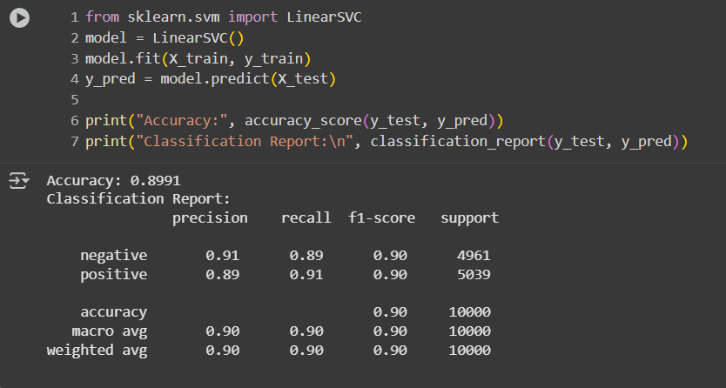
3. SUPPORT VECTOR MACHINE - LINEAR SVC

Slide 22
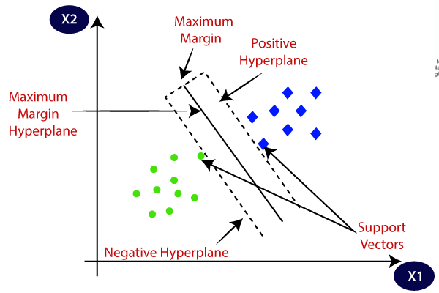
Reasons for Choosing Support Vector Machine:
Excellent for high-dimensional data: Text data with TF-IDF features typically has thousands of dimensions, and SVMs are specifically strong in such settings.
Robust to overfitting: Especially with the linear kernel, SVMs generalize well even with noisy data.
Maximizes the margin: SVM tries to find the best boundary that separates positive and negative sentiments with maximum margin — which improves generalization.
Why preferred over others:
Unlike Logistic Regression, which maximizes likelihood, SVM maximizes the margin — this often gives better performance when classes overlap.
Compared to Naïve Bayes, SVM doesn’t assume independence between features, making it more flexible and capable of capturing more complex word relationships.
While deep learning models (like LSTM or CNN) could achieve similar results, they require massive labeled data and tuning, whereas SVM works great with limited labeled reviews.

Slide 23
REQUIREMENTS:-
1. Hardware Requirements:
Processor: Intel i3 or higher for smooth execution.
RAM: Minimum 4 GB (8 GB recommended for faster processing).
Storage: At least 2 GB free space for dataset and libraries.
Operating System: Windows / Linux / macOS operating system.
2. Software Requirements:
Programming Language: Python 3.x
IDE / Editor: Jupyter Notebook, Google Colab, or VS Code.
Libraries: pandas, scikit-learn, nltk, joblib, matplotlib (optional).
Dataset: IMDb Movie Reviews dataset (CSV format). [downloaded from Kaggle datasets]

Slide 24
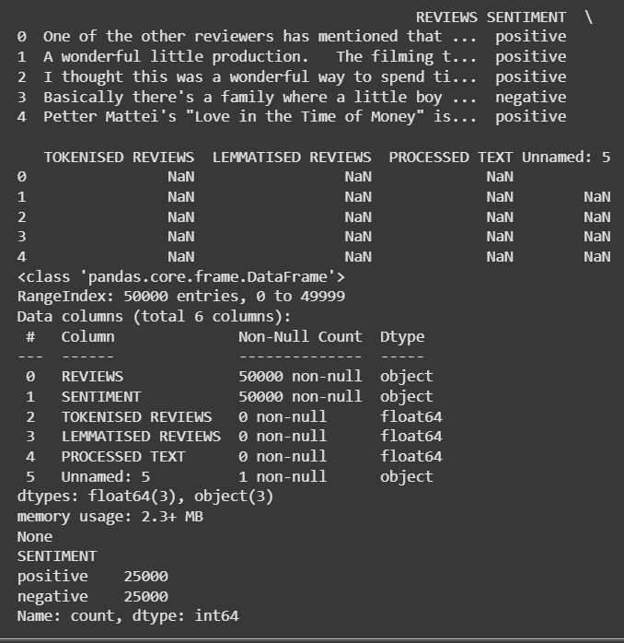
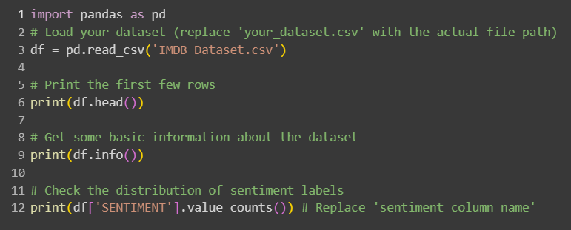
IMPLEMENTATION:-

Slide 25
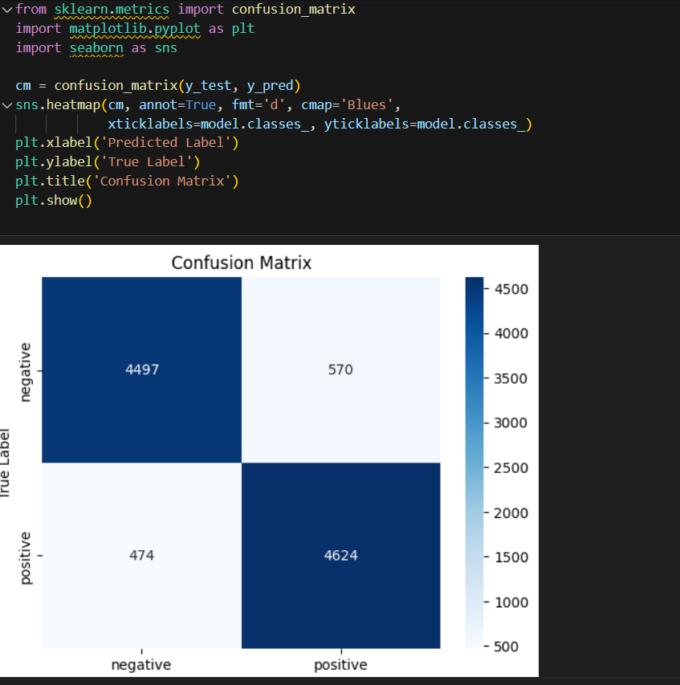
IMPLEMENTATION:-

Slide 26
RESULTS:
Support Vector Machine gives the highest accuracy with 89.91%
Navie bayes classification gives the lowest accuracy of 86.84%
Model is tested with different other reviews and got a confidence score of 94.61%
The models achieved good performance metrics

Slide 27
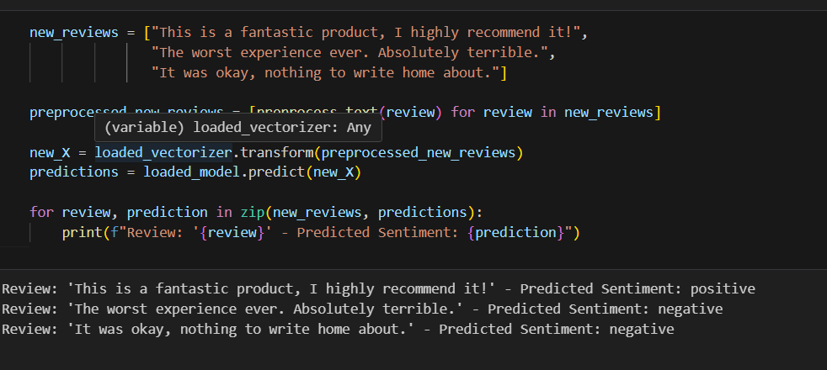
MODEL TESTING

Slide 28
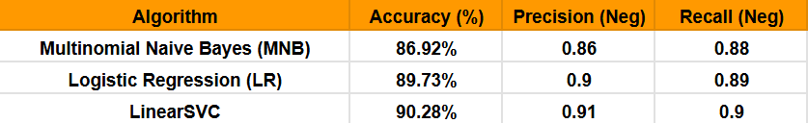
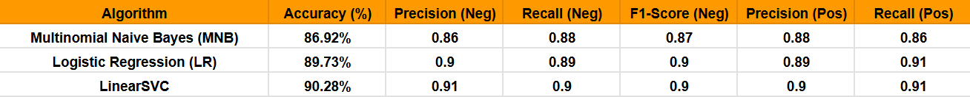
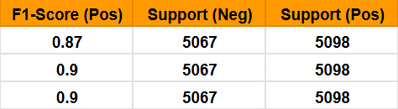
MODEL PERFORMANCE METRICS

Slide 29
CONCLUSION:
This project successfully developed a machine learning model for sentiment analysis of text reviews using Logistic Regression.
The model demonstrates high accuracy and balanced performance, indicating its potential for practical applications.
The project highlights the importance of text preprocessing and feature extraction in natural language processing tasks.
The developed sentiment analysis system can be used to automate the analysis of customer feedback, enabling businesses to gain valuable insights into customer opinions and improve their products and services.

Slide 30
REFERENCE LINKS:
Project Documentation:
https://docs.google.com/document/d/1hXjZIhnCCrmgAiRUMVIrYfOVoIv-
2. IMDb Sentiment Analysis Dataset
Kaggle dataset with 50,000 labeled reviews for binary classification
kaggle.com/datasets/lakshmi25npathi/imdb-dataset-of-50k-movie-reviews
Complete ML Project in Google Colab:
https://colab.research.google.com/drive/1TZ0KP-_Vhte9eLcfXl-L7lPcNnvAA0OU?usp=sharing

Slide 31
THANK YOU!
--------------- For your attention ---------------

