Slide 1
MoodSyncAI
Multi-Modal Sentiment & Emotion Analyser
Veera Raghava Mallikarjuna Naidu Bhogadi
Data Analytics 3 — Final Project
SRH Hamburg · Prof. Dr. Gayan de Silva · May 2026

Slide 2
The Problem: Words Don't Always Match Faces
A person may say "I'm fine" while their face shows distress.
Single-modality emotion analysis misses these incongruences.
Goal: combine visual and verbal signals to detect mismatch and produce a plain-language explanation.
2
input modalities
Image + Text
fused into a single emotional verdict
Inspired by Data Analytics 3 lectures on multimodal models, RNN/LSTM, and Transformers.

Slide 3
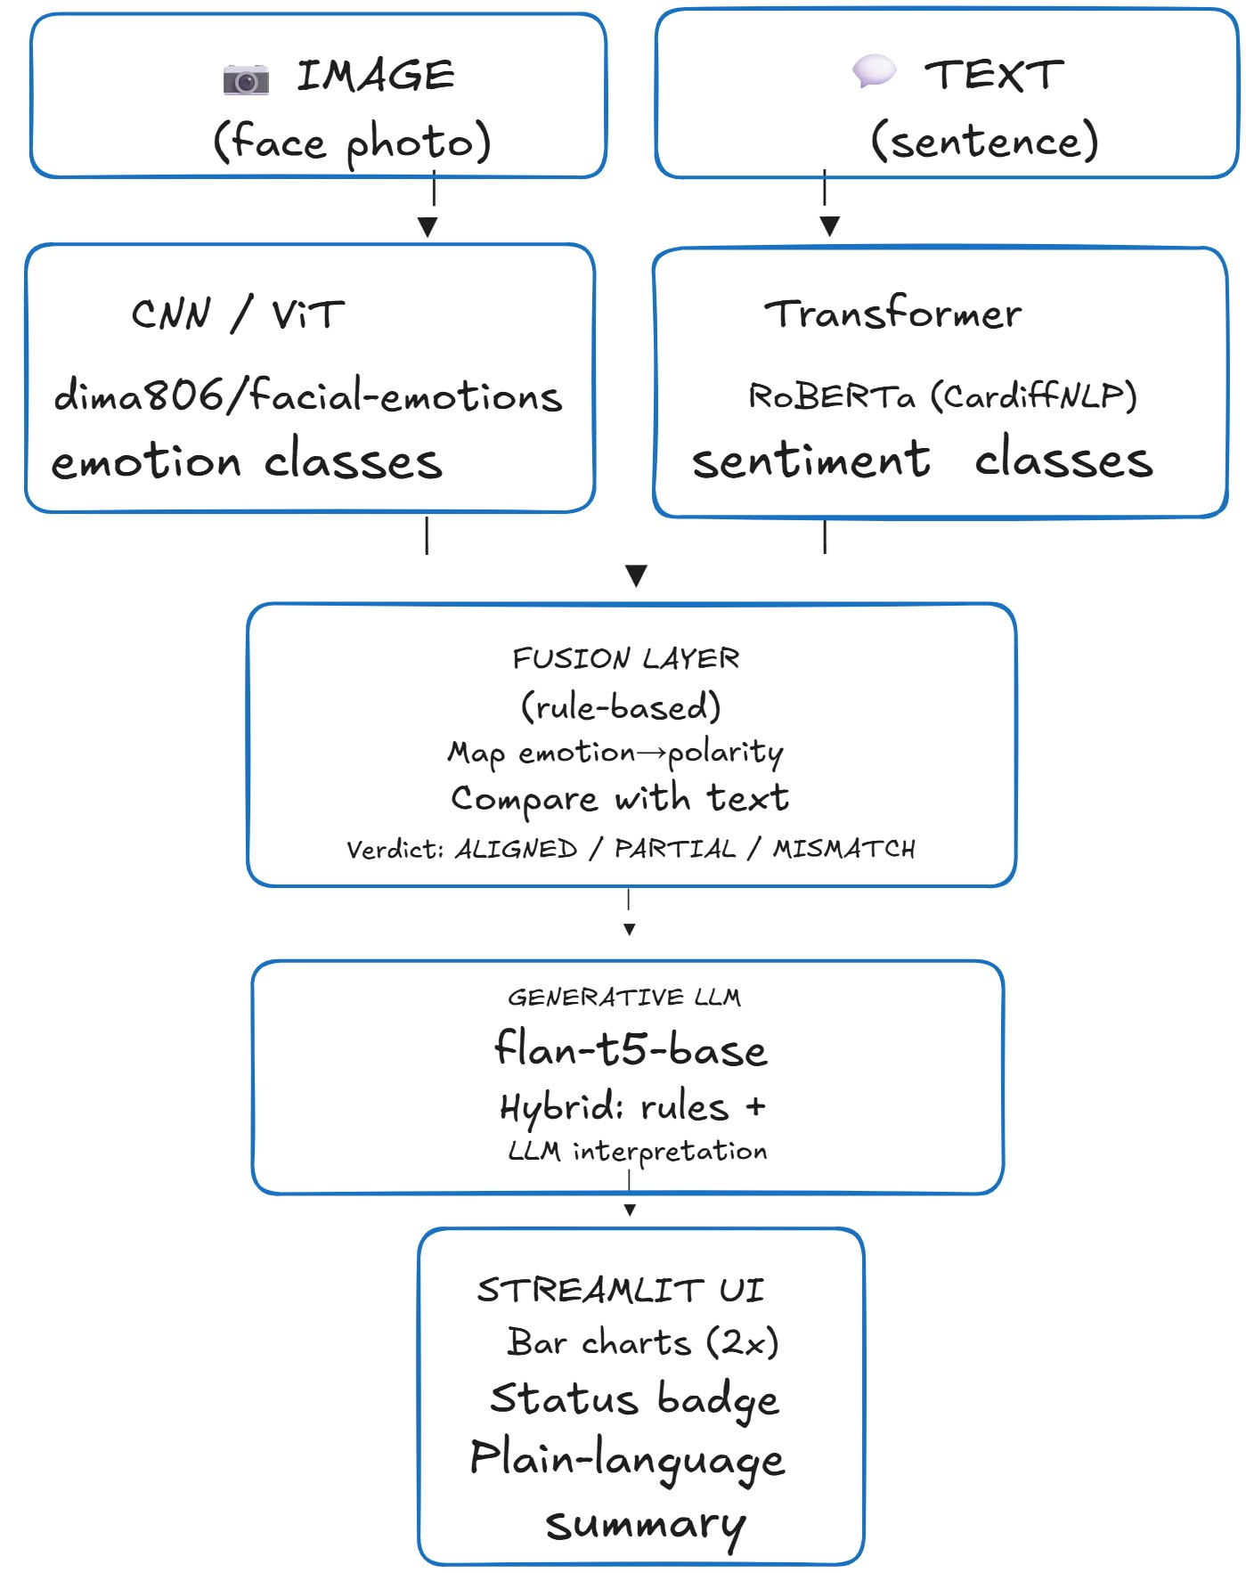
System Architecture
Two pretrained models in parallel
CNN/ViT classifies facial emotion (7 classes).
RoBERTa classifies text sentiment (3 classes).
Rule-based fusion layer
Maps each emotion to a polarity, compares with text sentiment, outputs ALIGNED / PARTIAL / MISMATCH.
Generative summary + Streamlit UI
flan-t5-base generates a plain-language explanation. Streamlit exposes bar charts, status badge, and summary.

Slide 4
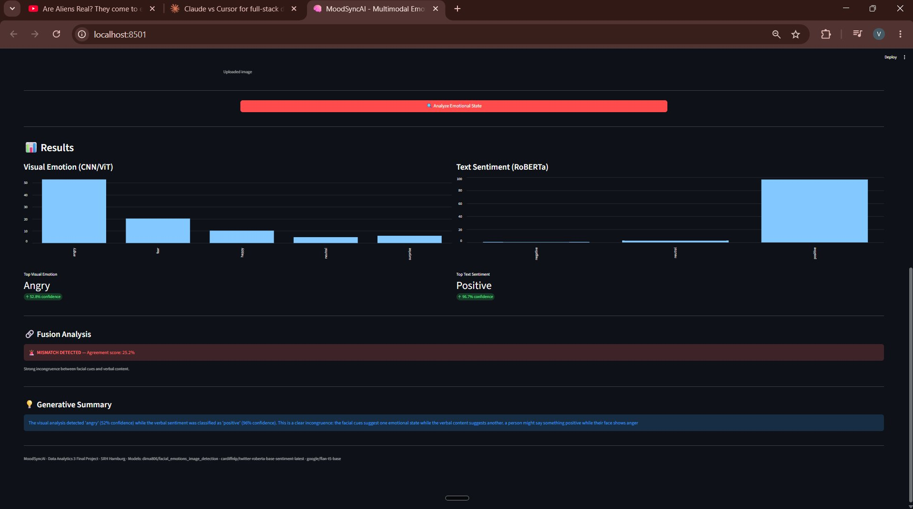
Demo: Detecting an Emotional Mismatch
INPUT
Image: person showing anger
Text: "No, I think the project is going really well."
OUTPUT
Visual emotion
angry (52.8%)
Text sentiment
positive (96.7%)
Fusion status
MISMATCH
Streamlit dashboard, MISMATCH DETECTED state
Agreement
25.2%
Generative summary explains the incongruence in plain language.

Slide 5
Extended Features Implemented
Three of the optional features from section 4 of the assignment brief.
EXT. FEATURE 1
EXT. FEATURE 2
EXT. FEATURE 3
Webcam Input
Audio + Whisper
ViT Attention Rollout
Streamlit st.camera_input captures a live still from the user's webcam.
No separate upload step required. Pipes directly into the existing CNN pipeline.
Coexists with file upload via a radio toggle.
Streamlit st.audio_input records speech in-browser.
Whisper-tiny (~39 MB) transcribes the clip; the transcript auto-fills the text box.
Feeds the existing RoBERTa sentiment model.
Visualises which face regions the ViT attended to (Abnar & Zuidema, 2020).
12-layer attention rollout with residual identity; CLS-to-patch attention reshaped to 14x14 and overlaid as a JET heatmap.
Chosen over Grad-CAM (CNN-only) for this transformer architecture.
MoodSyncAI · Data Analytics 3 Final Project · May 2026

Slide 6
Challenges I Overcame & What's Next
CHALLENGES OVERCOME
WHAT'S NEXT
1. Generative summary hallucination
Real-time video timeline
Show emotion changes frame-by-frame as the user speaks.
Learned fusion network
Replace rules with a small neural net once paired labelled data is available.
Cloud deployment
Host on Hugging Face Spaces with a public URL (requires paid tier for 3 GB model footprint).
Domain-specific fine-tuning
Re-train RoBERTa on workplace dialogue rather than tweets.
flan-t5-base parroted prompts when asked for full 3-sentence summaries. Solved with a hybrid: rule-based factual sentences + LLM for interpretation only.
2. Multimodal alignment without labels
No paired image-text dataset with mismatch labels. Used a deterministic emotion-to-polarity mapping and rule-based fusion instead of training a fusion network.
3. ViT attention without exposed weights
HuggingFace pipeline hides attention tensors. Re-loaded the model via AutoModelForImageClassification with output_attentions=True to extract them.
MoodSyncAI · Data Analytics 3 Final Project · May 2026

