Slide 1
GWTeX^{[1]} Collective LaTeX Workshop
Brandon Waller
Notes:
[1] Pun by Samsara Counts

Slide 2
Outline
Introduction
Goals
Getting Started
Math
Formatting
Images, Tables, and Figures
Exercises
Resumes
Upon Request
Inserting Code
Journal Formatting

Slide 3

Introduction
What are the differences between the Word document and the TeX document?
Notes:
[1] https://en.wikipedia.org/wiki/Leslie_Lamport
Choose any document, have participants copy contents into word, and Overleaf, have participants find differences between the programs
Main differences:
-paragraphs (auto tabs in LaTeX)
-Line breaks (When LaTeX chooses to make one?)
-Quotes
- ...

Slide 4
Introduction
Language Types
Programming (Java, C)
Markup (HTML, Markdown)
Typesetting (LaTeX)
Why use LaTeX?
Separation of formatting and text
Templates
Easy bibliographies/citation management

Slide 5
Goals
Understanding the capabilities of LaTeX
Develop a foundation to be able to learn more independently
Learn how to use templates, and create a resume in LaTeX

Slide 6
\documentclass{article}
\usepackage[utf8]{inputenc}
\usepackage{graphicx}
\usepackage{amsmath}
\newcommand{\quadequation}{$\frac{-b\pm \sqrt{b^2 -4ac}{2a}}$}
\newcommand{\three}{3}
\title{New Document}
\author{me}
\begin{document}
\maketitle
\section{Section 1}
\subsection{Sub 1}
\subsection{Sub 2}
\end{document}
Preamble
Document

Slide 7
Basic Formatting Title
Define Title Parameters in Preamble
\title{Document Title}
\author{Document Author}
After \begin{document}
\maketitle
Look into titlepage for more advance title options

Slide 8
Basic Formatting Paragraphs Sections
Paragraphs
1 Line Breaks: Noting
2 Line Breaks: Line Break + Indent
\noindent on next line
\\: Line Break No Indent
section
subsection
subsubsection

Slide 9
Basic Formatting Text Modifiers
\textbf{bold-face text}
\textit{italicized text}
\underline{underlined text}
\textsc{SMALL CAPITAL TEXT}
\emph{}
\textsubscript{}
\textsuperscript{}
\texttt{type-writer style text}

Slide 10
Basic Modifiers Text Size
\tiny{tiny text}
\small{small text}
\large{large text}
\Large{larger text}
\huge{huge text}
\Huge{huge-er text}

Slide 11
Math Mode
To enter Math Mode:
In line math: $ Math $
New line and Centered: $$ Math $$
Multi-step aligned equations: \begin{align*}
1 & 2\\
ABC & 3
\end{align*}
Notes:
\section{Math Demo}
3 + 3 = 4\\
$3 + 3 = 4$\\
The equation for force is: $F = \frac{M}{A}$\\
The area of a circle is: $$A = \pi r^2$$
Problem 1. Solve $x^2 - 5x + 6 = 0$
\begin{align}
x^2 - 5x + 6 & = 0\\
(x - 3)(x - 2) & = 0\\
& x = 3, x = 2
\end{align}

Slide 12

Math Basic Commands
\text{}
Write normal text in math mode
\frac{num}{denom} $\frac{num}{denom}$
\int $∫$
\iint $∬$
\times $×$
\Re e \Im m $ℜe ℑm$
\partial $∂$
\lim
\lim\limits_{x \to \infty}
\ adds a blank character
Notes:
\section{Math Demo}
3 + 3 = 4\\
$3 + 3 = 4$\\
The equation for force is: $F = \frac{M}{A}$\\
The area of a circle is: $$A = \pi r^2$$
Problem 1. Solve $x^2 - 5x + 6 = 0$
\begin{align}
x^2 - 5x + 6 & = 0\\
(x - 3)(x - 2) & = 0\\
x = 3, x = 2
\end{align}

Slide 13

Math Symbols
\alpha \Alpha $α Α$
Same for all Greek letters
\infty $∞$
\rightarrow \Rightarrow $→⇒$
Same for other directions
\leq $≤$
\pm $±$
Notes:
\section{Math Demo}
3 + 3 = 4\\
$3 + 3 = 4$\\
The equation for force is: $F = \frac{M}{A}$\\
The area of a circle is: $$A = \pi r^2$$
Problem 1. Solve $x^2 - 5x + 6 = 0$
\begin{align}
x^2 - 5x + 6 & = 0\\
(x - 3)(x - 2) & = 0\\
x = 3, x = 2
\end{align}

Slide 14
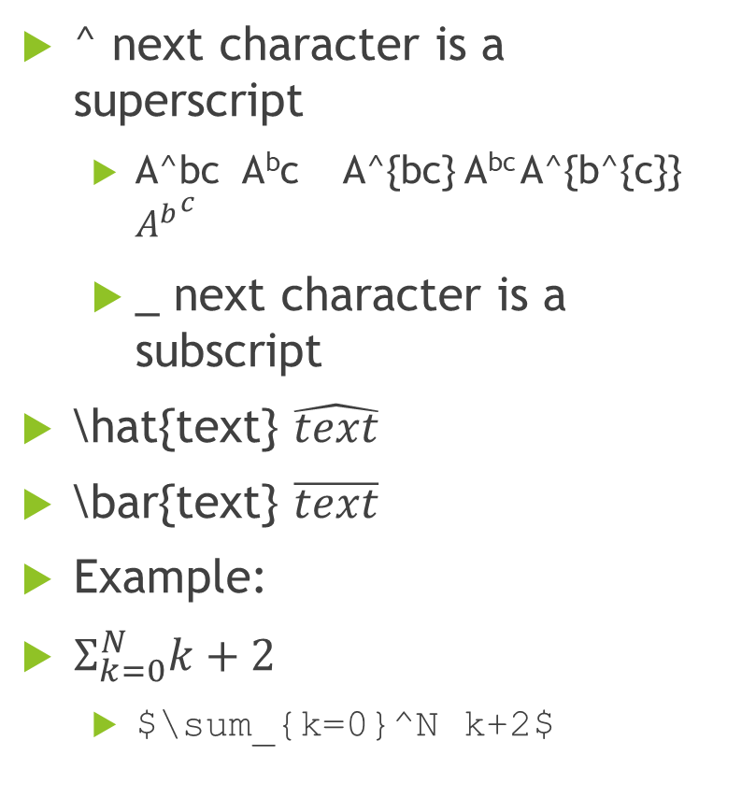
Math Modifiers
^ next character is a superscript
A^bc A^{b}c A^{bc} A^{bc} A^{b^{c}} ${A^{b}}^{c}$
_ next character is a subscript
\hat{text} $\hat{text}$
\bar{text} $\overline{text}$
Example:
$Σ_{k=0}^{N}k+2$
$\sum_{k=0}^N k+2$
Notes:
\section{Math Demo}
3 + 3 = 4\\
$3 + 3 = 4$\\
The equation for force is: $F = \frac{M}{A}$\\
The area of a circle is: $$A = \pi r^2$$
Problem 1. Solve $x^2 - 5x + 6 = 0$
\begin{align}
x^2 - 5x + 6 & = 0\\
(x - 3)(x - 2) & = 0\\
x = 3, x = 2
\end{align}

Slide 15

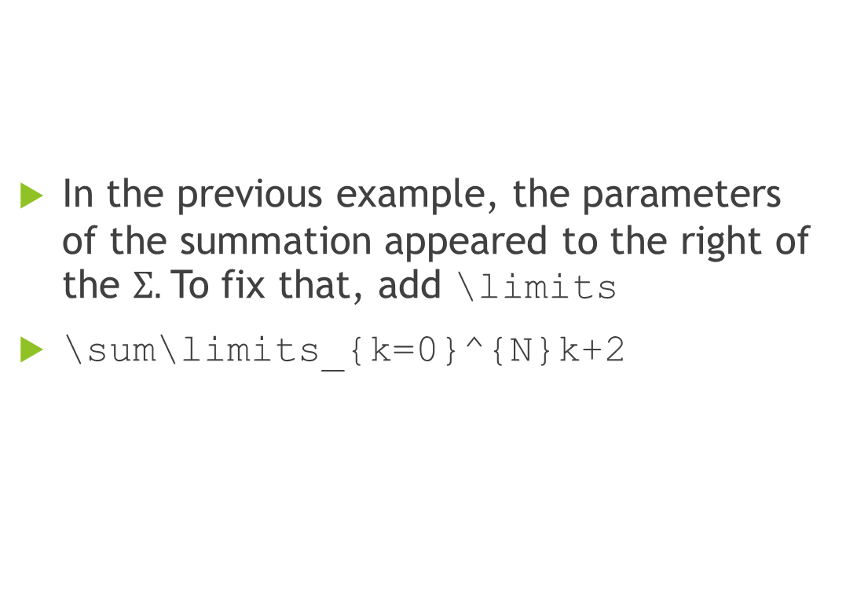
Math limits
In the previous example, the parameters of the summation appeared to the right of the $Σ.$To fix that, add \limits
\sum\limits_{k=0}^{N}k+2
Notes:
\section{Math Demo}
3 + 3 = 4\\
$3 + 3 = 4$\\
The equation for force is: $F = \frac{M}{A}$\\
The area of a circle is: $$A = \pi r^2$$
Problem 1. Solve $x^2 - 5x + 6 = 0$
\begin{align}
x^2 - 5x + 6 & = 0\\
(x - 3)(x - 2) & = 0\\
x = 3, x = 2
\end{align}

Slide 16
Exercises
Notes:
\section{Math Demo}
3 + 3 = 4\\
$3 + 3 = 4$\\
The equation for force is: $F = \frac{M}{A}$\\
The area of a circle is: $$A = \pi r^2$$
Problem 1. Solve $x^2 - 5x + 6 = 0$
\begin{align}
x^2 - 5x + 6 & = 0\\
(x - 3)(x - 2) & = 0\\
x = 3, x = 2
\end{align}

Slide 17
Figures
\begin{figure}[float-option]
…contents
\end{figure}
Float-Options
h: Here. Same [approximate] location as text
t: Top. Top of page
b: Bottom. Bottom of Page
p: Special page for only figures
*!: Ignore other LaTeX auto formatting
H: Exactly at the location specified
\usepackage{foat}

Slide 18
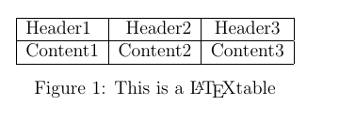
Figures Table
\begin{figure}[h]
\centering
\begin{tabular}{|l|r|c|}
\hline
Header1 & Header2 & Header3\\
\hline
Content1 & Content2 & Content3\\
\hline
\end{tabular}
\caption{This is a \LaTeX table}
\end{figure}

Slide 19
Figures Images
\usepackage{graphicx}
\begin{figure}[h]
\centering
\includegraphics[parameters]{file_name}
\caption{caption}
\end{figure}
Parameters
height = 3in
width = .7\textwidth

Slide 20
Subfigures
%preamble
\usepackage{subcaption}
\begin{figure}[h]
\begin{subfigure}[b]{.5\textwidth}
\includegraphics[width=\textwidth]{path}
\end{subfigure}
\begin{subfigure}[b]{.5\textwidth}
\includegraphics[width=\textwidth]{path}
\end{subfigure}
\end{figure}

Slide 21
Itemize
\begin{itemize}
\item First Item
\item Second Item
\end{itemize}
First Item
Second Item

Slide 22
Itemize
\begin{itemize}
\item First Item
\subitem Subitem
\subsubitem Subsub item
\item Second Item
\end{itemize}
First Item
Subitem
Subsubitem
Second Item

Slide 23
Itemize
\begin{itemize}
\item First Item
\begin{itemize}
\item Subitem
\end{itemize}
\item Second Item
\end{itemize}
First Item
Subitem
Second Item

Slide 24
More Exercises

Slide 25
LaTeX Resumes
https://www.overleaf.com/13490924tqxfzwgtgdhy#/52083750/
https://www.overleaf.com/13490936svhnhynyxfxk#/52083795/
https://www.overleaf.com/13490956qyvxsxnbgbzn#/52083864/
Notes:
https://www.overleaf.com/13490924tqxfzwgtgdhy#/52083750/
https://www.overleaf.com/13490936svhnhynyxfxk#/52083795/
https://www.overleaf.com/13490956qyvxsxnbgbzn#/52083864/

Slide 26
Some More Commands
\textsc{Short capital letters}
\clearpage fill page
\hfill fill horizontally

Slide 27
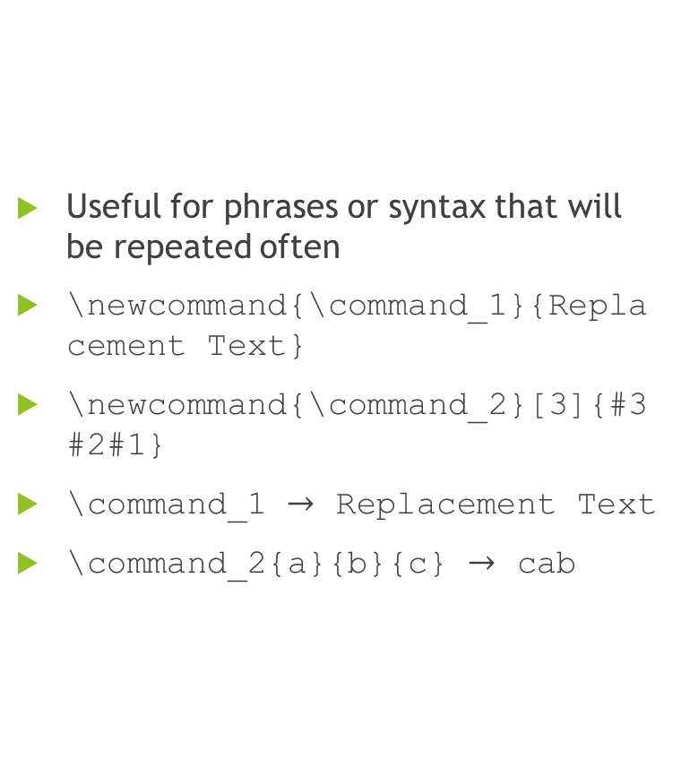
New Command
Useful for phrases or syntax that will be repeated often
\newcommand{\command_1}{Replacement Text}
\newcommand{\command_2}[3]{#3#2#1}
\command_1 $→$ Replacement Text
\command_2{a}{b}{c} $→$ cab

Slide 28
Questions? Anything Else?

