Slide 1
CSC 4630 · ADVANCED SOFTWARE ENGINEERING · GROUP 20
Pharmacy Point-of-Sale System
Final presentation · Unified Process · Analysis and design
University: [University Name] Lecturer: [Lecturer Name]
System roles: Administrator · Pharmacist/Cashier (no separate Cashier)
Implementation has not started — documentation and design only
September 2026
1 / 35

Slide 2
WEEKS 1–2 · INCEPTION
Problem statement
Many small and medium pharmacies in Zambia still combine paper registers, memory, and generic retail tools that were not designed for medicines. That mix produces four recurring failures: expired packs can be sold; life-saving lines run out without a reliable warning; prices and receipts are inconsistent; and there is a weak audit trail when a regulator or owner asks who sold or adjusted a batch. A generic supermarke…
Expired stock
Paper and memory let expired packs reach a customer.
False availability
A medicine is promised that the shelf no longer has.
Weak audit
Nobody can show who sold or adjusted a batch.
Wrong product shape
A supermarket till has no prescription or batch expiry.
Group 20 · CSC 4630 · Pharmacy POS · Unified Process · Documentation phase
2 / 35

Slide 3
INCEPTION
Business case
Operational
Accurate sale + matching batch update. Receipts that match the till.
Strategic
Expiry control and prescription recording become ordinary work, not a later panic.
Financial
Less wasted stock and less time reconstructing a day's takings. No invented ROI %.
Boundary
NHIMA claims and e-commerce would be a different system. They stay out.
Group 20 · CSC 4630 · Pharmacy POS · Unified Process · Documentation phase
3 / 35

Slide 4
INCEPTION
Vision and objectives
A pharmacy-specific point-of-sale system in which the Pharmacist runs the counter (search, sale, prescription capture, payment, receipt) and the Administrator runs the office (catalogue, stock, users, suppliers, reports). The system makes the dangerous path — selling expired or untracked medicine — hard, and the routine path — a correct paid sale — fast enough for a busy counter.
BO-01 Prevent sale of expired or insufficiently stocked medicine.
BO-05 Give the Administrator reliable catalogue, stock, user, and report control.
BO-02 Complete counter sales accurately with a printed or viewable receipt.
BO-06 Leave an audit trail for sales, voids, stock adjustments, and user changes.
BO-03 Keep inventory quantities consistent with sales and stock movements.
BO-07 Fit a 15-week UP schedule with architecture proven before construction.
BO-04 Support prescription-linked dispensing without creating extra user roles.
Group 20 · CSC 4630 · Pharmacy POS · Unified Process · Documentation phase
4 / 35

Slide 5
INCEPTION
System scope
In scope
Out of scope
• Authentication and role-based authorisation for two roles only
• Medicine catalogue maintenance
• Batch-level inventory with expiry and quantity
• Over-the-counter and prescription-linked counter sales
• Payments recorded as cash, card, or mobile money
• Receipt generation
• Sale void with reason and stock restore
• Customer record when a named patient is required
• A separate Cashier, Manager, or Inventory Clerk user role
• Online / e-commerce ordering
• NHIMA or other insurance claim submission
• Live card or mobile-money gateway settlement (manual confirmation only)
• National electronic prescription network
• Clinical diagnosis or drug-interaction decision support
• Multi-branch warehousing and inter-store transfers
• Full accounting / general ledger
Group 20 · CSC 4630 · Pharmacy POS · Unified Process · Documentation phase
5 / 35

Slide 6
INCEPTION
Stakeholders and actors
The Pharmacist performs the cashier function; there is no separate Cashier role.
System users (accounts)
• Administrator — catalogue, stock, users, suppliers, reports, settings
• Pharmacist/Cashier — search, sell, prescription, payment, receipt, void
External (no login)
• Customer — buys; talks to the Pharmacist, not the software
• Supplier — source of batches; recorded on receipts of stock
• No Manager, Cashier, or Inventory Clerk account
Group 20 · CSC 4630 · Pharmacy POS · Unified Process · Documentation phase
6 / 35

Slide 7
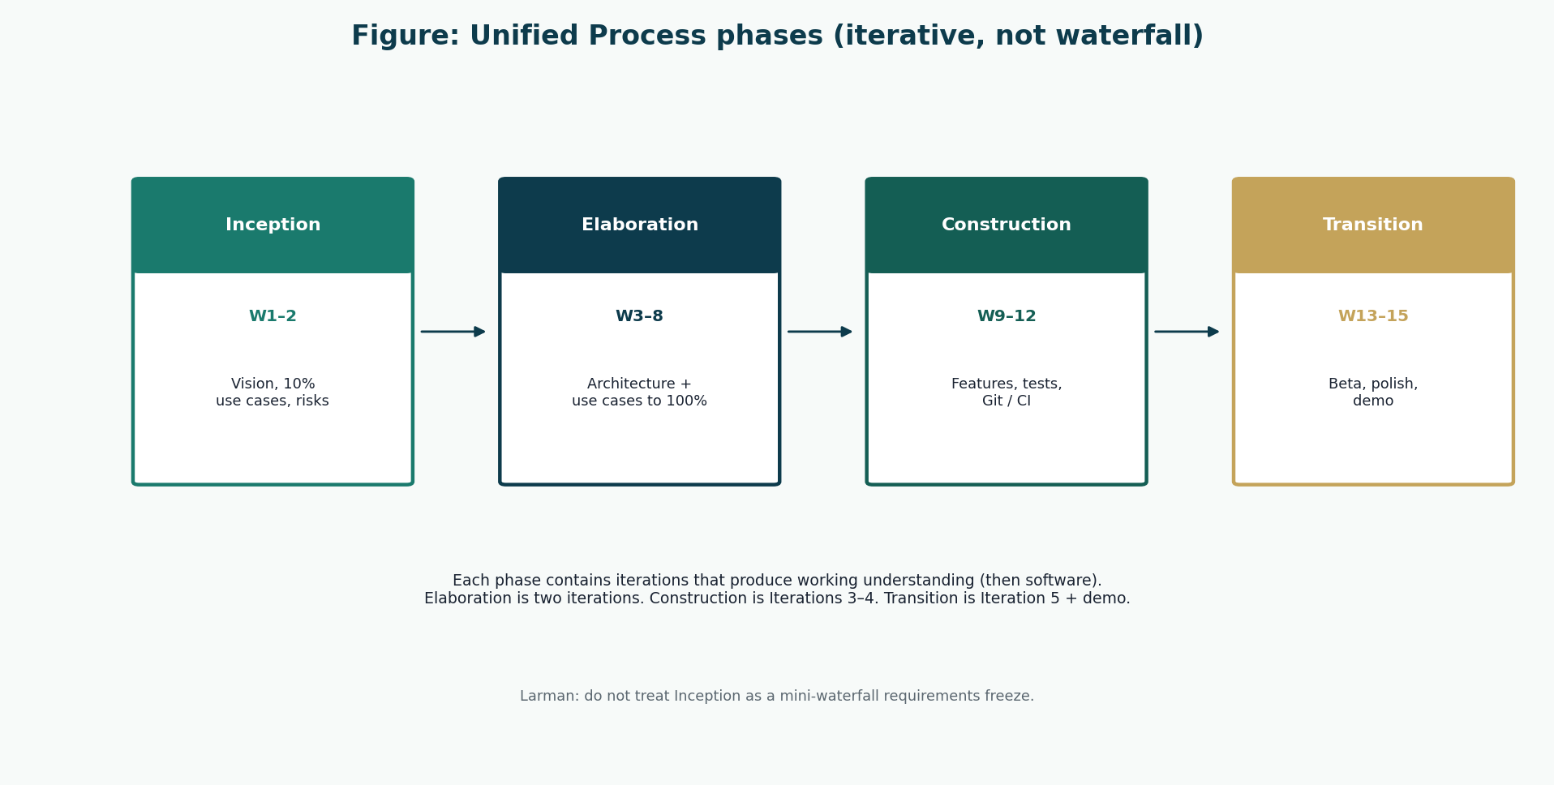
METHODOLOGY
Unified Process — iterative, not waterfall
Group 20 · CSC 4630 · Pharmacy POS · Unified Process · Documentation phase
7 / 35

Slide 8
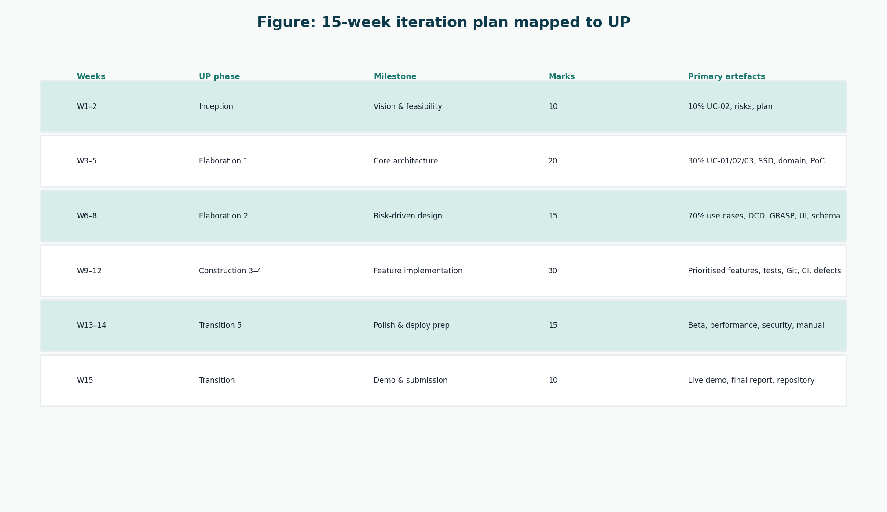
METHODOLOGY
15-week iteration plan
Group 20 · CSC 4630 · Pharmacy POS · Unified Process · Documentation phase
8 / 35

Slide 9
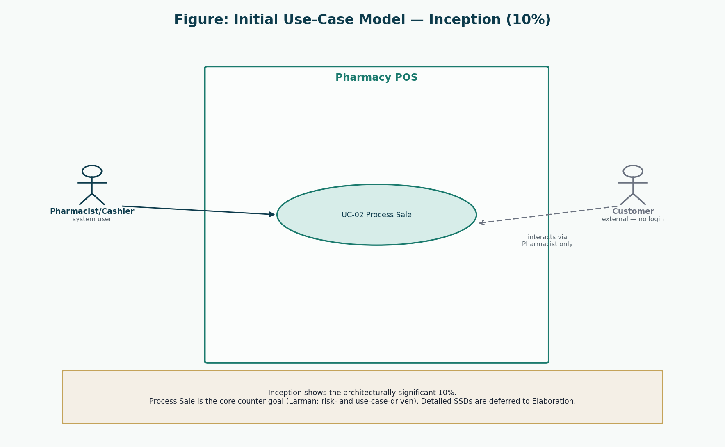
INCEPTION · 10%
Initial use cases — Process Sale
Group 20 · CSC 4630 · Pharmacy POS · Unified Process · Documentation phase
9 / 35

Slide 10
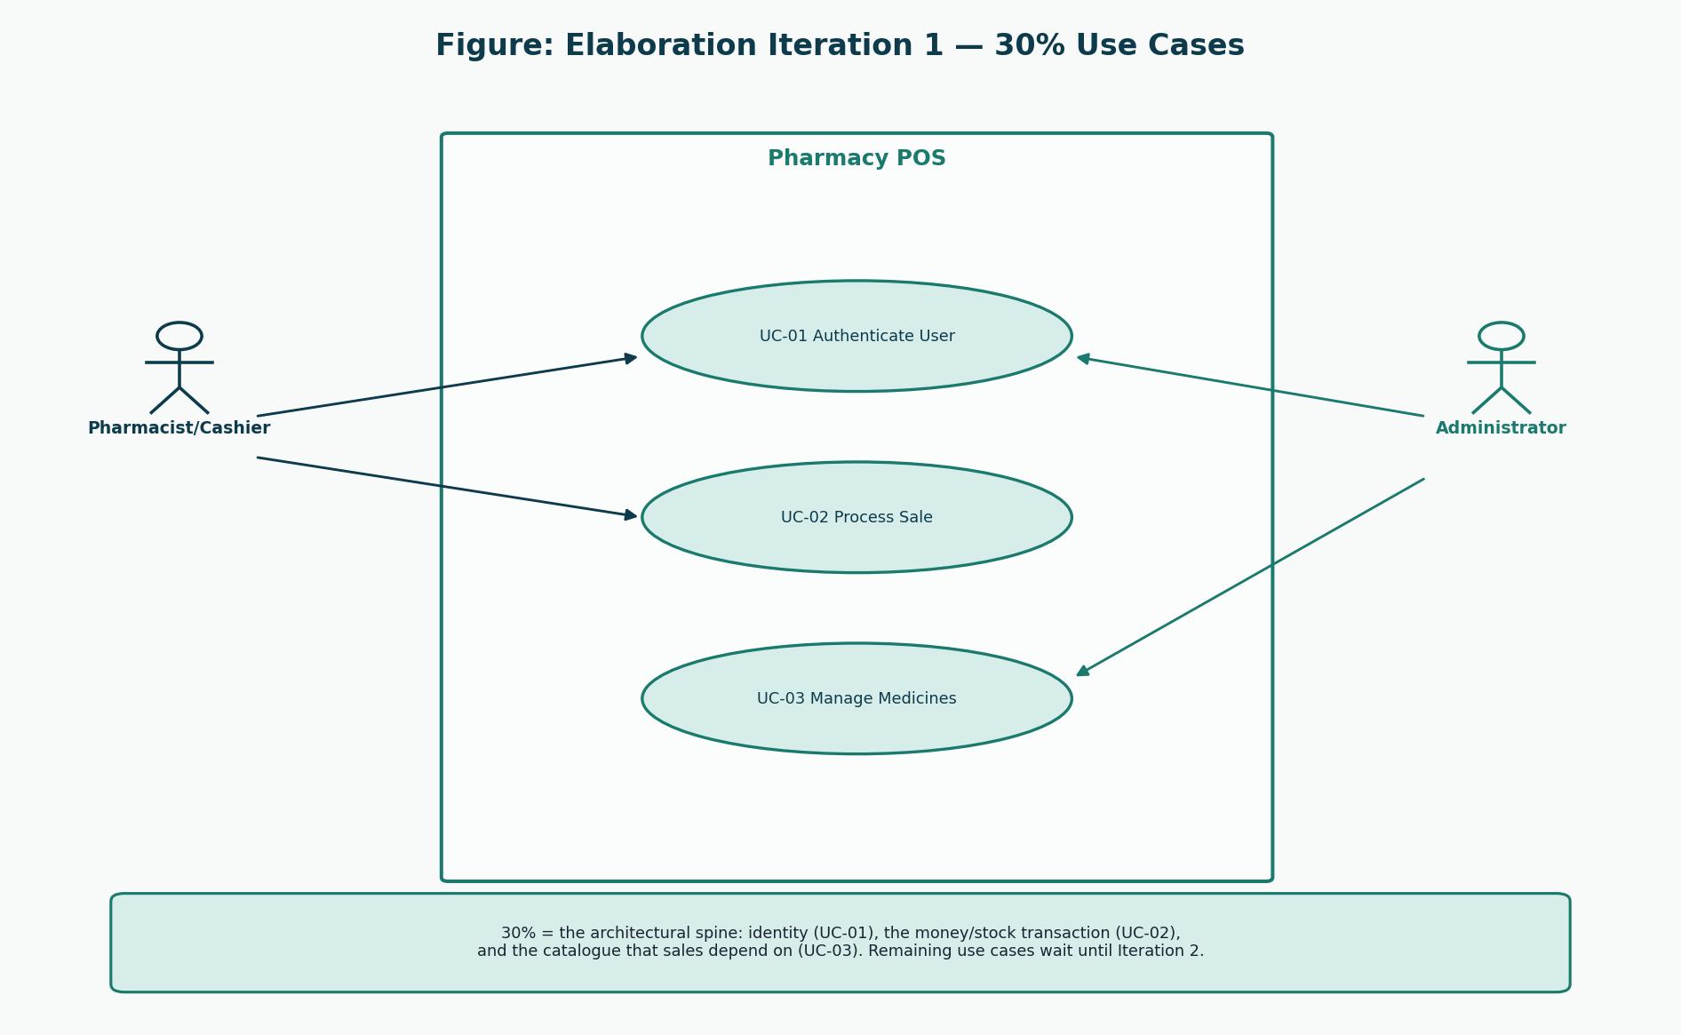
ELABORATION 1 · 30%
Architecturally significant use cases
Group 20 · CSC 4630 · Pharmacy POS · Unified Process · Documentation phase
10 / 35

Slide 11
ELABORATION 1
Detailed use case — UC-02 Process Sale
Main success scenario (short)
• makeNewSale — empty sale in progress
• enterItem(medicineId, qty) — repeat
• Refuse expired or short batches
• attachPrescription when required
• endSale — show total
• makePayment(amount, method)
• Stock down + receipt out
Why this use case leads design
• Touches money, stock, expiry, Rx, audit
• Customer does not generate system events
• Scan is only a technology of enterItem
• Fully dressed text is in the Elaboration 1 report
• Extensions cover short cash and failed persist
Group 20 · CSC 4630 · Pharmacy POS · Unified Process · Documentation phase
11 / 35

Slide 12
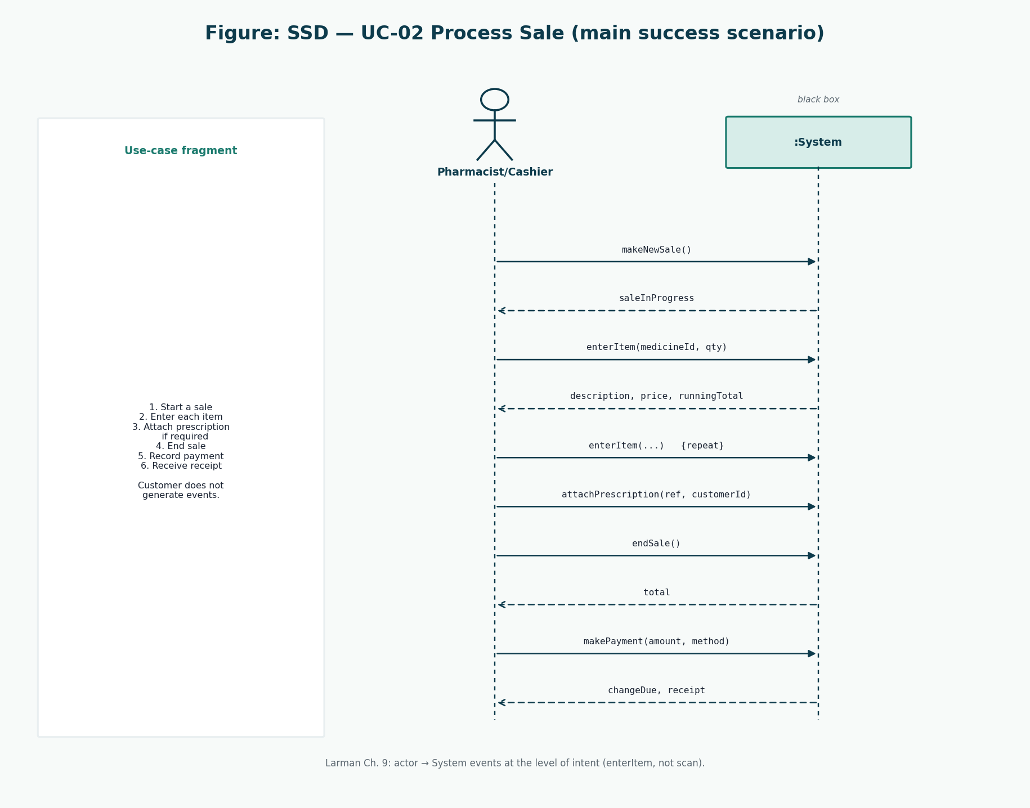
ELABORATION 1
System sequence diagram — Process Sale
Group 20 · CSC 4630 · Pharmacy POS · Unified Process · Documentation phase
12 / 35

Slide 13
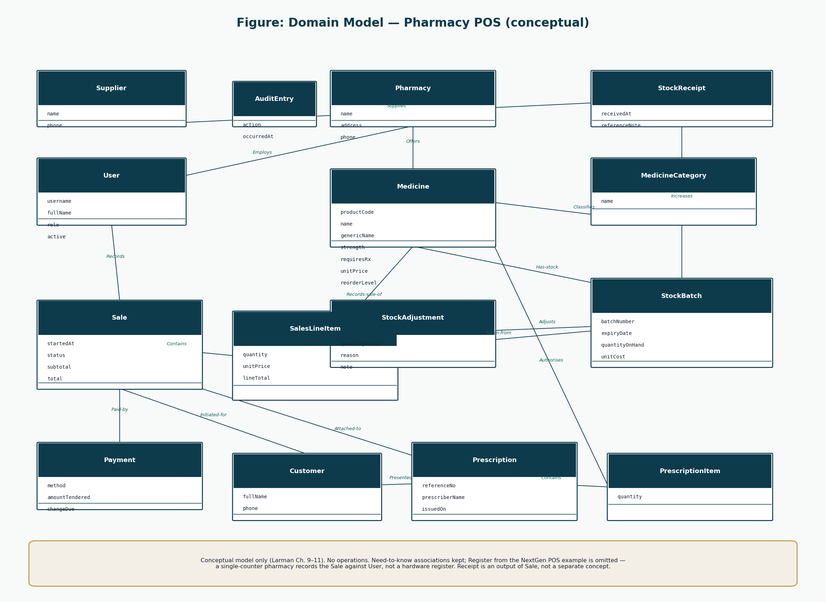
ELABORATION 1
Domain model (conceptual — no methods)
Group 20 · CSC 4630 · Pharmacy POS · Unified Process · Documentation phase
13 / 35

Slide 14
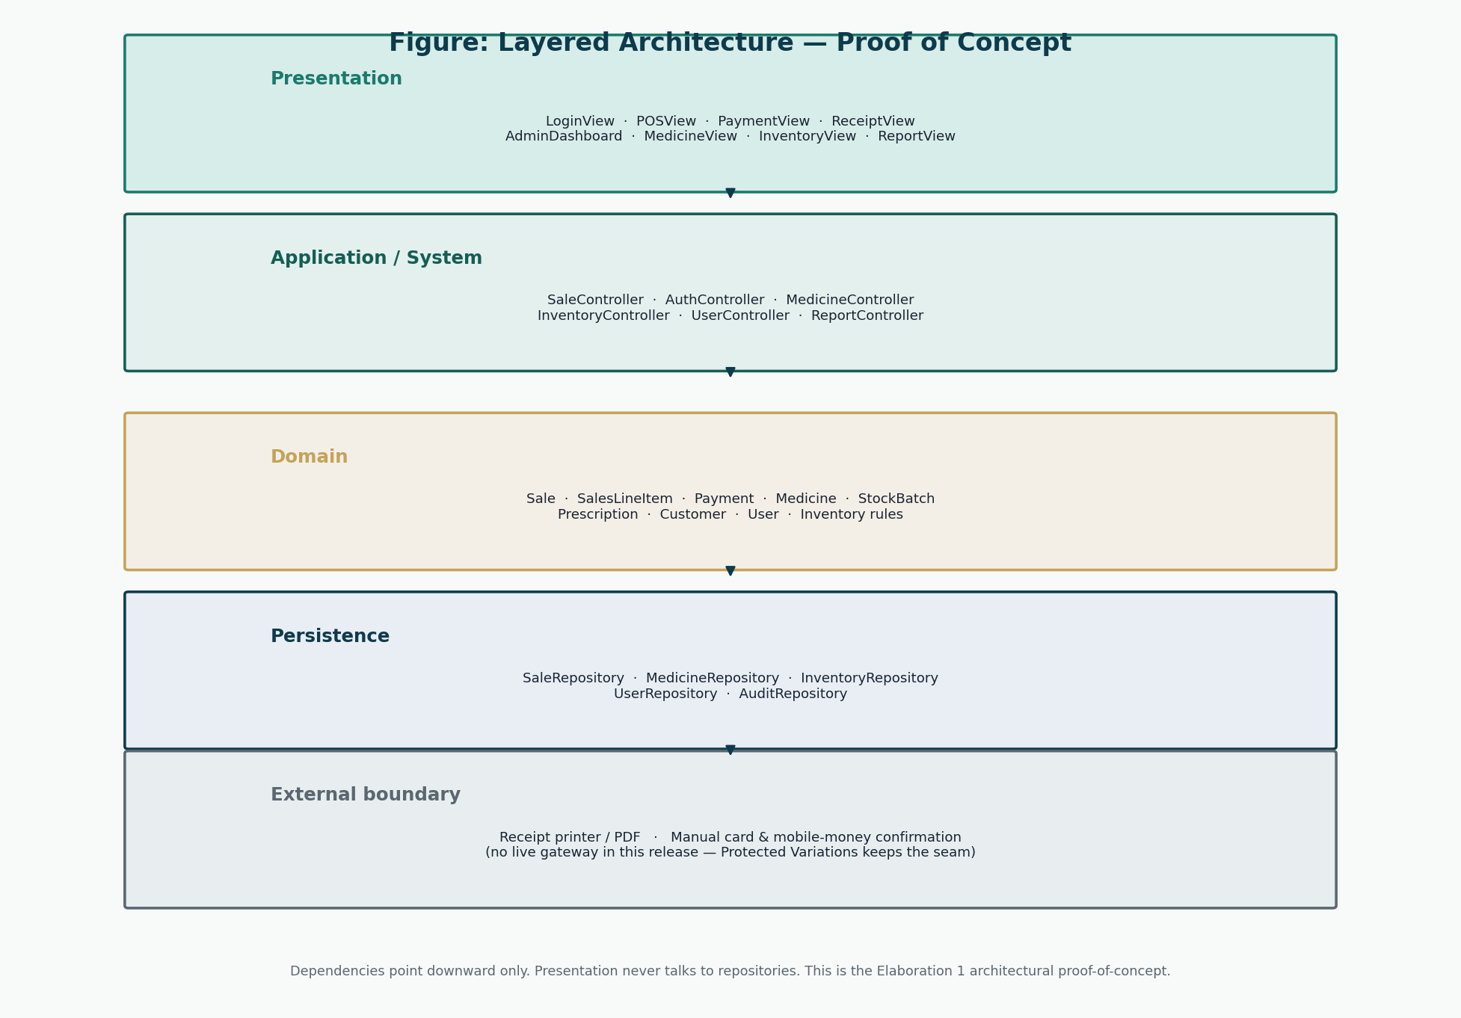
ELABORATION 1
Architectural proof-of-concept
Group 20 · CSC 4630 · Pharmacy POS · Unified Process · Documentation phase
14 / 35

Slide 15
ELABORATION 2
From requirements to design
Use cases 70%
UC-04 to UC-10 dressed
SSDs
Inventory and void events
Responsibilities
GRASP on each sale operation
DCD
Methods on software classes
UI
Both roles, no third role
Schema
3NF + sale price copy
Group 20 · CSC 4630 · Pharmacy POS · Unified Process · Documentation phase
15 / 35

Slide 16
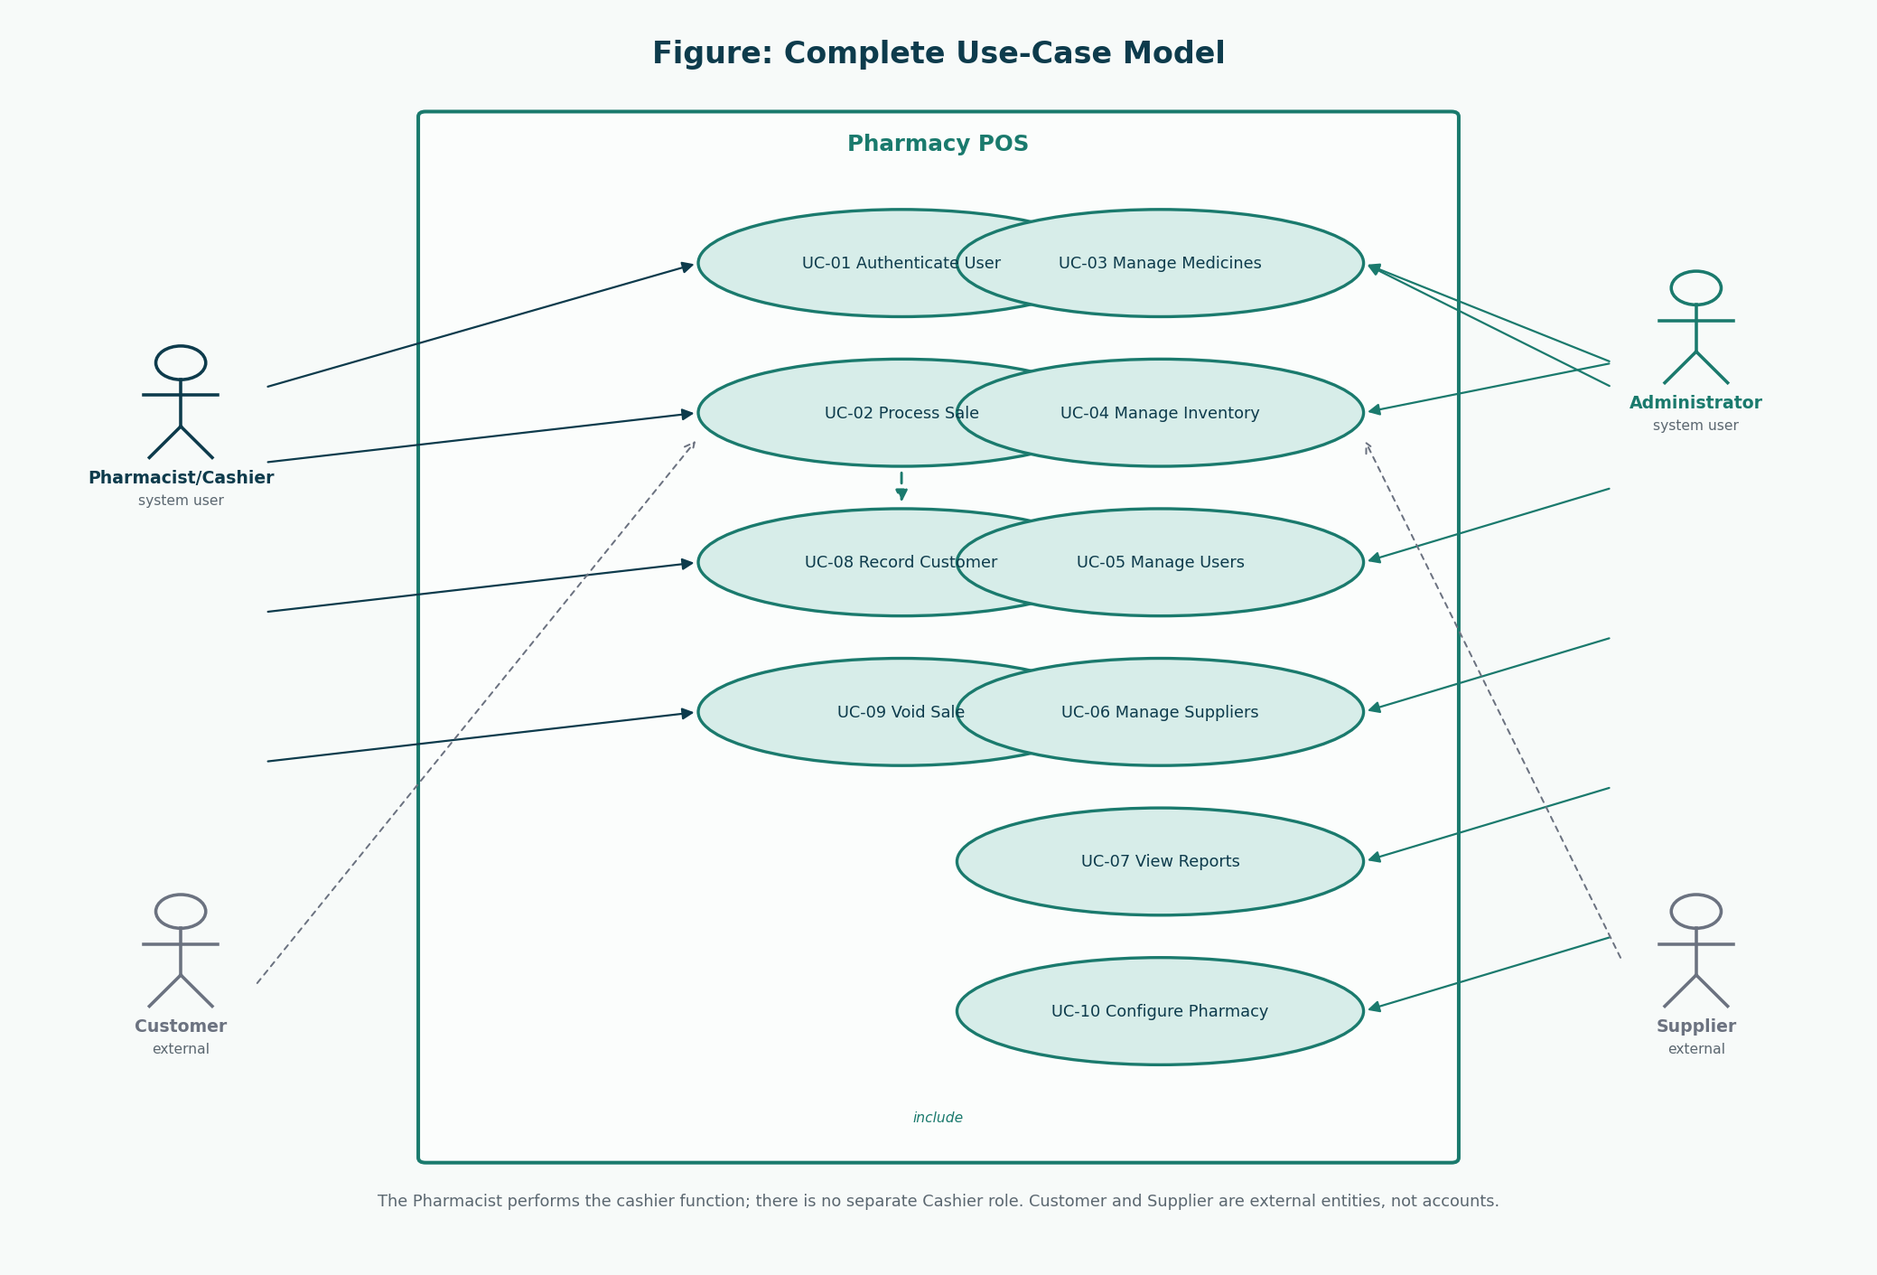
ELABORATION 2
Complete use-case model
Group 20 · CSC 4630 · Pharmacy POS · Unified Process · Documentation phase
16 / 35

Slide 17
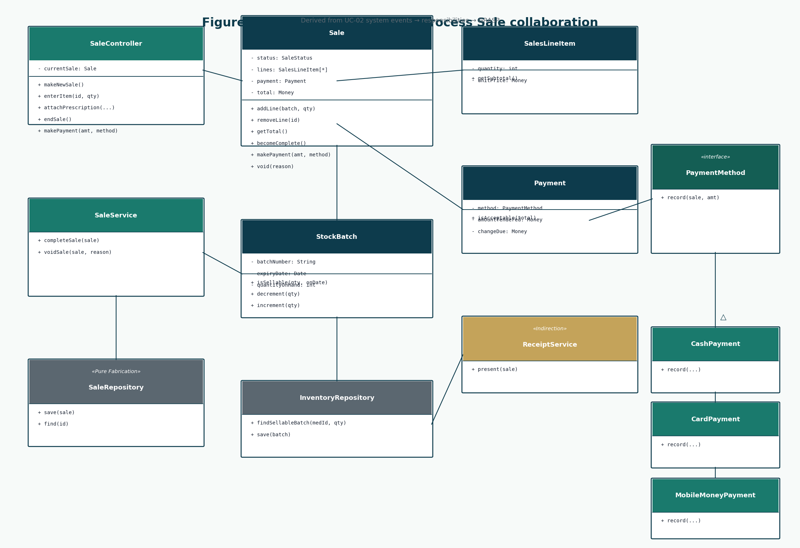
ELABORATION 2
Design class diagram — Process Sale
Group 20 · CSC 4630 · Pharmacy POS · Unified Process · Documentation phase
17 / 35

Slide 18
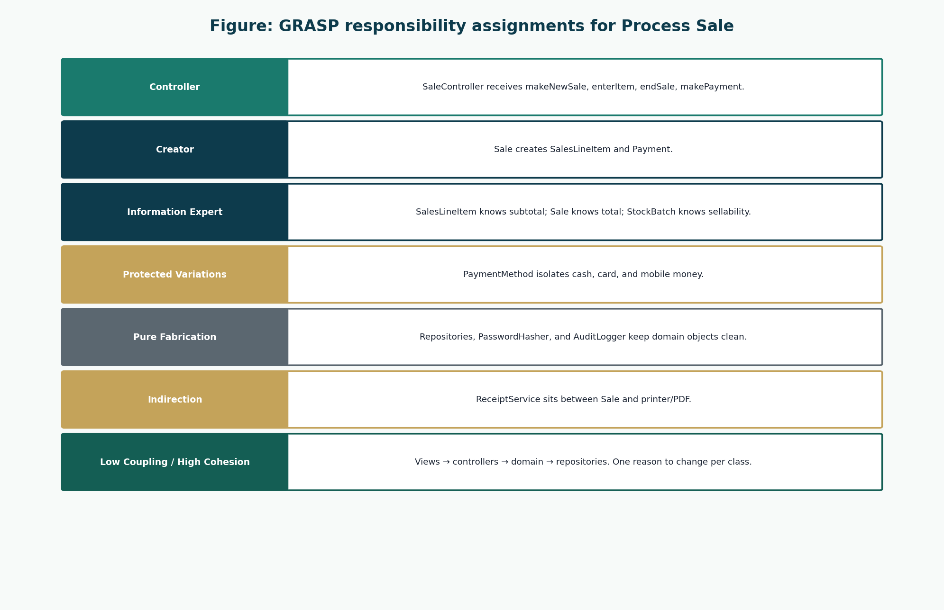
ELABORATION 2
GRASP — who does what, and why
Group 20 · CSC 4630 · Pharmacy POS · Unified Process · Documentation phase
18 / 35

Slide 19
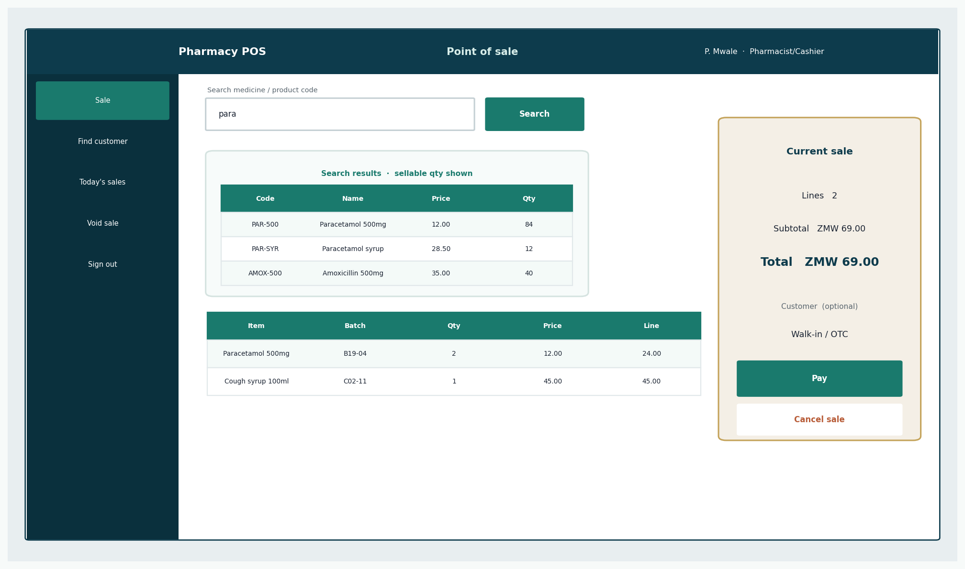
ELABORATION 2
UI prototype — Pharmacist counter
Group 20 · CSC 4630 · Pharmacy POS · Unified Process · Documentation phase
19 / 35

Slide 20
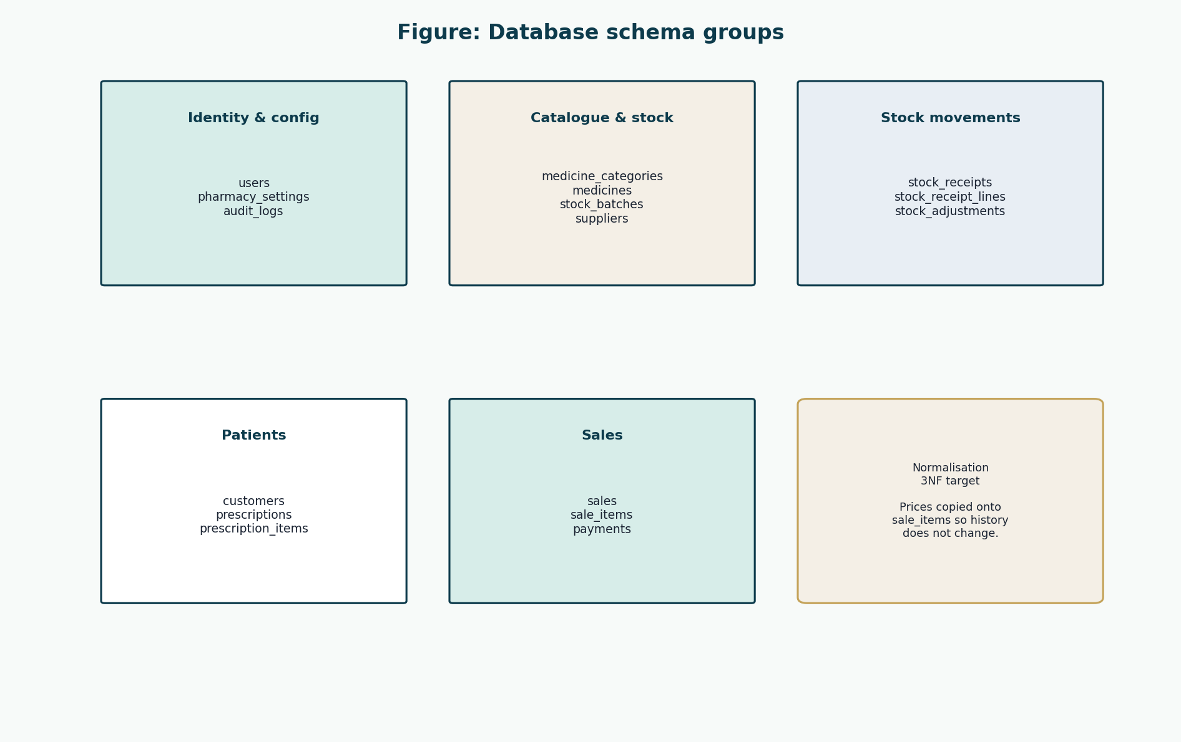
ELABORATION 2
Database design groups
Group 20 · CSC 4630 · Pharmacy POS · Unified Process · Documentation phase
20 / 35

Slide 21
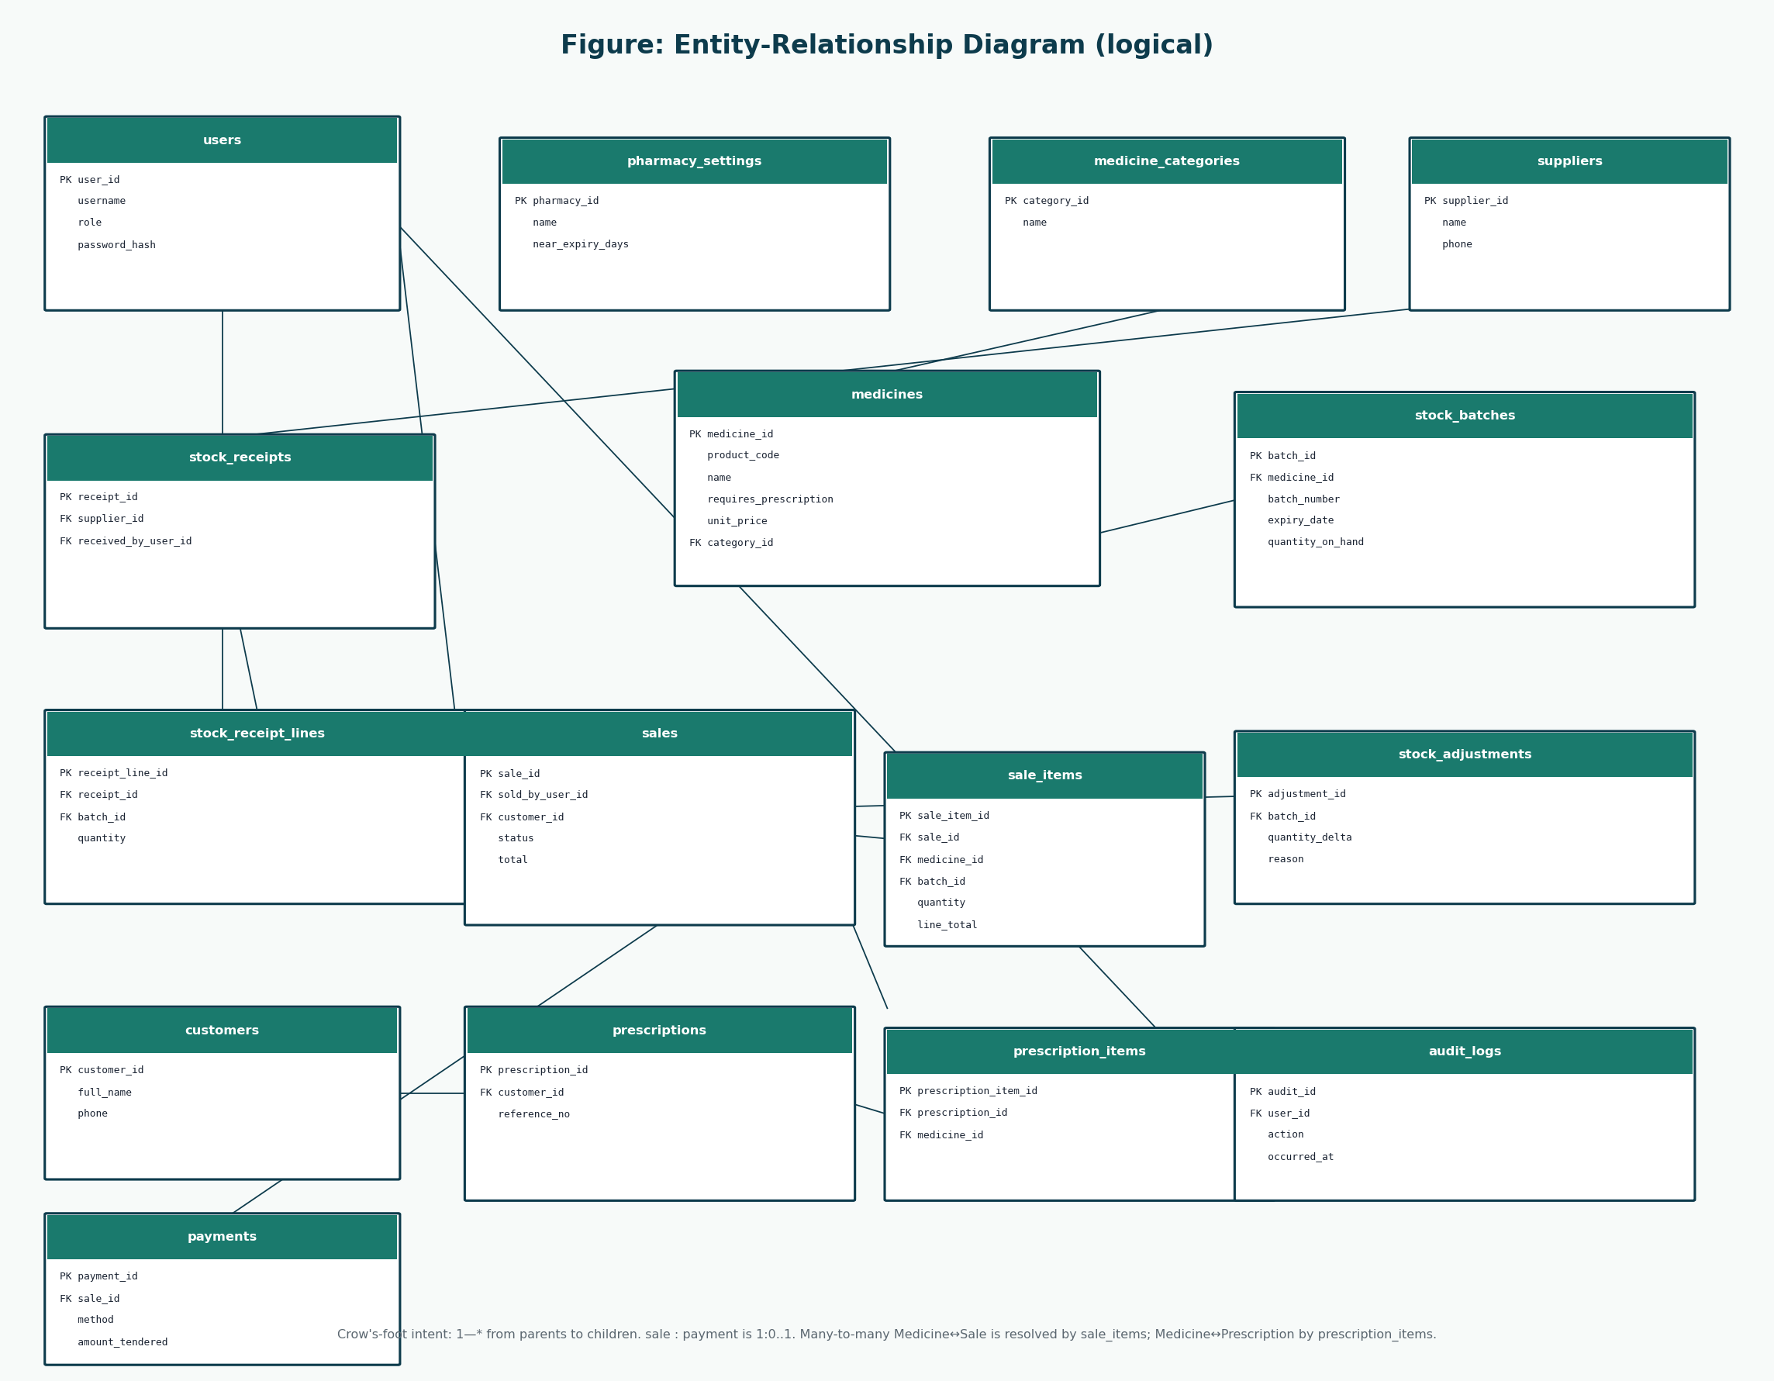
ELABORATION 2
Entity-relationship diagram
Group 20 · CSC 4630 · Pharmacy POS · Unified Process · Documentation phase
21 / 35

Slide 22
ELABORATION 2
Major tables and relationships
Persistent form of the domain model — design only, no SQL scripts
• users.role ∈ {ADMINISTRATOR, PHARMACIST} · password_hash never plaintext
• medicines described; stock_batches hold expiry and quantity_on_hand
• sales 1—* sale_items · sale_items copies unit_price (history stays still)
• sales 1—0..1 payments · method = CASH | CARD | MOBILE_MONEY
• customers / prescriptions support attachPrescription; no customer login
• stock_receipts + stock_adjustments are Administrator movements
• audit_logs record login, sale, void, stock, and user-admin events
• 3NF target; M:N resolved by sale_items and prescription_items
Group 20 · CSC 4630 · Pharmacy POS · Unified Process · Documentation phase
22 / 35

Slide 23
WEEKS 9–12
Construction — Iterations 3 and 4
Iteration 3 — spine
• F-01 Auth
• F-08 Medicines
• F-02…F-07 Process Sale
• UT-01–UT-09 · IT-01–IT-03
Iteration 4 — widen
• F-09–F-10 Inventory
• F-15 Void
• F-11–F-16 Admin + reports
• Remaining tests
Feature status is Planned. Results: TO BE COMPLETED DURING CONSTRUCTION.
Group 20 · CSC 4630 · Pharmacy POS · Unified Process · Documentation phase
23 / 35

Slide 24
CONSTRUCTION
Testing strategy
Unit (examples)
• UT-04 expired batch not sellable
• UT-08 failed persist leaves stock
• UT-10 void restores quantity
• UT-02 wrong password → no session
Integration (examples)
• IT-01 full OTC path in the database
• IT-02 expiry refusal leaves no line
• IT-05 void + audit row
• IT-06 Pharmacist cannot create medicines
Group 20 · CSC 4630 · Pharmacy POS · Unified Process · Documentation phase
24 / 35

Slide 25
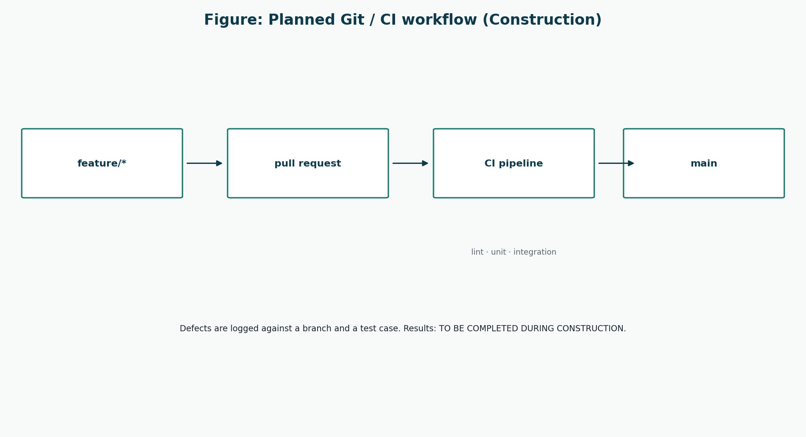
CONSTRUCTION
Git and continuous integration
Group 20 · CSC 4630 · Pharmacy POS · Unified Process · Documentation phase
25 / 35

Slide 26
CONSTRUCTION
Defect tracking
A defect is a failed test or a broken use-case guarantee — not a new feature request.
• Log fields: DEF-id, test id, UC/FR, severity, status, commit hash
• Template row DEF-000 exists so the log format is ready
• No invented defect counts or “12 bugs closed” stories
• New ideas (NHIMA, web shop) go to the backlog, not the defect log
• Status: TO BE COMPLETED DURING CONSTRUCTION
Group 20 · CSC 4630 · Pharmacy POS · Unified Process · Documentation phase
26 / 35

Slide 27
WEEKS 13–14
Transition — beta, performance, security
Beta users
One Administrator account, one Pharmacist/Cashier account. Same human may switch — never a merged role.
Feedback
Structured prompts. Analysis splits usability / defect / out-of-scope.
Performance
Time enterItem on the real workstation against NFR-02. No fake timings today.
Security
Plaintext password must fail; Pharmacist must not open user-create; voids need reasons.
Group 20 · CSC 4630 · Pharmacy POS · Unified Process · Documentation phase
27 / 35

Slide 28
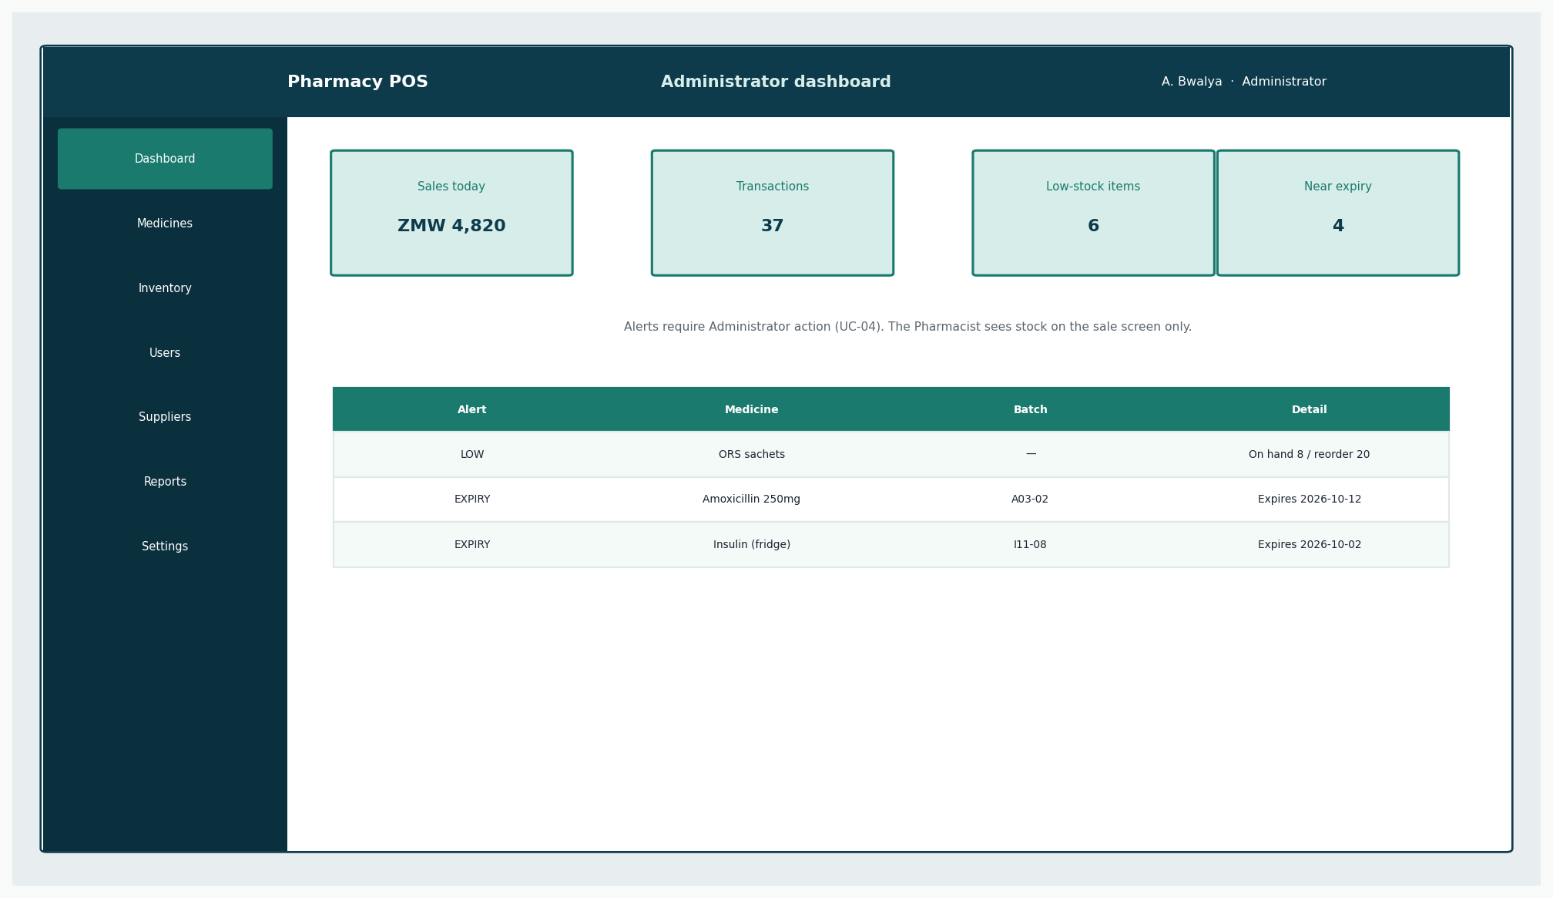
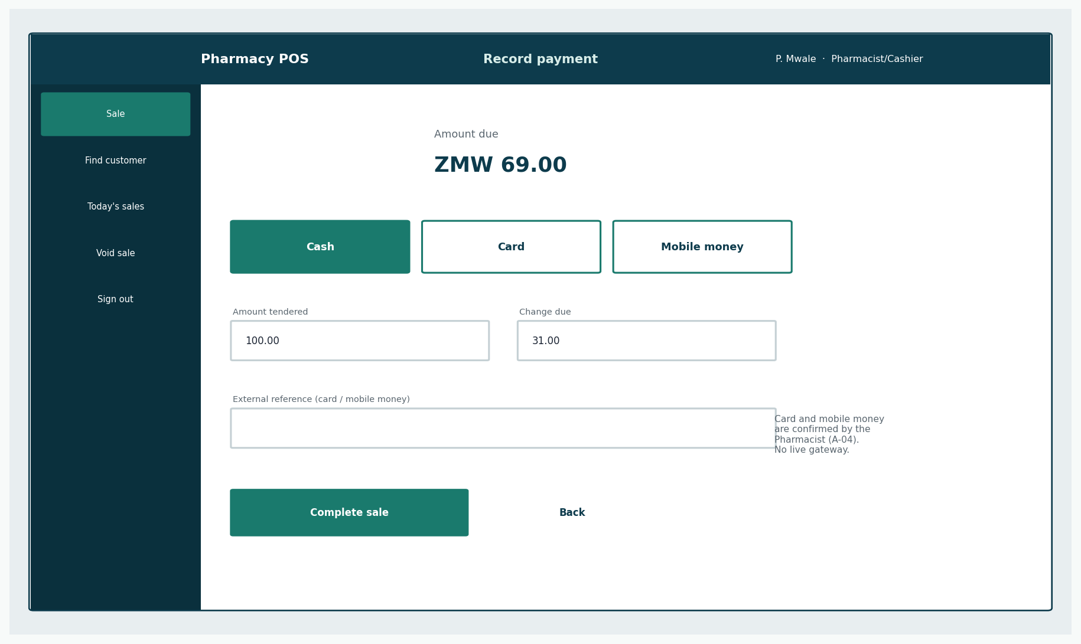
DESIGNED SYSTEM
What the constructed system will be
Administrator dashboard and Pharmacist payment — same two roles on every screen. The running product will replace these prototypes after construction.
Group 20 · CSC 4630 · Pharmacy POS · Unified Process · Documentation phase
28 / 35

Slide 29
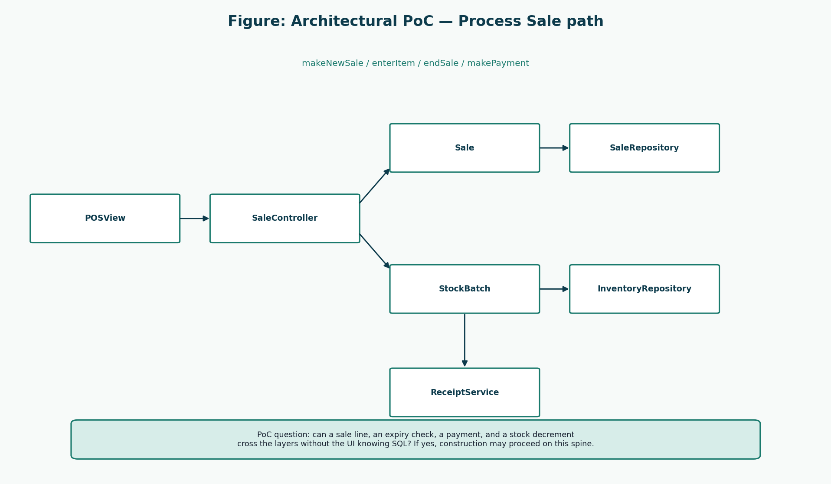
WEEK 15
Final UML — the same approved models
Group 20 · CSC 4630 · Pharmacy POS · Unified Process · Documentation phase
29 / 35

Slide 30
WEEK 15
UP reflection
Inception
Treating 10% as Process Sale stopped insurance/refill scope creep from an earlier briefing slide.
Elaboration
SSDs and StockBatch made the pharmacy difference from NextGen POS real. Register was omitted on purpose.
Construction
Not lived yet. Planned lesson: vertical slices, not layer-by-layer waterfall.
Transition
Not lived yet. R-05 (training) will be confirmed only when a non-author Pharmacist uses the till.
Group 20 · CSC 4630 · Pharmacy POS · Unified Process · Documentation phase
30 / 35

Slide 31
WEEK 15
Lessons learned (design phase)
• A use case is a goal. “Click Search” is not a use case.
• Two roles change the diagram, the UI, and the users table — not just a sentence on a slide.
• Pharmacy POS ≠ NextGen POS. Expiry and prescriptions in; Register out.
• Assumptions that are not written become fake requirements.
• “Mitigated in design” is not “gone”.
• Stable IDs (FR-05, UC-02, UT-04) are how UP documents stay one project.
Group 20 · CSC 4630 · Pharmacy POS · Unified Process · Documentation phase
31 / 35

Slide 32
WEEK 15
Key achievements (this pack)
Marking-guide compliance matrix covering all 100 marks
Ten goal-level use cases with a justified 10 / 30 / 70 split
Larman-style SSDs, domain model, DCDs, and GRASP
Logical schema + ERD consistent with Process Sale
UI prototypes for both roles only
Honest placeholders where construction has not occurred
Group 20 · CSC 4630 · Pharmacy POS · Unified Process · Documentation phase
32 / 35

Slide 33
WEEK 15
Live demonstration plan
SC-01
OTC cash sale → receipt → stock down
SC-02
Prescription-only line blocked until details exist
SC-03
Expired batch refused
SC-06
Void restores stock and keeps the sale
SC-07
Pharmacist cannot open user administration
SC-08
Administrator report shows the completed sale once
Group 20 · CSC 4630 · Pharmacy POS · Unified Process · Documentation phase
33 / 35

Slide 34
CLOSE
Conclusion
Group 20 has a single connected design.
• Process Sale is the thread through every artefact.
• Exactly two roles — the Pharmacist is the cashier.
• UP phases and the lecturer’s 15-week marks are mapped, not decorated.
• Code starts only on the instruction START IMPLEMENTATION.
Group 20 · CSC 4630 · Pharmacy POS · Unified Process · Documentation phase
34 / 35

Slide 35
Questions
Group 20 · CSC 4630 · Pharmacy POS Unified Process · Documentation first
35 / 35

