Slide 1

Amazing
Not Bad ?!
Uhhh !!
Wow
Terrible
100%
20%
‘To be earth most customer centric company and build a place where people can discover anything’ -Amazon
Recommendation System
Based on Amazon Reviews | Analyzed & Designed by Team BRIE

Slide 2

Summary Report
Overview
1
2
3
4
5
6
7
1
Business Analysis
3
Data Preparation
4
Modeling
3.1 Exploratory Analysis
Manager 1
1.1 Business Case
Improve personalization
1.2 Market Study
4.1 Sentiment Analysis-Text Analysis
4.2 K-means Clustering
9
Columns
568,454
Instances
5
Results
2
Data Understanding
3.2 Pre-processing
Text Analysis
Tokenization
Word Count
Final Dataset
(Dataset: 365 x 360)
Test Train Split
2.1 Data Extraction
GZ zip format -> Json file -> .csv data frame
2.2 Data Understanding
6
Business Use
7
Future Scope
2

Slide 3
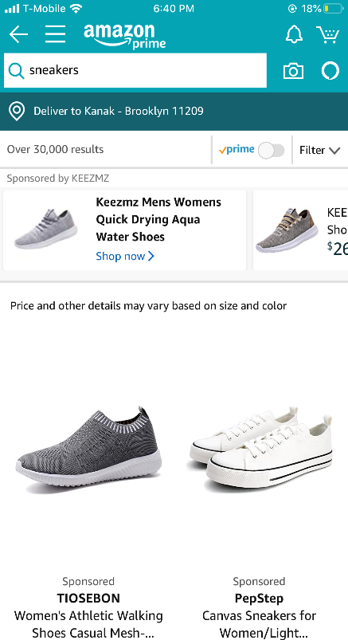
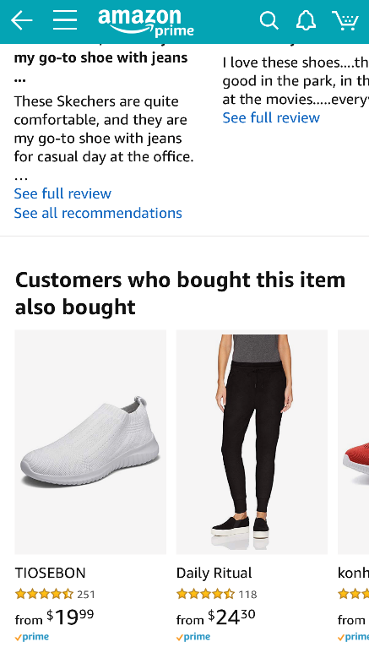
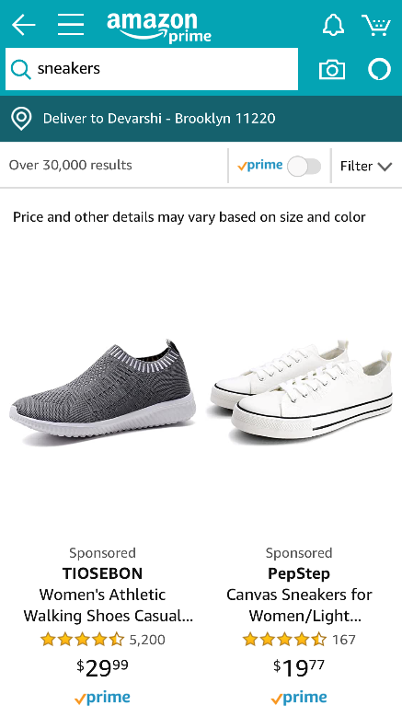
Business Analysis > Amazon > Product Recommendation
1.1 Product Recommendation
Above images are screenshots from two different Amazon user accounts providing similar recommendation
Amazon strives to be the pioneer of personalization to improve customer experience
TechCrunch
3

Slide 4
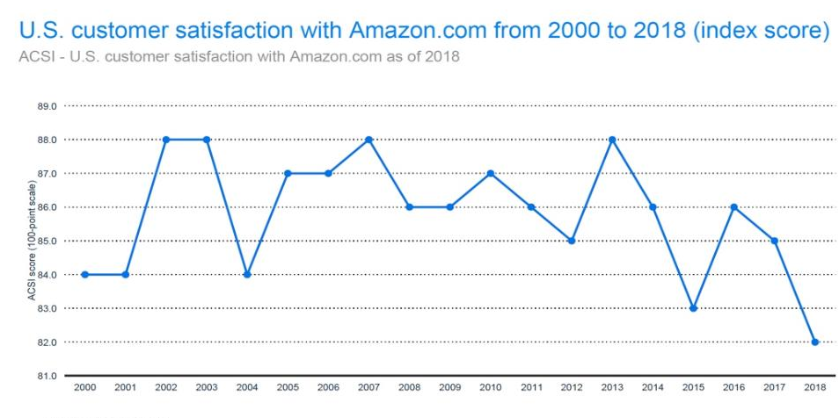
Business Analysis > Business Case & Market Study
1.2 Help Improve personalization based on user-reviews
1
Problem
1.1
Problem
57%
User Reviews
of the purchasing decision driven by product reviews.
Lack of personalization in recommendation systems
$1.9B
1
Problem
1.2
Market Study
?
Personalized
Recommendation
Revenue Proportion With/without
Recommendation System
Reviews
4

Slide 5
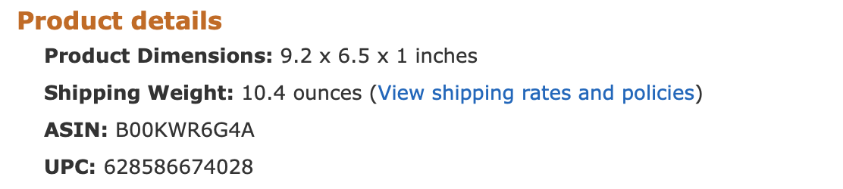
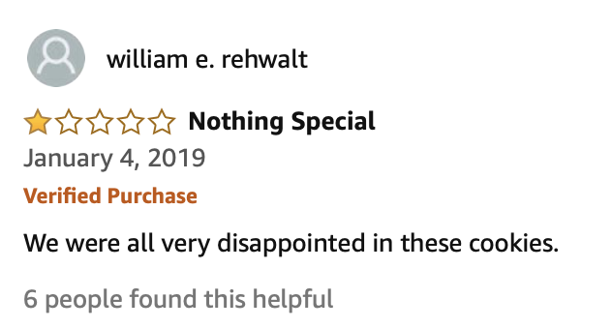
Data > Data Understanding
2. Extracting and understanding dataset
Source: Amazon Fine foods
Stanford.edu, J. Leskovec
ASIN:
Unique Identification Number
1
9
Product ID
GZ Zip Format
Username/ User ID
2
8
Unix Review Time
Ratings
7
Json file
3
Summary
Reviews
4
csv file
People who find
it helpful:
Helpfulness Num
Helpfulness Den
5
9
6
Columns
568,454
Instances
5

Slide 6
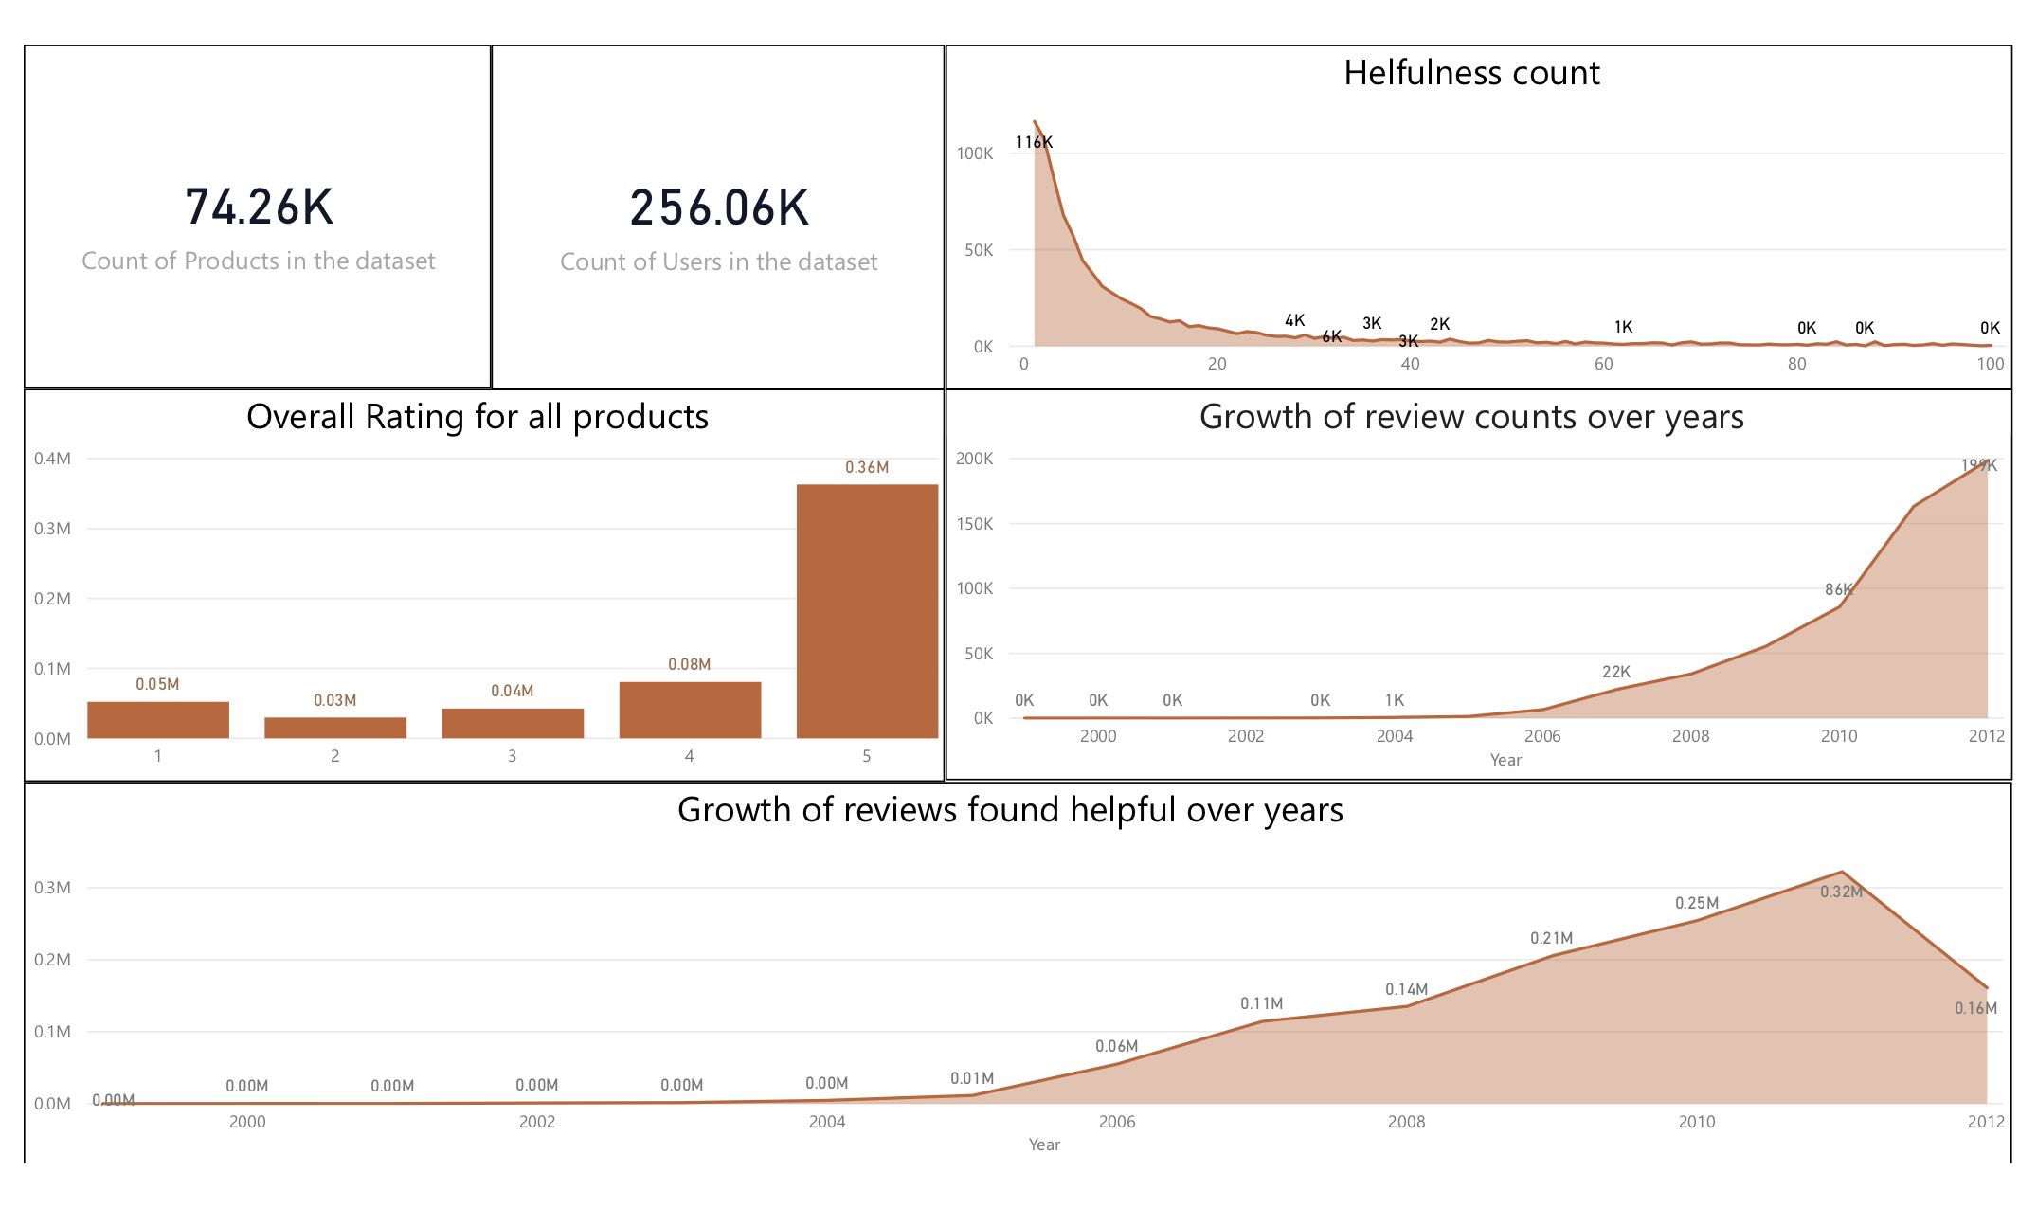
Data > Data Preparation
3.1 Exploratory Analysis
6

Slide 7
Data > Data Preparation: text analysis, tokenization & sum count
3.2 Data Preprocessing
1. Removed Duplicates
Asin | Reviewer ID | Reviews
B001E4KF | A3SGXH | I had bought …
F101E4EF | A5PGDF | Nice Product
B001E4KF | A3SGXH | I had bought …
2. Data Filtering
3. Removed Stop Words, White Space
4. Removed Punctuations, Numbers
5. Normalize: Lower Case, Stemming
Asin | Reviewer ID | Reviews
B001E4KF | A3SGXH | I had bought …
F101E4EF | A5PGDF | Nice Product
6. Word Count
7. Processed Dataset
7

Slide 8
Data > Data Preparation: text analysis, tokenization & sum count
3.2 Data Preprocessing
1. Removed Duplicates
2. Data Filtering
Filtered by
Product Reviews
3. Removed Stop Words, White Space
4. Removed Punctuations, Numbers
5. Normalize: Lower Case, Stemming
>100
6. Word Count
7. Processed Dataset
8

Slide 9
Data > Data Preparation: text analysis, tokenization & sum count
3.2 Data Preprocessing
#Amazon Review
1. Removed Duplicates
“We were Disappointed with 1, cookies”.
2. Data Filtering
3
3. Removed Stop Words, White Space
“Disappointed 1, cookies”.
4. Removed Punctuations, Numbers
4
Disappointed cookies
5. Normalize: Lower Case, Stemming
5
6. Word Count
disappoint cookies
7. Processed Dataset
9

Slide 10
Data > Data Preparation: text analysis, tokenization & word count
3.2 Data Preprocessing
1. Removed Duplicates
Asin | Reviews
B001E4KF | Nice Product
F101E4EF | Awesome features
B001E4KF | Best Product
2. Data Filtering
3. Removed Stop Words, White Space
4. Removed Punctuations, Numbers
5. Normalize: Lower Case, Stemming
Asin | Reviews
B001E4KF | Nice Product Best Product
F101E4EF | Awesome features
6. Word Count
7. Processed Dataset
Processed Dataset
 | Awesome | Best | Features | Nice | Product
B1001E4KF | 0 | 1 | 0 | 1 | 2
F101E4EF | 1 | 0 | 1 | 0 | 0
Top 300 High Frequency Words
10

Slide 11
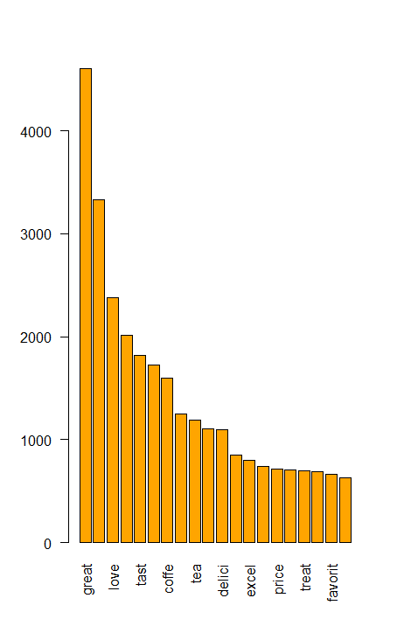
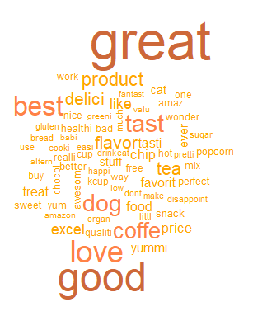
Modeling > Sentiment Analysis
Text Analysis
4.1 Sentiment Analysis
11

Slide 12
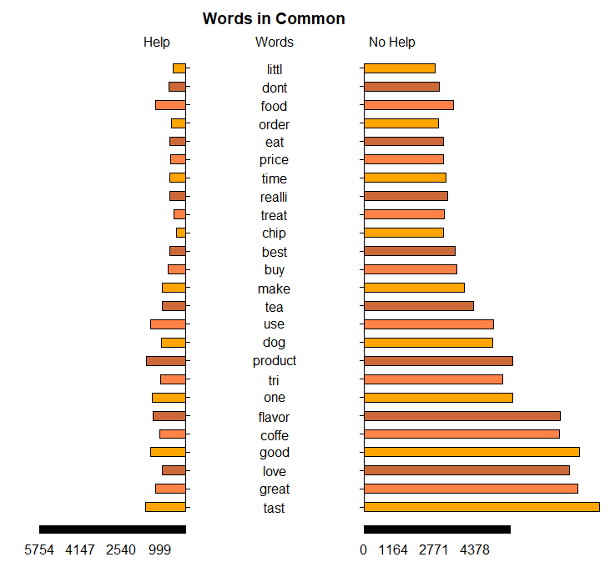
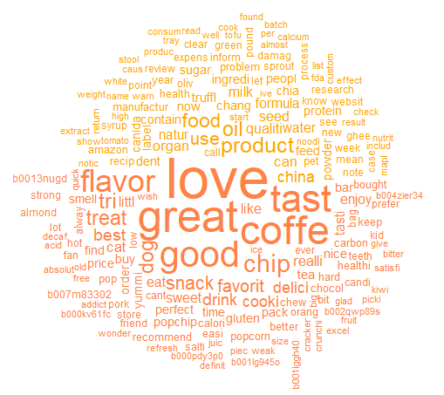
Modeling > Sentiment Analysis
Helpfulness
4.1 Sentiment Analysis
Help
No Help
12

Slide 13
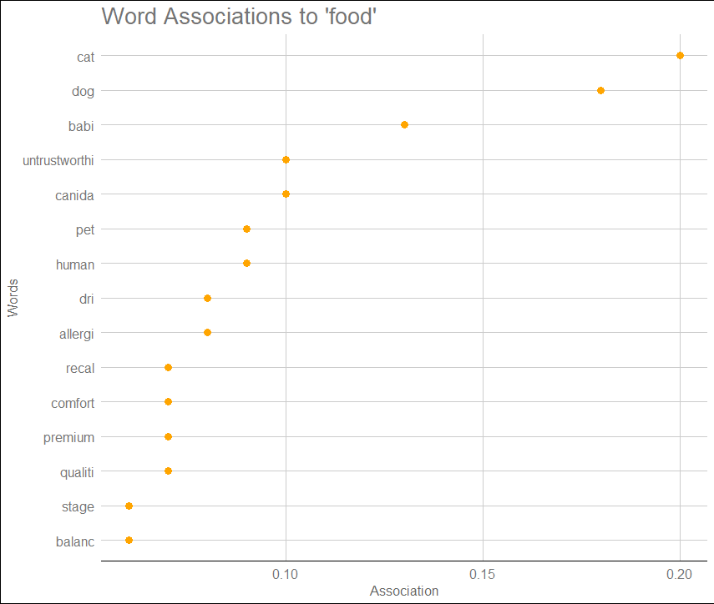
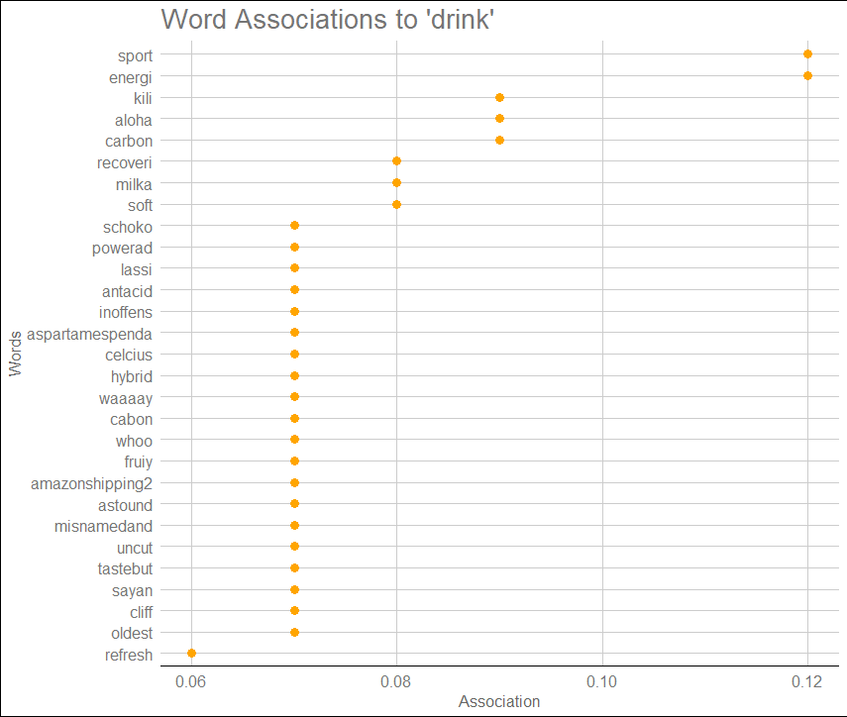
Modeling > Sentiment Analysis
4.1 Sentiment Analysis
FOOD
DRINK
Word Association: Food &Drink
13

Slide 14

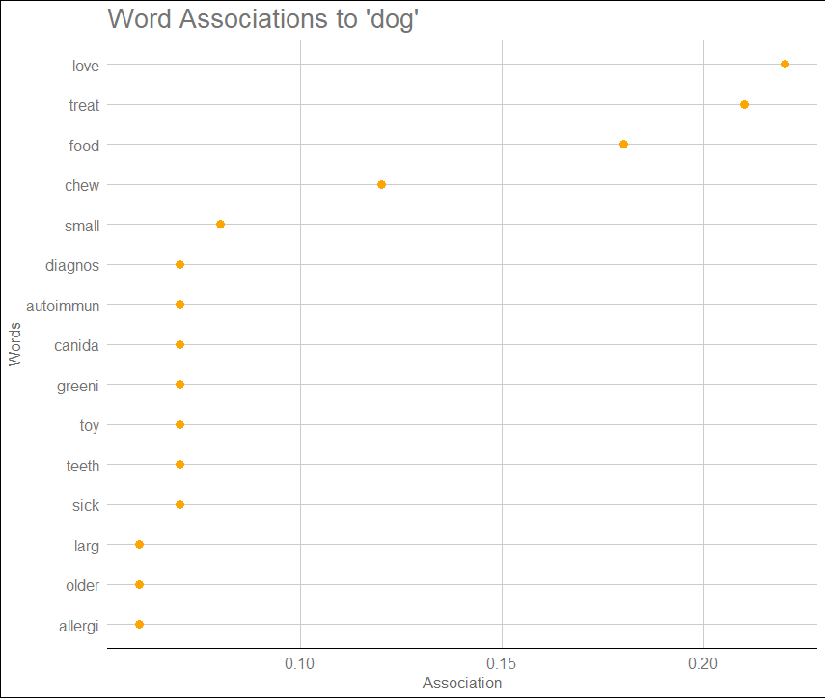



Modeling > Sentiment Analysis
Word Association: Dog
4.1 Sentiment Analysis
14

Slide 15
Modeling > K-means Clustering
A
8
D
5
C
7
For Product D: Suggestions are Product C & B
B
15

Slide 16
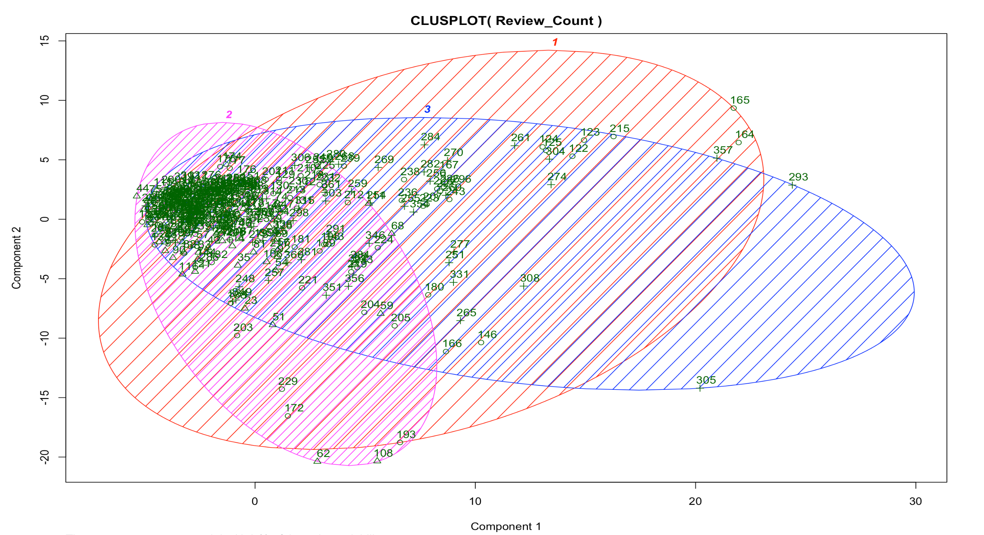
Modeling > K-means Clustering
4.2 K-means Clustering
16

Slide 17
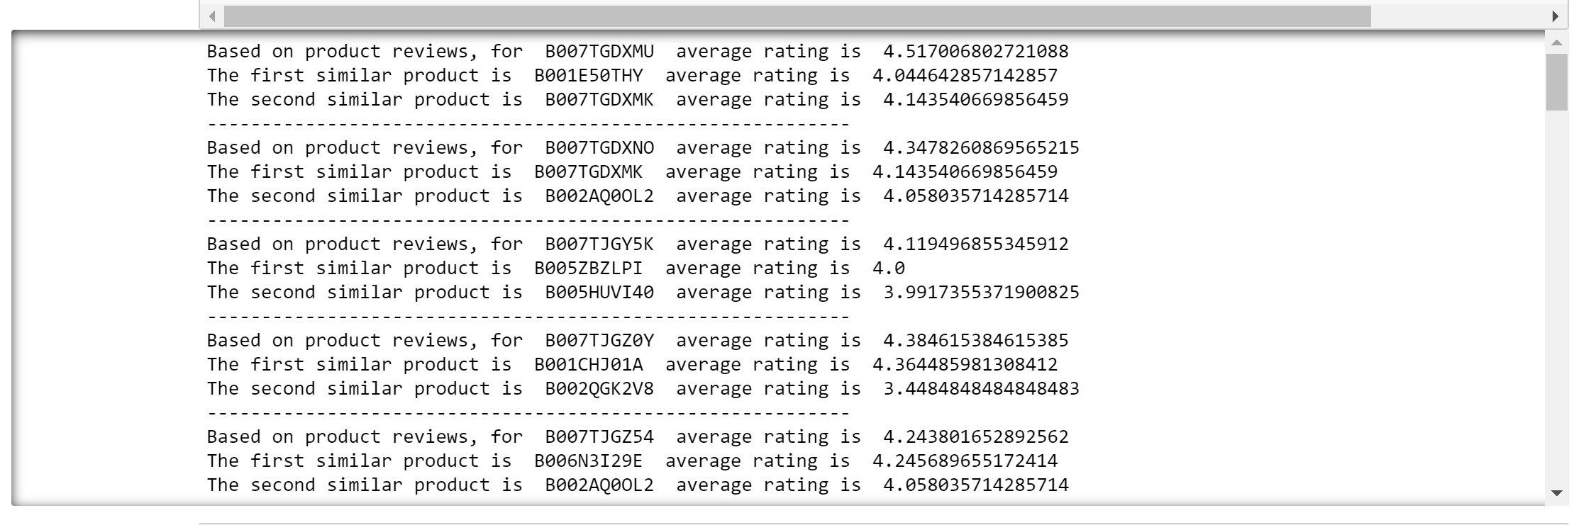
Modeling > Implications
5. Results
Product1
Based on Product Reviews
Product3
Product2
17

Slide 18

Modeling > Business Insights
Initially not suggested
Suggested now
6. Business Use
New Personalized Recommendation
(based on reviews)
Subconscious (Still in mind)
Conversion: High Chance
PERSONALIZED
EXPERIENCE
CROSS SELLING
COMPLIMENTARY PRODUCTS
ENGAGE SHOPPERS
18
Reach
Act
Convert
Engage
Amazon’s general RACE strategy

Slide 19






Modeling > Business Insights
Future Scope : User Profiling by Tag words
Tag Words from product reviews
Tag Words from the user reviews
#High Definition #Low Cost
#Healthy
#Good Skin
#Comfortable #Pregnant
#Comfortable #Pregnant
#Healthy
#Good Skin
#Long Lasting
#Low Cost
19

Slide 20
Business Analytics | Fall 2019
My voice
counts,
Thanks !
Questions ?
Thank You
#Amazon Prime
#Black Friday
#Games
#Movies
#Personalized
#Toys
#Recommendation
#Year 2020
#Ecommerce
#United States
-
#AWS
#Clothing
#Office Products
#Digital Music
#Brie
#Gadgets
#Customer Centric
#Champions
#Digital
#No Words
Researched, analyzed & presented by Team BRIE

