Slide 1
Introducing Grammar of Modeling R package (gmod) and the Decision Twigs online tool for building HTA models in R
Hawre Jalal, MD, PhD
University of Ottawa

Slide 2

Acknowledgements
Fernando Alarid-Escudero
Tom Trikalinos
Eline Krijkamp
Petros Pechlivanoglou
Eva Enns
Alexandra Moskalewicz
David U. Garibay-Treviño
Alan Yang
Jeremy D. Goldhaber-Fiebert
Myriam Hunink

Slide 3


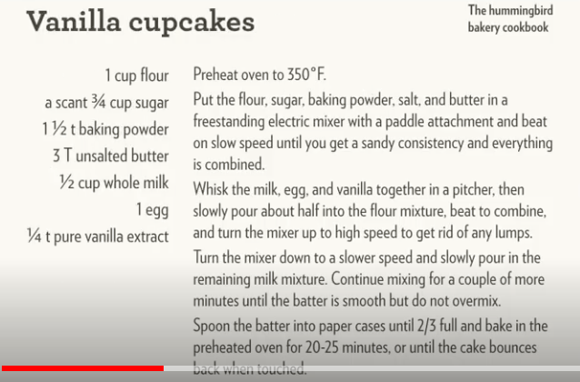
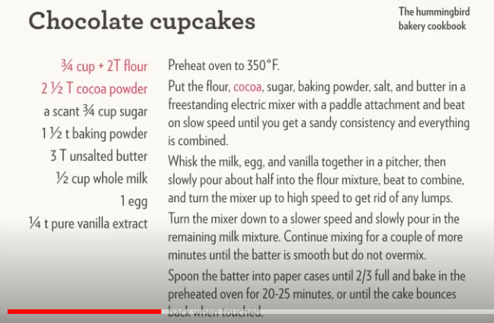
Motivation
Grammar of Graphics (ggplot2) and Tidyverse
Hadley Wickham - Cupcakes (for-loops vs map/lapply)
https://www.youtube.com/watch?v=GyNqlOjhPCQ

Slide 4
Why is a grammar needed in modeling?
Many of our HTA models in R (and other languages) are very similar to the Hummingbird Bakery Cookbook
Full of redundancies
Difficult to debug, troubleshoot and maintain
Challenging to read and communicate
Not easily reproducible

Slide 5
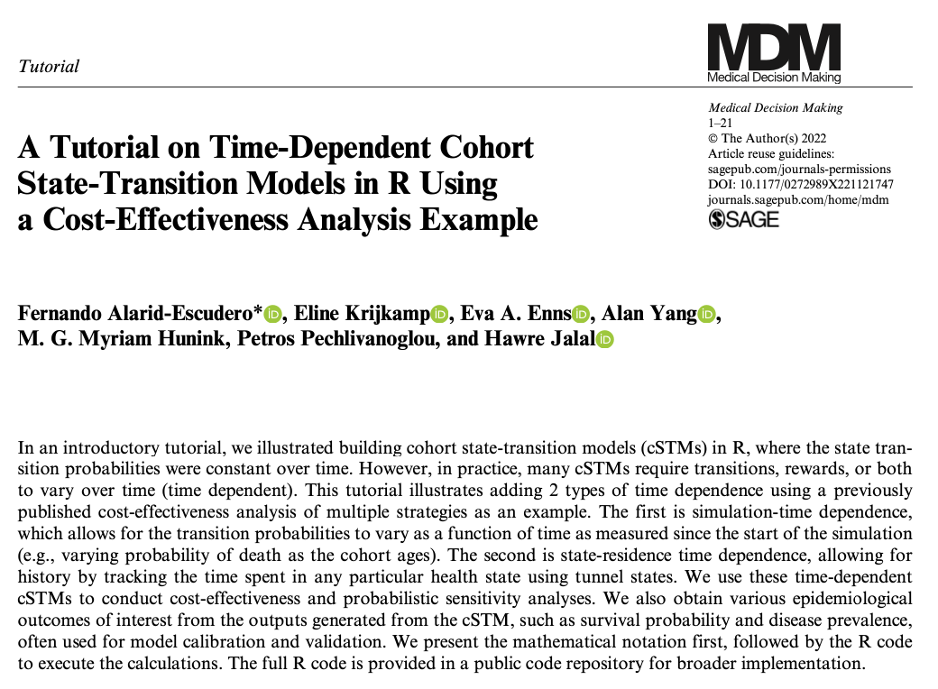
Example

Slide 6
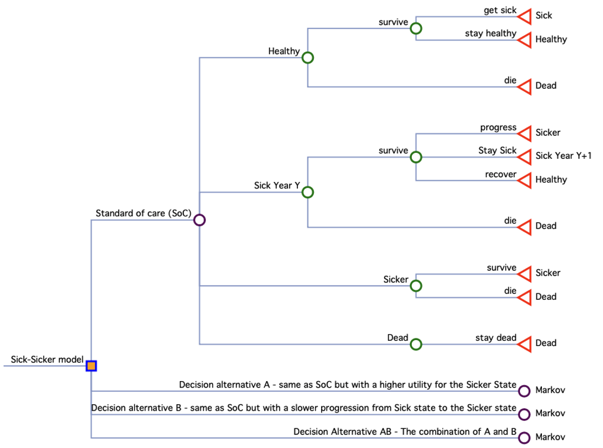
Current practice (Grammar)
For example, same event die is repeated 16 times:
If SoC & Healthy then pDie = …
If SoC & Sick Yr Y then pDie = …
If SoC & Sicker then pDie = …
If ….

Slide 7
But what you want to say is:
pDie = function(decision, health state, age).

Slide 8
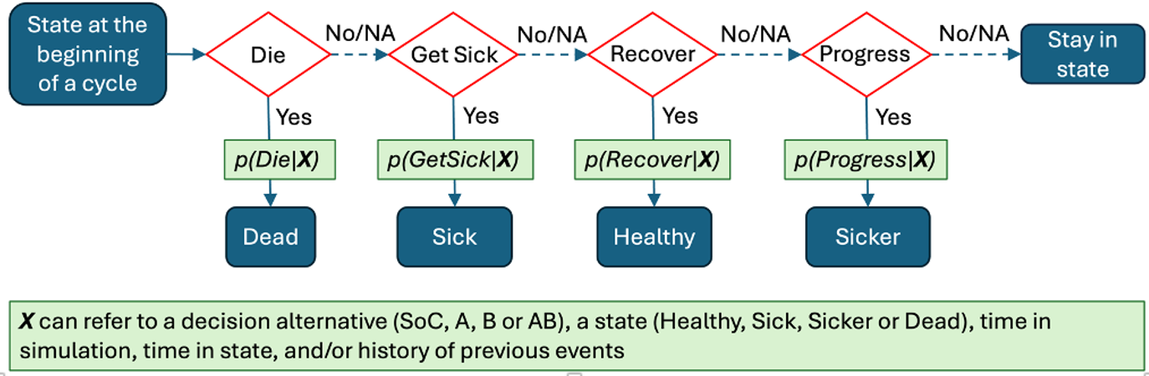
What is Grammar of Modeling (gmod) ?
https://github.com/hjalal/gmod
Defines a generic cycle tree that gets applied to every health state and decision

Slide 9
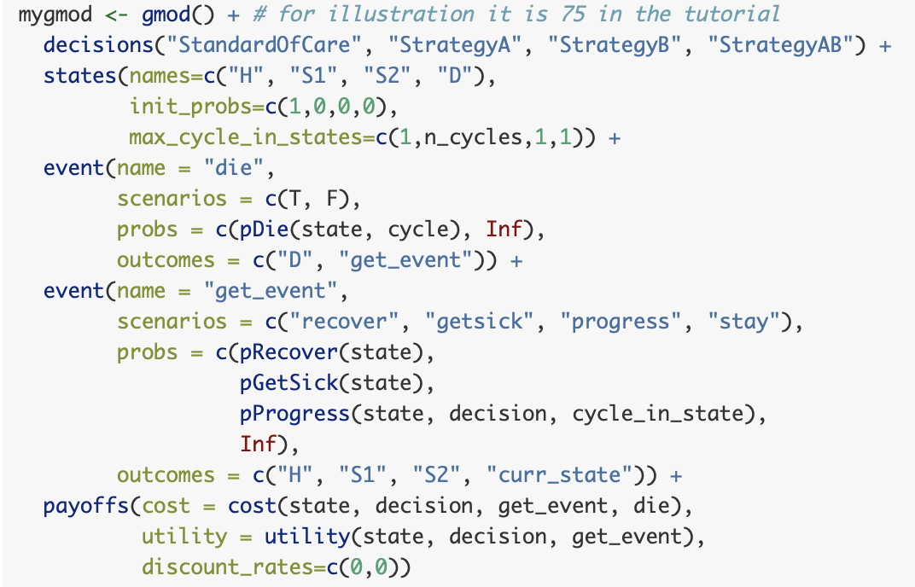
Same example in gmod
Number of allowed tunnels
Inf is a placeholder that computes the complement = 1 – sum(other probs)
Prob of dying depends on health state and age
Prob of progression depends on health state, decision and tunnels
Costs and utilities can depend on state, decision, transitions rewards of moving among states

Slide 10
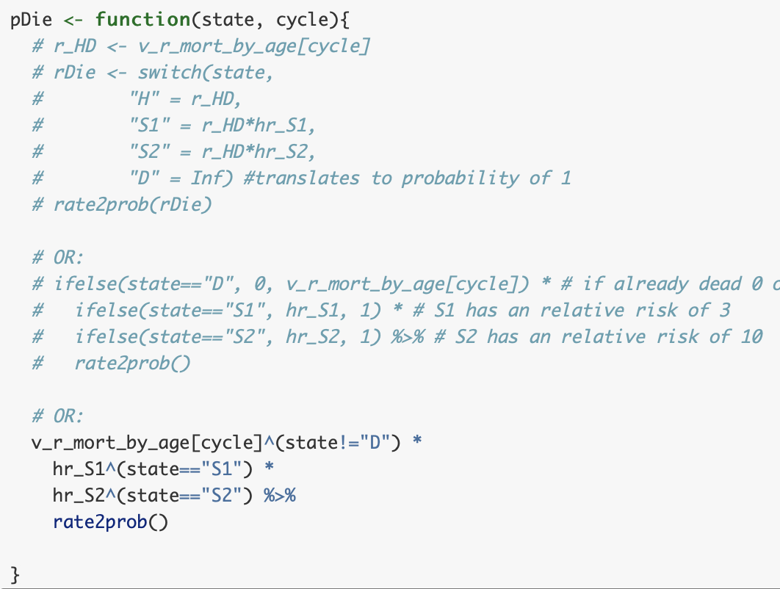
User-defined functions

Slide 11
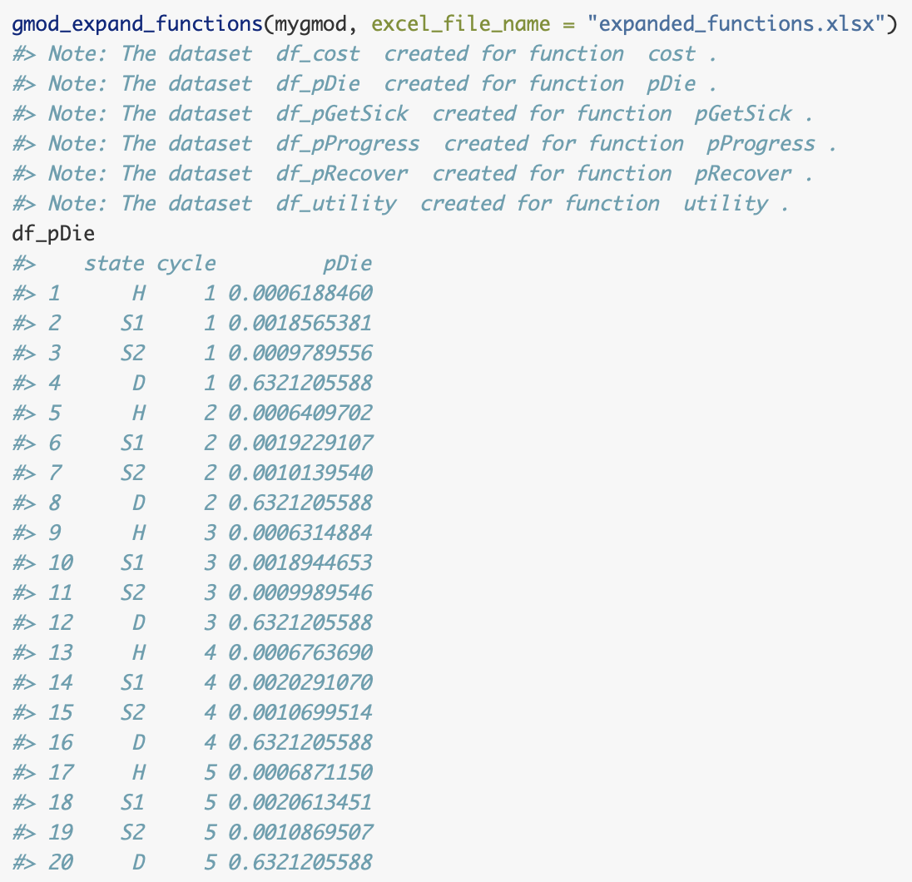
Evaluating functions

Slide 12
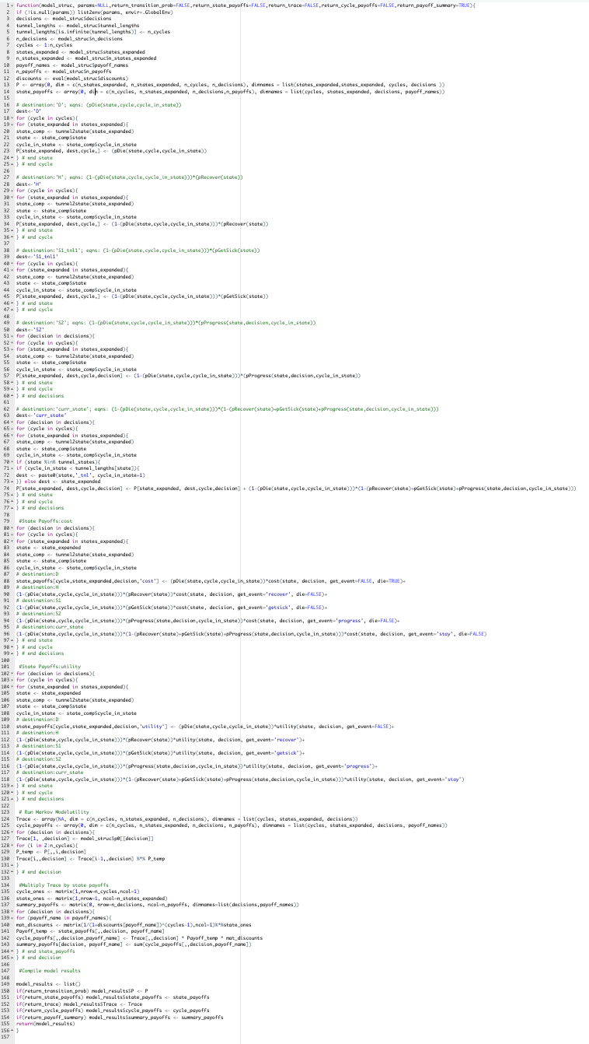
Running the model
Create a model function my_Markov_model(…)
Run the model

Slide 13
Running the model
Create a model function my_Markov_model(…)
Run the model

Slide 14
Running the model
Create a model function my_Markov_model(…)
Run the model

Slide 15
Running the model
Create a model function my_Markov_model(…)
Run the model

Slide 16
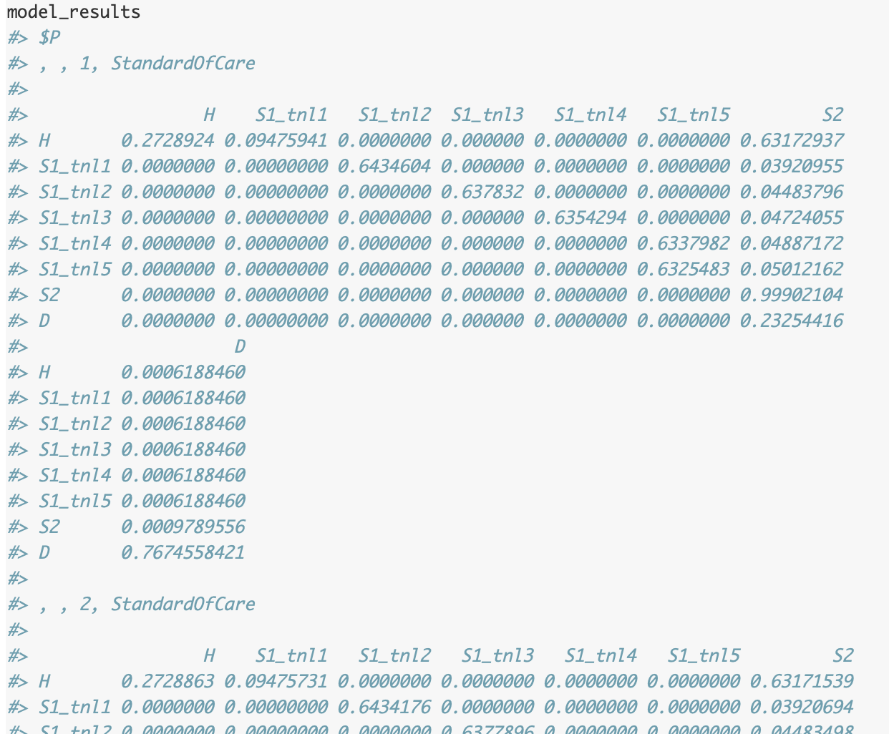
Transition matrices

Slide 17
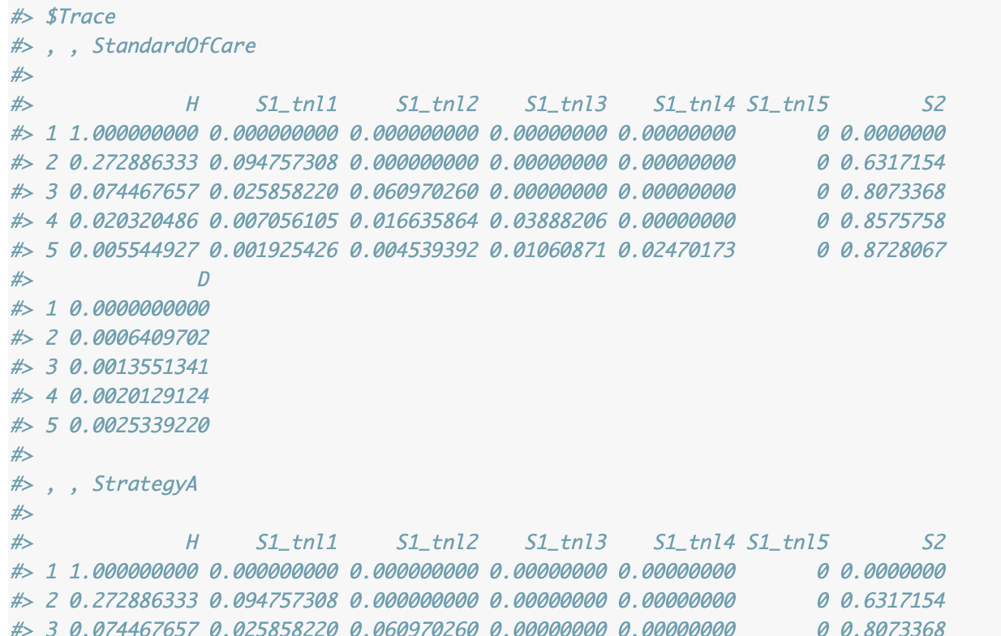
Markov Trace

Slide 18
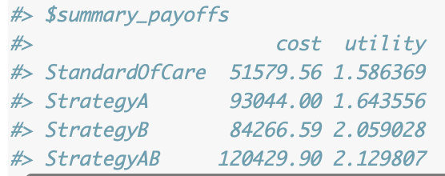
Summary of results
Can request other outputs:
my_markov_model(model_struc,params,return_transition_prob=FALSE,return_state_payoffs=FALSE,return_trace=FALSE,return_cycle_payoffs=FALSE,return_payoff_summary=TRUE)

Slide 19
Other analyses
Since the model is a function (params), you can run these analyses as we describe in the DARTH tutorials:
Deterministic analyses – tornado, oneway, two-way, …
Probabilistic – CEAC, CEAF, scatterplots, ….
Calibration ….
VOI …
In beta version and working on documentation and adding new features including support to other model types

Slide 20
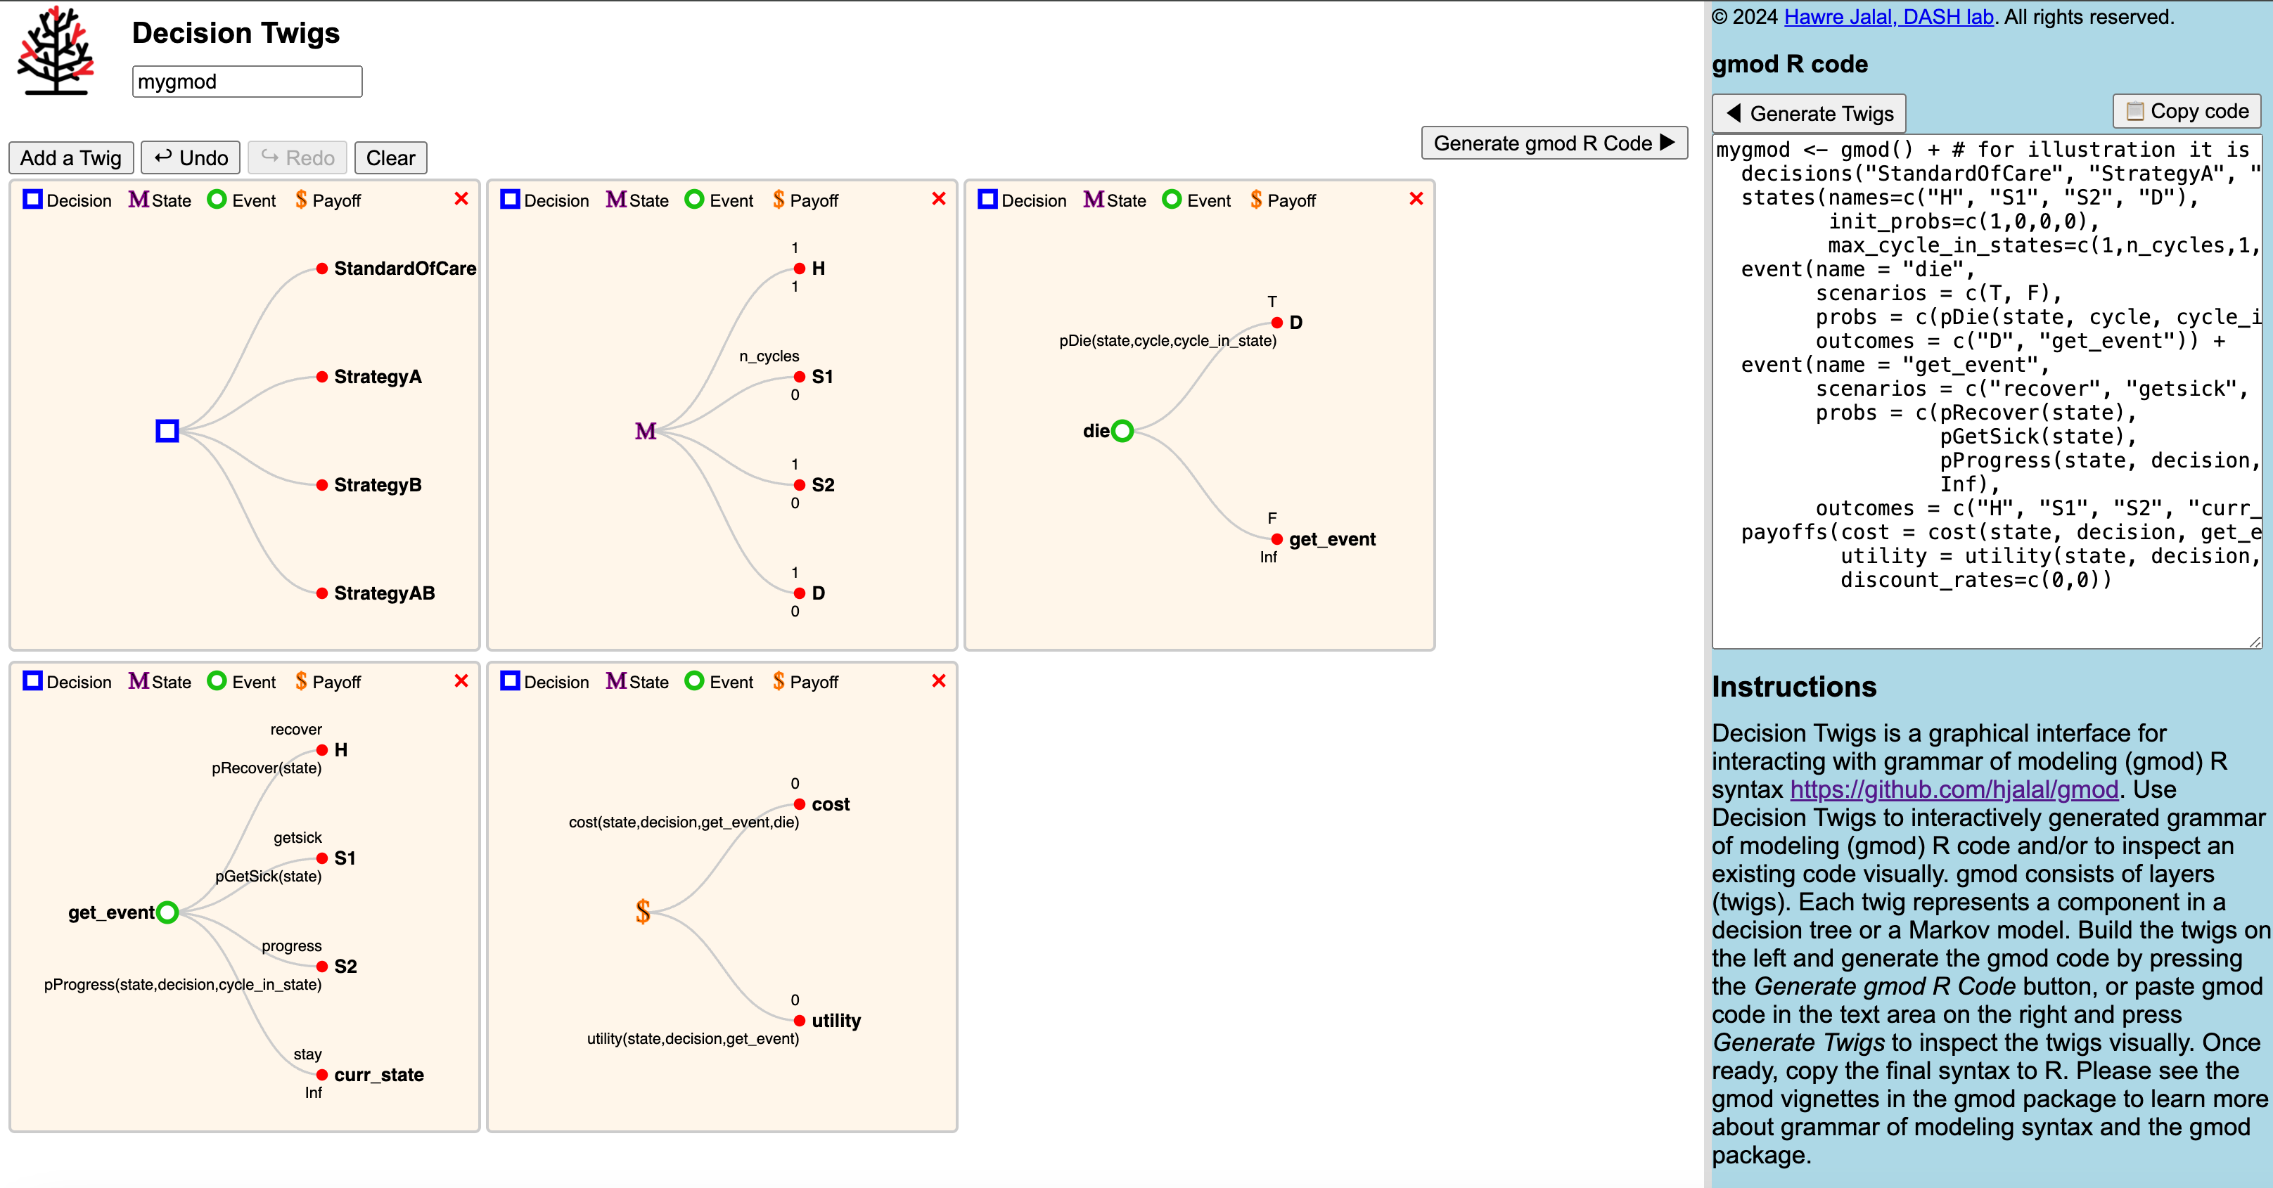
Decision twigs (Demo)
https://dashlab.ca/projects/decision_twigs/

Slide 21
Grammar of Modeling (gmod)
Reduce redundancies in models
Simplify coding, troubleshooting and maintenance
Increase code readability and transparency
Improve reproducibility

