Slide 1
The advantages and challenges of using R and Shiny to develop diagnostic pathway models for NICE clinical guidelines
The case of asthma
Alfredo Mariani

Slide 2
Overview of asthma diagnosis
Recent data suggest that around 12% of British population have been diagnosed with asthma. However, it is widely recognised that asthma tend to be over-diagnosed
The lack of a gold standard test means that diagnosis is often reached looking at a combination of different diagnostic tests
In 2017, NICE recommended a diagnostic algorithm, but this was poorly implemented, due to its low flexibility and lack of availability of certain recommended test
For the most recent update, we conducted a new economic analysis to identify new diagnostic algorithms that could be flexible and easier to implement

Slide 3
Two main reasons to use R
Conditional dependency
Flexibility in the definition of the strategies
This represents the correlation between different test results
Tests that always agree with each other are not useful when given together in an algorithm
When developing a diagnostic pathway with multiples tests, final accuracy could change depending on the conditional dependencies

Slide 4
Conditional dependency
Punctuality in the office
Alfredo late
Dave late
Independent?
Commutes by train
Train strike!

Slide 5
Conditional dependency
Diagnosing asthma
Test A positive
Test B positive
Independent
Test C positive
Independent?
Asthma
Measures lung inflammation
Measures airway flow
COPD,
seasonal allergy etc

Slide 6

Conditional dependency in the literature
Notes:
https://www.valueinhealthjournal.com/article/S1098-3015(13)01694-X/fulltext?_returnURL=https%3A%2F%2Flinkinghub.elsevier.com%2Fretrieve%2Fpii%2FS109830151301694X%3Fshowall%3Dtrue

Slide 7
Methods to incorporate conditional dependencies
Joint accuracy | Multivariate probit model
Requires individual patient data (IPD) | Requires diagnostic accuracy and correlation data
Not flexible: does not allow sensitivity analyses | Flexible: allows sensitivity analyses
Computationally simple | Microsimulation: computational complex
Does not require a statistical software | Requires a statistical software like R
Adults diagnostic model | Children diagnostic model

Slide 8
Joint accuracy
Observed individual patient data
 | Test 1 | Test 2 | Test 3 | Asthma
Patient A | 0 | 1 | 1 | Yes
Patient B | 0 | 0 | 0 | No
Patient C | 1 | 0 | 1 | Yes
Example diagnostic strategy:
1st step: Test 1 to everyone
2nd step: Test 2 to those who tested negative
Sensitivity = 0.5 Specificity = 1
Sensitivity = 1 Specificity = 1
IPD rarely available
It is uncommon to find a study where a large sample of people are tested with the entire battery of tests included in the analysis

Slide 9
Methods to incorporate conditional dependencies
Joint accuracy | Multivariate probit model
Requires individual patient data (IPD) | Requires diagnostic accuracy and correlation data
Not flexible: does not allow sensitivity analyses | Flexible: allows sensitivity analyses
Computationally simple | Microsimulation: computational complex
Does not require a statistical software | Requires a statistical software like R
Adults diagnostic model | Children diagnostic model

Slide 10


Multivariate probit model
If It is possible to generate pseudo IPD tests results if we have:
1) $x_{i }=$
Sensitivity and specificity
Fed into
Used to calculate
Multivariate probit model
Simulates
Pseudo IPD test results
Joint accuracy
2) ∑ $=$
Correlation matrix ∑
Fed into
 | Test 1 | Test 2 | Test 3 | Asthma
Patient A | 0 | 1 | 1 | Yes
Patient B | 0 | 1 | 0 | No
Patient C | 1 | 0 | 1 | Yes

Slide 11
Two main reasons to use R
Conditional dependency
Flexibility in the definition of the strategies
For the previous diagnostic model, 6 diagnostic strategies were identified and included in the model
For this update, the committee could not agree on a set of diagnostic pathways to explore
It was clear they were interested in exploring several strategies during the mode development to produce a set of recommendations that could be flexible and implementable

Slide 12
Diagnostic pathways
There are countless way to develop diagnostic pathways!
Step 1
Step 2
Step 3
Test 1
Test 2
Test 3
Three tests can be arranged in a specific sequence

Slide 13
Diagnostic pathways
There are countless way to develop diagnostic pathways!
Step 1
Step 2
Step 3
Test 1
Test 2
Test 3
... but they can also be rearranged in various ways

Slide 14
Diagnostic pathways
There are countless way to develop diagnostic pathways!
Step 1
Step 2
Step 3
Test 1
Test 2
Test 3
... And could be combined in a single step!

Slide 15
Defining diagnostic strategies
To avoid criticisms of poor implementability and flexibility, the committee sought to explore and define new diagnostic pathways during model development.
This required a different approach from the previous update, where a set of strategies were defined before model development and could not be changed.
The package Shiny was found to be the best solution to this issue.

Slide 16
Demonstration time

Slide 17
Challenges
R has become increasingly accessible to non-expert users, but a number of challenges were identified during this process:
Challenges | Description | Potential solutions
Self-learning limits | Lack of feedback and mentors Technical “thresholds” Overcomplicated (“spaghetti”) coding | More advanced training including on specific and useful packages (e.g. “Survival, “Shiny”) More engagement with and feedback from experienced users both within and outside NICE
QA | Inefficient codes are harder to interpret Lack of a standard template Lack of internal protocol for QA in R | Develop a template for standard Markov model in R with a built-in and customizable Shiny interface Develop an internal protocol for the QA of model in R

Slide 18
Conclusions
Despite the challenges, this model had 2 main advantages:
The use of R enabled advanced statistical analyses around conditional dependencies
The use of a Shiny interface increase committee’s engagement throughout the entire development process
The guideline is currently in consultation so any information on the results are subjected to embargo…
however, most of the strategies that were finalised in the report were not identified before the use of Shiny.
This means that it is likely that the choice of using Shiny will have a positive impact for the final recommendations!

Slide 19
© NICE [insert year]. All rights reserved. Subject to Notice of rights.

Slide 20

Multivariate probit model
The multivariate probit model is ideal to represent correlated binary responses of multiple entities (such as diagnostic tests)
The observed values Y1, Y2 etc take the value of 1 if the latent variable Y* is positive
The latent variables Y* are correlated with each other based on a covariance matrix ∑
$$Y^{∗}=\left(Y_{1}^{∗}, …,Y_{n}^{∗}\right) ∿ N(μ\left(x_{i}\right),\text{Σ}\text{)}$$

Slide 21
Limits of self-learning
R has become increasingly accessible to non-expert users
Network of passionate users within NICE and across the NHS
Large language model like ChatGPT can assist in generating codes and spotting errors
However, self-learning has its limits
Overcomplicated (“spaghetti”) coding
Lack of feedback and mentors
Self-learning “thresholds”

Slide 22
Quality assurance
The absence of a standard template or standard structure complicated the QA process in R
Inefficient and overcomplicated (“spaghetti”) codes are difficult to interpret
There is no established protocol at NICE for quality assurance of R and Shiny models.

Slide 23
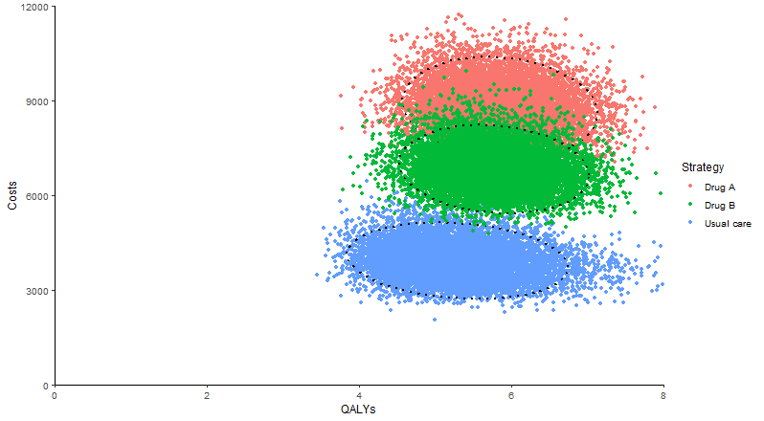
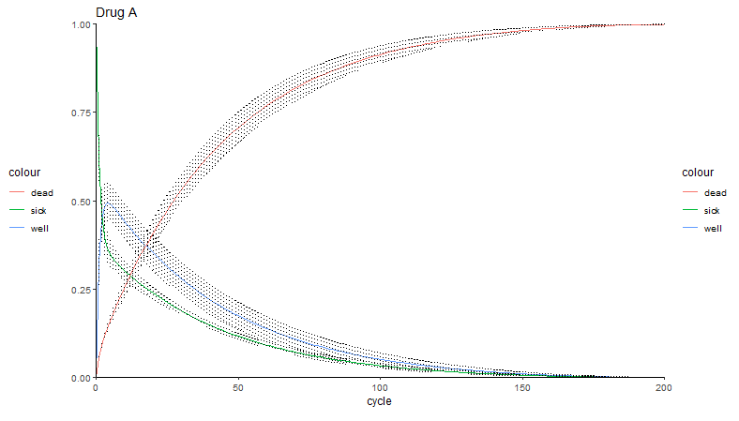
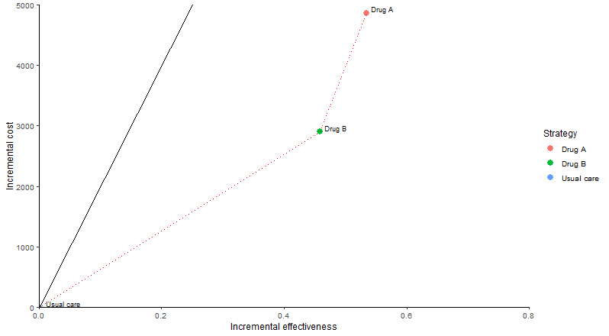
Ggplot examples

