Slide 1
Report about the genbb/decay0 C++ port
F. Mauger, LPC Caen
SuperNEMO Software Phone Meeting
2013-05-28

Slide 2
What ?
Genbb/decay0 : event generator by Vladimir Tretyak for :
  ββ modes for many isotopes (Se, Mo, Nd...)
  Radioactive decays for many background or calbration isotopes (Bi, Tl, Co, Cs...)
  Event model : a stack of emitted particles (e-, e+, γ, α...)
Used by :
  NEMO3, BiPo, SuperNEMO...
  Many other experiments (ββ, DM...)
Support, maintenance and updates by Vladimir: 1995-201X,
Notes :
  Original code : Fortran 77 with CERNLIB linkage
  Configuration parameters and output data model stored in common blocks (static)
  Monolithic code (one single large file)
  Was G77 only
  Today : 64 bits issues

Slide 3
The genbb_help library (Bayeux)
Originally created as a wrapper for genbb/decay0
A C++ interface
Additionnal tools (C++event model, flexible management of random generators, dynamic instantiation of event generator based on simple parametrization interface, a manager class)
Support for g77 and gfortran
Support for 64bits arch
No more CERNLIB linkage
Depends on :
  datatools (data model, configuration, factories, I/O)
  mygsl (PRNG, histogramming)
  Geomtools (vertex model)

Slide 4
New genbb_help
Replace the fortran-based part of the library by a C++ version
Reasons :
  Maintenance and support for F77 is more and more difficult (see Ben's comments on MacOs)
  Static code structures (common blocks) prevent
  some programming technique and design approach
⇒ genbb/decay0 C++ port

Slide 5
How that was made ?
About 160 fortran « original » files to translate :
  60 files : generic functions for particle and decay management and numerical methods (alpha.f, beta.f, compton.f, genbb_fermi.f, genbb_gauss.f ...)
  100 files : isotopes' decay scheme (bb.f, Ac228.f,Am241.f, Co60.f, Bi214.f...)

Slide 6
First step
Design the parametrization, data model, PRNG and argument passing interface :
  Configuration parameters stored in simple C struct
  Output data model uses the C++ genbb ::primary_event and genbb::primary_particle classes
  PRNG uses the mygsl::rng class (GSL)
  Argument passing used anonymous void * pointersreferencing structs and function pointers wherever necessary (ala C)
This technique preserves (as far as possible) the original naming scheme used by Vladimir as well as the contents of common blocks (in structs) ⇒ easy maintenance and synchro with original code

Slide 7
Second step
Manually translate the core (60) files :
  Tedious and repetitive
  Reimplement some numerical methods (gaussian quadrature, Golden section...)
  Some test programs to validate the port (coding and results)

Slide 8
Third step
Automated F77->C++ translation of « decay » files :
  Mixing bash/sed/Python to obtain a first bunch of C/C++ files translated from the original F77 files
  Generate standard *.h headers and skeleton *.cc files
  ~70 % compiled immediately (reason : Vladimir has coded the original files regorously with a rather stable coding style)
  Remaining 30 % : need manual fixes
    Undeclared variables
    Complex data structures, complex goto layouts, if/then/else structures, loops
    Argument passing issues
    A rather long process but mainly repetitive

Slide 9
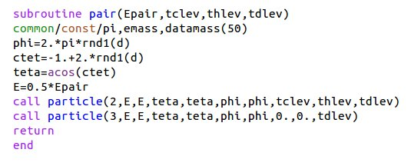
Example : the pair function
positron
electron

Slide 10
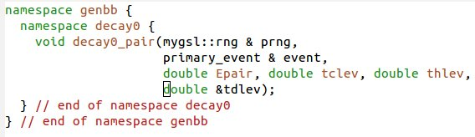
Example : the pair function

Slide 11
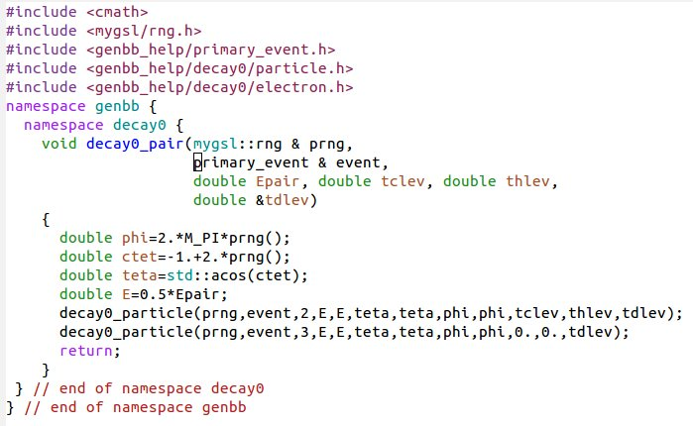
Example : the pair function

Slide 12
Step 4 : integration
Add the C++ port in the genbb_help library
Preserve original F77 code in the genbb_help_decay0_fortran companion library (built as an option)
Create new wrapper generator classes on top of the new C++ code :
⇒ the genbb::wdecay0 class
This is no more a singleton because there is no static code in it. Several instances may run simultaneoulsy
Can be integrated within a genbb::combined_particle_generator object

Slide 13
Validation
Protocol :
  New tool implemented : The genbb_inspector program
  Run the original fortran version of a given generator (ex : Co60) and store the output within a collection of histograms
  Run the new C++ version and store also in the corresponding collection of histograms
  Investigate differences :
    Diff Fortran and C++ output XML files
    Diff trace PRNG generated values
    New tools implemented : datatools and mygsl::rng tracing features
  Understand differences (tedious and depressing):
    Bug tracking
    Single precision (F77) vs double precision (C++) rounding
    Differences in numerical methods implementation

Slide 14
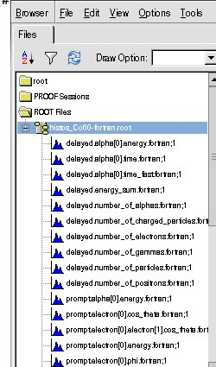
Example : Co60
genbb_inspector output :
autogenerated ROOT
histograms
Single energy distributions
for e-, gammas...
+ angular and energy sum
distr.
~20 prompt particles related histos
~10 delayed (>1ns) particles rel. histos

Slide 15
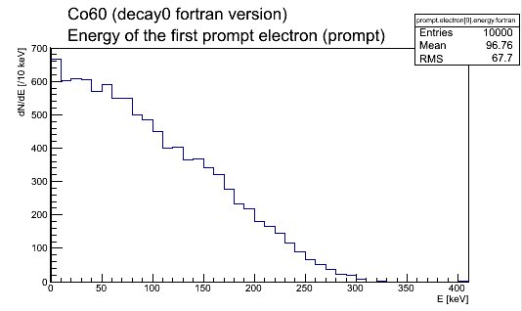
Co60 : first electron energy

Slide 16
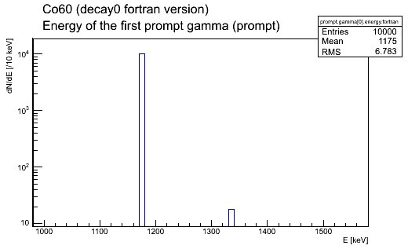
Co60 : first gamma energy distribution

Slide 17
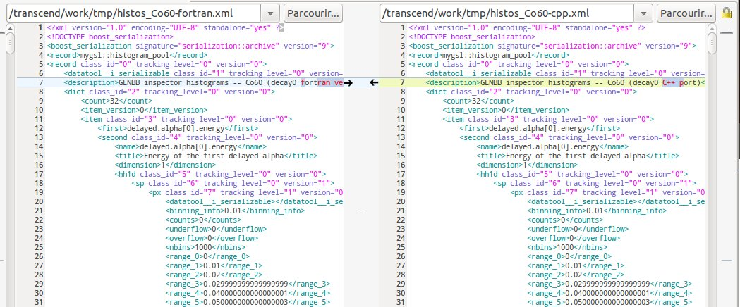
Boost XML output histograms
Diff the fortran and C++ files (meld)

Slide 18
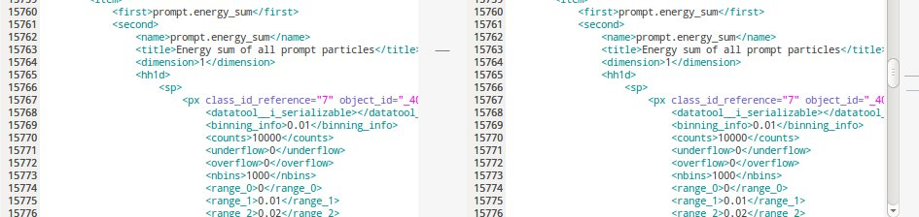
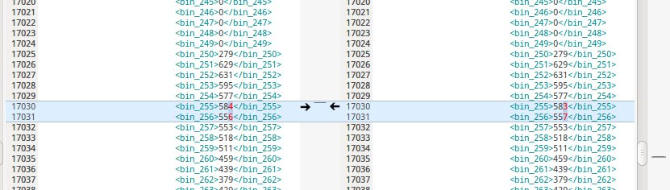
Investigate XML diff :

Slide 19
Understanding possible discrepancies...
Roundoff errors in PNRG (7digit in F77 , 15 digits in C++)
  Artificially degrade the real number precision in
  C++ to check the results with Fortran
  use the new mygsl::rng::set_trunc method to emulate low precision random number generation
Use special trace files to check PRNG and arbitrary values...

Slide 20
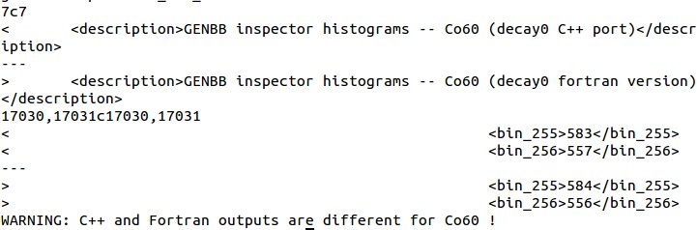
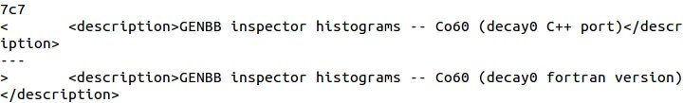
⇓

Slide 21
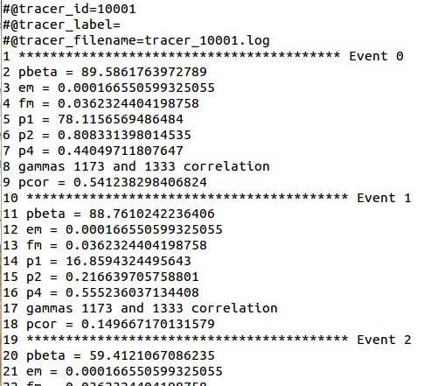
Print some values of interest from within the generator function

Slide 22
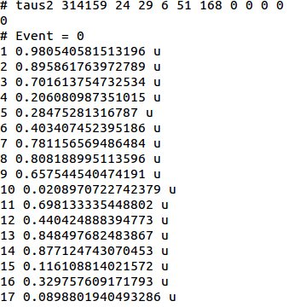
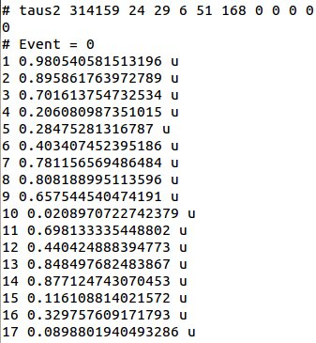
PRNG generated values within each event
Co60 fortran
Co60 C++

Slide 23
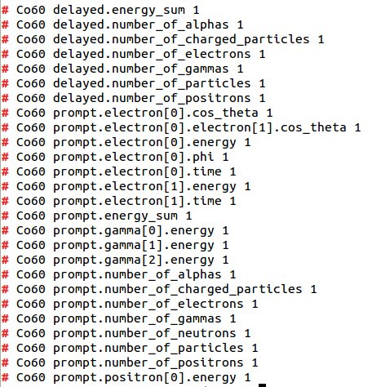
Automated Kolmogorov Fortran vs C++ test on histograms
All histograms 100 % compatible

Slide 24
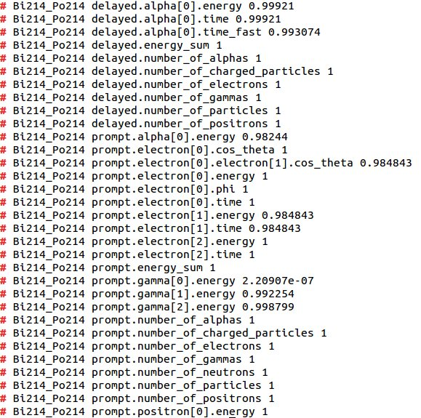
Another example : Bi214/Po214
Still some issues to be investigated :

Slide 25
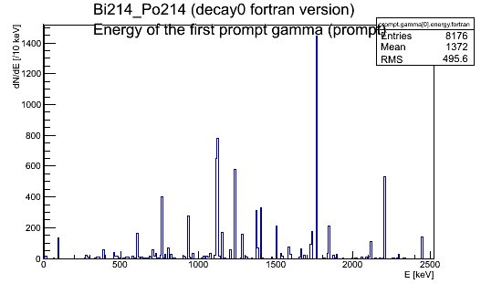
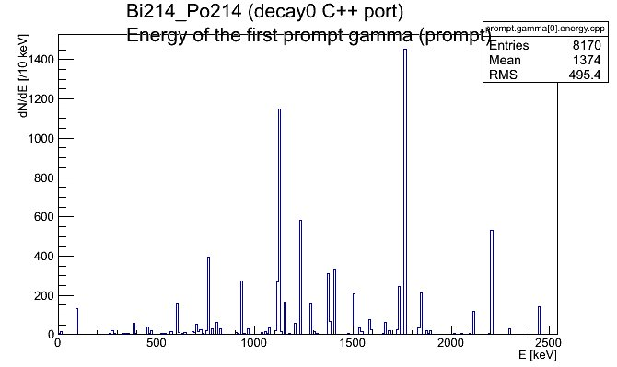

Slide 26
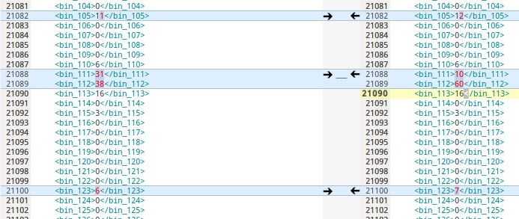
May be only remaining roundoff/binning effect...

Slide 27
Conclusion
genbb/decay0 C++ port is implemented from genbb_help (pre-5.0.0)
(almost) all original functionnalities are available
Respect the original coding approach to keep sync with Vladimir
Now validating the physics results for all isotopes
Possible issues :
  F77→C++ port bugs
  C++ bugs
  Differences due to expected roundoff errors and/or implementation of special numerical methods
New tools to perform semi-automatically this validation
Preliminary results are satisfactory for tested isotopes (Co60, K40...)
Remaining discrepancies to be understood and eventually fixed
Need more work/test to make sure we can use in production mode in the near future

