Slide 1
Report about the genbb/decay0 C++ port
F. Mauger, LPC Caen
SuperNEMO Software Phone Meeting
2013-05-28

Slide 2
What ?
Genbb/decay0 : event generator by Vladimir Tretyak for :
  ββ modes for many isotopes (Se, Mo, Nd...)
  Radioactive decays for many background or calbration isotopes (Bi, Tl, Co, Cs...)
  Event model : a stack of emitted particles (e-, e+, γ, α...)
Used by :
  NEMO3, BiPo, SuperNEMO...
  Many other experiments (ββ, DM...)
Support, maintenance and updates by Vladimir: 1995-201X,
Notes :
  Original code : Fortran 77 with CERNLIB linkage
  Configuration parameters and output data model stored in common blocks (static)
  Monolithic code (one single large file)
  Was G77 only
  Today : CERNIB and 64 bits issues

Slide 3
The genbb_help library (Bayeux)
Originally created as a wrapper for genbb/decay0
A C++ interface
Additionnal tools : C++event model, flexible management of random generators, dynamic instantiation of event generator based on simple parametrization interface, a manager class.
Support for g77 and gfortran
Support for 64bits arch
No more CERNLIB linkage
Depends on :
  datatools (data model, configuration, factories, I/O)
  mygsl (PRNG, histogramming)
  geomtools (vertex model)

Slide 4
New genbb_help
Replace the fortran-based part of the library by a C++ version
Reasons :
  Maintenance and support for F77 is more and more difficult (see Ben's comments on MacOs)
  Static code structures (common blocks) prevent
  some programming technique and design approach
⇒ genbb/decay0 C++ port

Slide 5
How that was made ?
About 160 fortran « original » routine files to translate :
  60 files : generic functions/routines for particle and decay management and numerical methods (alpha.f, beta.f, compton.f, genbb_fermi.f, genbb_gauss.f ...)
  100 files : isotopes' decay scheme (bb.f, Ac228.f,Am241.f, Co60.f, Bi214.f...)

Slide 6
First step
Design the parametrization, data model, PRNG and argument passing interface :
  Configuration parameters stored in simple C struct
  Output data model uses the C++ genbb ::primary_event and genbb::primary_particle classes
  PRNG uses the mygsl::rng class (GSL)
  Argument passing used anonymous void * pointers referencing structs and function pointers wherever necessary (ala C)
This technique preserves (as far as possible) the original naming scheme used by Vladimir as well as the contents of common blocks (in structs) ⇒ easy maintenance and synchro with original code

Slide 7
Second step
Manually translate the core (60) files :
  Tedious and repetitive
  Reimplement some numerical methods (gaussian quadrature, Golden section...)
  Some test programs to validate the port (coding and results)

Slide 8
Third step
Automated F77->C++ translation of « decay » files :
  Mixing bash/sed/Python to obtain a first bunch of C/C++ files translated from the original F77 files
  Generate standard *.h headers and skeleton *.cc files
  ~70 % compiled immediately (reason : Vladimir has coded the original files rigorously with a rather stable coding style)
  Remaining 30 % : need manual fixes
    Undeclared variables (damned implicit !)
    Complex data structures, complex goto layouts, if/then/else structures, loops...
    Argument passing issues
    A rather long process but mainly repetitive

Slide 9
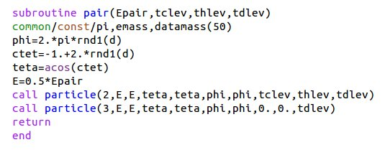
Example : the pair function
positron
electron

Slide 10
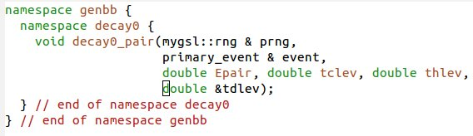
Example : the pair function

Slide 11
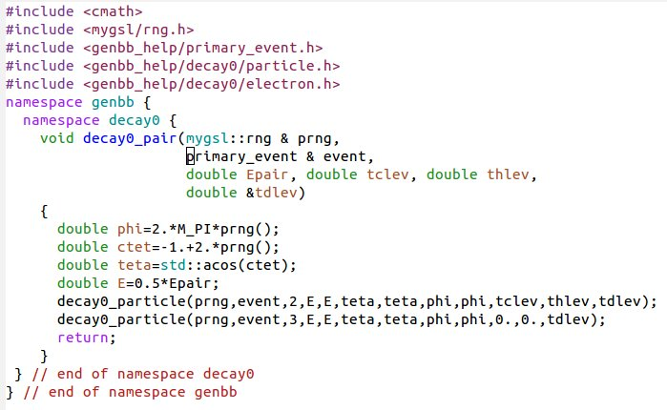
Example : the pair function

Slide 12
Step 4 : integration
Add the C++ port in the genbb_help library
Preserve original F77 code in the genbb_help_decay0_fortran companion library (built as an option)
Create new wrapper generator classes on top of the new C++ code :
⇒ the genbb::wdecay0 class
This is no more a singleton because there is no static code in it. Several instances may run simultaneoulsy
Can be integrated within a genbb::combined_particle_generator object

Slide 13
Validation
Protocol :
  New tool implemented : The genbb_inspector program
  Run the original fortran version of a given generator (ex : Co60) and store the output within a collection of histograms
  Run the new C++ version and store also in the corresponding collection of histograms
  Investigate differences :
    Diff Fortran and C++ output XML histogram files and/or ROOT files for visu
    Diff trace PRNG generated values
    New tools implemented : datatools and mygsl::rng tracing features
  Understand differences (tedious and depressing):
    Bug tracking
    Single precision (F77) vs double precision (C++) rounding
    Differences in numerical methods implementation

Slide 14
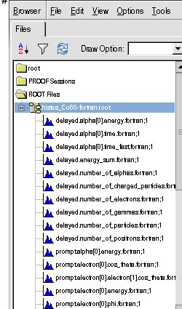
Example : Co60
genbb_inspector output :
autogenerated ROOT
histograms
Single energy distributions
for e-, gammas...
+ angular and energy sum
distr.
~20 prompt particles related histos
~10 delayed (>1ns) particles rel. histos

Slide 15
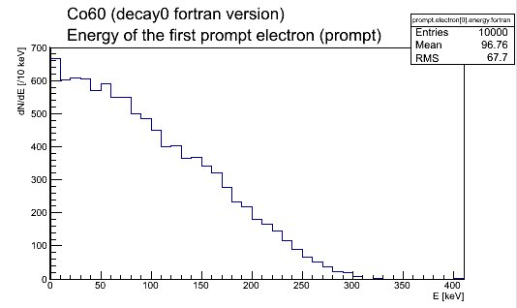
Co60 : first electron energy

Slide 16
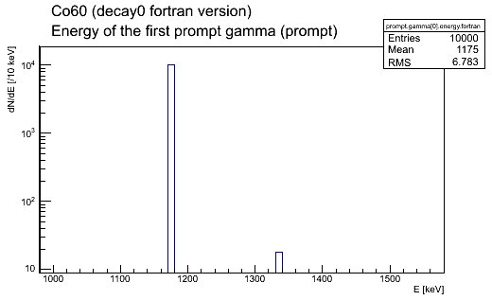
Co60 : first gamma energy distribution

Slide 17
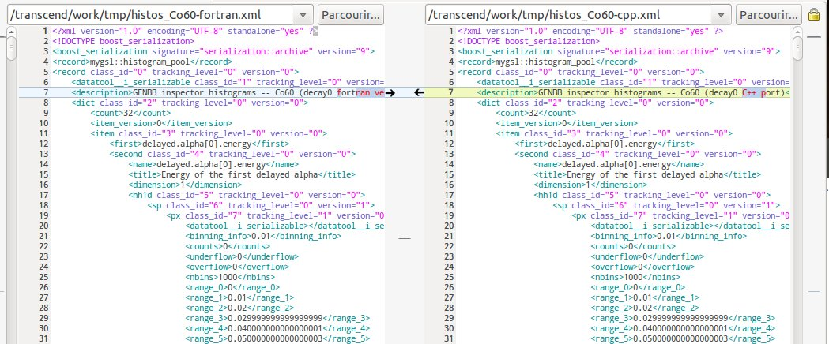
Boost XML output histograms
Diff the fortran and C++ files (meld)

Slide 18
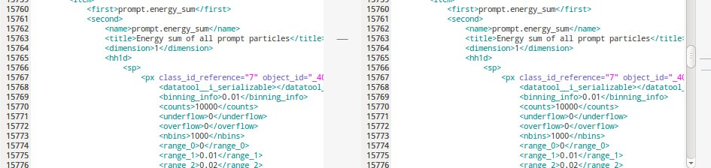
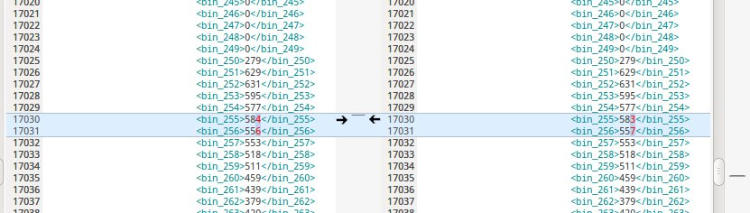
Investigate XML diff :

Slide 19
Understanding possible discrepancies...
Roundoff errors in PNRG (7digit in F77 , 15 digits in C++)
  Artificially degrade the real number precision in
  C++ to check the results with Fortran
  use the new mygsl::rng::set_trunc method to emulate low precision random number generation
Use special trace files to check PRNG and arbitrary values...

Slide 20
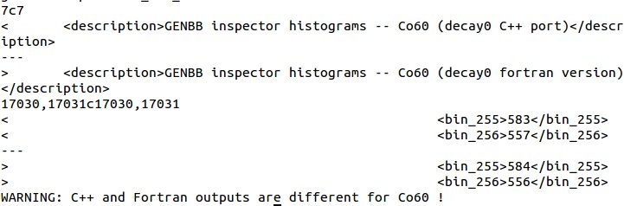
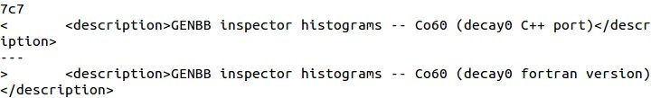
⇓

Slide 21
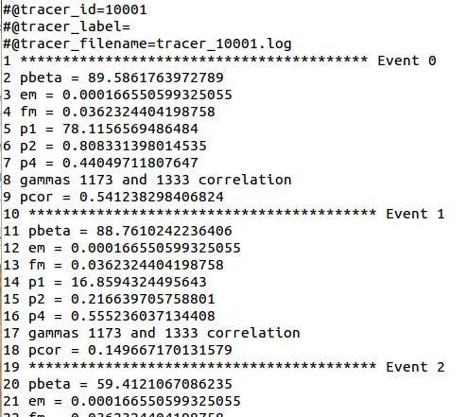
Print some values of interest from within the generator function

Slide 22
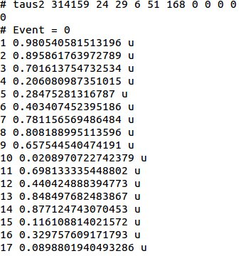
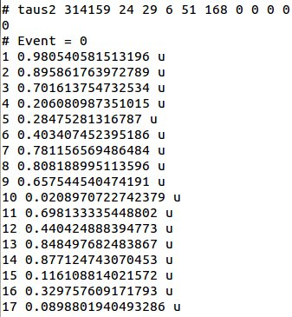
PRNG generated values within each event
Co60 fortran
Co60 C++

Slide 23
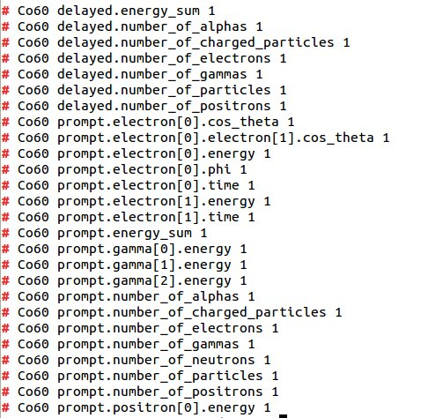
Automated Kolmogorov Fortran vs C++ test on histograms
All histograms 100 % compatible

Slide 24
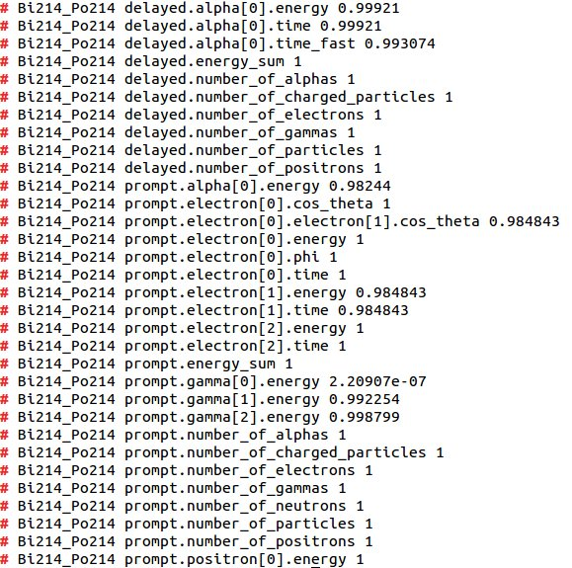
Another example : Bi214/Po214
Still some issues to be investigated :

Slide 25
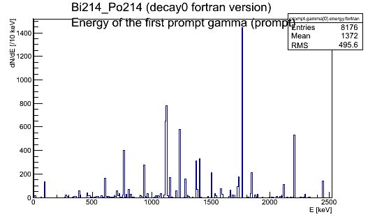
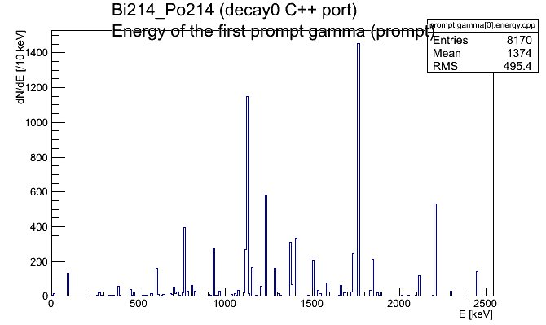
Diff in 2 neighbour bins

Slide 26
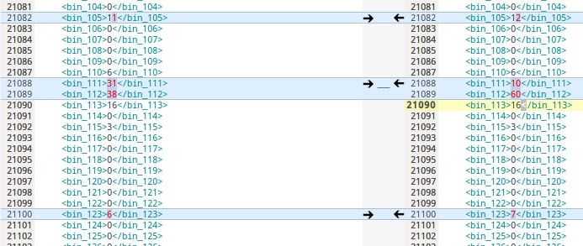
May be only remaining roundoff/binning effect...
Compatible statistics => rounding effect vs histogram binning ?

Slide 27
Conclusion
genbb/decay0 C++ port is implemented from genbb_help (pre-5.0.0)
(almost) all original functionnalities are available
Respect the original coding approach to keep sync with Vladimir
Now validating the physics results for all isotopes
Possible issues :
  F77→C++ port bugs
  C++ bugs
  Differences due to expected roundoff errors and/or implementation of special numerical methods
New tools to perform semi-automatically this validation
Preliminary results are satisfactory for tested isotopes (Co60, K40...)
Remaining discrepancies to be understood and eventually fixed
Need more work/test to make sure we can use in production mode in the near future

Slide 28

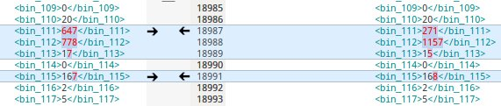
Addendum
Investigate difference for the Bi214 generator output from F77 and C++ : suggest a rounding effect at 1120 ± ε keV combined with histogram binning (1 bin = 10 keV)
Fortran
~1440 gammas @ 1.120 MeV
C++

Slide 29
Check this hypothesis :
Artificially « blur » the energy of all particles inserted in the output data model by 0,025 keV
Truncate PRNG output at 6 digits, same seed
Both in C++ and Fortran code...
Now results are compatible !

Slide 30


Same effects at other places...
Before « bluring » :
Effect is smaller due to low statistics, but visible

Slide 31


After « bluring »
→Now we have perfect matching between C++ and Fortran output

Slide 32
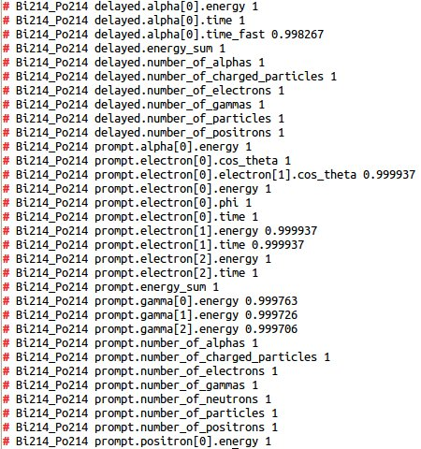
Bluring + PRNG 6 digit truncation + more Bi214 events generated : 10⁴ Þ 10⁵
⇒ Kolmogorov test passed all histograms

Slide 33
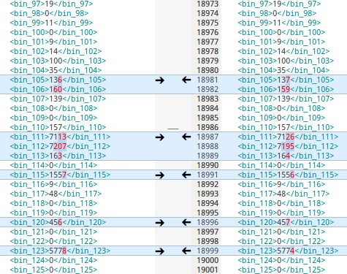
Remaining differences compatible with statistical fluctuations on rounding effect associated to internal calculations (untraceable): real*4 in F77 vs double in C++

Slide 34
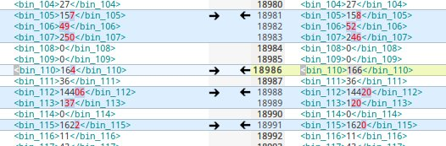
Another cross-check for Bi214 :
- change the 1.120 MeV γ line to 1.120001 MeV
- but don't use bluring
No more issue

Slide 35
Validation table
Generator | Nevents | Check Fortran/C++ | Comments
Co60 | 10⁵ | OK | SF
K40 | 10⁵ | OK | SF
Bi214_Po214 | 10⁵ | OK | SF+BRE
Bi212_Po212 | 10⁵ | OK (by Nils) | SF+BRE
Tl208 | 10⁵ | OK | SF+BRE
Cs137 | 10⁵ | OK | exact match
bb0nu_Se82 | 10⁵ | OK | SF
bb2nu_Se82 | 10⁵ | OK | SF
SF : statistical fluctuations
BRE : binning+rounding effects

