Slide 1
Nature10 Prompt v3 Evaluation Wrap-up
English briefing deck | Dataset: 10 papers | Model: gpt-5.2-2025-12-11 | Runs: high/high ×2

Slide 2
What Was Delivered
Dynamic challenge workflow: run -> compare with human gold -> immediate high-effort challenge on mismatches.
Prompt upgraded to v3 with Q1/Q3/Q6/Q9/Q12 coder notes and strict abstention policy.
Two-round high/high evaluation completed on the same 10-paper set with full parsing coverage.
Outputs now include score report, per-paper summary, challenge diagnostics, and visual dashboards.
Run ID: nature10_v3_highhigh2_20260211

Slide 3
Baseline vs v3 (Key Shift)
High baseline: 5/10 match, 3 mismatch, 2 unclassified
Medium baseline: 6/10 match, 2 mismatch, 2 unclassified
Current high/high members: R1=6/10 (0.60), R2=7/10 (0.70).
Q6 accuracy moved from baseline High=0.111 / Medium=0.200 to current=0.800.
Vote result: 6/10 correct, coverage=0.90 (1 tie).

Slide 4
Prompt v3 Changes (Implemented)
Q6 clarified as within-domain transferability (not cross-domain universal adjudication).
Q1 gate widened: decision-relevant diagnostics/scenario/projection papers are in-scope.
Q9 expanded to implicit technocratic optimization and income/consumption/labor-response logic.
Q9 and Q12 explicitly non-mutual-exclusive; social-welfare/externality layers allowed in Q12.
Type 4 softened from strict non-negotiable language to non-utility-dominant frame.
Strict abstention: if Q1=True, avoid q15=null unless truly indeterminable.
Source files: nature10_v3_highhigh2.yaml + 4pt_theory_v3_20260211.md

Slide 5
Input Capacity Check (Max Prompt Safety)
Constraint check passed: all papers and full prompt template were ingested without truncation failures.
Observed prompt tokens: max=9735, mean=7976.6 across 20 calls.
Observed completion tokens: max=1550, mean=973.9.
JSON parse quality: 20/20 strict parse success, 0 parse errors, 0 LLM errors.
Current config remains safe for full-paper Nature10 high/high runs (max_output_tokens=6000).

Slide 6
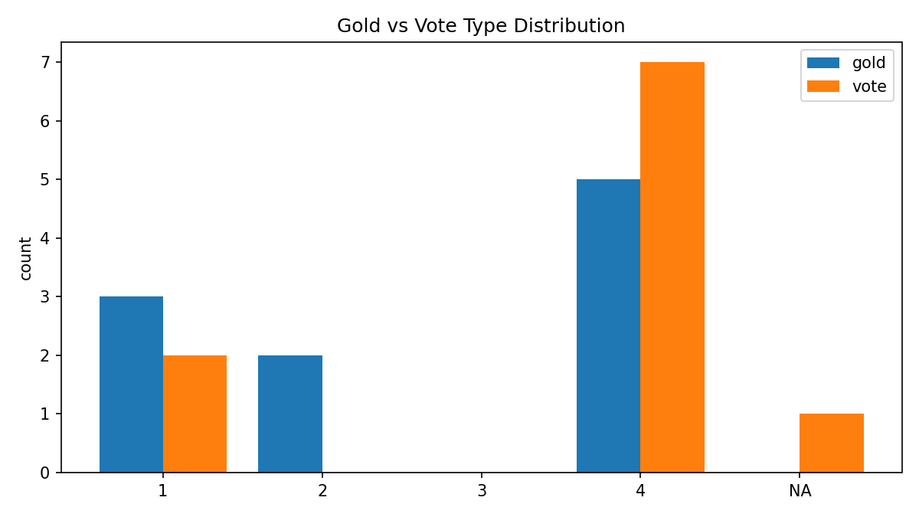
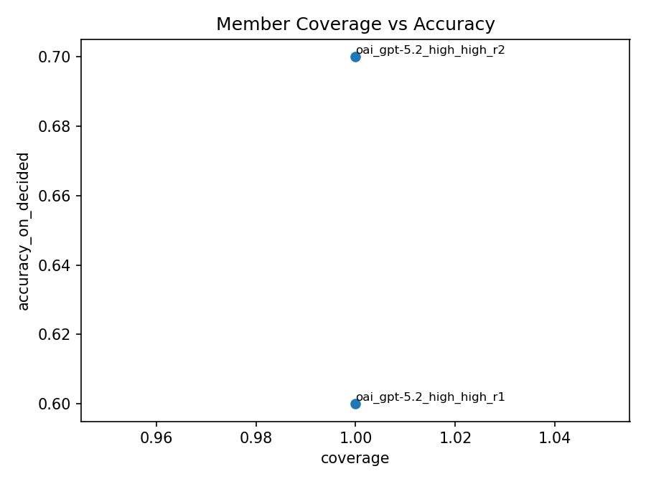
Current Run Visuals
Gold vs Vote Distribution
Member Coverage vs Accuracy

Slide 7
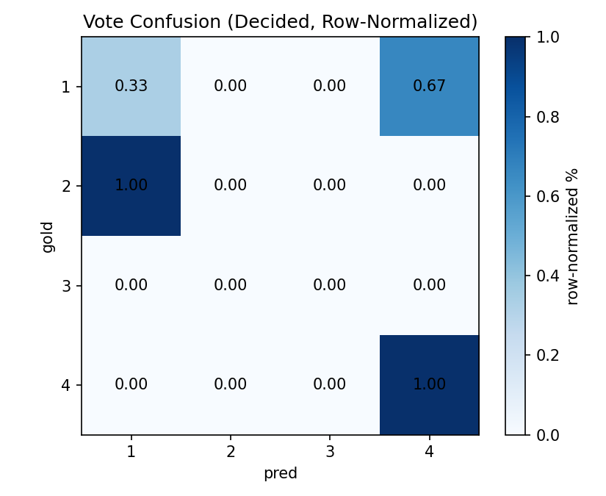
Vote Confusion and Field Accuracies
q1_fit: 1.00
q3_on_ground: 0.80
q6_generalizable: 0.80
q9_self_interested: 0.80
q12_beyond_self_interest: 0.65
q15_final_type: 0.65
Confusion concentrated in Type1/Type2/Type4 boundaries

Slide 8
Per-Paper Results (1/2)
Paper | Title | Human | R1 | R2 | Vote | Status
1 | Feasibility of peak temperature targets in light of institutional... | 4 | 4 | 4 | 4.0 | ok
4 | Elevated urban energy risks due to climate-driven biophysical fee... | 1 | 4 | 4 | 4.0 | ok
5 | Global patterns and drivers of tropical aboveground carbon changes | 4 | 4 | 4 | 4.0 | ok
9 | Relaxing fertility policies and delaying retirement age increase ... | 1 | 4 | 4 | 4.0 | ok
18 | Energy and socioeconomic system transformation through a decade o... | 1 | 1 | 1 | 1.0 | ok

Slide 9
Per-Paper Results (2/2)
Paper | Title | Human | R1 | R2 | Vote | Status
19 | Representing gender inequality in scenarios improves understandin... | 4 | 4 | 4 | 4.0 | ok
27 | High-income groups disproportionately contribute to climate extre... | 4 | 4 | 4 | 4.0 | ok
30 | Improving cost–benefit analyses for health-considered climate mit... | 2 | 1 | 2 | - | tie
40 | Restoration cannot be scaled up globally to save reefs from loss ... | 4 | 4 | 4 | 4.0 | ok
50 | Power price stability and the insurance value of renewable techno... | 2 | 1 | 1 | 1.0 | ok

Slide 10
Feedback Focus: Problem Cases After v3
Paper | Current Issue | Observed AI | High-Challenge Revision | Priority
4 | Type drift to 4 | Human=1, R1=4, R2=4 | Rev: 1 (both rounds) | P0
9 | Type drift to 4 | Human=1, R1=4, R2=4 | Rev: 1 (both rounds) | P0
30 | Tie / boundary 1 vs 2 | Human=2, R1=1, R2=2 | Rev: 2 | P1
50 | Type drift to 1 | Human=2, R1=1, R2=1 | Rev: 2 (both rounds) | P0
Pattern: Most residual errors are Type-boundary errors (Type1/Type2/Type4), not parser failures.

Slide 11
Feedback-Driven Error Diagnosis (Main Findings)
Paper 4 & 9: AI over-shifted to Type 4; challenge says both should remain Type 1.
Paper 30: Type 1 vs Type 2 boundary remains unstable when papers are methodological CBA critiques.
Paper 50: Simulation-based market analysis was over-coded as Type 1; challenge moves it to Type 2.
Residual risk is now concentrated in boundary rules, not in Q1 scope or parser robustness.

Slide 12
What This Feedback Means for Prompt Design
Need tighter Q3 gate: simulation/forecast outputs alone should not auto-count as on-the-ground interventions.
Need tighter Q12 gate: externality/welfare terms alone should not imply beyond-self-interest framing.
Need Q15 disambiguator: projection evidence useful for planning is not equivalent to action-ranking/recommendation.
Need clearer Type1 vs Type2 boundary when social-welfare CBA appears in methodological papers.

Slide 13
Code Review & Pipeline Hardening Status
Implementation tracker status (2026-02-09): 18 items resolved/verified in code.
Resolved critical issues include P0=6, P1=10 (config gating, parse safety, voting semantics, reporting consistency).
Current run confirms hardening impact: stable raw->parse->report chain, deterministic outputs, and clean challenge artifacts.
Result: remaining performance gaps are primarily prompt semantics and labeling boundaries, not pipeline reliability.
Source: CODE_IMPLEMENTATION_ISSUES.md

Slide 14
Recommended Next Iteration
Apply a small v3.1 prompt patch only on Q3/Q12/Q15 boundary clauses (keep successful Q6/Q1/Q9 changes intact).
Re-run the same 10-paper benchmark with high/high x2 for direct A/B comparability.
Use the 4 persistent error papers (4/9/30/50) as mandatory regression cases for every prompt revision.
Promote to wider set only after vote-level accuracy and tie-rate improve on this fixed benchmark.
This deck is ready for direct researcher meeting use.

