Slide 1
Data Mining Course: Introduction
Cam Tu Nguyen
阮锦绣
Software Institute, Nanjing University
nguyenct@lamda.nju.edu.cn
ncamtu@gmail.com

Slide 2
Prerequisites
Basic Databases
Algorithms:
Dynamic Programming, basic data structures
Basic statistics
Fundamental distributions (Gaussian, Bernoulli distributions, etc)
Regression
Programming
Your choice, but Java/Python will be very useful.

Slide 3
Course Outline
Fundamental:
Data Exploration & Preparation
Classification
Basic Algorithms: Decision Trees, KNN, Linear Models
Evaluation: Cross-validation
Clustering
Basic Algorithms: K-means, Hierarchical Clustering; Example of Hierarchical Clustering; Incremental Clustering
Evaluation
Association rules, Frequent items
Outlier Detection

Slide 4
Course Outline (2)
Special Topics
Recommendation Systems
Information Retrieval & PageRank
Text Mining & Topic Analysis
Introduction to Representation Learning
Neural network & Deep Learning
Large Scale Data mining on Map-Reduce and/or Spark
Large Scale Data mining algorithms

Slide 5
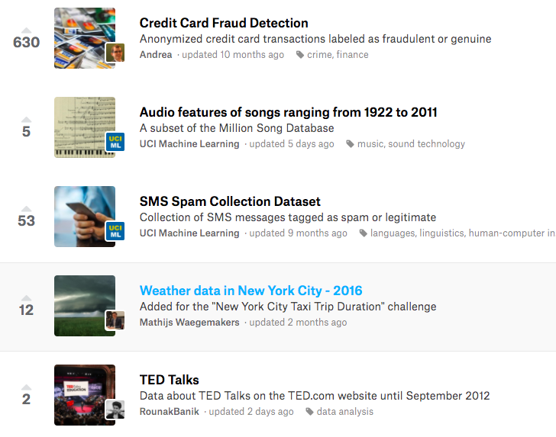
Possible Projects (10% credit bonus)
Choose a dataset of interest, e.g. those from Kaggle.com
Perform data analysis and data mining.
Write a short report (5-10 pages) on the result.
Honor code: do not copy!

Slide 6
Possible Projects
Team work:
It is possible to work in team of 3-4 students
Each student needs to have a clear role in the project.
Registering for teams and projects
Need to send out by October 1st .
Project report Due
Possible dates: November 15th

Slide 7
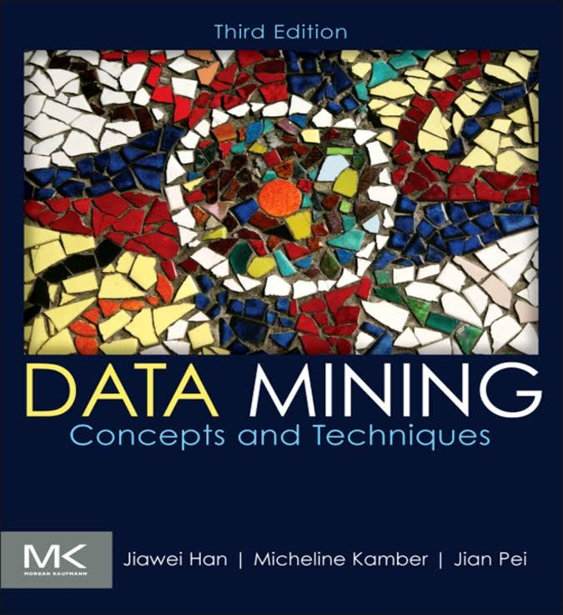
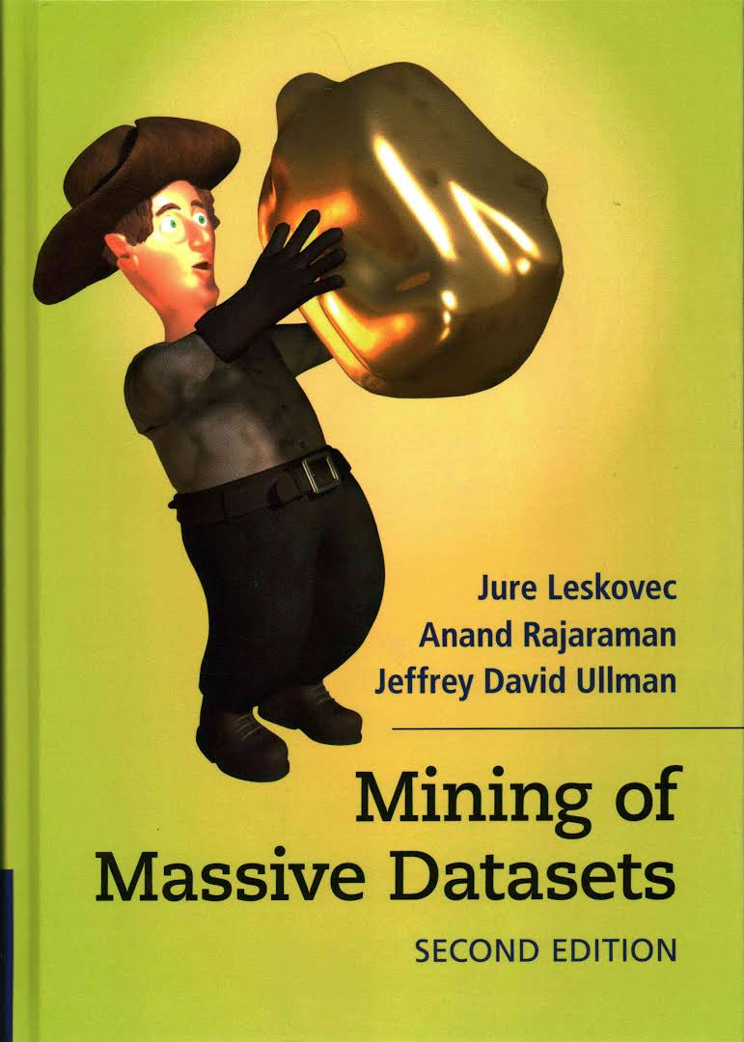
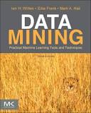
Text Books
Data Mining: Concepts and Techniques
Mining of Massive Datasets
Data Mining: Practical Machine Learning Tools and Techniques.

